Slide 1
PREDICTION OF PTM SITES USING ProtMAMBA
MILESTONE 1: DATA ANALYSIS AND ESTABILISHING BASELINE MODELS
-HARSH CHAUHAN

Slide 2
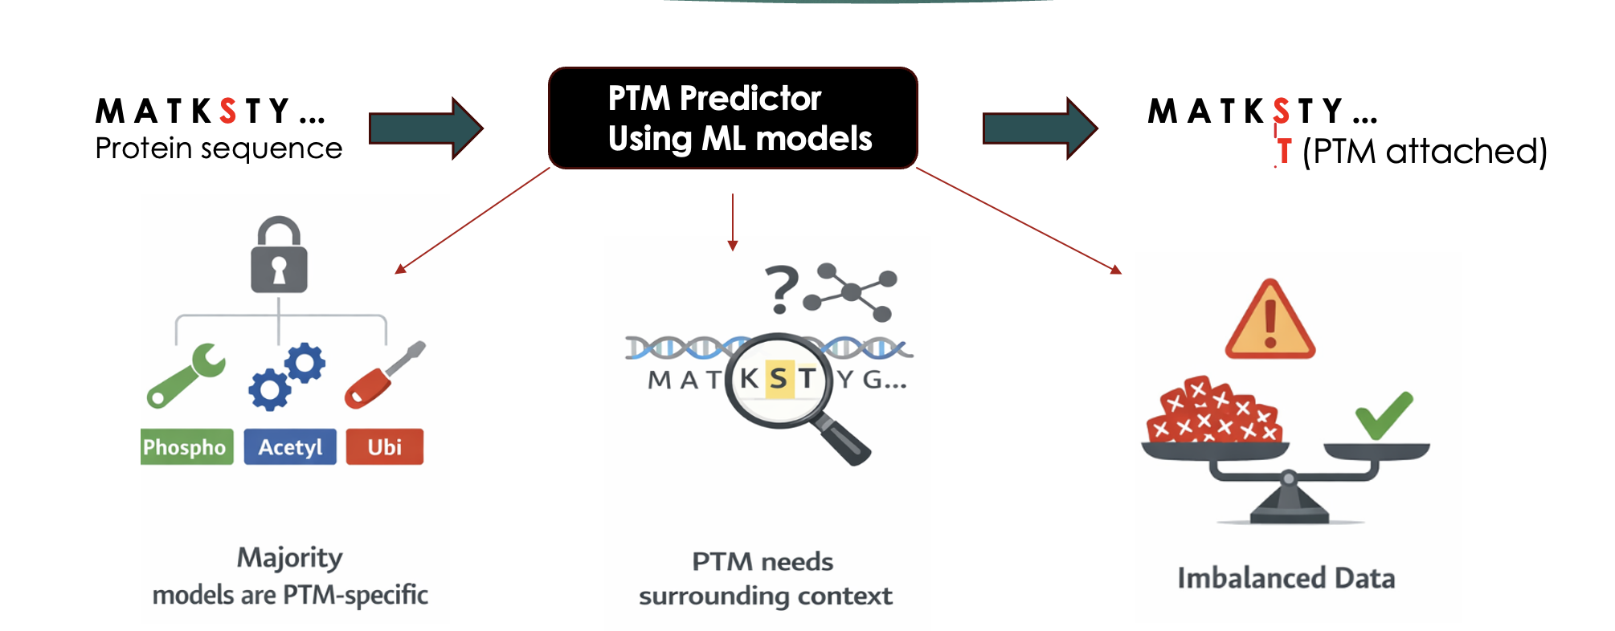
RECAP
Notes:
English characters -> 26 characters.
Protein sequence -> 20 residues / amino-acids
“PTMs are small chemical changes on specific residues, like adding a tag that changes how the protein behaves.”
For each amino acid in a protein, we predict whether that residue is modified or not.

Slide 3
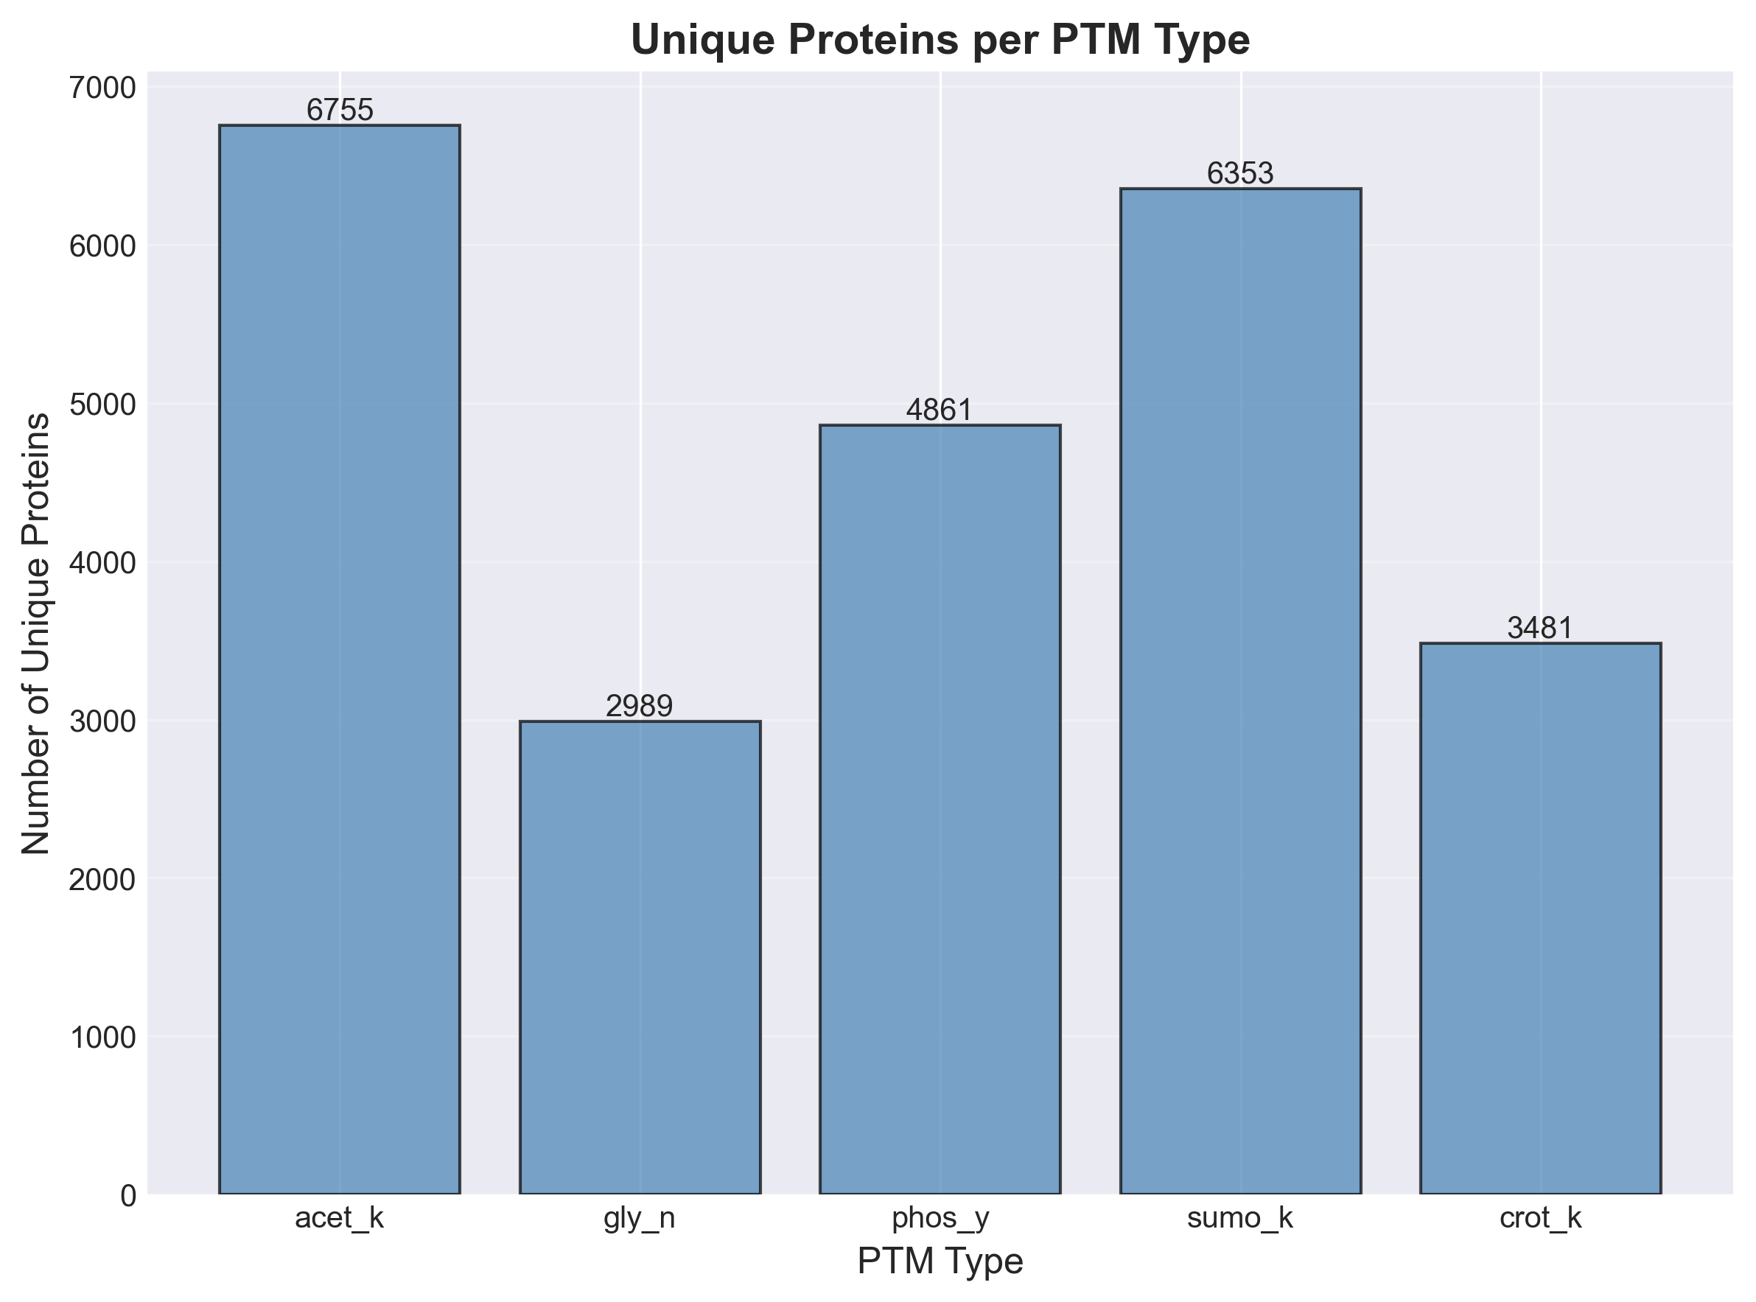
DATASETS IN SCOPE
Label | Count
Negative PTMs | 193,462
Positive PTMs | 87,030
Modification | Target Residue | Total samples
Acetylation | K | 68859
Glycosylation | N | 42256
Phosphorylation | Y | 64535
Sumoylation | K | 80068
Crotonylation | K | 24773
Notes:
There are more than 500 PTMs and I will be working with 5 PTMs.
For milestone 1 I have treated each PTM type independently to establish benchmark for our models.
As you see there is class Imbalance, so focus more on Precision-Recall curve and MCC as our evaluation metric

Slide 4
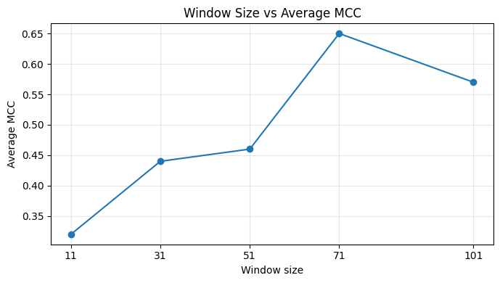
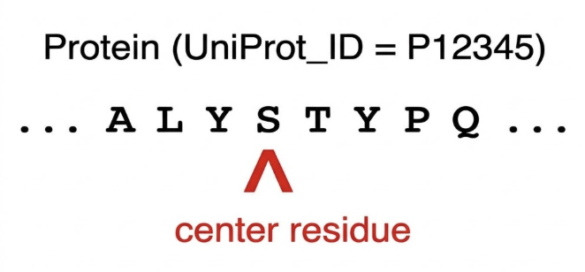
WINDOW/SEQUENCE CHARACTERISTICS
One UniProt_ID → many residue-centered windows
Each window = one training sample
Windows share protein context but differ locally
Notes:
One UniProt ID does not correspond to one sample — it corresponds to many samples.
We generate multiple windows per protein by sliding across residues. Each window shares the same global protein context, but differs locally depending on where the center residue sits.

Slide 5
FEATURES | DESCRIPTION
original_sequence | Fixed-length residue window (e.g. 101 aa) centered on the candidate PTM site.
ptm_type | Binary label: 1 = PTM site at center, 0 = non-PTM.
UniProt_ID | UniProt accession of the protein; used for grouping and protein-level train/test split.
embedding_dispersion | Spread/variance of residue embeddings over the full window.
center_window_dispersion | Spread of embeddings over the center region of the window.
embedding_entropy | Entropy of the embedding distribution over the full window.
center_window_entropy | Entropy of embeddings over the center region.
svd_entropy | Entropy from SVD of the embedding matrix (sequence-complexity measure).
center_svd_entropy | SVD-based entropy for the center window.
cluster | Numeric cluster ID from complexity-based clustering (e.g. 0/1).
cluster_label | Categorical complexity label: LCR (low-complexity region) or HCR (high-complexity region).
LCR_prob | Predicted probability that the window lies in a low-complexity region.
HCR_prob | Predicted probability that the window lies in a high-complexity region.
Notes:
Every protein has a unique identifier, name UniProt_ID
UniProt lists around 100 features for each protein, but not all contribute towards modifications.
I have selected 12 for our baseline model. Why these 12 ?
Prof Dukka is my advisor who is working in this field for many years, and suggested to go ahead with these 12.

Slide 6
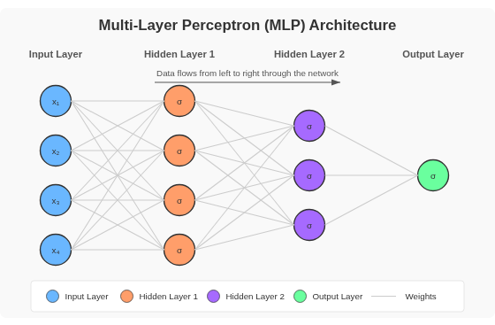
BASELINE MODEL
Representations:
71-residue window context
One-hot encoded (21 symbols) + 11 numeric
Total input dimension: 1502
Architecture & Hyperparameters:
1502 → 512 → 256 → 1 (ReLU/Dropout 0.3)
BCE + pos_weight, Adam 1e-3, 50 Epochs
Notes:
Context window is represented into a 21 symbol one hot encoding, with our 11 extra numerical features. Taking our total input vector size to 1502.
The model itself is a standard 3-layer MLP.
we use Binary Cross Entropy with a calculated pos_weight. This is our primary mechanism for handling the 1:5 class imbalance we saw earlier—it forces the model to pay attention to the rare positive class during gradient descent.

Slide 7
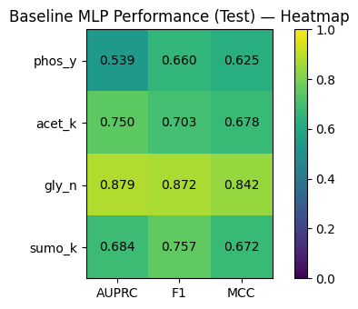
RESULTS AND NEXT STEPS
Develop ProtMAMBA prototype for Milestone 2
Fine tune hyperparameters in ProTMAMBA for Milestone 3
Notes:
Finally, I ran a Hyperparameter Search with a sweep of 240 configurations across all PTMs.
I have likely hit the capacity limit of this local, fixed-window representation. Further hyperparameter tuning yields diminishing returns.
Now, To improve substantially in Milestone 2, I will be changing the architecture to ProtMAMBA to capture long-range dependencies, rather than just tuning this MLP."

Slide 8
QUESTIONS ?

