Slide 1
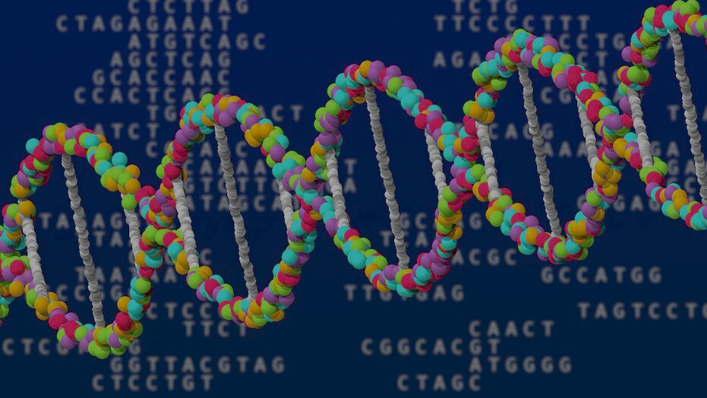
PREDICTING PTM SITES USING Prot-MAMBA
Harsh Chauhan

Slide 2
BACKGROUND AND MOTIVATION
Language of Proteins:
Amino acids are the fundamental building blocks of proteins.
20 standard residues: A, R, N, D, C, E, Q, G, H, I, L, K, M, F, P, S, T, W, Y, V
POST-TRANSLATIONAL MODIFICATIONS (PTMs) are chemical changes added after the protein is made
PTMs control protein function, signaling, stability, and are critical in disease mechanisms
PTM Type | Happens on
Phosphorylation | S/ T/ Y
Acetylation | K
Ubiquitination | K
Notes:
Proteins are like programs in biology — they do work in the cell.”
“PTMs are small chemical changes on specific residues, like adding a tag that changes how the protein behaves.”
“Finding PTM sites in the lab is expensive and slow, so prediction helps narrow down which residues are worth testing.”
“So the core motivation: use computation to quickly predict likely PTM locations from protein sequences.”

Slide 3
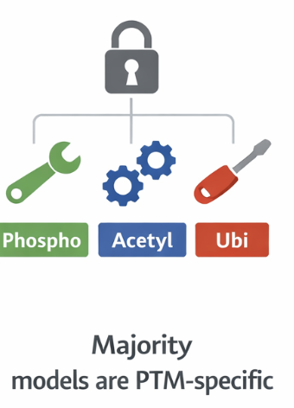

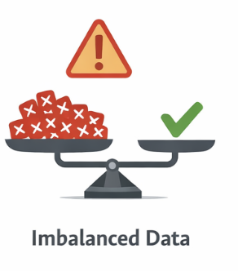
PROBLEM STATEMENT
M A T K S T Y ...
Protein sequence
PTM Predictor
Using ML models
M A T K S T Y ...
T (PTM attached)
Notes:
“Most residues in a protein are not modified.”
“So the dataset is highly imbalanced — a model can get high accuracy by always predicting ‘no PTM’.”
“We need metrics and training methods that actually reward catching rare PTM sites.”
PTM depends on surrounding context
“A PTM doesn’t depend only on the residue itself.”
“The neighboring and sometimes long-range sequence context affects whether a site gets modified.”
“So we need a model that can understand patterns across the whole sequence, not just local windows.”
Most models are PTM-specific
“Many tools are built only for one PTM type and don’t generalize well.”
“The goal is to move toward a more flexible approach that can transfer across PTMs and proteins.”

Slide 4
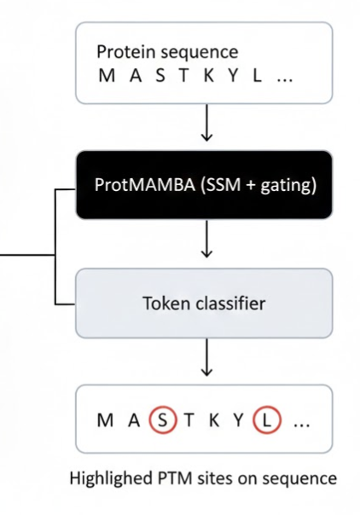
APPROACH
MAMBA is made of:
STATE SPACE MODELS (SSMs)
efficient for long sequences, captures long-range context, linear-time scanning
RNN-STYLE GATING selective memory, filters noise, strong sequential inductive bias
Notes:
“Our plan is to use ProtMAMBA, which is based on the MAMBA architecture.”
“MAMBA combines two useful ideas: State Space Models (SSMs) and RNN-style gating.”
“SSMs are efficient for long sequences — they can process information across thousands of tokens without the heavy cost of attention.”
“That’s important because proteins can be long, and PTMs may depend on far-away context.”
“The gating behaves like selective memory — it helps keep useful signals and ignore noise.”
“That’s useful when only a few residues matter for the PTM decision.”
“Input is just the amino acid sequence.”
“ProtMAMBA converts it into contextual representations.”
“Then we add a small classifier head that predicts PTM probability per residue.”
“Output is a heatmap or highlighted sequence showing likely PTM locations.”
“So the model is essentially doing token classification — like labeling each residue as PTM or not.”

Slide 5
EVALUATION
Train/ Val/ Test split
Compare to benchmarks
Report per-PTM results
Model | F1 | AU-PRC
AstraPTM | 0.67-0.71 | 0.7-0.74
DeepMVP | 0.75-0.79 | 0.78-0.82
PLM-ESM2 | 0.65-0.72 | 0.68-0.76
SiteStack | 0.64-0.69 | 0.66-0.73
ProtMAMBA | ? | ?
Notes:
“We’ll evaluate using a clean train/validation/test split, making sure proteins don’t leak between splits.”
“Accuracy is not enough because ‘no PTM SITES’ dominates.”
F1 → balance of both
AUPRC → especially important because PTMs are rare”
“False positives waste lab effort.”
“False negatives miss important biology.”
“So we want a model that keeps both under control.”
To summarize: we’re predicting PTMs from sequence using ProtMAMBA, tackling imbalance and context challenges, and we’ll validate with strong metrics designed for rare labels

Slide 6
QUESTIONS ?

