Slide 1

PTM Prediction with ProtMamba
Milestone 2
Harsh Chauhan

Slide 2
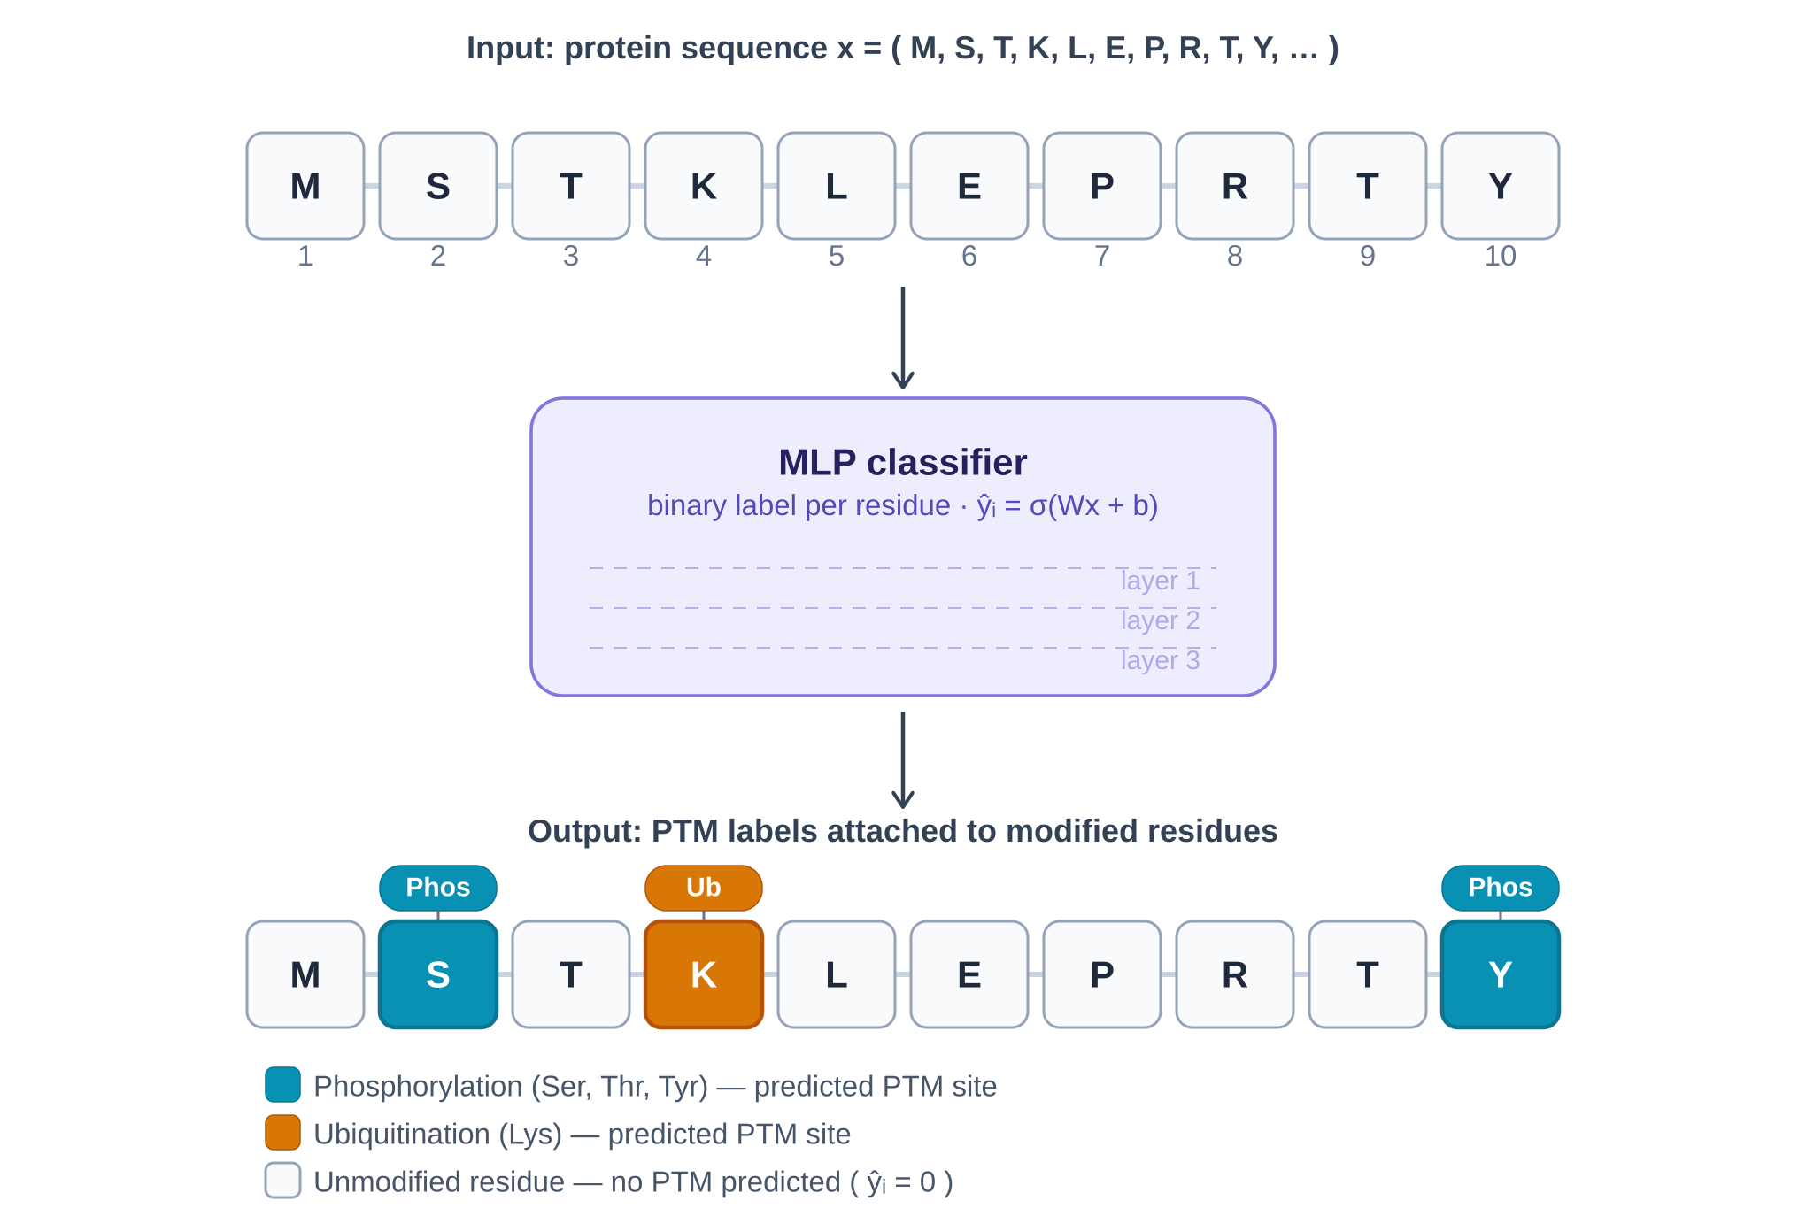
1
Recap
Milestone 1 Achievements
•
Dataset Preparation: PTM datasets with residue-level labels
•
Data Splitting: Protein-wise train/validation/test to prevent leakage
MLP CLASSIFIER
•
Baseline Model: MLP classifier for validation
Key Insight
Pipeline confirmed functional with baseline performance established. Focus shifted to improving feature representation using protein language models.
Notes:
Proteins are composed of sequences of amino acids, which determine the structure and function of the protein. After a protein is synthesized, it often undergoes post-translational modifications, or PTMs. These are chemical changes to specific amino acid residues that can regulate protein activity, localization, or interactions.
Experimentally identifying PTM sites is expensive and time-consuming, so computational models are often used to predict which residues are likely to be modified
In Milestone 1, the goal was to establish a working baseline pipeline for this prediction task.
The main outcome of Milestone 1 was verifying that the data preprocessing, training pipeline, and evaluation framework were working correctly, and establishing baseline performance before moving to more advanced representations.

Slide 3
2
ProtMamba: Architecture and Training Constraints
What is ProtMamba?
Computational Constraints
ProtMamba is a protein language model designed to capture long-range dependencies in biological sequences using State Space Models (SSMs).
Single Training Iteration
~35 days
State Space Models
Long-Range Context
Efficient sequence modeling with linear complexity
Captures dependencies across entire protein sequences
Hyperparameter Search
Months
Timeline incompatible with project constraints
Training Challenge
Initial plan was to fine-tune ProtMamba end-to-end for PTM prediction. However, experiments revealed prohibitive computational requirements.
Strategic Pivot
Strategy adjusted to use ProtMamba as a frozen feature extractor .
New Approach:
→
Generate contextual embeddings for sequence windows
→
Use embeddings as input to downstream classifiers
→
Enable efficient training with rich representations
Notes:
ProtMamba is based on state space models, or SSMs, which provide an alternative to transformer architectures.
Most modern large language models rely on self-attention mechanisms. While powerful, attention mechanisms have quadratic computational complexity with respect to sequence length, which becomes expensive for long sequences like proteins.
State space models, on the other hand allows them to process sequences with linear complexity while still capturing long-range dependencies.
Because of this, Mamba architectures can scale efficiently to long biological sequences.
The original plan was to fine-tune the ProtMamba model directly for PTM prediction.
However, during experimentation I discovered that training this architecture is extremely computationally expensive. A single full training run was estimated to take approximately 35 days, and running hyperparameter searches would extend the timeline to several months.
Given these constraints and discussions with my advisor, we made a strategic pivot.
Instead of training the model end-to-end, we now use ProtMamba in inference mode as a frozen feature extractor.
In this setup, ProtMamba generates contextual representations for protein sequence windows, and these representations are used as input features for downstream models that are much faster to train.”

Slide 4
3
New Architecture
CNN + RNN ARCHITECTURE
Protein Sequence
ProtMamba
51 × 768
CNN Layers
GRU Layers
PTM Prediction
Window: 51 residues
Frozen Feature Extractor
Embeddings
Feature Extraction
Sequence Modeling
Binary Classification
Model Variants Tested
Hyperparameter Search
Systematic search over convolutional and recurrent layer depths to identify optimal configuration.
CNN + GRU
OPTIMAL
Convolutional + Gated Recurrent Unit
Best Configuration:
CNN + BiLSTM
Alternative
CNN Layers
GRU Layers
Convolutional + Bidirectional LSTM
2
2
Selection Criteria: Highest validation MCC
Notes:
In the new architecture, ProtMamba is used to generate contextual embeddings for sequence windows.
Each input is a 51-residue window centered which is passed through the pretrained ProtMamba model during inference, it produces a 51 by 768 embedding matrix.
The number 51 corresponds to the number of residues in the sequence window, while 768 represents the dimensionality of the embedding vector produced for each residue.
The embedding matrix is then passed into a downstream neural architecture.
First, convolutional layers extract local sequence motifs from the embedding representation.
Next, GRU layers model sequential dependencies across the window.
Finally, a classification layer predicts whether the central residue is a PTM site.
Through hyperparameter search, the best performing configuration was two convolutional layers followed by two GRU layers, selected based on the highest validation MCC.”

Slide 5
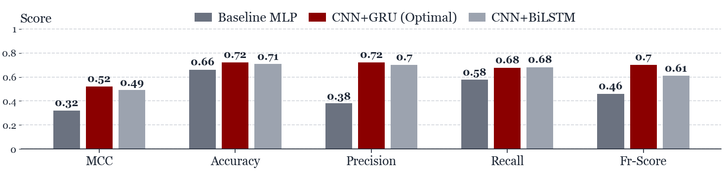
4
Results and Performance
FIGURE 3: MODEL PERFORMANCE COMPARISON
Key Findings
Performance Metrics
•
CNN+GRU (2 conv + 2 GRU) achieved highest validation MCC
0.52
72%
•
ProtMamba embeddings provide rich contextual information
MCC (Validation)
Accuracy
•
Frozen feature extraction enables efficient training
72%
68%
Precision
Recall
Notes:
The baseline MLP model achieved an MCC of approximately 0.32, which served as our reference point.
When we introduced ProtMamba embeddings combined with sequence models, we observed consistent improvements across multiple metrics.
Among the architectures tested, the CNN + GRU model with two convolution layers and two GRU layers achieved the best performance, reaching a validation MCC of approximately 0.52.
We also evaluated a CNN + BiLSTM variant, which performed slightly better than the baseline but did not outperform the CNN + GRU model.

Slide 6
Questions?

