Slide 1
What factors have what effect in influencing income

Slide 2
An INCOME OF AN INDIVIDUAL RESULTS FROM VARIOUS FACTORS. INTUITIVELY, it is influenced by the individual’s education level, age, gender, occupation, and etc. wE WILL DIVE IN TO LOOK INTO SUCH FACTS AND FIGURES THAT WILL HELP US IDENTIFY THE INFLUENCING FACTORS.

Slide 3

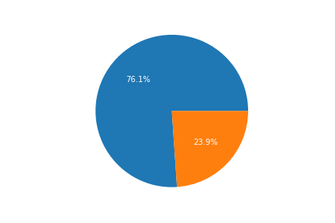
The income is divided into 2 classes >50K and <=50k

Slide 4
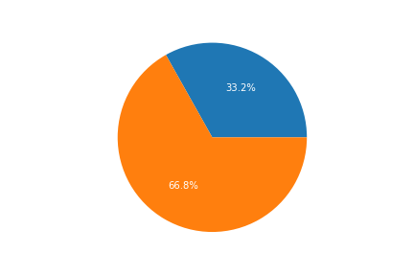
Now if we look at the gender classification of our Data, we can see that it is a male dominant figure I.e majority of the earning population is male.

Slide 5
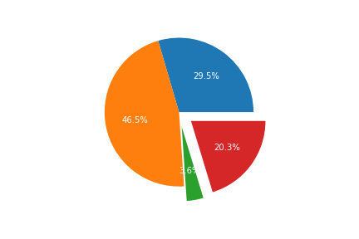
The given data tells us that while 30% of the male population is earning more than 50k on the other hand only 11% of the female population is earning above 50k. this tells us that gender has an influencial factor on which income class will the individual lie

Slide 6
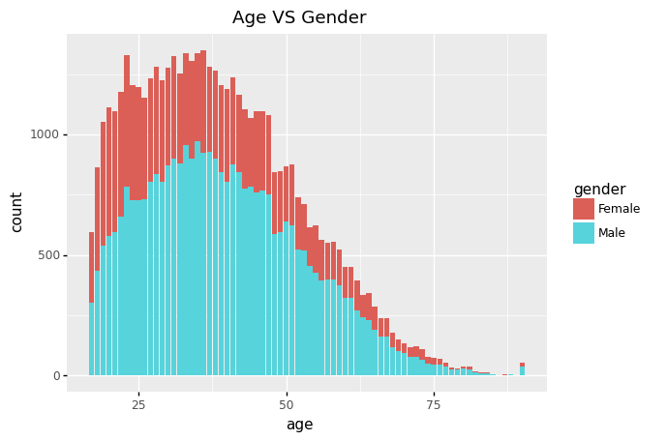
What is the relation between age and gender of the population?
We can notice that a majority of woking class lies between the age of 20 and 50, after which we can notice a decline as the age grows.
The ratio between male and female over age increases as the age increases

Slide 7
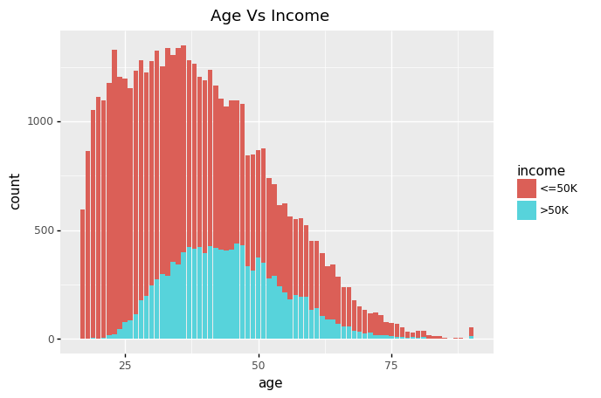
How is income and age related irrespective of the gender?
The income of an individual increases with age.
However it attains and remains at peak between the age 40 and 50
The ratio of people earning above and below 50k increases with age.

Slide 8
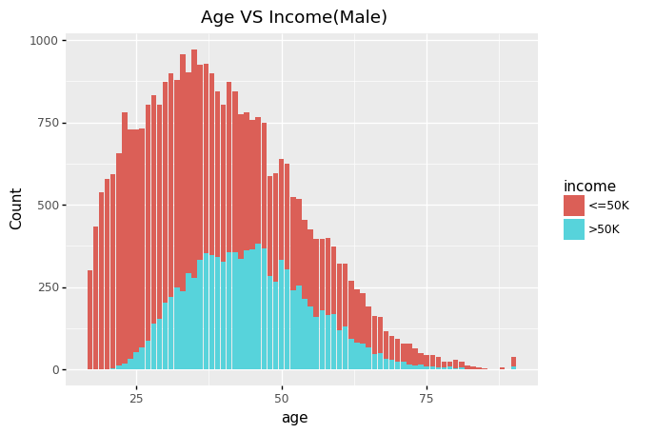
Let us look at age vs income gender wise
The graph shows similar behaviour as the age vs income irrespective of gender.
We can notice the income increasing over age
The ratio of men earning more than 50k is also seen increasing with age

Slide 9
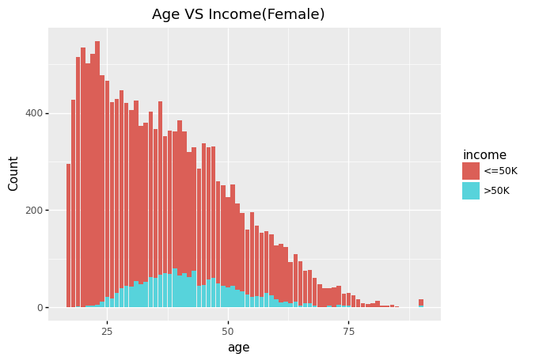
Does the female age vs income graph shows similar trend?
The following graph tells a different story.
The female working population decreases over age from the very start of their career.
However the women earning more than 50K increases with age up until they attain a peak at the of 45 and then starts to decline.

Slide 10
Insights
Age plays an important factor for both the genders In terms of their earning.
While the male population workforce grows over age until they achieve a peak, their female counterpart sees a decline in workforce from the very start of career.
This decline in female workforce can be a factor of low above and below 50k income ratio.
However as the age increases the difference between the male and female workforce sees a sudden decline.

Slide 11
What are the different sectors resulting in economy?
Government Sector
Private sector
Self-imployed
Others/no-work

Slide 12
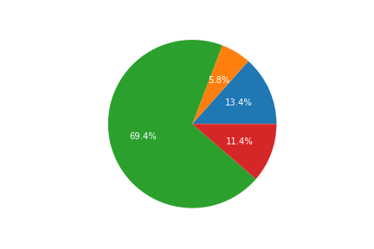
Distribution of workforce in the given sectors

Slide 13
Income by industry
Let us look at what amount of workforce in a given sector lies in which income class

Slide 14
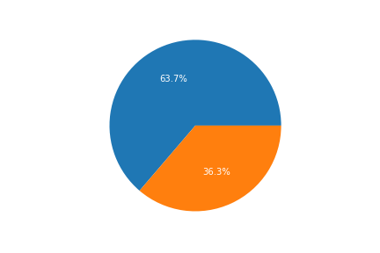
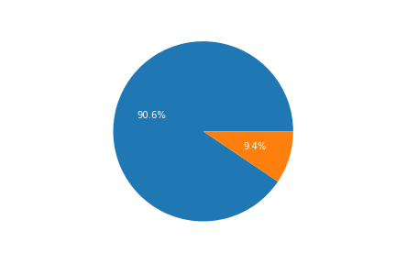
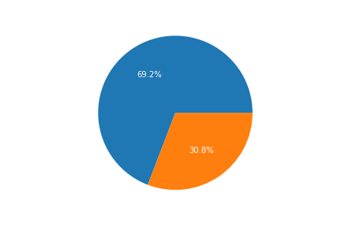
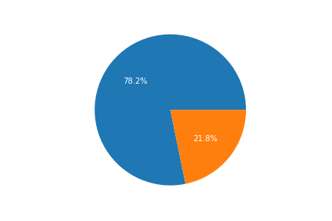
We can notice that Self-Employed people and Government sector people have a higher conversion rate of earning more than 50k.
While private sector absorbs majority of the workforce, it still shows a good percent of population earning above 50k

