Slide 1
Problem Statement Description
System that provides farmers an interface to sell their produce , and connect with the buyers all over India
Simple interface that works on mobile, SMS to upload produce details and respond via phone and SMS (taking care of digital divide)
Interface for anyone to buy the produce/vegetable – initially visit the place and buy or have courier service integrated to deliver the vegetables .
Technology that can be used as a platform for connecting car buyer to Seller
Farmers can get a better price for their produce, no additional cost spent in marketing and delivery of goods , however they can choose to charge more by delivering the items themselves
Hack NITJ - 2020
Problem Statement : Portal for farmers
Category: Agriculture and Rural Development
Organisation : CDK Global
Problem Code: #RA27
Team Name : Hacking Bad
Team Leader Name : Arsh Goyal

Slide 2
Solution /Approach:
KrishiHub
A Platform for farmers
A Digital Solution that brings together Farmers and Buyers at a common E-marketplace .
A Farmer’s Platform where they can sell their produce connecting with buyers all over India supported with an SMS service for farmers to update the details of their crops from their verified mobile number .
It aims to empower small and medium scaled farmers of India to reach customers all over the country and sell their produce at best prices by irradiating the role of middlemen .
A Buyer’s Platform where they can buy Agricultural Commodities from all over India .
E-commerce is revolutionizing the way we all shop in India and we aims to bring the same revolution for farmers enabling them to live with pride and make extra income .

Slide 3
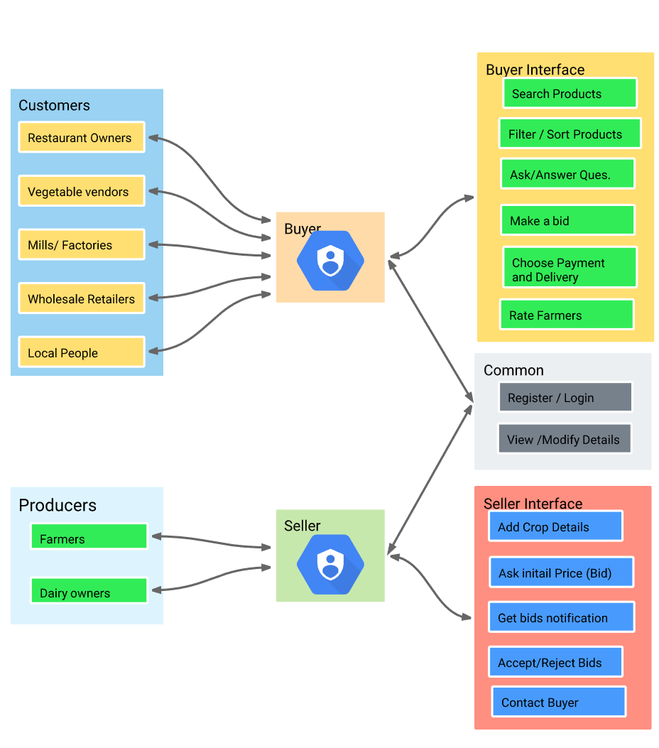
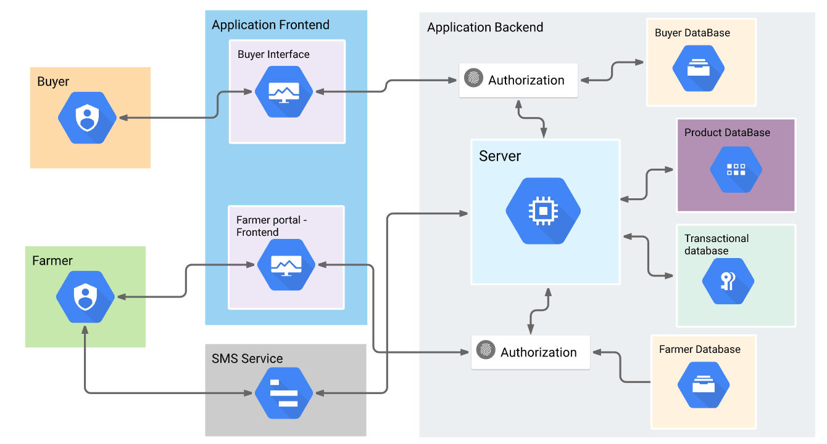
Use Cases :
Flow Diagram :
Technologies:
Server-Side :
Django
Database :
Postgre SQL
Frontend :
HTML5,CSS3
JavaScript
Bootstrap
SMS Service :
Twilio

Slide 4
Farmer’s Platform :
KrishiHub
A Simple Web interface that even works well on mobile devices for farmers from where they can upload their crop details and select bids to sell their crops all over India .
Farmers from all over India will be able to register on the platform.
If farmers have any product they want to sell they will share with us all the information on specifications and the prices they are offering as well as the optional logistics .
We already have most common agricultural products listed ( 140 + ) and if you have another product to sell you can always contact us through the Platform .
With this farmers can directly sell agricultural commodities without need of Intermediaries .
It Avoids the price of intermediation and help farmers to increase their margins .
Multilingual platform so that farmers can comfortably use it in their regional Language .

Slide 5




Procedure :
Evaluate Bids
Confirmation from buyer
Crop Sold
Register/Login
Add Crop
Farmer Registers on the portal with his complete details and is ready to sell .
Farmer adds Crops (SMS) he want to sell with complete details and the same is listed for buyers .
Compare various prices offered by buyers and selects among them .
Buyer Confirms the purchase and decides upon Delivery and Payment
Details like Pickup, Delivery Address are confirmed and transaction is complete .
KrishiHub makes Easier, Faster and More Transparent to buy and sell Agricultural Commodities with this easy yet effective Procedure.
It’s many features include suggesting Minimum Price based upon MSP decided by Government of India .

Slide 6
On the homepage farmers can a select Add a crop option and fill in the specific details related to goods they are offering and optional logistics ( if they want to deliver themselves or use our logistic services ) and Submit it and,
Buyers will then be able to analyze their proposal and bid upon them .
MSP
Minimum Support Price Details
Homepage
Add Crop
View my Crops
View Bids
Sell at Price , Location and Buyer of your Choice
Modify
Accept
Delete
Reject
Multilingual , Simple and Easy to use
Among other options the farmer have, they can view the details of all their previous crops up on sale and can Modify / Delete them based upon their local sales .
For all his listed offerings farmers can view all the bids offered by interested buyers and can decide upon to Accept or Reject a bid.

Slide 7
SMS Service
After farmer has registered on web portal , He/ She can use the SMS service to upload crop details he want to sell and,
Will be able to use the same to respond to bids by interested buyers .
01
OTP message for verification of phone no. and ,
Crop Upload Template .
Upon Successful registration the farmer will receive a template message with all required fields , and farmer can use/edit the same template message to upload crop details .
Farmers can select a particular bid via responding in SMS with CropId and BidId .
02
Add crop message by farmer with all relevant information , via editing the Template message .
03
Various Bids message to farmer with BidId to select a specific Bid and Respond via SMS .
04
Confirmation message with complete payment ,delivery Details .

Slide 8

Buyer’s Portal
A Web Platform through which buyers can buy Agricultural Commodities from all over India .
It accommodates direct transactions between buyers and sellers. All intermediators are eliminated and you can buy directly from the farm .
Search:
Buyer can directly Search for the commodity that he wishes to buy on the web platform and select among listed options.
Buyer after selecting his desired product can Bid on it with his Offered Price .
After which all the bids for a crop will go the farmer to select the best from them .

Slide 9


Buyer and Farmer out to use our web messaging platform to Negotiate Price, clear doubts .
Farmer can also message buyer regarding payment and Delivery Classifications .
After a Bid has been selected the buyer will proceed to checkout with complete details about Payment , Pickup or Delivery , Delivery Address etc. .
After it a transactionId will we allocated to buyer through which it can trace status of its purchase and track its whereabout .
Buyers will have additional features like :
Buyer can mark items as Favorites which he may want to buy in future or order repeatedly like Wheat , Rice etc. .
Buyer can trace the status of their purchase via transactionId

Slide 10

Categories
Price
Buyer’s can Sort and Filter products based upon various parameters to make search results more Relevant and purchase easier .
Sort and Filter
Rating
Quality
Buyers having any trouble can go through the FAQ’s section and contact us for Help .
Dependencies:
Secure Payment Gateway.
Delivery service to deliver the produce .
SMS provider .
Web Portal Hosting Services.
MSP (Minimum Support Price ) Data.

