Slide 1
HACK NITJ - 2020
PROBLEM STATEMENT : PORTAL FOR FARMERS
CATEGORY: AGRICULTURE AND RURAL DEVELOPMENT
ORGANISATION : CDK GLOBAL
PROBLEM CODE: #RA27
TEAM NAME : HACKING BAD
TEAM LEADER NAME : ARSH GOYAL
Problem Statement Description :
System that provides farmers an interface to sell their produce , and connect with the buyers all over India
Simple interface that works on mobile, SMS to upload produce details and respond via phone and SMS (taking care of digital divide)
Interface for anyone to buy the produce/vegetable – initially visit the place and buy or have courier service integrated to deliver the vegetables .
Technology that can be used as a platform for connecting car buyer to Seller
Farmers can get a better price for their produce, no additional cost spent in marketing and delivery of goods , however they can choose to charge more by delivering the items themselves

Slide 2
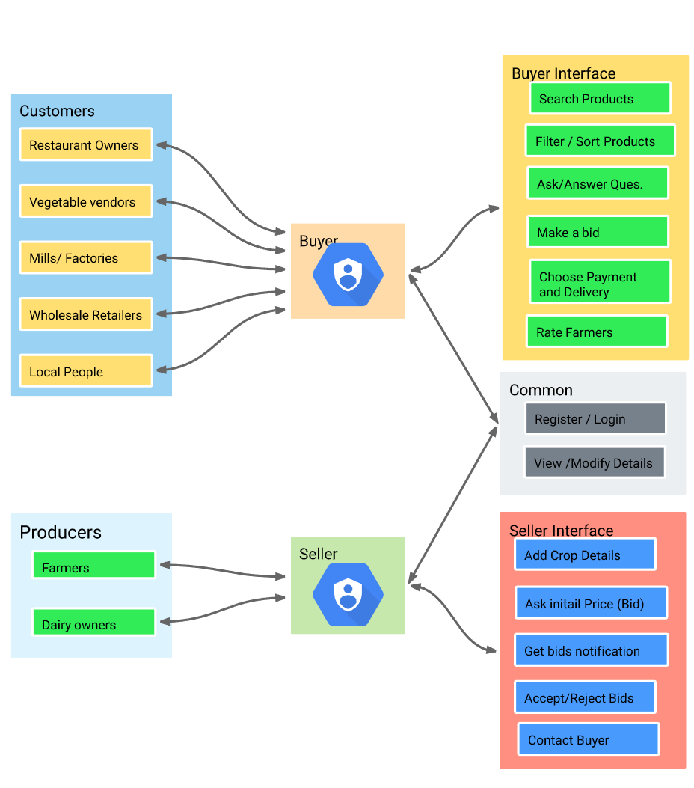
Solution /Approach:
KrishiHub
Use Cases :
A Platform for farmers
A Digital Solution that brings together Farmers and Buyers at a common E-marketplace .
A Farmer’s Platform where they can sell their produce connecting with buyers all over India supported with an SMS service for farmers to update the details of their crops from their verified mobile number .
It aims to empower small and medium scaled farmers of India to reach customers all over the country and sell their produce at best prices by irradiating the role of middlemen .
A Buyer’s Platform where they can buy Agricultural Commodities from all over India .

Slide 3
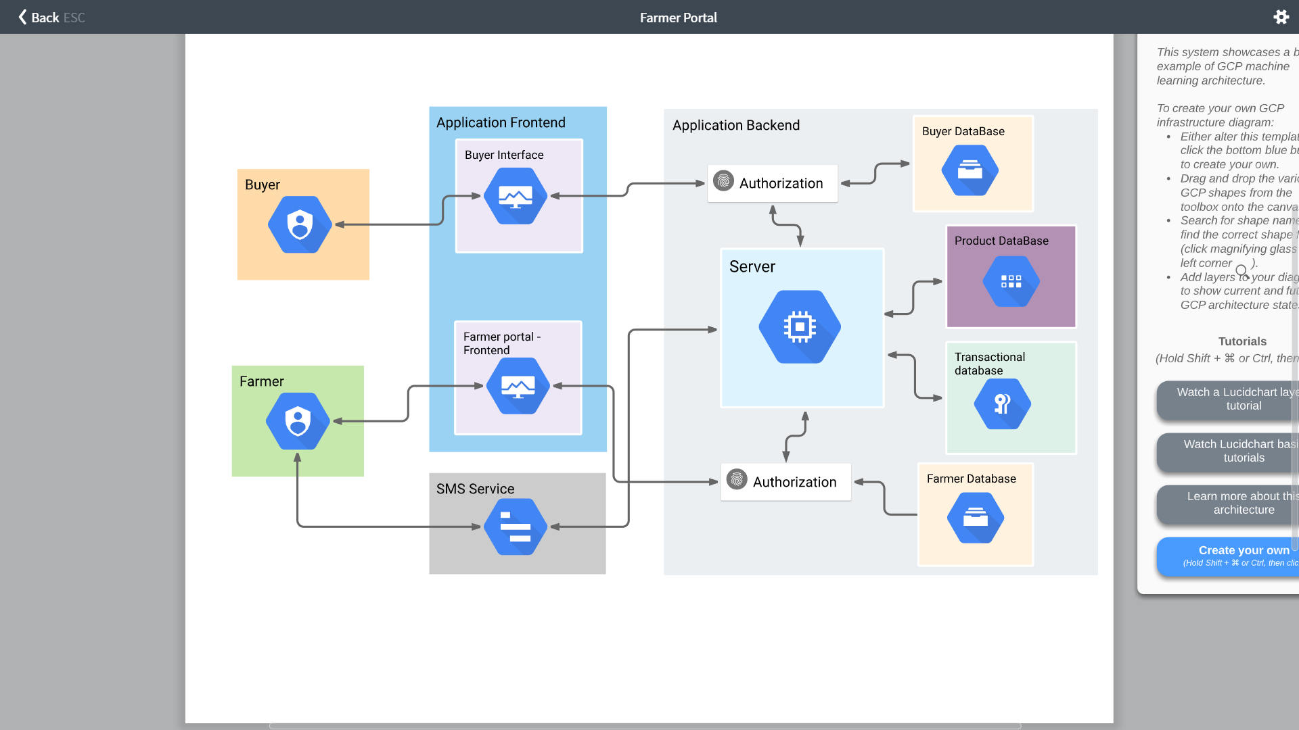
Flow Diagram :
Technologies:
Server-Side :
  Django
Database :
  Postgre SQL
Frontend :
  HTML5,CSS3
  JavaScript
  Bootstrap
SMS Service :
  Twilio

Slide 4
FARMER’S PLATFORM :
KrishiHub
A Simple Web interface that even works well on mobile devices for farmers from where they can upload their crop details and select bids to sell their crops all over India .
Farmers from all over India will be able to register on the platform.
If farmers have any product they want to sell they will share with us all the information on specifications and the prices they are offering as well as the optional logistics .
We already have most common agricultural products listed ( 140 + ) and if you have another product to sell you can always contact us through the Platform .
With this farmers can directly sell agricultural commodities without need of Intermediaries .
It Avoids the price of intermediation and help farmers to increase their margins .
Multilingual platform so that farmers can comfortably use it in their regional Language .
Specific KYC ( Know Your Customer ) procedure for verification of buyers to prevent inconvenience .

Slide 5





How it Works :
Evaluate Bids
Confirmation from buyer
Crop Sold
Register/Login
Add Crop
Farmer Registers on the portal with his complete details and is ready to sell .
Farmer adds Crops (SMS) he want to sell with complete details and the same is listed for buyers .
Compare various prices offered by buyers and selects among them .
Buyer Confirms the purchase and decides upon Delivery and Payment
Details like Pickup, Delivery Address are confirmed and transaction is complete .
KrishiHub makes Easier, Faster and More Transparent to buy and sell Agricultural Commodities with this easy yet effective Procedure.
It’s many features include suggesting Minimum Price based upon MSP decided by Government of India .

Slide 6
On the homepage farmers can a select Add a crop option and fill in the specific details related to goods they are offering and optional logistics ( if they want to deliver themselves or use our logistic services ) and Submit it and,
Buyers will then be able to analyze their proposal and bid upon them .
MSP
Minimum Support Price Details
Homepage
Add Crop
View my Crops
View Bids
Sell at Price , Location and Buyer of your Choice
Modify
Accept
Delete
Reject
Multilingual , Simple and Easy to use
Among other options the farmer have, they can view the details of all their previous crops up on sale and can Modify / Delete them based upon their local sales .
For all his listed offerings farmers can view all the bids offered by interested buyers and can decide upon to Accept or Reject a bid.

Slide 7
SMS SERVICE
After farmer has registered on web portal , He/ She can use the SMS service to upload crop details he want to sell and,
Will be able to use the same to respond to bids by interested buyers .
01
OTP message for verification of phone no. and ,
Crop Upload Template .
Upon Successful registration the farmer will receive a template message with all required fields , and farmer can use/edit the same template message to upload crop details .
Farmers can select a particular bid via responding in SMS with CropId and BidId .
02
Add crop message by farmer with all relevant information , via editing the Template message .
03
Various Bids message to farmer with BidId to select a specific Bid and Respond via SMS .
04
Confirmation message with complete payment ,delivery Details .

Slide 8

BUYER’S PORTAL
A Web Platform through which buyers can buy Agricultural Commodities from all over India .
It accommodates direct transactions between buyers and sellers. All intermediators are eliminated and you can buy directly from the farm .
Search:
Buyer can directly Search for the commodity that he wishes to buy on the web platform and select among listed options.
Bid:
Buyer after selecting his desired product can Bid on it with his Offered Price .
After which all the bids for a crop will go the farmer to select the best from them .

Slide 9


Buyer and Farmer out to use our web messaging platform to Negotiate Price, clear doubts .
Farmer can also message buyer regarding payment and Delivery Classifications .
After a Bid has been selected the buyer will proceed to checkout with complete details about Payment , Pickup or Delivery , Delivery Address etc. .
After it a transactionId will we allocated to buyer through which it can trace status of its purchase and track its whereabout .
Buyers will have additional features like :
Buyer can mark items as Favorites which he may want to buy in future or order repeatedly like Wheat , Rice etc. .
Buyer can trace the status of their purchase via transactionId

Slide 10
Categories
Price
Buyer’s can Sort and Filter products based upon various parameters to make search results more Relevant and purchase easier .
Sort and Filter
Rating
Quality
Buyers having any trouble can go through the FAQ’s section and contact us for Help .
Dependencies:
Secure Payment Gateway.
Delivery service to deliver the produce .
SMS provider .
Web Portal Hosting Services.
MSP (Minimum Support Price ) Data.
Location Based Weather Dataset

Slide 11
Farmers decision Chatbot according to rain and weather Conditions:
ML Model Trained on the dataset of previous 100 hundred years of weather conditions and platform’s crop sales data.
24X7 seamless connectivity to AI expert Chatbot along with multi lingual support .
Crop Recommendation System
Development of Chatbot for taking decisions about crop selectivity and precautions .
Modelling a farmer decision support system on basis of data .

Slide 12
Daily Markets for Perishable Goods :
Feature that closely replicates the daily market system
Daily Market
In the starting hours of the day a 4 Hrs (5am – 9am) portal for perishable goods will open for farmers where they will establish the market by listing the commodities they want to sell ,quantity and offered Price .
The Identity of farmers will remain anonymous to prevent favouritism and only details like price ,rating will we available .
1
4
The buyers can bid for commodities till the end of bidding time after which farmers will see the list of top three bidding buyers and will choose one of them .
5
Once the market is established buyers will come into picture , a city-wise Bidding portal for buyers will open at 9:30 am till 12 :30 pm .
2
6
The Order will be acknowledged from both the sides and UPI interface will be available for instant Transactions .
Buyers can search commodity they want to buy and list of farmers selling the same would be populated
3
The Order will to be delivered by the next day morning hours .

Slide 13
Waste Management and reducing Pollution:
Most Farmers don’t Realize that Wheat Stubble left after harvest (a major waste product) is also used to generate electricity at powerplants, instead they burn it creating uncontrolled unmonitored pollution .
Stubble burning in Punjab and Haryana in northwest India
has been cited as a major cause of air pollution in Delhi.
We have addressed the solutions of all the farmers in the process of handling the wheat stubble. Famers will get information about licensed Electricity Generation plant’s where they can Sell their stubble .
Farmers will be benefitted with added revenue of their waste which they burn because of no information about uses of the stubble.
Industries are benefit because of cheap price of fuel they can get .
It will also benefit Environment as it would prevent uncontrolled burning of stubble creating pollution , also government will know exactly when and where stubble is burned .

