Slide 1

Data-Driven Stellar Projection and Classification
SET ID-222248
Name and Reg. No. Supervisor
Aman Kumar Sharma (22MCB0021) Dr. Parthasarathy G
Harsh Tyagi (22MCB0022) (19042) (SCOPE)
Rajat Moundekar (22MCB0004)
Date: 09/06/2023
Venue: SJT 307, VIT Vellore

Slide 2
CONTENTS
Objective
Introduction
Literature Survey
Proposed Work
Experiments and Results
Summary
References
VIT Vellore

Slide 3
OBJECTIVE
To build an end-to-end advanced machine learning solution for the Stellar Classification problem in Astronomy.

Slide 4
INTRODUCTION
Astronomy is the study of everything beyond the Earth's atmosphere in the universe.
Using stellar classification, astronomers categorize stars based on their spectral characteristics. Spectral characteristics enable astronomers to extract additional information about stars, including their elements, temperatures, densities, and magnetic fields.
The galaxies, quasars, and stars classification scheme are one of the most fundamental in astronomy. The objective of this project is to classify stars, galaxies, and quasars (luminous supermassive black holes) according to their spectral properties.

Slide 5
LITERATURE SURVEY
Author | Adopted Scheme | Features | Challenges
Zhuliang Qipaper | including artificial neural networks, support vector machines, decision trees, and random forests | High accuracy | need for large and diverse datasets
Jishant Talwar et al | support vector machines, decision trees, and random forests | High accuracy | need for large and diverse datasets Imbalanced dataset
S. Saha et al | fuzzy clustering and self-organizing map-based approach | Reduced error | the need to choose appropriate parameters
Xiang-Ru Li et al | random forest algorithm. | High accuracy | need for large and diverse datasets had to select appropriate hyperparameters

Slide 6
LITERATURE SURVEY
Author & Year | Adopted Scheme | Features | Challenges
Harinder P. Singh et al | principal component analysis (PCA) and artificial neural networks (ANNs). | Reduced error | potential loss of information when reducing the dimensionality of spectra using PCA.

Slide 7
PROBLEM STATEMENT
According to the literature review, the following difficulties still persist.
1. need for large and diverse datasets
2. Tuning Hyper Parameters for higher accuracy

Slide 8
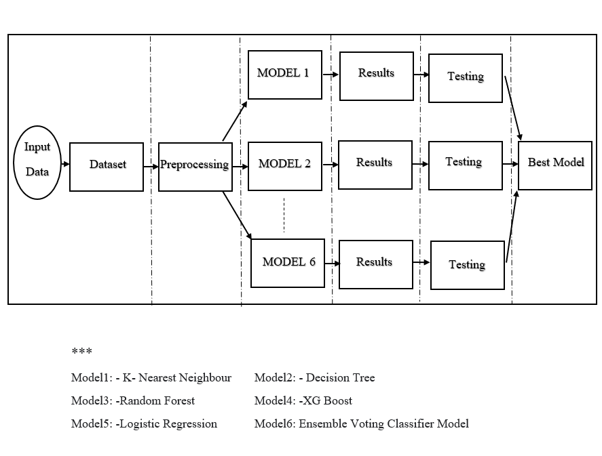
Proposed System

Slide 9
Dataset
Dataset | Records
Star dataset | 100000
The data consists of 100,000 space observations made by SDSS(Sloan Digital Sky Survey). Each data point has 17 feature columns that characterize it, and one class column that designates whether it is a star, galaxy, or quasar

Slide 10
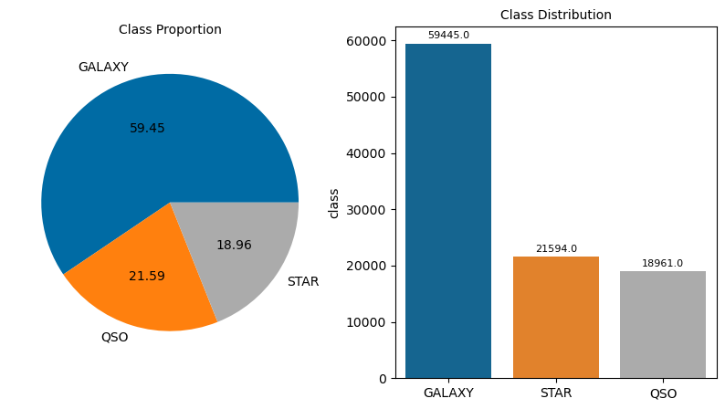
Dataset

Slide 11
Experiments and Results
Preprocessing
Description | Dataset | Description
EDA(Exploratory Data Analysis) | SDSS Dataset | Checking for Missing data Univariate analysis Multivariate analysis Data Standardization

Slide 12
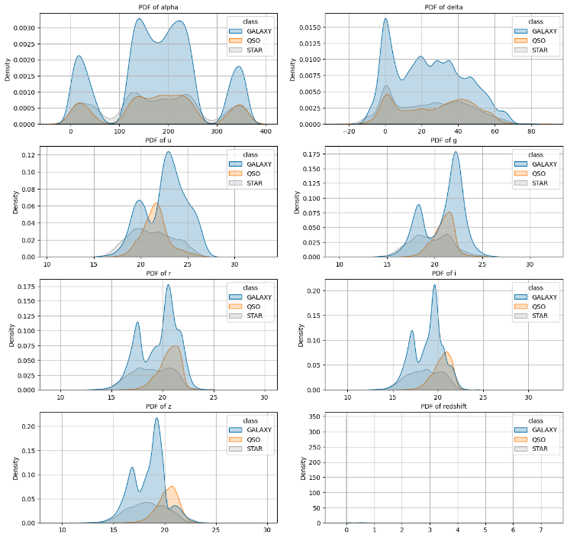
Experiments and Results
Univariate analysis

Slide 13
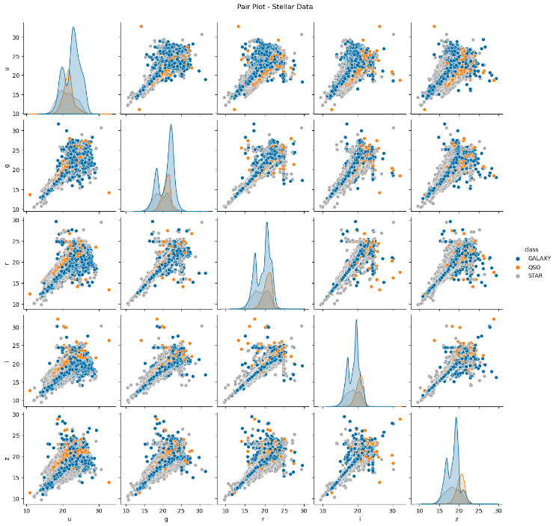
Experiments and Results
Multivariate analysis

Slide 14
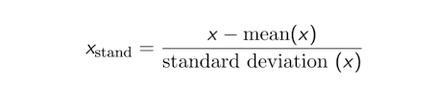
Experiments and Results
Data Standardization
A data standardization technique transforms many data sets into a uniform framework. After data has been acquired from various sources, it must be transformed before being put into target systems
The range of features in our dataset is different so we have done data standardization

Slide 15
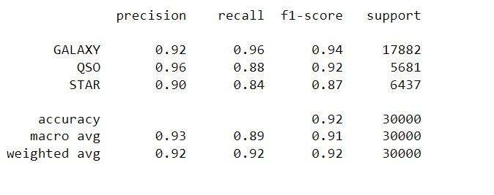
Experiments and Results
K Nearest Neighbor

Slide 16
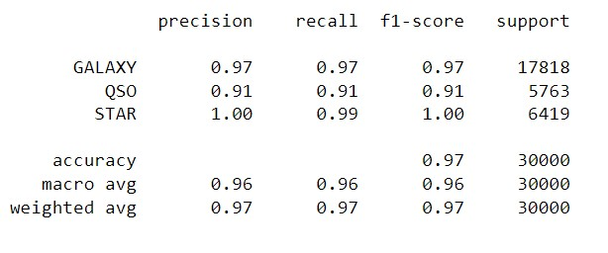
Experiments and Results
Decision Tree:

Slide 17
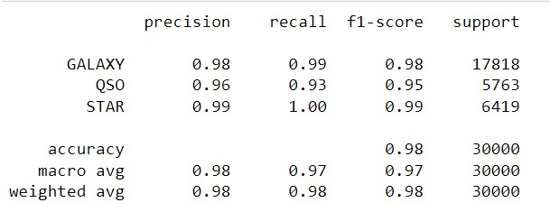
Experiments and Results
Random Forest:

Slide 18
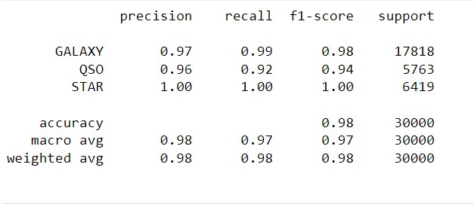
Experiments and Results
XG Boost:

Slide 19
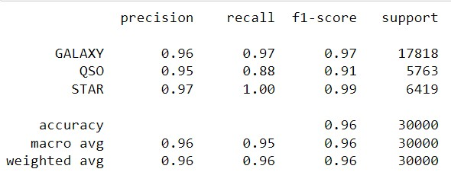
Experiments and Results
Logistic Regression:

Slide 20
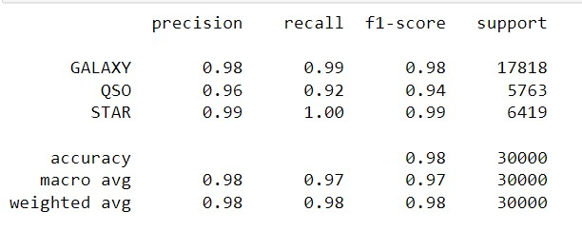
Experiments and Results
Ensemble Voting Classifier Model:

Slide 21
Experiments and Results
Model | Avg. Accuracy | Avg. Precision | Avg. Recall | Avg. F1-score
KNN | 0.92 | 0.93 | 0.89 | 0.91
D.T. | 0.97 | 0.96 | 0.96 | 0.96
R.F. | 0.98 | 0.98 | 0.97 | 0.97
XG Boost | 0.98 | 0.98 | 0.97 | 0.97
Logistic Regression | 0.96 | 0.96 | 0.95 | 0.96
Ensemble Model | 0.98 | 0.98 | 0.98 | 0.98
Qi.Z.[4] | 0.97 | 0.97 | 0.97 | 0.97
The Ensemble Voting Classifier model is shown to have an overall accuracy of 98%. When compared to other models, the Ensemble Voting Classifier Model has the highest accuracy, precision, recall, and F1 score

Slide 22
Summary
In this work, astronomical objects including galaxies, stars, and quasars were categorized using ML techniques like KNN, decision tree, Logistic Regression, Random Forest, XG-Boost, and Ensemble Model, all based on data from the SDSS. The Classification Report of the six models shows that the Ensemble Voting Classifier Model performed best and achieved an accuracy rate of 98% while using very few processing resources. Furthermore, all six algorithms achieved outstanding results when tasked with classifying galaxies, stars, and quasars.

Slide 23
References
YORK D G, ADELMAN J, ANDERSON JR J E, et al. The Sloan digital sky survey: technical summary[J]. The Astronomical Journal, 2000, 120(3); 1579
Zhou Jie, Zhu Jianwen. Research on machine learning classification problem and algorithm [J] Software, 2019, 40 (7): 205-208
Liu Shifang. Application of Python in Artificial Intelligence. Industrial Technology Innovation, 2019, 25
Qi, Z. (2022). Stellar Classification by Machine Learning. SHS Web of Conferences. https://doi.org/10.1051/shsconf/202214403006
Jishant Talwar et al, “Stellar and Pulsar Classification using Machine Learning” HANS SHODH SUDHA, Vol. 1, Issue 4, (2021), pp. 71-80
Saini, Naveen & Chourasia, Shubham & Saha, Sriparna & Bhattacharyya, Pushpak. (2017). A Self Organizing Map Based Multi-objective Framework for Automatic Evolution of Clusters. 672-682.

Slide 24
References
objective Framework for Automatic Evolution of Clusters. 672-682.
Li, Xiangru & Lin, Yang-Tao & Qiu, Kai-Bin. (2019). Stellar spectral classification and feature evaluation based on a random forest. Research in Astronomy and Astrophysics. 19. 111. 10.1088/1674-4527/19/8/111.
Singh, Harinder & Gulati, Ravi & Gupta, Ranjan. (2002). Stellar Spectral Classification using Principal Component Analysis and Artificial Neural Networks. Monthly Notices of the Royal Astronomical Society. 295. 312 - 318. 10.1046/j.1365-8711.1998.01255.x.
Abdurro’uf et al., The Seventeenth data release of the Sloan Digital Sky Surveys: Complete Release of MaNGA, MaStar and APOGEE-2 DATA (Abdurro’uf et al. submitted to ApJS) [arXiv:2112.02026].
https://towardsdatascience.com/stellar-classification-a-machine-learning-approach-5e23eb5cadb1 last accessed on 10.05.2023
https://www.simplilearn.com/what-is-data-standardization-article#:~:text=Data%20standardization%20is%20converting%20data,YYYY%2DMM%2DDD). Last accessed on 10.05.2023

Slide 25
References
https://www.geeksforgeeks.org/xgboost/ Last accessed on 12.05.2023
https://towardsdatascience.com/logistic-regression-explained-from-scratch-visually-mathematically-and-programmatically-eb83520fdf9a Last accessed on 13.05.2023
https://scikitlearn.org/stable/modules/generated/sklearn.ensemble.VotingClassifier.html Last accessed on 14.05.2023
https://developers.google.com/machine-learning/crash-course/classification/precision-and-recall Last accessed on 18.05.2023
https://en.wikipedia.org/wiki/Celestial_sphere Last accessed on 18.05.2023
https://en.wikipedia.org/wiki/Celestial_equator Last accessed on 19.05.2023
https://www.esa.int/Science_Exploration/Space_Science/What_is_red_shift Last accessed on 19.05.2023
https://en.wikipedia.org/wiki/UBV_photometric_system Last accessed on 20.05.2023

Slide 26
Queries

Slide 27
Thank You

