Slide 1

IILM UNIVERSITY
GREATER NOIDA • SCHOOL OF COMPUTER SCIENCE & ENGINEERING
INTERNSHIP PRESENTATION
Web Development
Internship
at Sieve Capital
HARSH BABU
25SCS1003002404
B.Tech CSE • 3rd Semester • Batch 2025–29
15 MAY 2026 — 15 AUG 2026
01

Slide 2
01
Internship Snapshot
A quick overview before the technical journey.
03
DOMAIN
ORGANIZATION
Web Development
Sieve Capital
MONTHS
Web Development Internship
DURATION
RECOGNITION
3 Months
Completion Certificate
Sieve Capital
INTERNSHIP FOCUS
UI / UX
FRONTEND
API INTEGRATION
TESTING
DEPLOYMENT
15 MAY → 15 AUG
IILM UNIVERSITY • SCHOOL OF CSE
02

Slide 3
02
About Sieve Capital
The professional environment behind the internship.
SIEVE
SERVICES
CAPITAL
01
Hands-on technical internships with direct exposure to production-grade software development.
VENTURE CAPITAL + TECHNOLOGY
VISION
Sieve Capital leverages modern software engineering and automation to optimize financial and operational workflows, building high-performance digital platforms, proprietary tools, and data-driven systems.
02
Equip engineering students and early-career developers with industry-ready skill sets.
DELIVERY
03
Work alongside experienced teams on full-stack development, APIs, databases and cloud infrastructure.
THE TAKEAWAY
A technology-driven setting where classroom concepts could be applied to practical development work.
IILM UNIVERSITY • SCHOOL OF CSE
03

Slide 4
03
Problem → Objectives
Turning academic knowledge into production-oriented capability.
OBJECTIVES
THE PROBLEM
1
Understand the end-to-end web development lifecycle
Code is only part of the job.
2
Design and build responsive UIs with HTML5, CSS3/Tailwind and JS frameworks
3
Support smooth navigation and cross-browser compatibility
Production-ready web development also demands responsive design, scalability, maintainability, performance and security.
4
Apply state management for seamless data flow
5
Use cloud hosting and Git/GitHub version control
RESPONSIVE
SCALABLE
SECURE
MAINTAINABLE
6
Optimize performance, SEO and security practices
IILM UNIVERSITY • SCHOOL OF CSE
04

Slide 5
04
Technology Stack
A visual map of the tools used across the development lifecycle.
1
2
3
4
5
BUILD
CONTROL
DEBUG
DEPLOY
ASSIST
HTML5 CSS3 JavaScript
Git GitHub
VS Code Chrome DevTools
Vercel
Gemini AI
A complete loop: build → collaborate → debug → deploy → accelerate.
IILM UNIVERSITY • SCHOOL OF CSE
05

Slide 6
05
System Architecture
Two layers, one connected application flow.
01 PRESENTATION LAYER
02 BUSINESS LOGIC
Frontend
Backend + APIs
API
HTML5 • CSS3 JavaScript • React.js
HTTP requests • Validation Database • Secure routing
User interactions, responsive layouts and dynamic views.
Business logic, validation and data connectivity.
DATABASE → MONGODB / POSTGRESQL
IILM UNIVERSITY • SCHOOL OF CSE
06

Slide 7
06
Internship Journey
How the work progressed from onboarding to delivery.
WEEK 1–2
WEEK 3–5
WEEK 6–8
WEEK 9–10
WEEK 11–12
01
02
03
04
05
ONBOARD
BUILD
INTEGRATE
OPTIMIZE
DELIVER
Codebase • setup • Git • UI/UX
Responsive components • testing
REST APIs • database • dynamic content
Bugs • assets • SEO • security
Deployment • CI/CD • docs
AGILE / SCRUM
WEEKLY SPRINTS
CODE REVIEWS
CONTINUOUS INTEGRATION
IILM UNIVERSITY • SCHOOL OF CSE
07

Slide 8
07
What I Gained
Four outcomes that turned the internship into practical engineering experience.
FROM LEARNING TO DELIVERY
PRACTICAL DEVELOPMENT
FRONTEND PROFICIENCY
01
02
Build, structure and maintain a production-oriented web application.
Responsive design and modern component-based UI development.
The strongest takeaways were not just technical tools, but how those tools fit into real development work.
03
COLLABORATION
04
DELIVERY MINDSET
Git workflows, branches, reviews and team-oriented development.
Deployment, optimization and security awareness.
IILM UNIVERSITY • SCHOOL OF CSE
08

Slide 9
08
Challenges → Solutions
Two engineering problems and the practical approach used to address them.
CHALLENGE 01
CHALLENGE 02
Responsive consistency
Dynamic data flow
Keeping the website consistent across different screen sizes, breakpoints and browsers.
Connecting frontend and backend data flows without hurting page-load performance.
SOLUTION
SOLUTION
Mobile-first CSS + systematic breakpoint testing + reusable UI components.
Clear REST API contracts + efficient data fetching + asset optimization.
IILM UNIVERSITY • SCHOOL OF CSE
09

Slide 10
09
Conclusion & Future Scope
What the internship established — and where the learning can go next.
FUTURE SCOPE
CONCLUSION
01
Automated testing
A complete web-development learning experience.
Add unit and integration tests to CI/CD.
02
Role-based access
The internship provided hands-on exposure from responsive UI design through backend integration and deployment, strengthening practical skills in frontend engineering, APIs, collaboration and performance-conscious development.
Expand the admin interface with access controls.
03
Performance + SEO
Further improve accessibility, speed and search visibility.
BUILD
INTEGRATE
OPTIMIZE
DELIVER
IILM UNIVERSITY • SCHOOL OF CSE
10

Slide 11
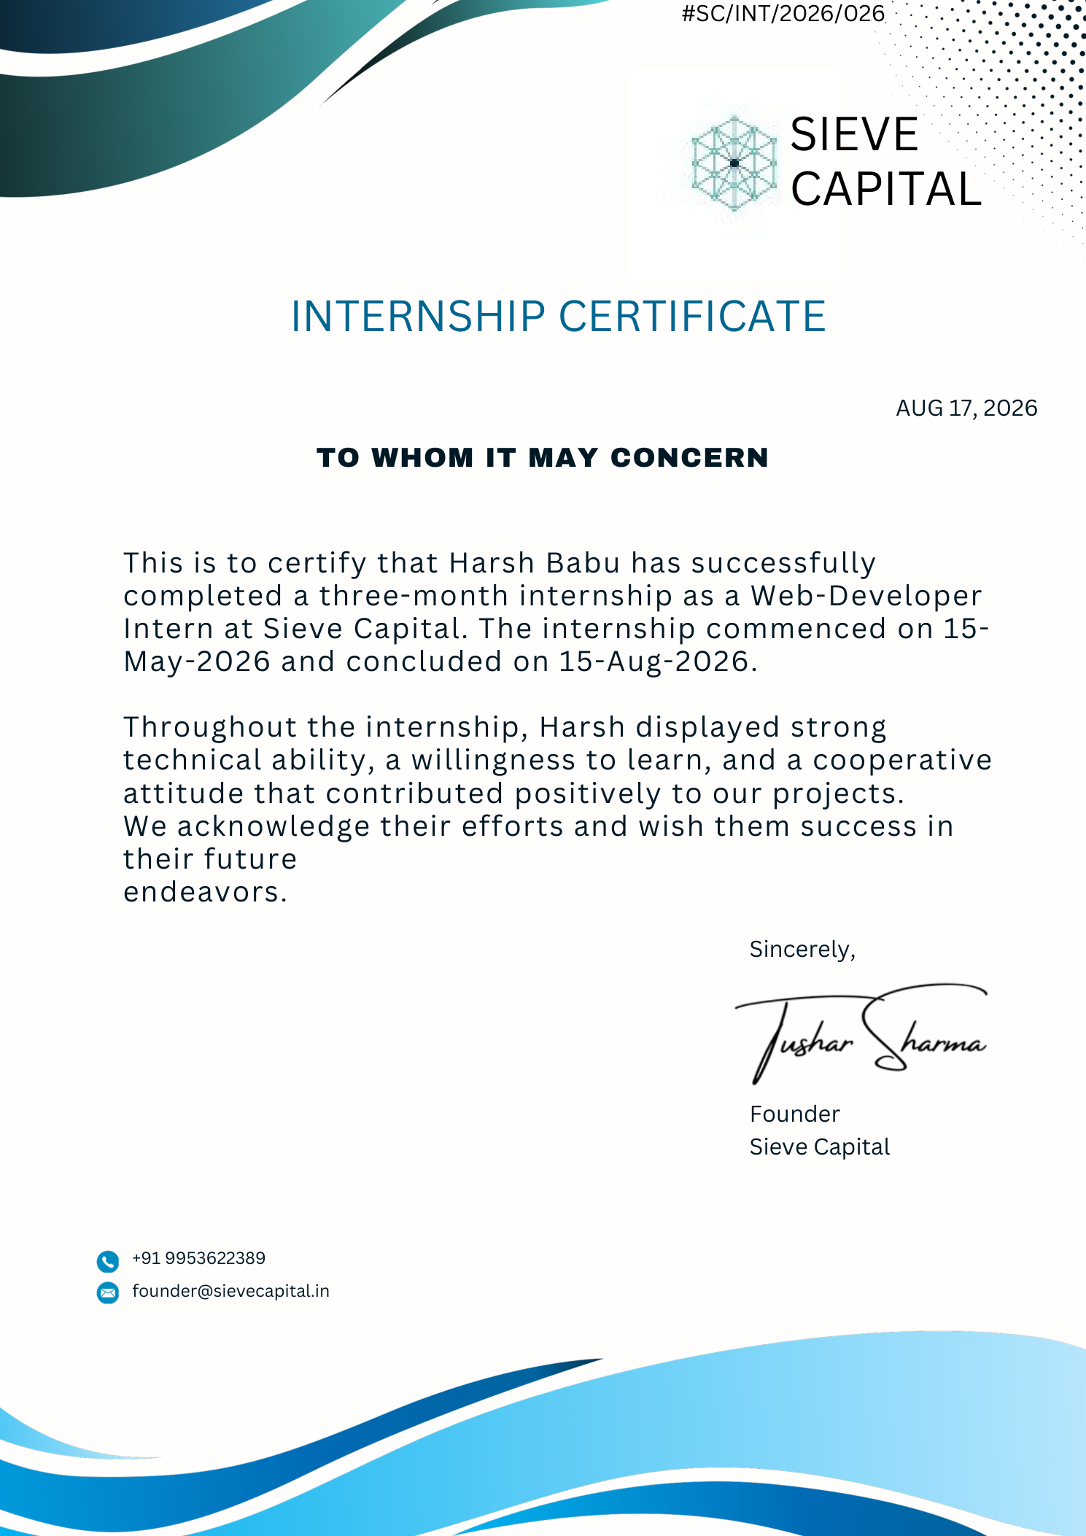
CERTIFICATION & OFFICIAL VERIFICATION
IILM UNIVERSITY • SCHOOL OF COMPUTER SCIENCE & ENGINEERING

Slide 12
THANK YOU
for your time & attention
HARSH BABU
25SCS1003002404
B.Tech CSE • Batch 2026–27
IILM University, Greater Noida | Sieve Capital
WEB DEVELOPMENT INTERNSHIP
11

