Slide 1
Inventory Management System
C Project by – Abhishek Singh, Harsh Shukla

Slide 2



Teammates Credentials…
Harsh Shukla(IT) 2nd year
2007190130010
Abhishek Singh (IT, 2nd Year)
2007190130003

Slide 3
Introduction
1.This Is project based on inventory management of store or any type shop.
2.It use C language to build this type of management system.
3.It will make the work easier for the shops or sector Who make sales in bulk and in wholesale market.
4.It can also be used by small Shops also.

Slide 4
Working
I have provides three interface here:
1.Dealer Menu
2.Customer Menu
3.Employee Menu
Each menu works is Different from each other:
1.Dealer Menu: The Dealer can here add the products its quantity and its stock value. By acceesing the software by the password provided to the dealer.
2. Customer Menu: Here customer can buy the items and simultaneously billing will also be done and at the final total price to be paid will be shown to customer
3. Employee menu: Employee will also be give access to make changes in stock and quantity of products.

Slide 5
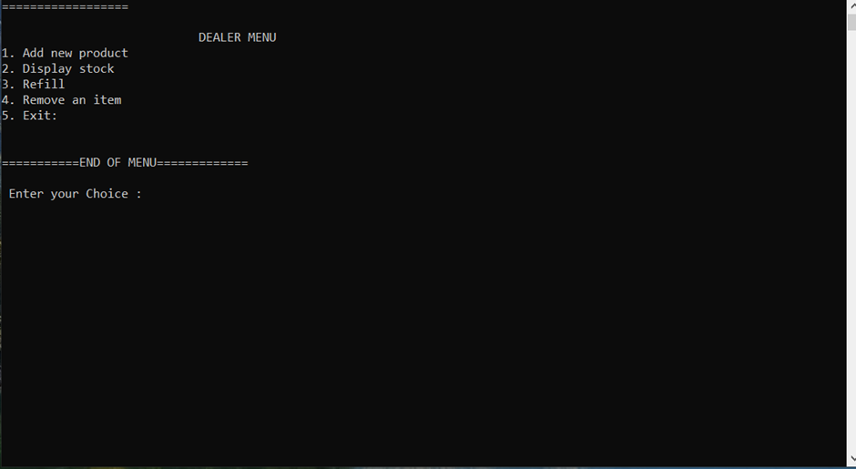

Slide 6
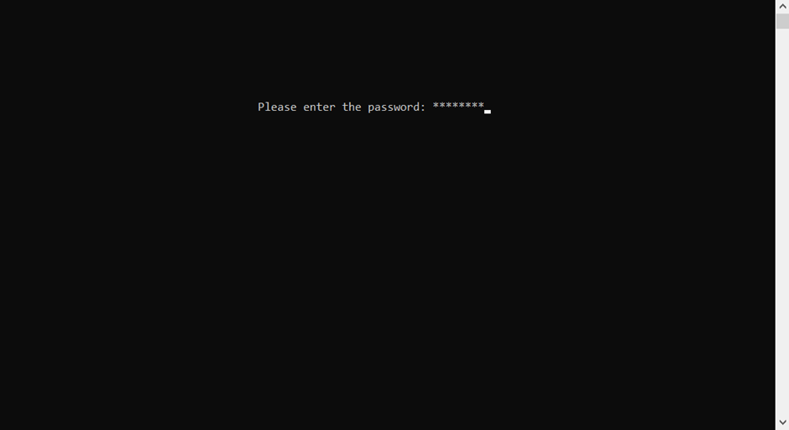

Slide 7
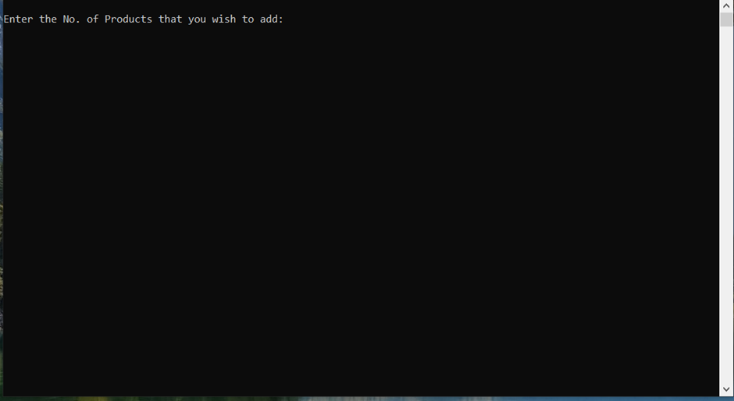

Slide 8
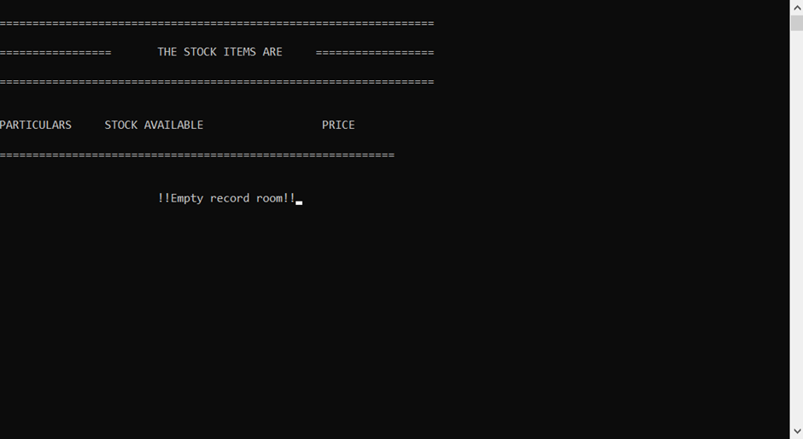

Slide 9
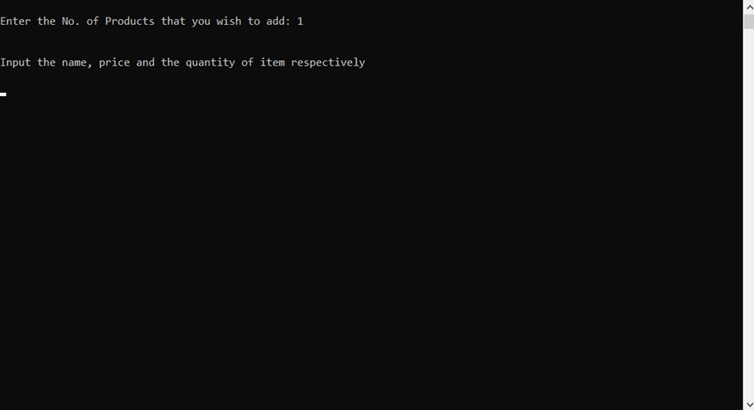

Slide 10
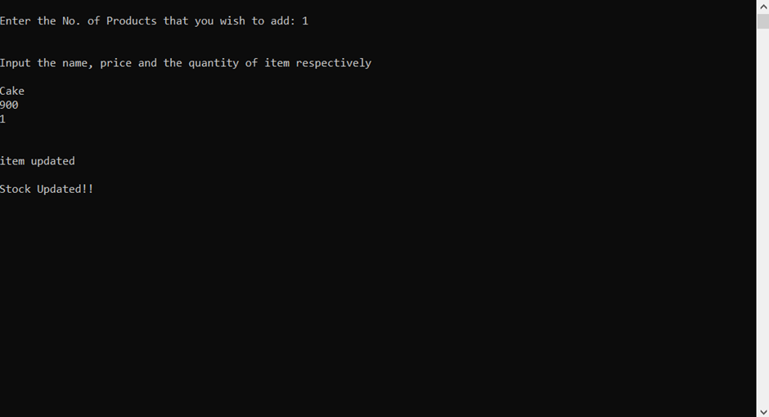

Slide 11
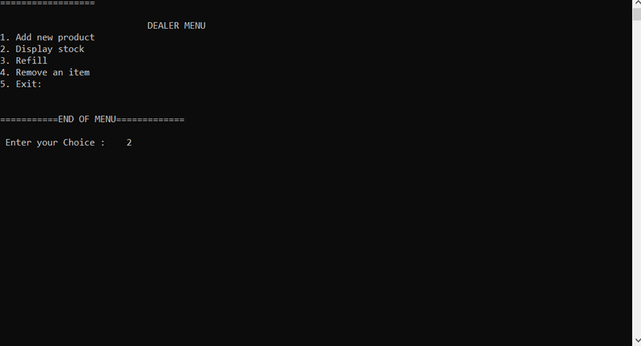

Slide 12
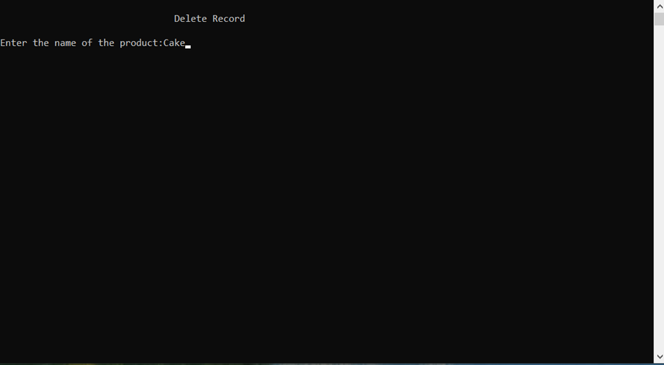

Slide 13
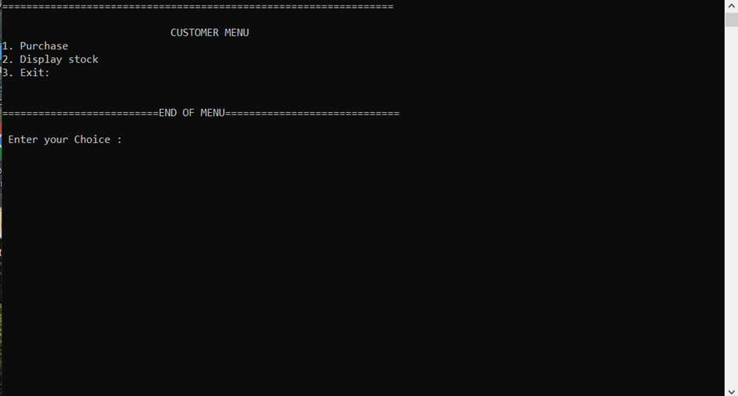

Slide 14
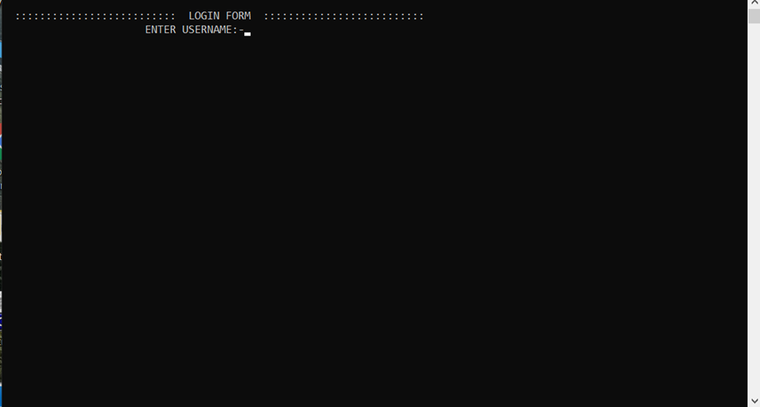

Slide 15
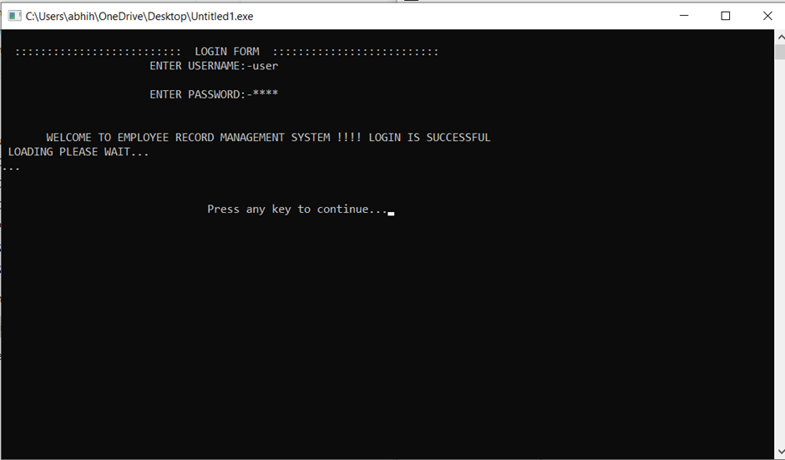

Slide 16
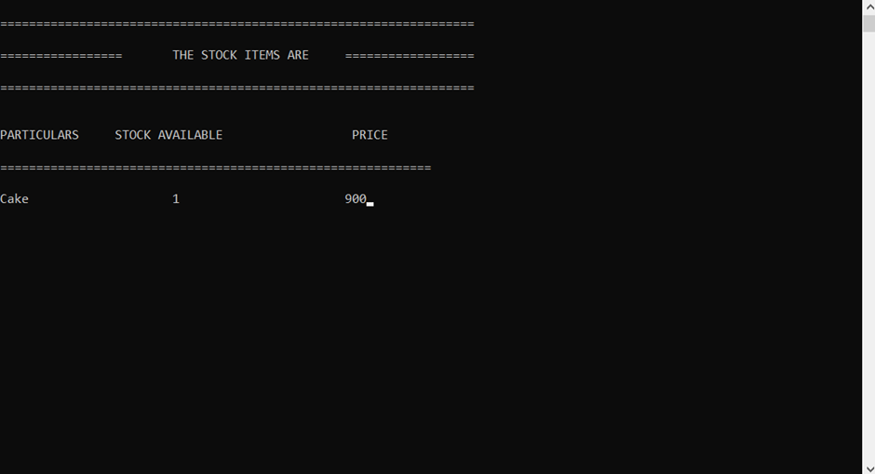

Slide 17
Software used
1.Only DevC++

Slide 18
The End…

