Slide 1


Bus Reservation System
OOPL Project
Group Members:
Course Coordinator:
Shivam Doharey (2019BCS-059)
Mr. Vinal Patel
Harsh Goswami (2019BCS-022)

Slide 2
Overview
Introduction
Objective
Features
Functionalities
Implementation
System Requirements

Slide 3
Introduction
Bus Reservation System is designed to help users maintain and organize bus reservation using highly user friendly interface. The
bus availability functionality will help user to see all available
options in single view. It is developed in C++ and the user can
perform tasks like install bus information, reserve bus seat, show reservation information and show information regarding the
buses available.

Slide 4
Objective
The purpose of the project is to build an application program to
reduce the manual work for managing the bus, ticket booking etc.
It tracks all the details about the buses, booking, seats availability, buses availability etc. The system is to reserve the bus from the bus information and it includes the bus no, seat number with the passenger’s name.

Slide 5
Features
Provides the searching facilities based on various factors such as buses and seats.
User can install bus information which includes bus no, driver’s name, etc.
Easy to operate and understandable.
User can book available seats.
User can view all available buses with their arrival time, departure time, destinations, bus number etc.
User can see available seats, driver's name etc.
Fast Performance

Slide 6
Functionalities
Add Bus: To Install a new bus by providing Bus Number, Driver’s name,
Arrival time, Departure time, Destination etc.
Reserve a seat: To reserve a seat for a passenger by providing bus number, seat number and passenger’s name.
Show Seat Availability: To view available seats, destination, arrival time and departure time of a bus by providing bus number.
Bus Availability: To view all available buses along with starting point, destination, arrival time, departure time etc.

Slide 7
Implementation
Taking a class, name as Bus_Reservation
Declaring the variables and character arrays as
Bus_no[5]
driver_name[10]
arrival_time[10]
departure_time[10]
from[20]
to[20]
seat[8][4][10].

Slide 8
Implementation
3. And the public member function of the class Bus_Reservation are:-
void add_bus();
void reserve_bus();
void empty();
void show_bus();
void is_bus_available();
void position(int i);

Slide 9
Implementation
4. And giving the maximum buses available as 15
5. And now with respect to add_bus function we gave few options to enter in the run time which will ask the user to enter the bus details from back end of the system like Bus number, Driver’s name, Arrival time, Departure time, and from and to i.e starting location and destination.
6. And from the reserve_bus function we can reserve seats for the travellers according to their preferable seat numbers.

Slide 10
Implementation
7. And the empty function shows that the seats are empty in the bus.
8. And the show_bus function shows the the details about bus like the driver’s name,destination,time of arrival and departure along with the number of seats that are empty and reserved in the bus.
9. And theis_bus_available function gives the information about total number of buses available the information contains bus number,driver’s name,arrival and departure time, arrival and destination location.

Slide 11
Implementation
10. And the position function gives the total number of empty seats in the bus along with a table with seat no and whether the seats are empty.

Slide 12
System Requirements
Hardware Requirements
PC with 2 core duo or more
512 MB RAM or above
180 GB hard disk or above
Software Requirements
Operating System
Dev C++ & Codeblocks compiler
Windows 7 or above

Slide 13
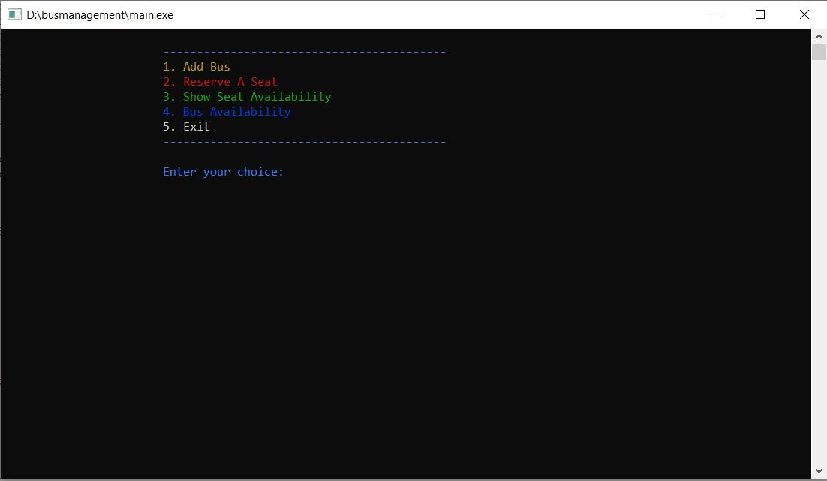
Outputs
Main Menu

Slide 14
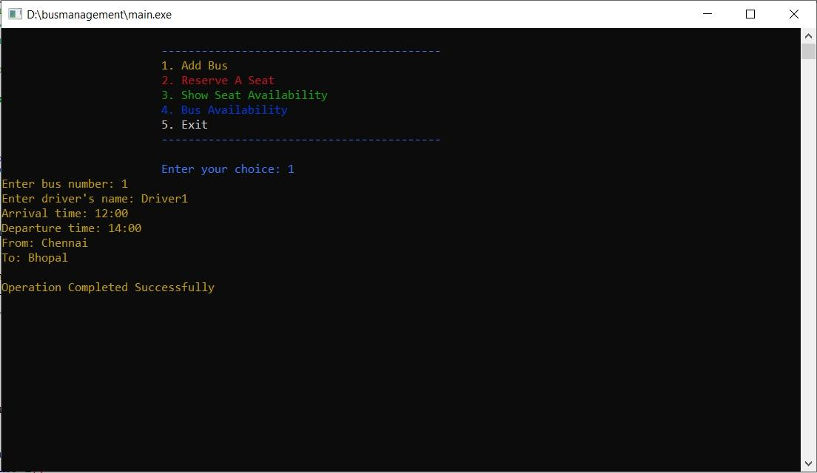
Outputs
2. Adding Bus Data

Slide 15
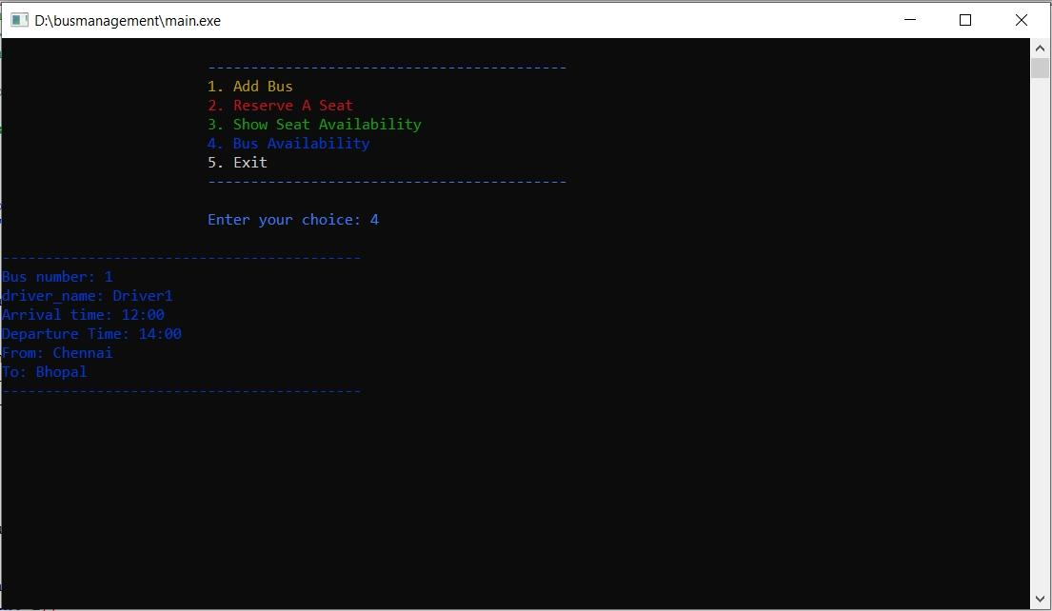
Outputs
3. Checking How Many Buses Available

Slide 16
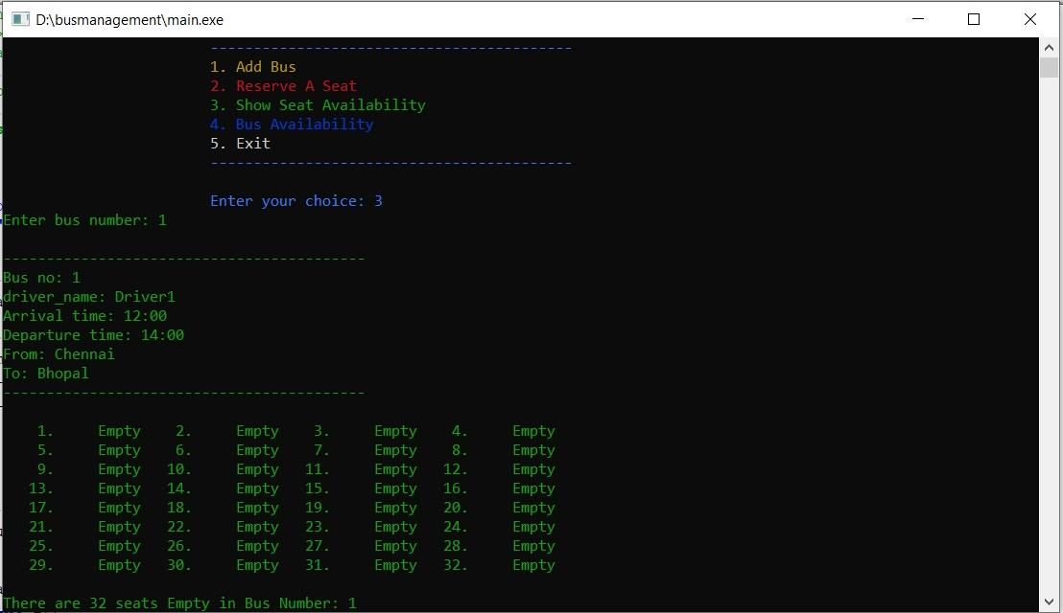
Outputs
4. Checking For Available Seats

Slide 17
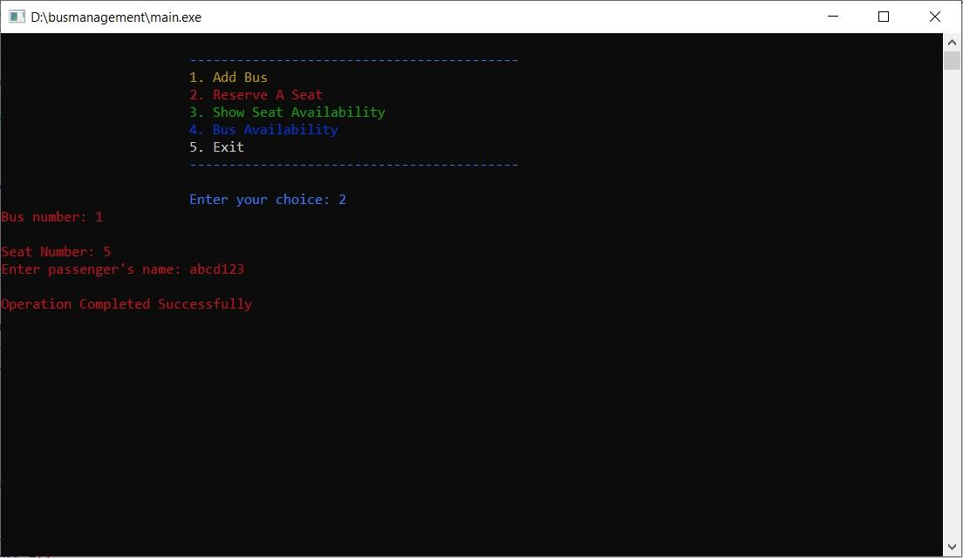
Outputs
5. Booking Seats

Slide 18
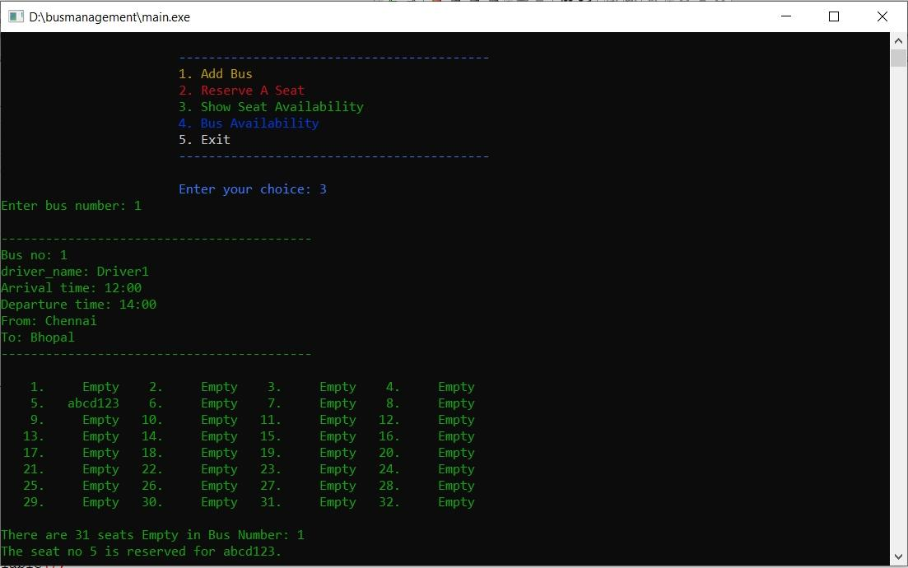
Outputs
6. Seeing The Booked Seats

Slide 19
Thank You

