Slide 1
EXOP-00323: Develop and deploy Java Spring Boot App to AWS with Elastic Beanstalk.
-Harsh Grover (1841138)
Mentor: Anil Sonnad (864651)

Slide 2
A case Study
Now day’s many E-commerce website are coming and establishing in the market.
One such company was Filpkart, they started with Online Bookstore and today they are one of the top E-commerce website in India.
After establishment of online Bookstore, Flipkart started to think big and they started to add more products to the website and within a year Online Bookstore was converted into a E-commerce website.
“What technical challenges they faced? How did they overcame it?”
The major problem they faced was to add the items other than books to showcase the website.
And the solution to this problem was the use of microservice Architecture.

Slide 3
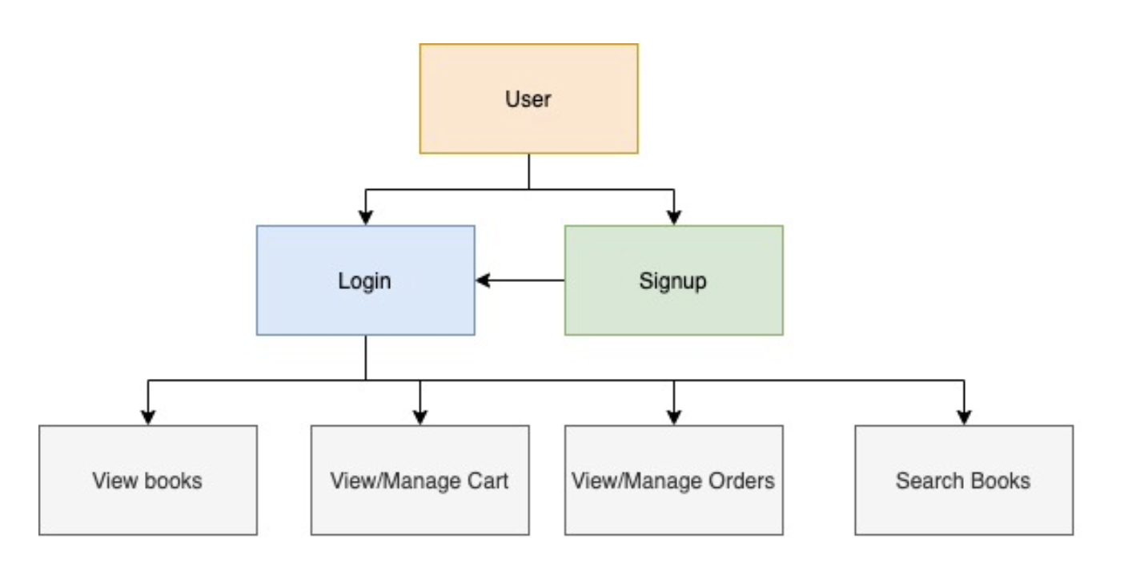
Bookstore Application
An Online Bookstore is an Application which will allow you to buy Books online and delivered it to you home like any other E-commerce Website.
So as an User point of view the basic functionality expected are
That you are able to login and Signup
That you able to find books.
Able to manage your cart and orders.

Slide 4
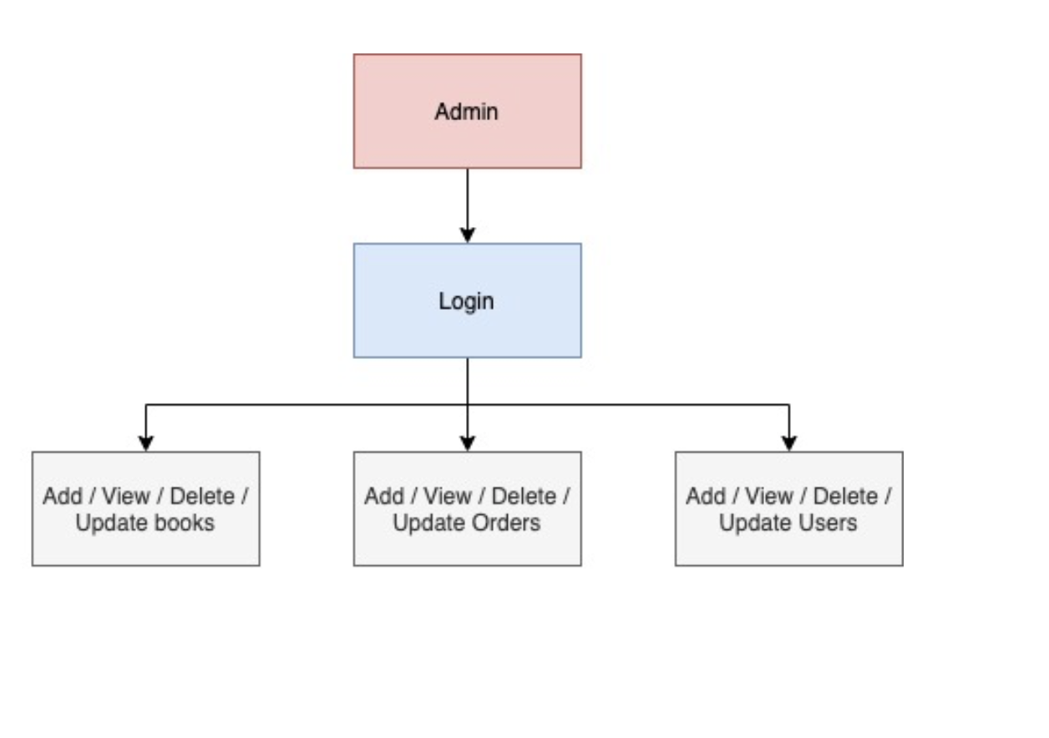
As an admin point of view the basic functionality expected are
You are able to login as an admin
Add/update/delete/view Books
Add/update/delete/view orders
Add/update/delete/view users

Slide 5
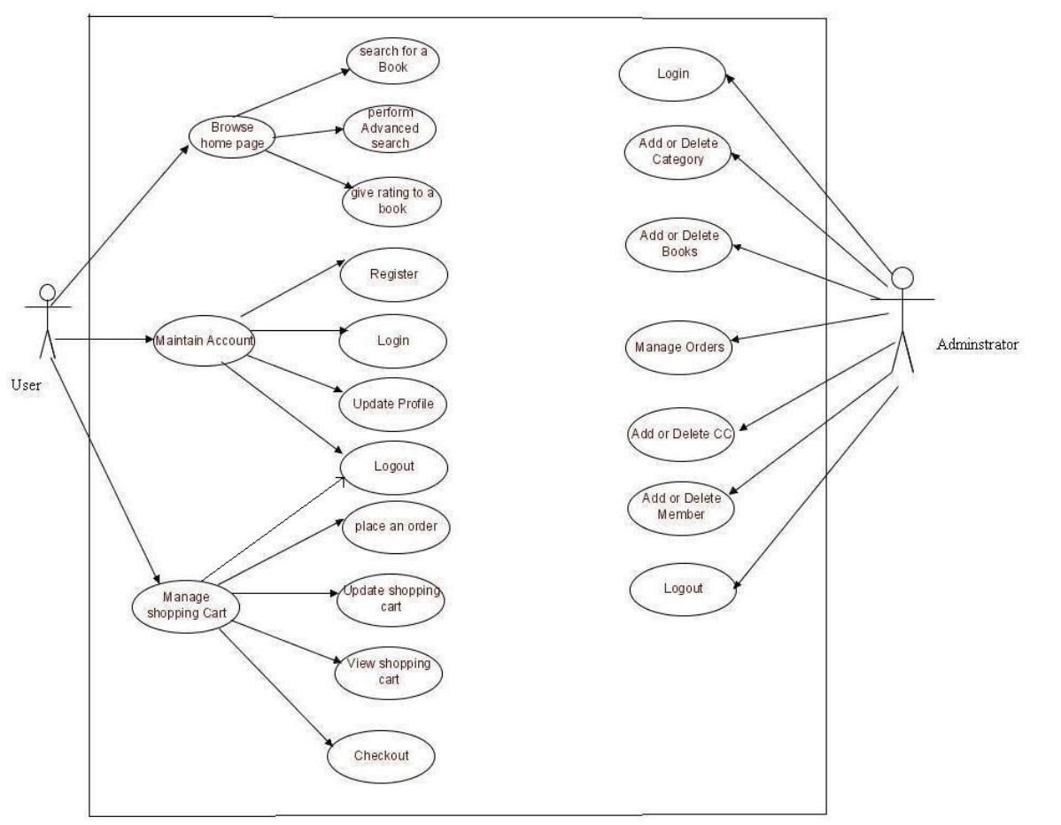
Basic Use case of an Online BookStore

Slide 6
Technical Requirement which my be required
Front End - HTML, CSS, JavaScript
Back End - PHP, NodeJS, Spring etc
Reason to use Spring Boot over others
Develop Spring Application Faster
Avoid Boiler Plate Code
Convention over Configuration
Embedded Tomcat

Slide 7
Advantages of microservice over monolithic.
Independent components.
Easier understanding
Better scalability
Flexibility in choosing the technology
The higher level of agility

Slide 8
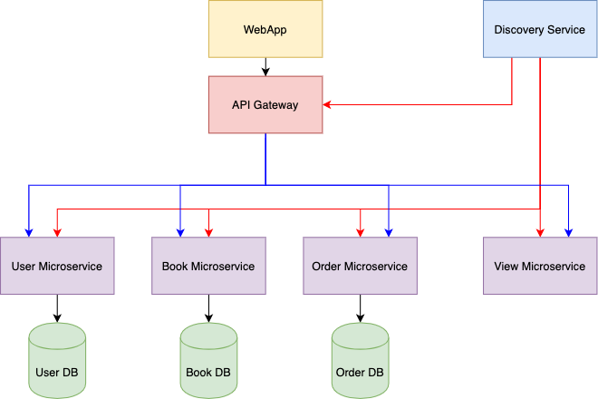
Application Design

Slide 9
Zuul API Gateway: Zuul Server is an API Gateway application. It handles all the requests and performs the dynamic routing of microservice applications. It works as a front door for all the requests. It is also known as Edge Server. Zuul is built to enable dynamic routing, monitoring, resiliency, and security.
Eureka Discovery Service: Eureka is a REST (Representational State Transfer) based service that is primarily used in the AWS cloud for locating services for the purpose of load balancing and failover of middle-tier servers.
Cassandra Database: Apache Cassandra is a free and open-source, distributed, wide column store, NoSQL database management system designed to handle large amounts of data across many commodity servers, providing high availability with no single point of failure.

Slide 10
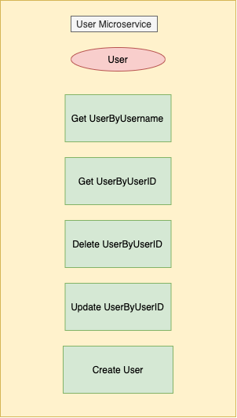
User Microservice
User Table: UserID (PK) ,Username (Unique) ,
Name, DOB, Email, Password,
PhoneNo.,

Slide 11
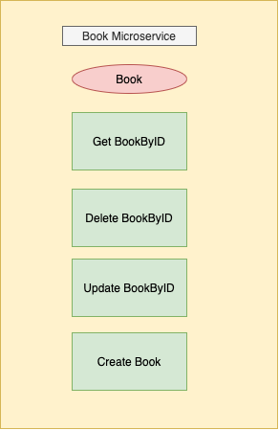
Book Microservice
Book Table: BookID (PK) , Name , Description ,
Price, Year, ISBN, AuthorName,
Category, Quantity

Slide 12
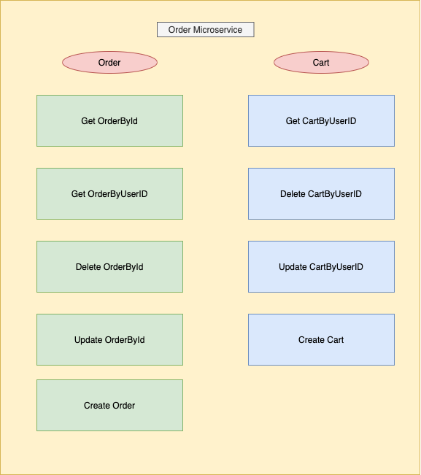
Order Microservice
Order Table: OrderID (PK) , DateOfOrder ,
UserID, BookID
Cart Table: UserID(PK), Books and Quantity (Map)

Slide 13
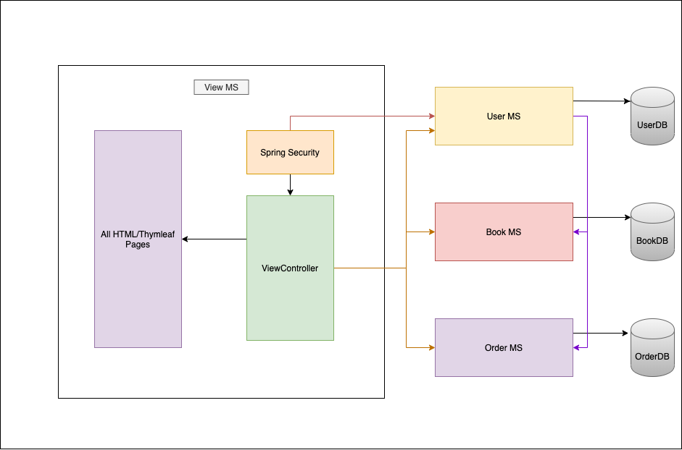
View Microservice

Slide 14
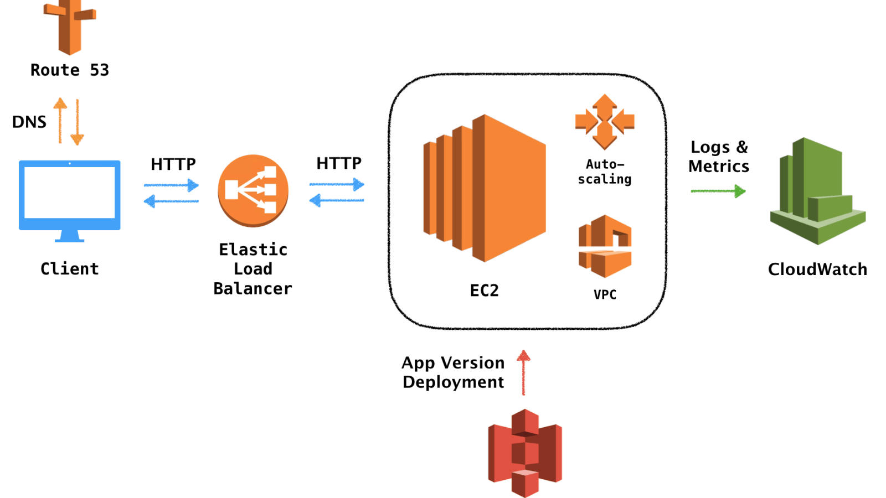
Deployment on Elastic Beanstalk
Working of Elastic Beanstalk

Slide 15
Docker : Docker is a set of platform as a service products that uses OS-level virtualisation to deliver software in packages called containers. Containers are isolated from one another and bundle their own software, libraries and configuration files; they can communicate with each other through well-defined channels.
Docker Hub: Docker Hub is a cloud-based repository in which Docker users and partners create, test, store and distribute container images. It is a cloud-hosted version of Docker Registry.

Slide 16
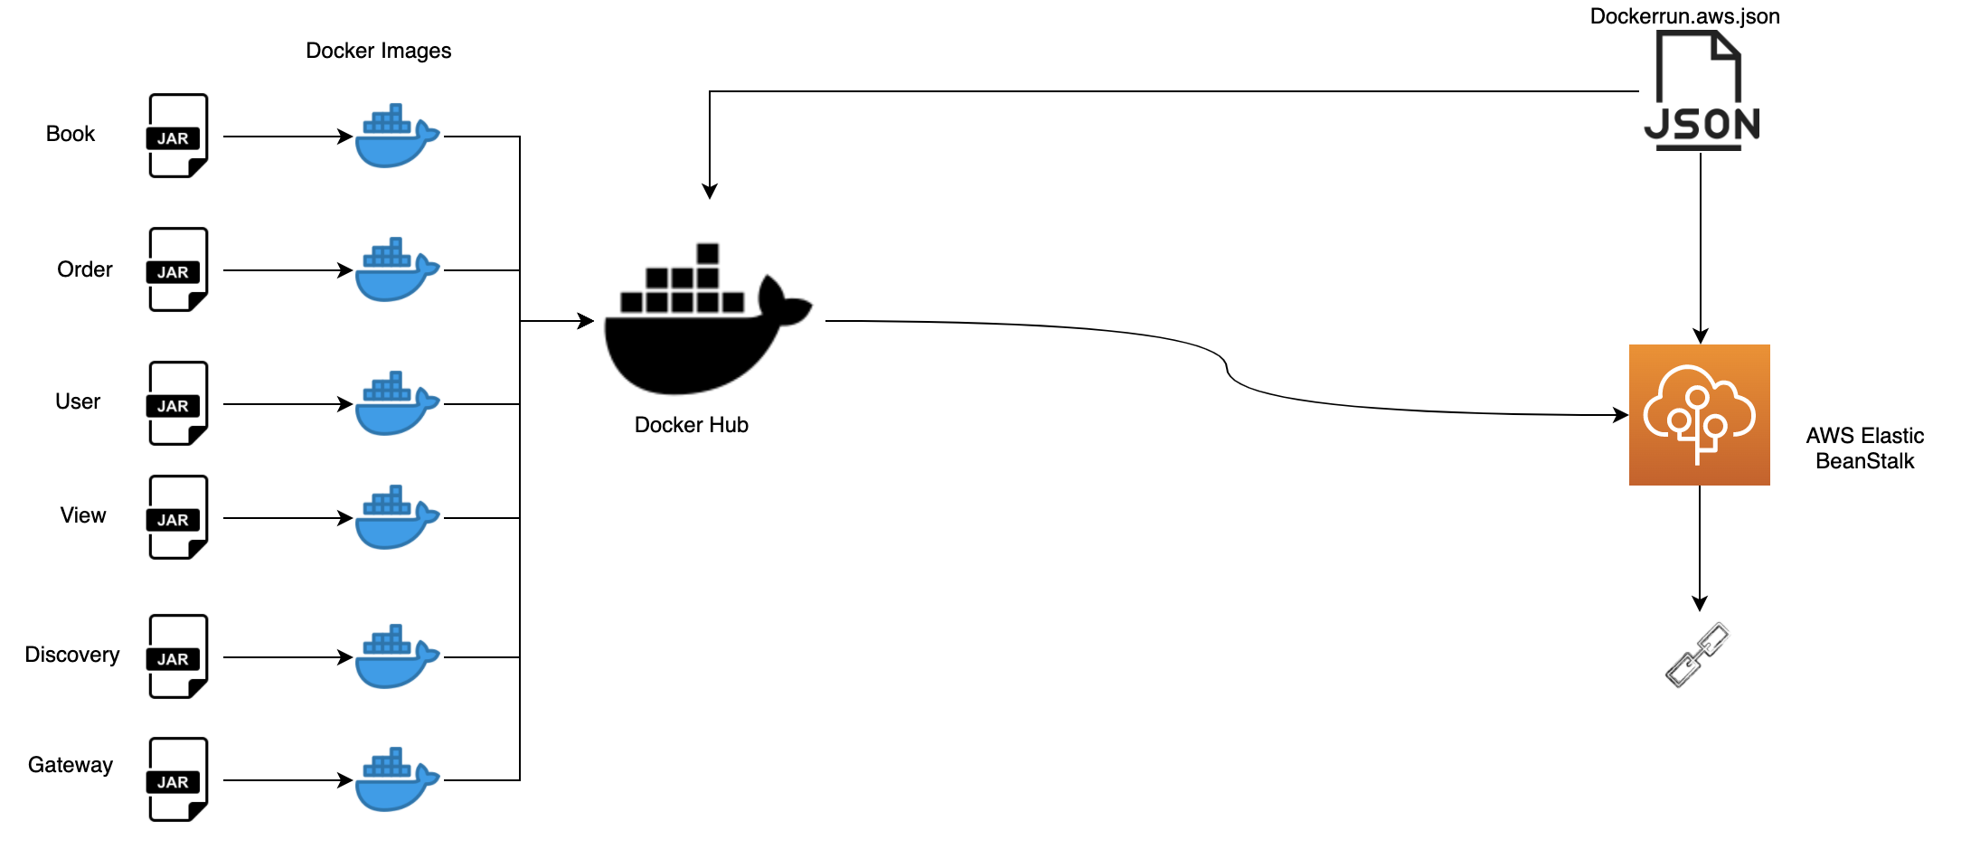
BookApp Deployment design

Slide 17
Challenges faced
I was new to spring boot framework, to understand the AOP concepts was little bit time consuming.
Configuring Cassandra database with the application was also challenging.
Understanding the concepts of Eureka Discovery and Gateway was also new to me.
Creating docker image of all the service and running it as a whole was bit challenging.
Converting the docker-compose file to dockerrun.aws.json to deploy the application on AWS was difficult at task at starting.

Slide 18
Implementation

