Slide 1
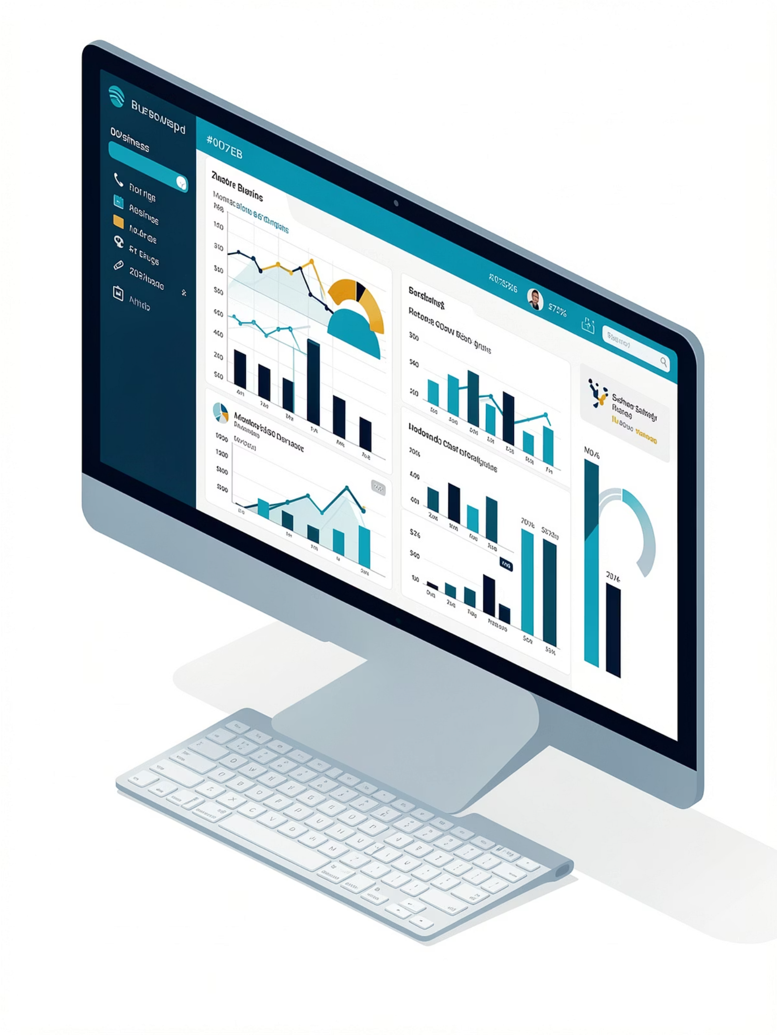
Blinkit Sales Analytics Dashboard
Power BI Implementation for Data-Driven Decision Making

Slide 2
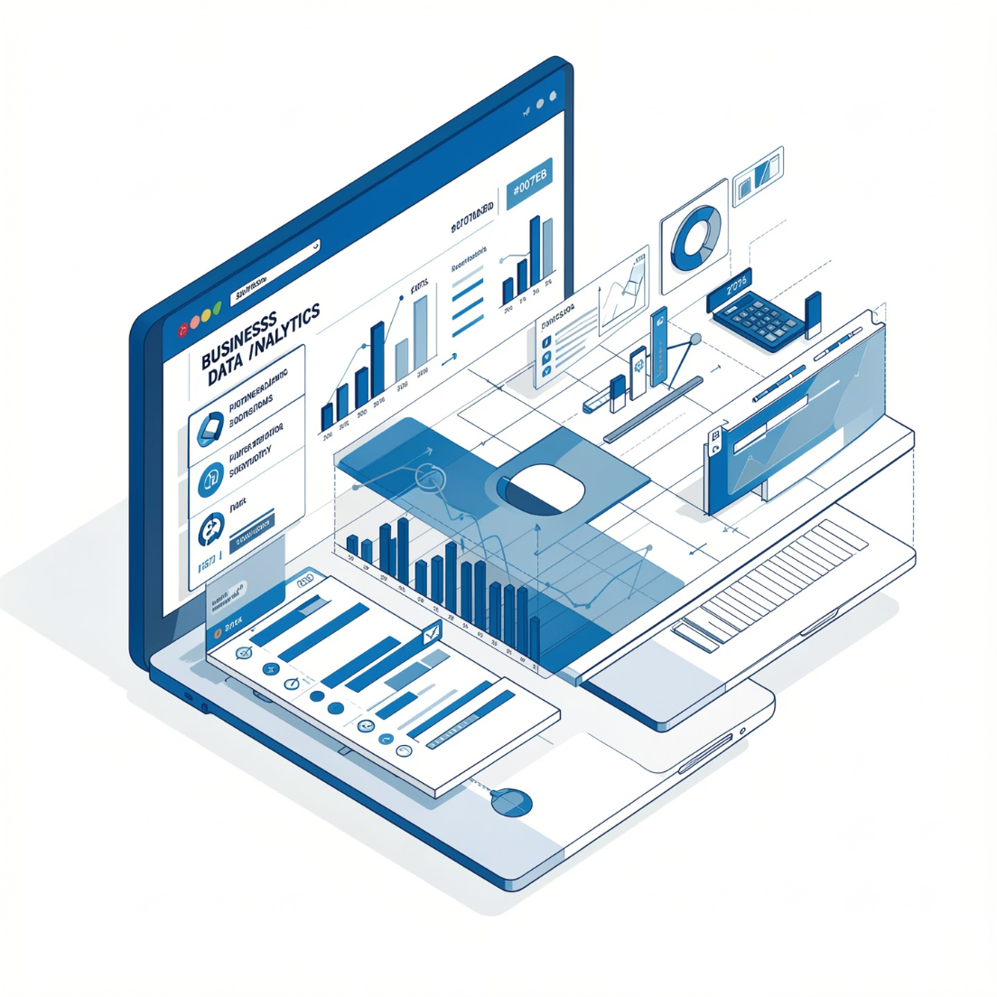
Project Overview
This comprehensive Power BI implementation transforms Blinkit's marketing and customer data into actionable insights. By visualizing key metrics and trends, we enable stakeholders to make informed decisions that drive revenue growth and improve customer satisfaction.
The dashboard consolidates sales performance, customer behavior, marketing effectiveness, and product performance into an interactive, user-friendly interface.

Slide 3

Primary Objectives
Five strategic goals to enhance Blinkit's operational efficiency and strategic decision-making capabilities
Sales Performance Analysis
Customer Behavior Insights
Marketing Strategy Evaluation
Analyze revenue trends and identify patterns in sales figures over time
Understand satisfaction levels and pinpoint improvement areas
Assess campaign effectiveness and optimize future initiatives
Performance Identification
Interactive Dashboard
Identify top-performing products and outlets for resource allocation
Build user-friendly interface for real-time data insights

Slide 4
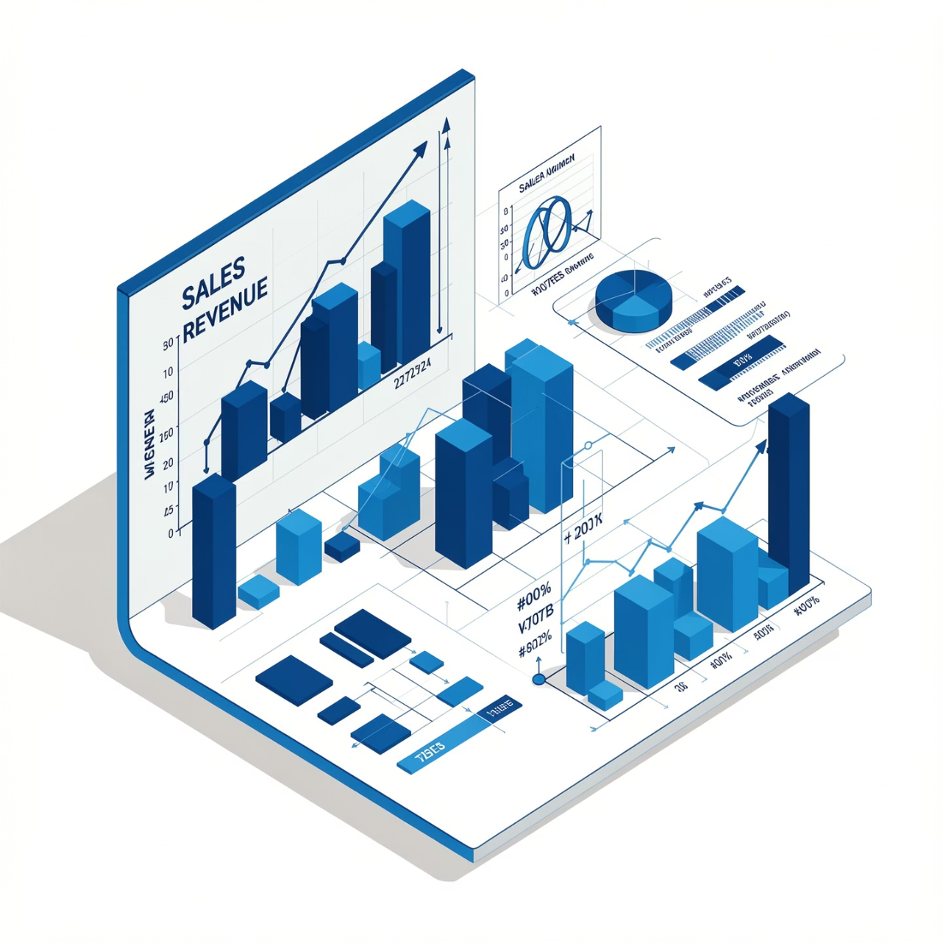
Sales Performance Analysis
Comprehensive Revenue Tracking
We meticulously analyze sales figures over time to identify trends and patterns that drive forecasting accuracy. This includes calculating total sales, average sales per transaction, and number of items sold across all outlets.
Calculate total sales across all time periods
Determine average sales per transaction
Track number of items sold by category
Forecast future revenues using historical patterns
Optimize inventory management based on demand trends

Slide 5
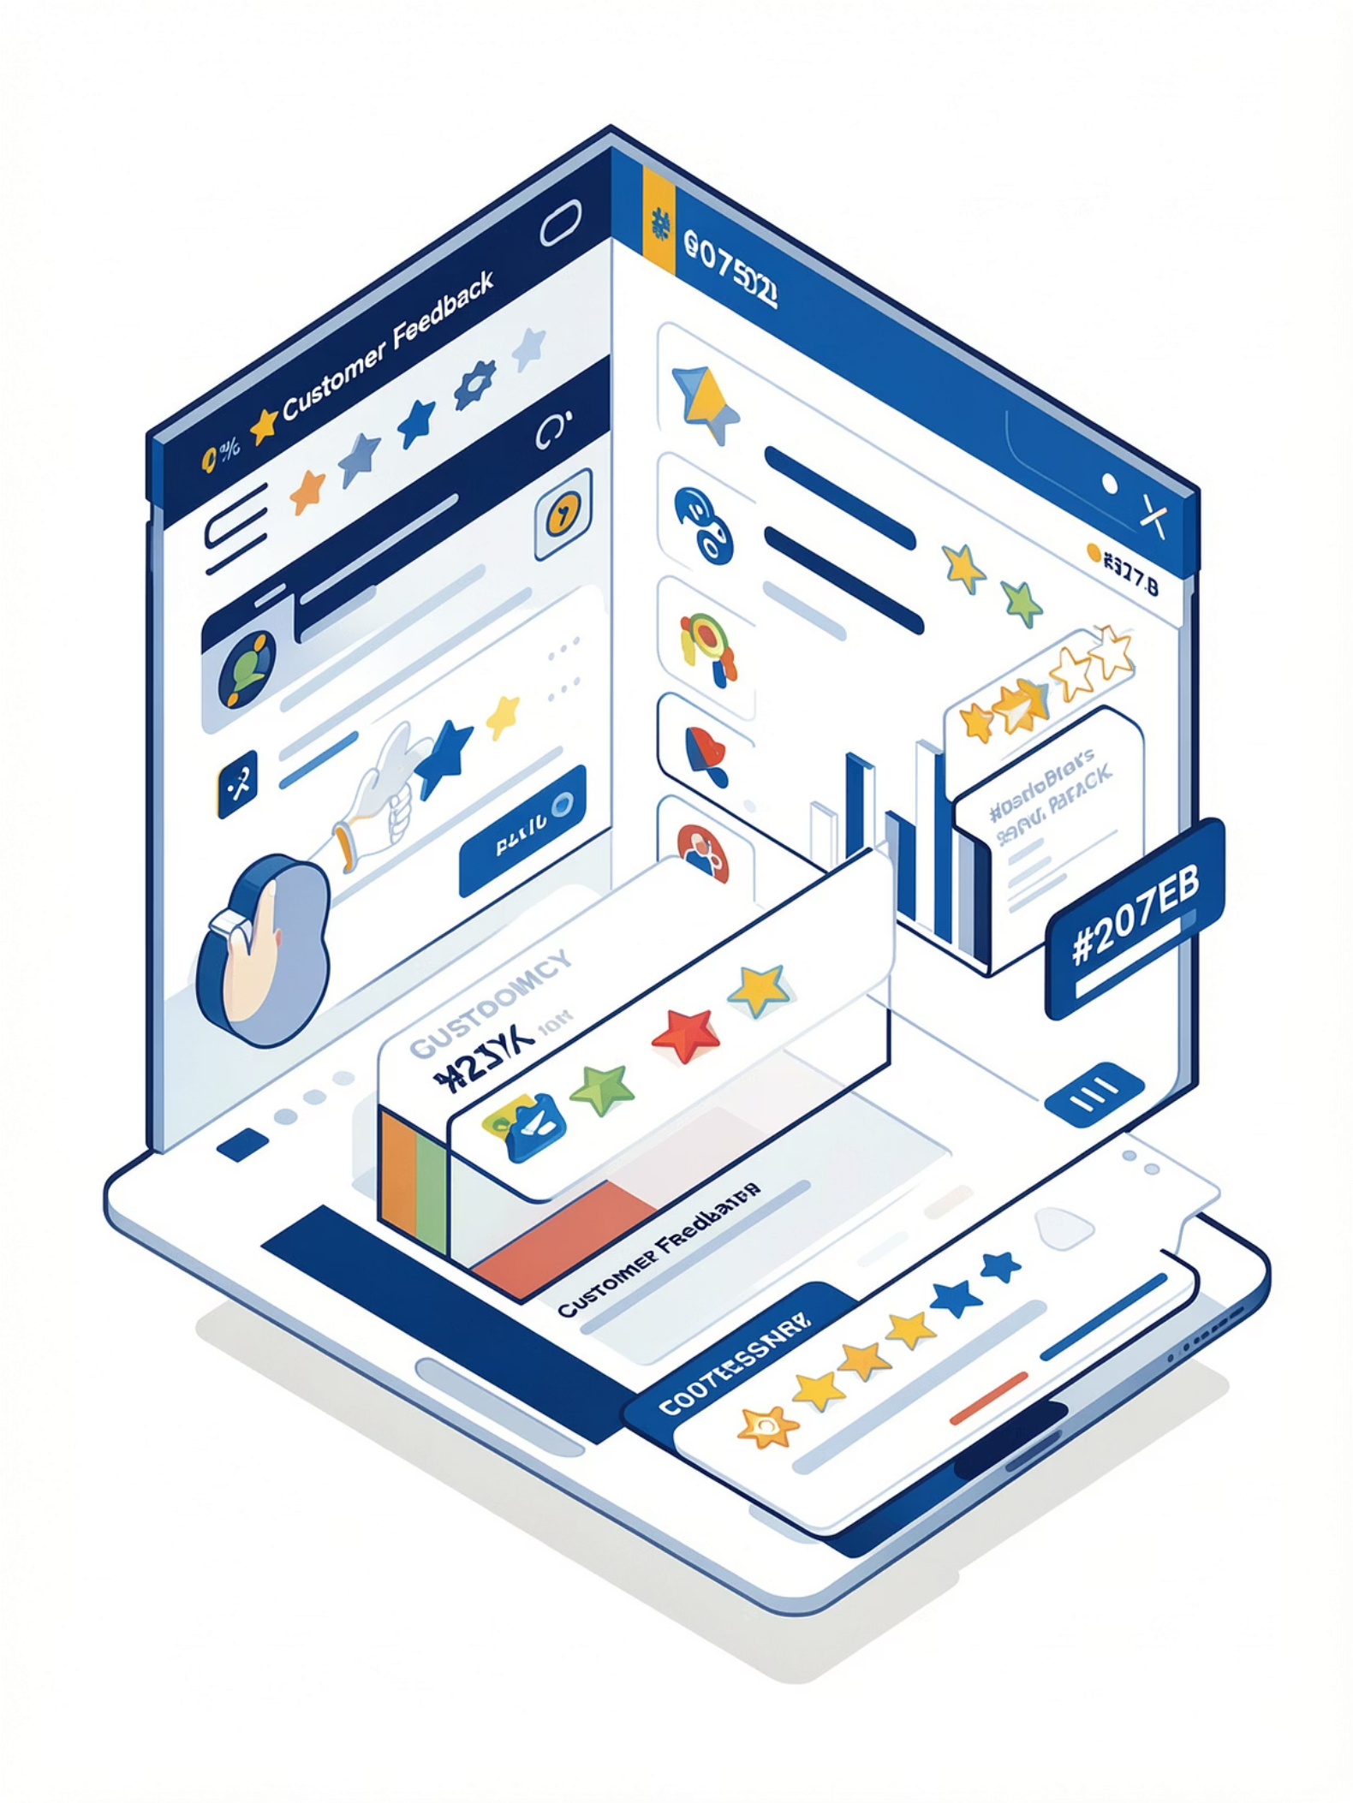
Customer Behavior and Satisfaction
1
2
Examine Ratings and Feedback
Identify Improvement Areas
Collect and analyze customer ratings across all touchpoints to gauge overall satisfaction levels
Pinpoint specific aspects of service or products that require enhancement based on feedback patterns
3
Refine Marketing Strategies
Use insights to tailor marketing messages and product offerings to customer preferences

Slide 6
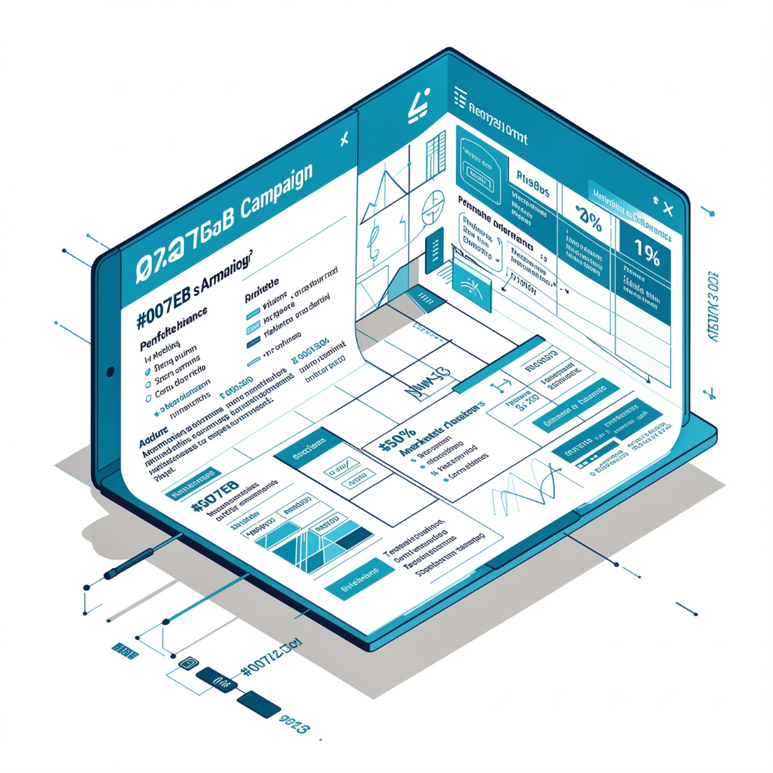
Marketing Strategy Evaluation
Campaign Effectiveness Assessment
Using data from various outlets and products, we evaluate the performance of different marketing campaigns. This analysis enables optimization of future campaigns based on proven strategies and measurable ROI.
Compare campaign performance across channels
Measure conversion rates and engagement
Calculate return on marketing investment
Identify most effective messaging approaches

Slide 7
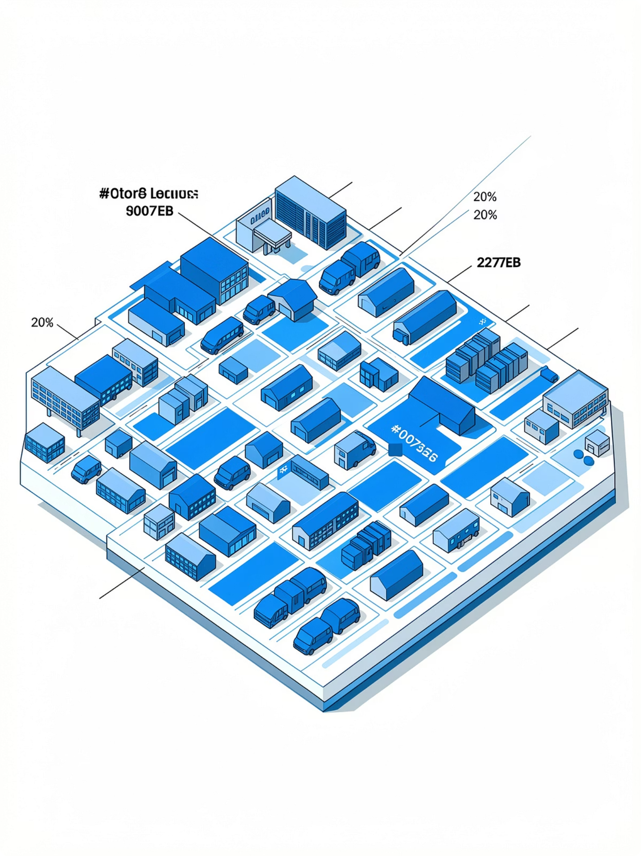



High-Performing Products and Outlets
Identifying top performers enables strategic resource allocation and maximizes profitability
Product Performance
Analyze sales by product category and SKU to identify best sellers
Outlet Analysis
Evaluate location performance to identify high-performing stores
Resource Reallocation
Redirect inventory and marketing spend to maximize returns

Slide 8
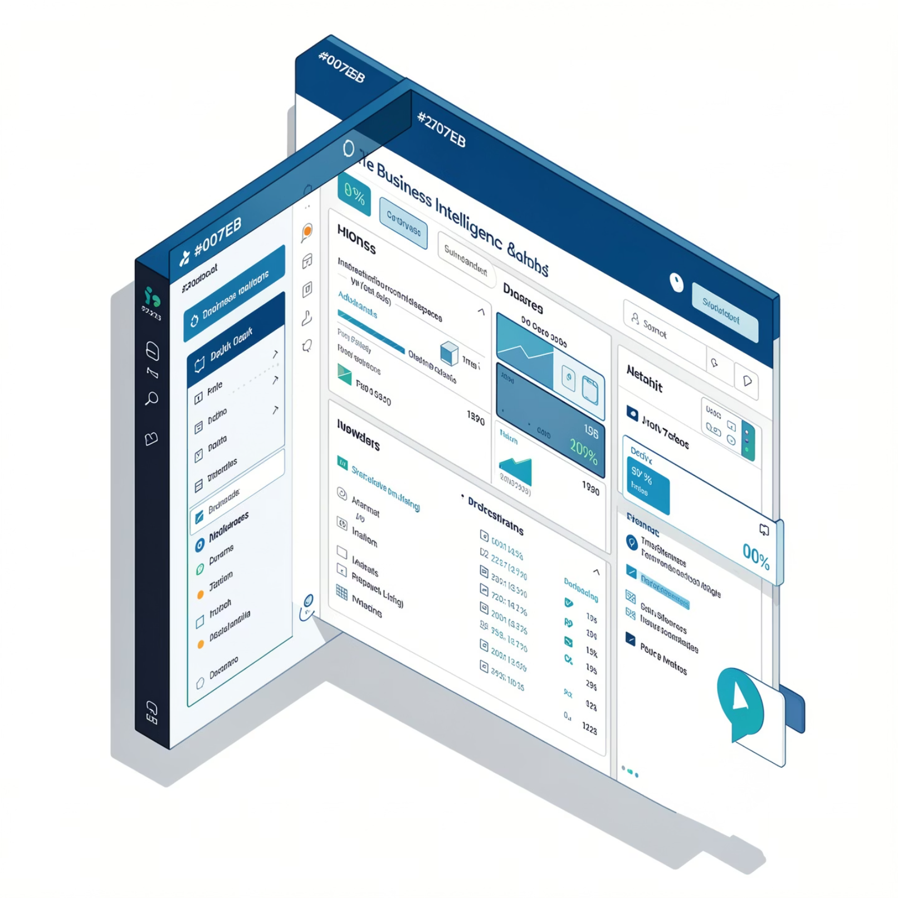
Interactive Power BI Dashboard
User-Friendly Interface
The dashboard consolidates all analyzed data into interactive charts and visuals that empower stakeholders to make informed decisions based on real-time insights.
Interactive filters for dynamic data exploration
Drill-down capabilities for detailed analysis
Real-time data refresh for current information
Mobile-responsive design for accessibility

Slide 9
Secondary Objectives
01
02
03
Develop Key Performance Indicators
Build Calculated Fields with DAX
Establish Table Relationships
Integrate relationships between tables in Power Query to ensure comprehensive and accurate data analysis across all sources
Create comprehensive KPIs including total sales, average customer rating, and number of items sold to measure business performance
Use Data Analysis Expressions to enhance analytical capabilities and create custom metrics for deeper insights

Slide 10

Success Criteria
The project is considered successful when these measurable outcomes are achieved
Accurate Metrics and KPIs
Intuitive and Interactive Design
Data-Driven Decision Making
The Power BI dashboard accurately reflects all key metrics and KPIs, providing a reliable source of truth for decision-making
Charts and visuals are intuitive and easy to understand, enabling stakeholders to identify actionable insights quickly without technical expertise
Business stakeholders can use the dashboard to make informed decisions that drive sales growth and improve customer satisfaction
Scope Note: Current phase focuses on marketing and customer data analysis. Beverages category, real-time integration, and advanced Python/SQL analytics are planned for future enhancements.

