Slide 1

MongoDB By-Manpreet Singh & Harsh kumar

Slide 2

Introduction
MongoDB is a popular NoSQL database that offers ﬂexibility, scalability, and performance.
This presentation will explore the beneﬁts of
using MongoDB and how it can help your business succeed.

Slide 3

What is MongoDB?
It is a cross-platform MongoDB ocument-oriented database that uses JSON-like documents with optional schemas. It was developed by MongoDB Inc. in 2007, and has quickly gained popularity due to its ﬂexibility and scalability. Unlike traditional relational databases, MongoDB stores data in collections of documents, which can be nested and have varying ﬁelds. This allows for easier data modeling and faster development, as well as better handling of unstructured data.
ABSTRACT: The image shows a collection of colorful abstract shapes, symbolizing the ﬂexibility and versatility of MongoDB's document-oriented approach

Slide 4

Beneﬁts of MongoDB
Some of the key beneﬁts of MongoDB include ﬂexibility, scalability, performance, agility, and ease of use. It can handle unstructured data and allows for rapid prototyping and iteration.

Slide 5
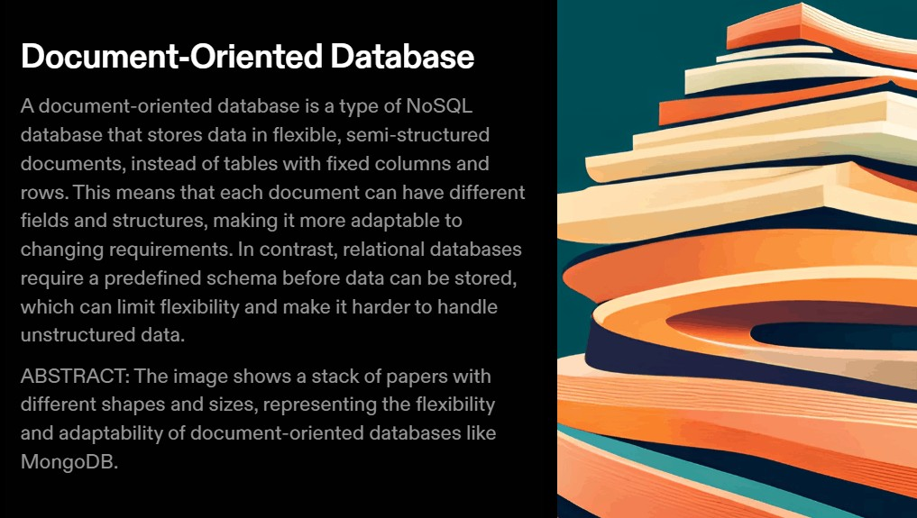

Slide 6
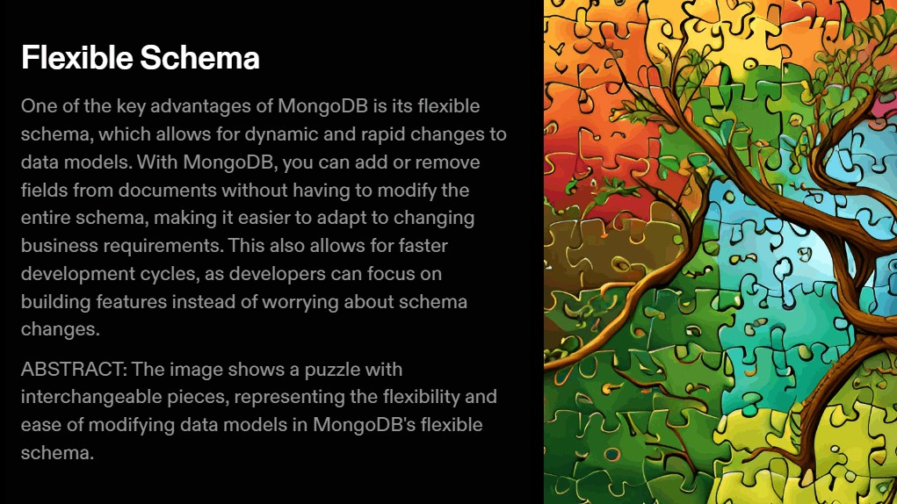

Slide 7
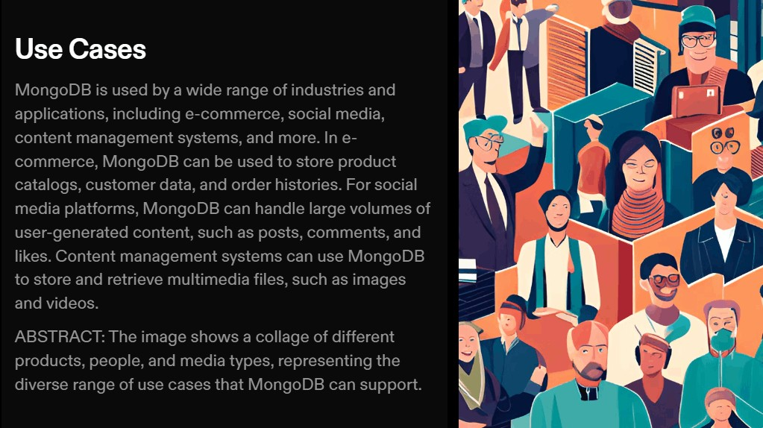

Slide 8

Challenges of Using MongoDB
While MongoDB offers many beneﬁts, there are also some challenges to using it. These include data consistency, data modeling complexity, higher memory usage, and lack of joins.
However, these challenges can be addressed with proper planning and
implementation.

Slide 9
Conclusion
In conclusion, MongoDB offers many beneﬁts for businesses that need a ﬂexible, scalable, and performant NoSQL solution. While there are some challenges to using it, these can be overcome with proper planning and implementation.
Consider using MongoDB for your next project.

Slide 10
Thanks!

