Slide 1


A PRESENTATION ON “Age and Gender Predictor” FOR INDUSTRIAL TRAINING(V SEMESTER)
Submitted By:
Harsh Soni
Section-A
CS Department
Submitted to:
Dr. Surender Kumar Yadav
HOD-CS Department
Poornima College of Engineering
Department of Computer Science & Engineering

Slide 2

Outline
Introduction
Company Details
Domain Area
Title of the project
Technology Used
Machine Learning
Numpy and OpenCv
Source Code
Future Works

Slide 3
Introduction
This project is based on the computer vision using Machine Learning.
This will be helpful in direct identifying or predicting the gender and age of a person directly from scanning by Camera or from a video.
This uses OpenCV library of python that is Open source Computer Vision.
This predicts the age of a person in range like form 15-20,40-45.

Slide 4
Company Details
Company name: Adhoc Networks Pvt. Ltd.
Place: E-19/C, Kings Street, 2nd Ave, Lal Bahadur Nagar, Jaipur, Rajasthan 302015
Phone: 088008 82664
Products and Services: www.adhocnw.org

Slide 5
Domain Area
Data Science
Cloud Platforms like AWS
Ansible
Docker
Machine Learning
Kubernetes

Slide 6
Age and Gender Predictor

Slide 7

Technology Used
Machine Learning.
Libraries used for Machine Learning :--
-NumPy
-OpenCV

Slide 8
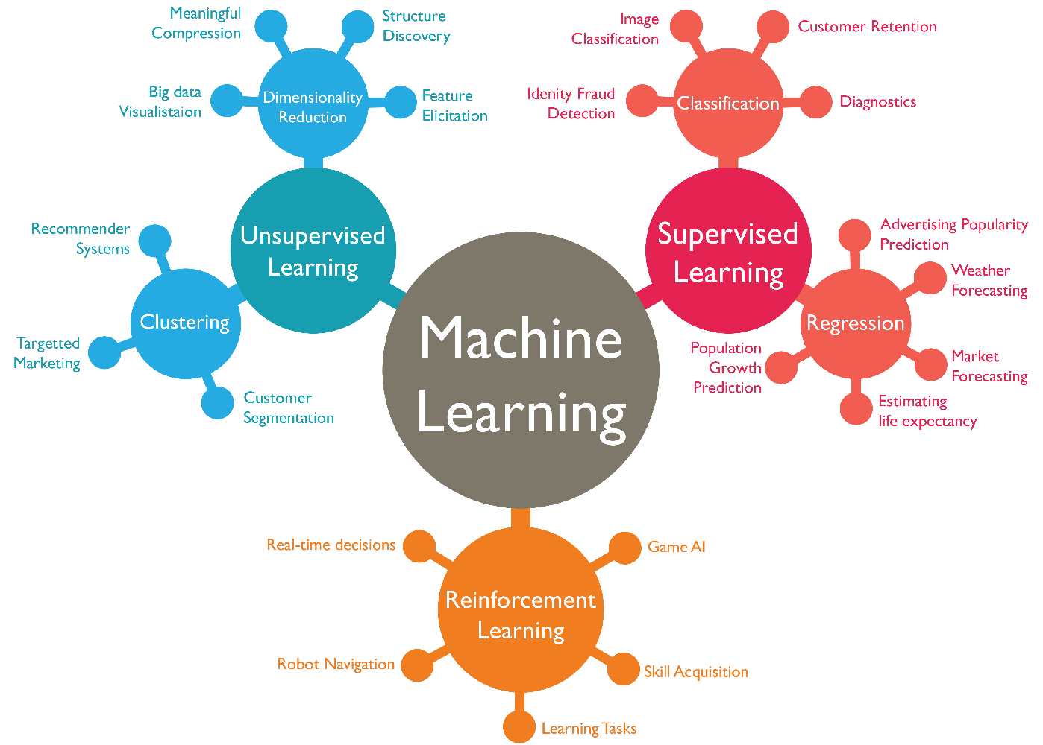
Machine Learning

Slide 9

NumPy
A powerful N-dimensional array object
Sophisticated functions
Tools for integrating C/C++ and Fortran code
Useful linear algebra and random number capabilities

Slide 10

OpenCV
free for use under the open-source BSD license
Real Time Computer Vision
Advance Vision Based
Image Processing
Can be used with NumPy

Slide 11
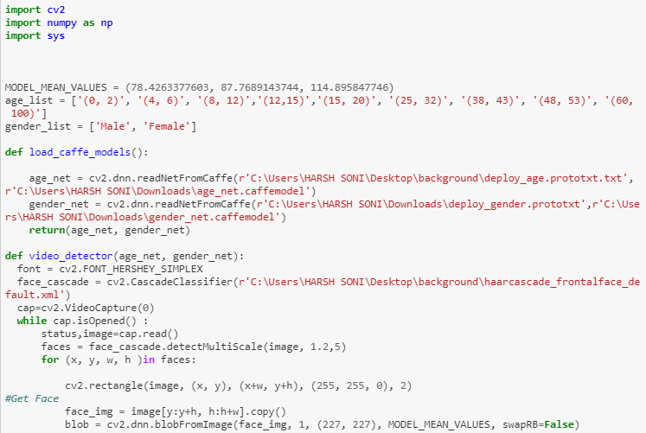
Source Code

Slide 12
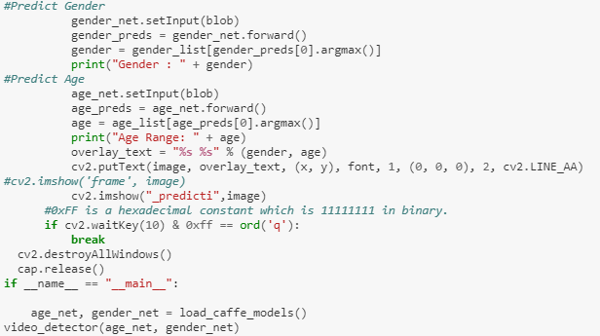
Source Code

Slide 13
Execution using video link
Link of the video:--
https://www.youtube.com/watch?v=iH1ZJVqJO3Y&source=post_page---------------------------

Slide 14
Future Uses
At the traffic light signals
At the Railway and bus ticketing Counter
At the places which have age restrictions like Voting Booths
Can be used in hospitals

Slide 15
References
HaarCascade File for Face:-
https://github.com/opencv/opencv/blob/master/data/haarcascades/haarcascade_frontalface_default.xml
-GitHub
-OpenCv.org
-W3schools

Slide 16
Thank You

Slide 17
Any Queries ?

