Slide 1


Crafting Your Career: A Guide to Maximizing Opportunities with CareerCrafter.
Trainer: Mr. Javeed
Teammates: Harsh Dangi and Krishnakant Patel

Slide 2






Welcome to CareerCrafter
Welcome to
. This presentation will provide valuable insights and strategies to
your career potential. Let's get
started!

Slide 3



Technology Stack and Tools
Backend Development: Spring Boot
Java Hibernate
JWT JSON
UnitTesting MySQL
Tomcat Server
Frontend Development: HTML/CSS
Javascript Typescript
Bootstrap Angular
JWT
Tools Postman SonarLint
.
.
.

Slide 4




About the Project:
Career Crafter is a user-friendly job portal for job seekers and employers, designed to streamline the recruitment process with a focus on user experience and efﬁciency.

Slide 5
Key Features:
Job Listings: Users can browse through a wide range of job listings across various industries and locations.
Resume Management: Job seekers can upload and manage their resumes directly on the platform, making it easy to apply for multiple jobs with just a few clicks.
User Registration and Login: Seamless registration and login process for both job seekers and employers, allowing for personalized user experiences.
Job Application: Job seekers can apply for jobs directly through the website, streamlining the application process.
Employer Dashboard: Employers have access to a dashboard where they can post job openings, manage applications, and track the status of their listings.
FontAwesome Integration: Utilization of FontAwesome for incorporating scalable vector icons into the user interface, enhancing visual appeal and usability.

Slide 6
Key Features:
API Integration: Utilizing REST APIs built with Spring Boot communication between the frontend and backend systems.
WebAPI, the platform ensures smooth
Security: Implementation of security measures such as JWT authentication and authorization to safeguard user data and prevent unauthorized access.
Error Handling and Logging: Comprehensive error handling and logging mechanisms ensure that any errors or exceptions are logged and presented to users in a user-friendly manner.
Testing and Quality Assurance: Unit testing of APIs using frameworks like Junit and integration with tools like Jenkins and SonarQube for continuous integration and quality assurance.
Security: Implementation of robust security measures, including Spring Security, to safeguard user data and prevent unauthorized access.
Email Notiﬁcation: Integration of Spring Mail for sending email notiﬁcations to users, providing updates on job applications, account activities, and more

Slide 7
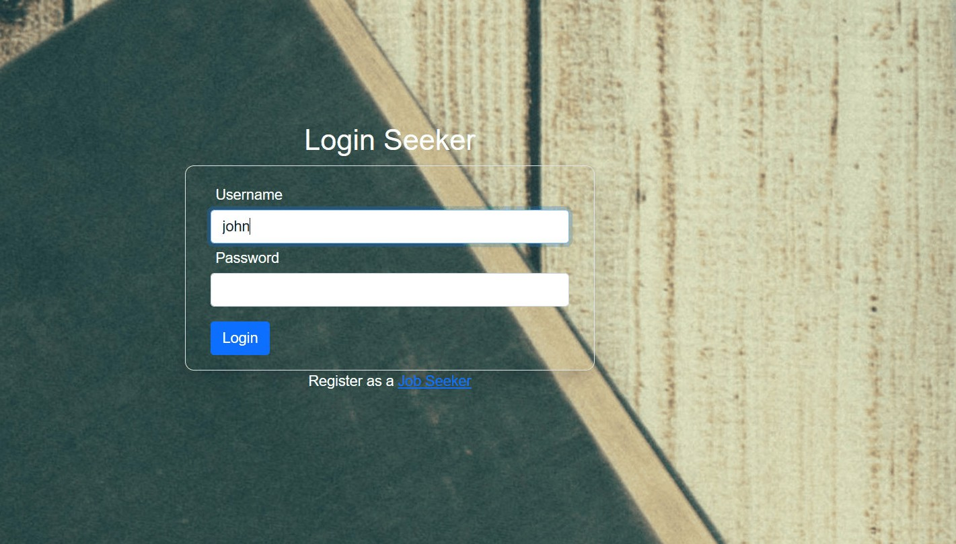
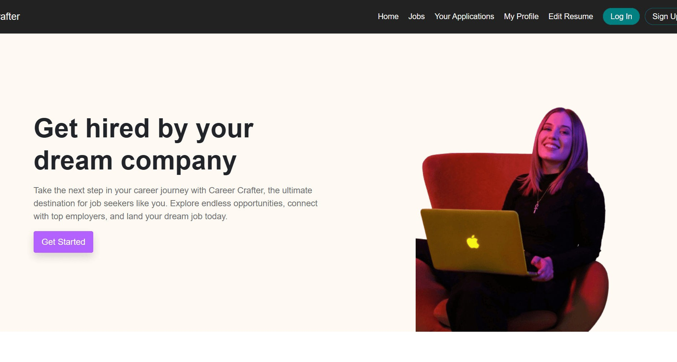
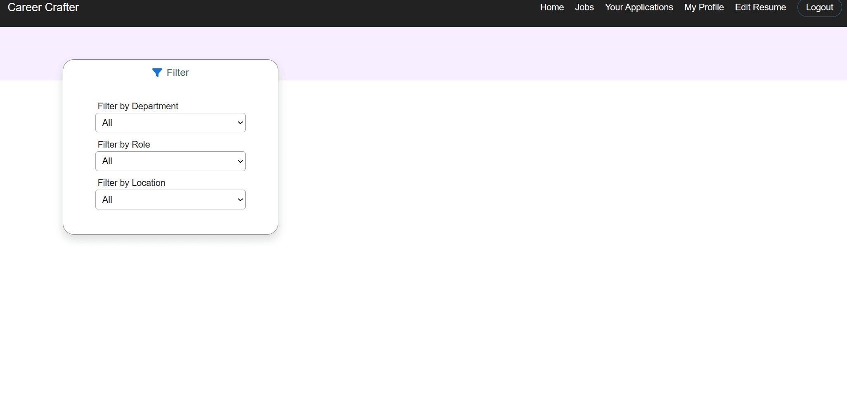
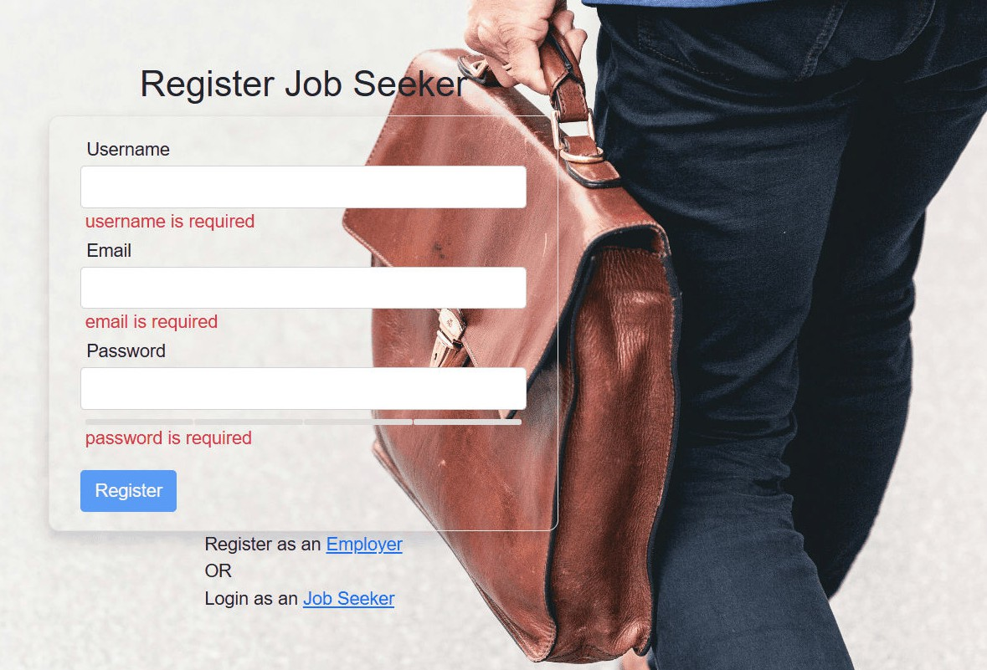
Career Crafter Website Screenshots

Slide 8
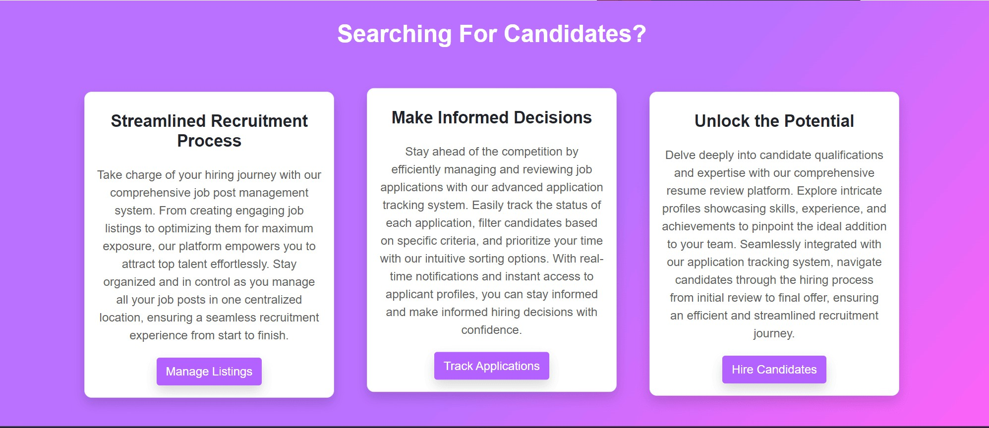
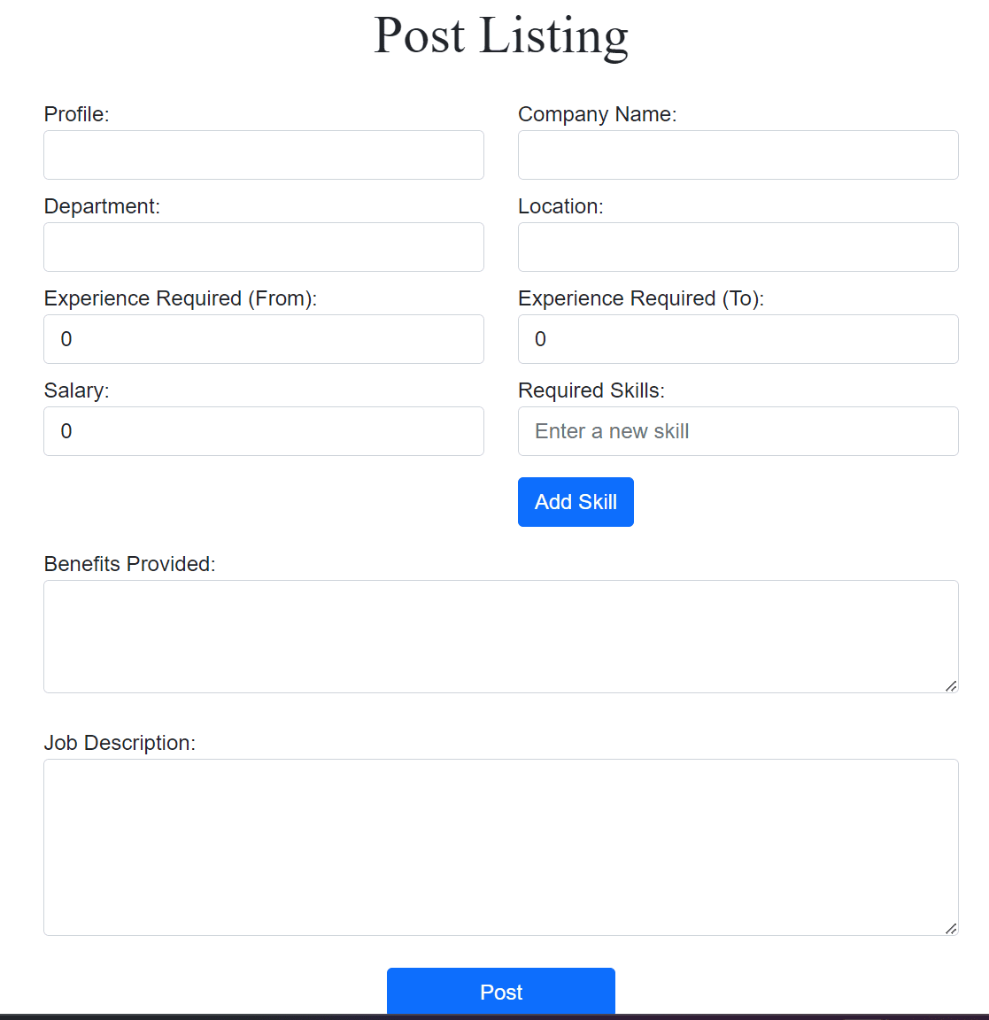
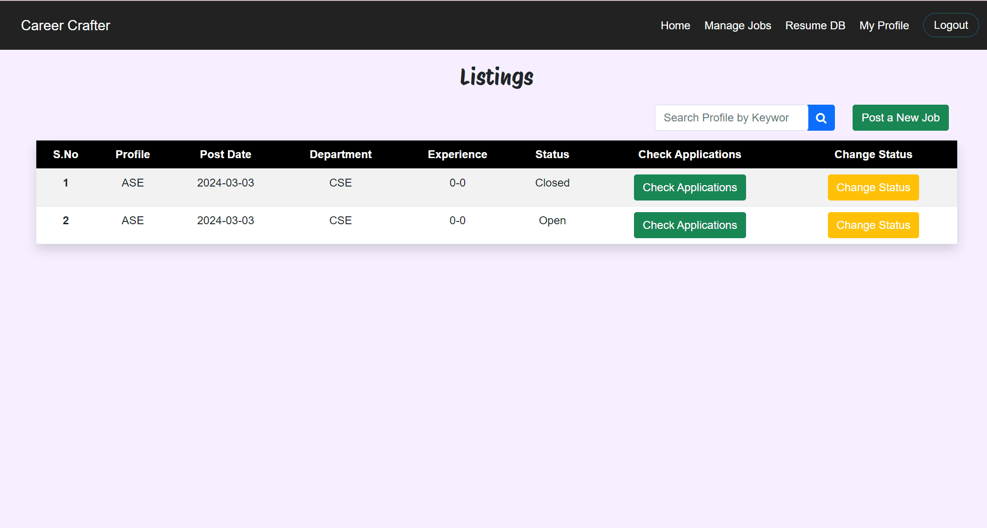

Slide 9


Mastering CareerCrafting Techniques
Hone your techniques by setting clear goals and developing a strategic career roadmap. Learn to adapt and evolve in the professional landscape.

Slide 10



Empowering Your Career Journey
Empower yourself to take control of your career journey with the insights gained from CareerCrafter. Seize opportunities, embrace challenges, and craft a fulfilling and successful career.

Slide 11


Conclusion
Congratulations on completing the journey of with CareerCrafter. Apply the strategies and insights gained to maximize your career potential and achieve lasting success.

Slide 12


Thanks!

