Slide 1

Event Management System
PRESENTED BY :
NAME | PRN
Mr. Rahul Ishi | 220930920021
Mr. Sumit Dhage | 220930920056
Mr. Girish Patil | 220930920016
Mr. Harsh Tiwari | 220930920019
Mr. Sachin Rathod | 220930920040
Mr. Chandan Mhaske | 220930920011
Mr. Akash Thakare | 220930920006

Slide 2

Points to be discussed
Introduction
Objectives
Diagrams
Screenshots
Specification
S/W and H/W Requirement
Advantages
Conclusion
References

Slide 3
Introduction
Event Management System is not only digitalizing the booking of orders providing ease of access to the customers, but will also digitalize the firm’s functionalities such as adding/removing employees, vendors etc. Providing All Events Info Features managing all employees and assign task for the events .In short, our management system will digitalize the whole firm along with its jobs.

Slide 4
Objectives
To produce a web-based system that allow the admin to add different Vendors and Employee’s and provide functionalities to its role.
To ease Clients by providing different functionalities for Event Booking.
To ease Managers to assign different tasks to Employees and track work efficiently.
In Other Words the main idea is to centralised all Event Management Operations

Slide 5
Technology Used
Front End : React.js
Back End : Java Spring Boot
Database : MySQL

Slide 6
Diagrams

Slide 7
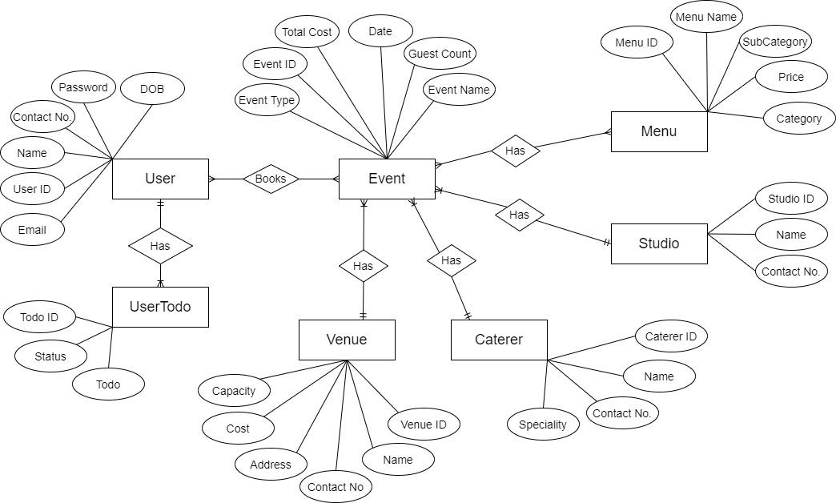
Manual E-R Diagram

Slide 8
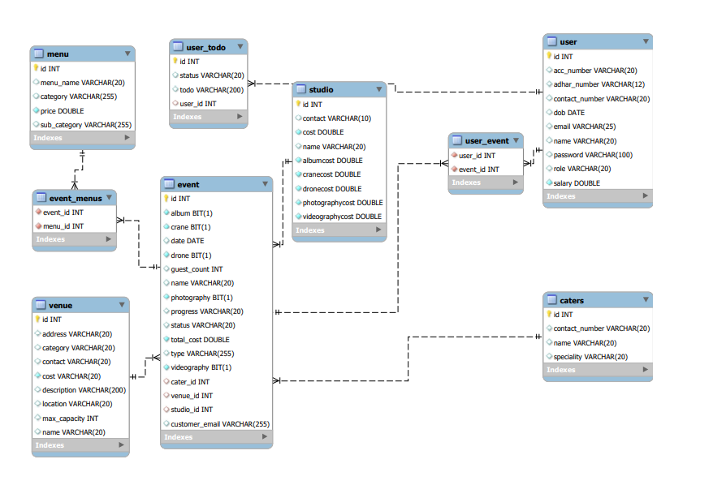
System Generated E-R Diagram

Slide 9
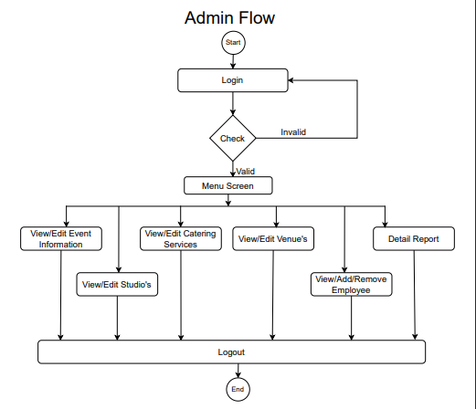
Activity Diagram Of Admin

Slide 10
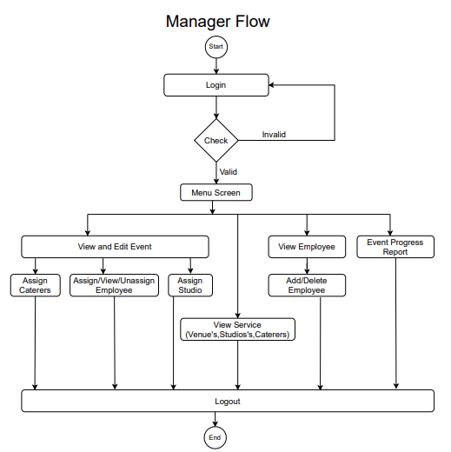
Activity Diagram Of Manager

Slide 11
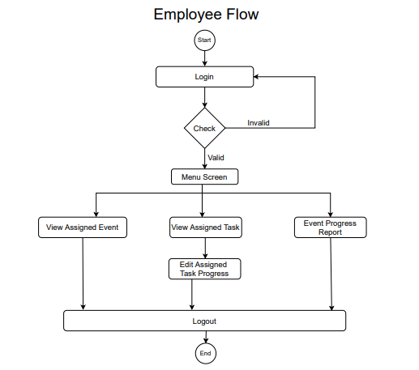
Activity Diagram Of Employee

Slide 12
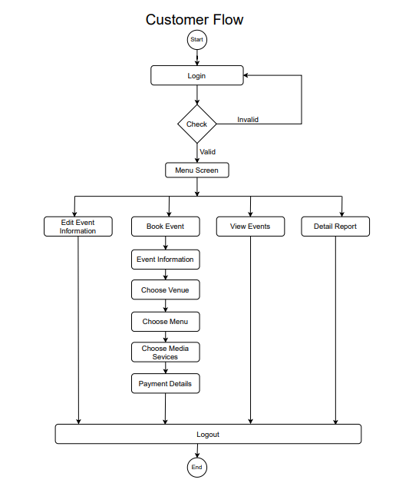
Activity Diagram Of Customer

Slide 13
Screenshots

Slide 14
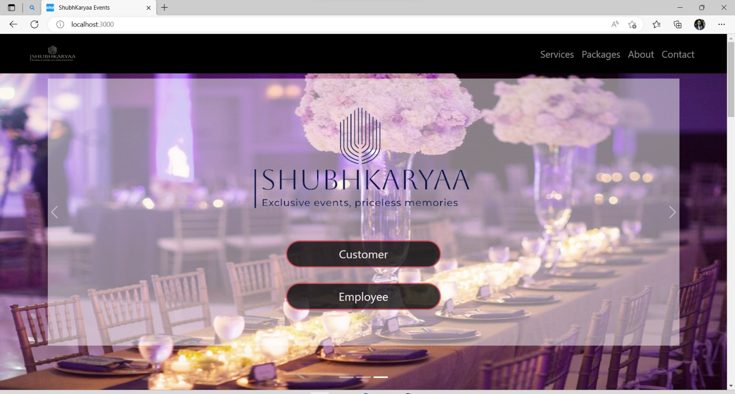

Slide 15
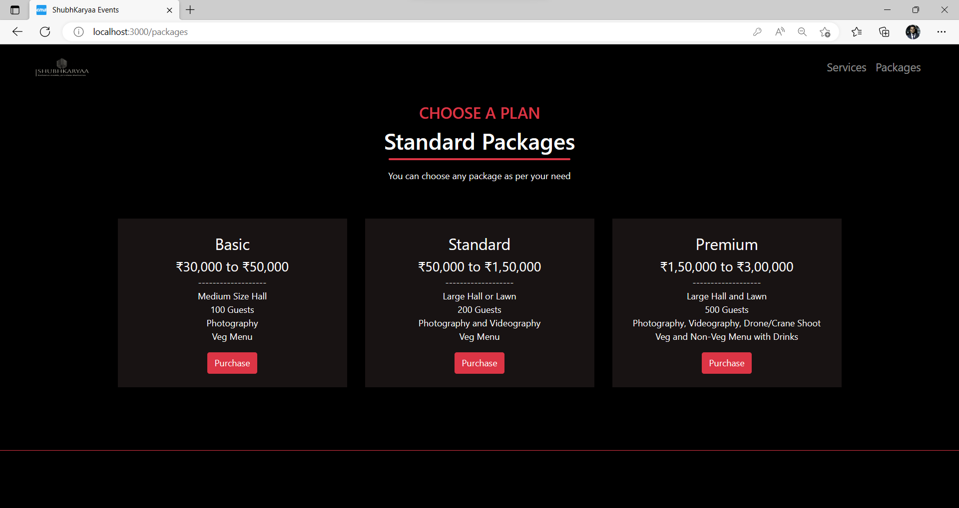
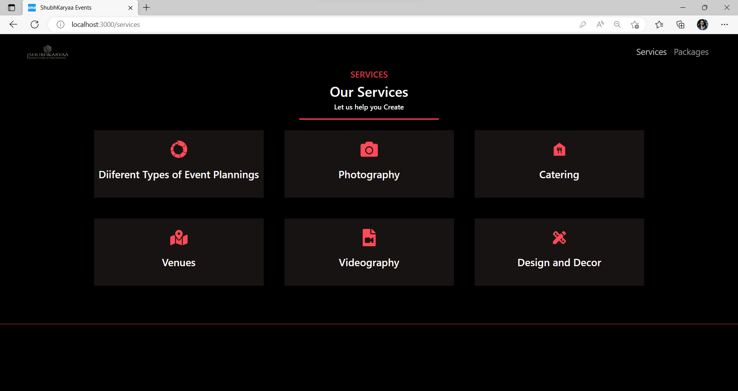
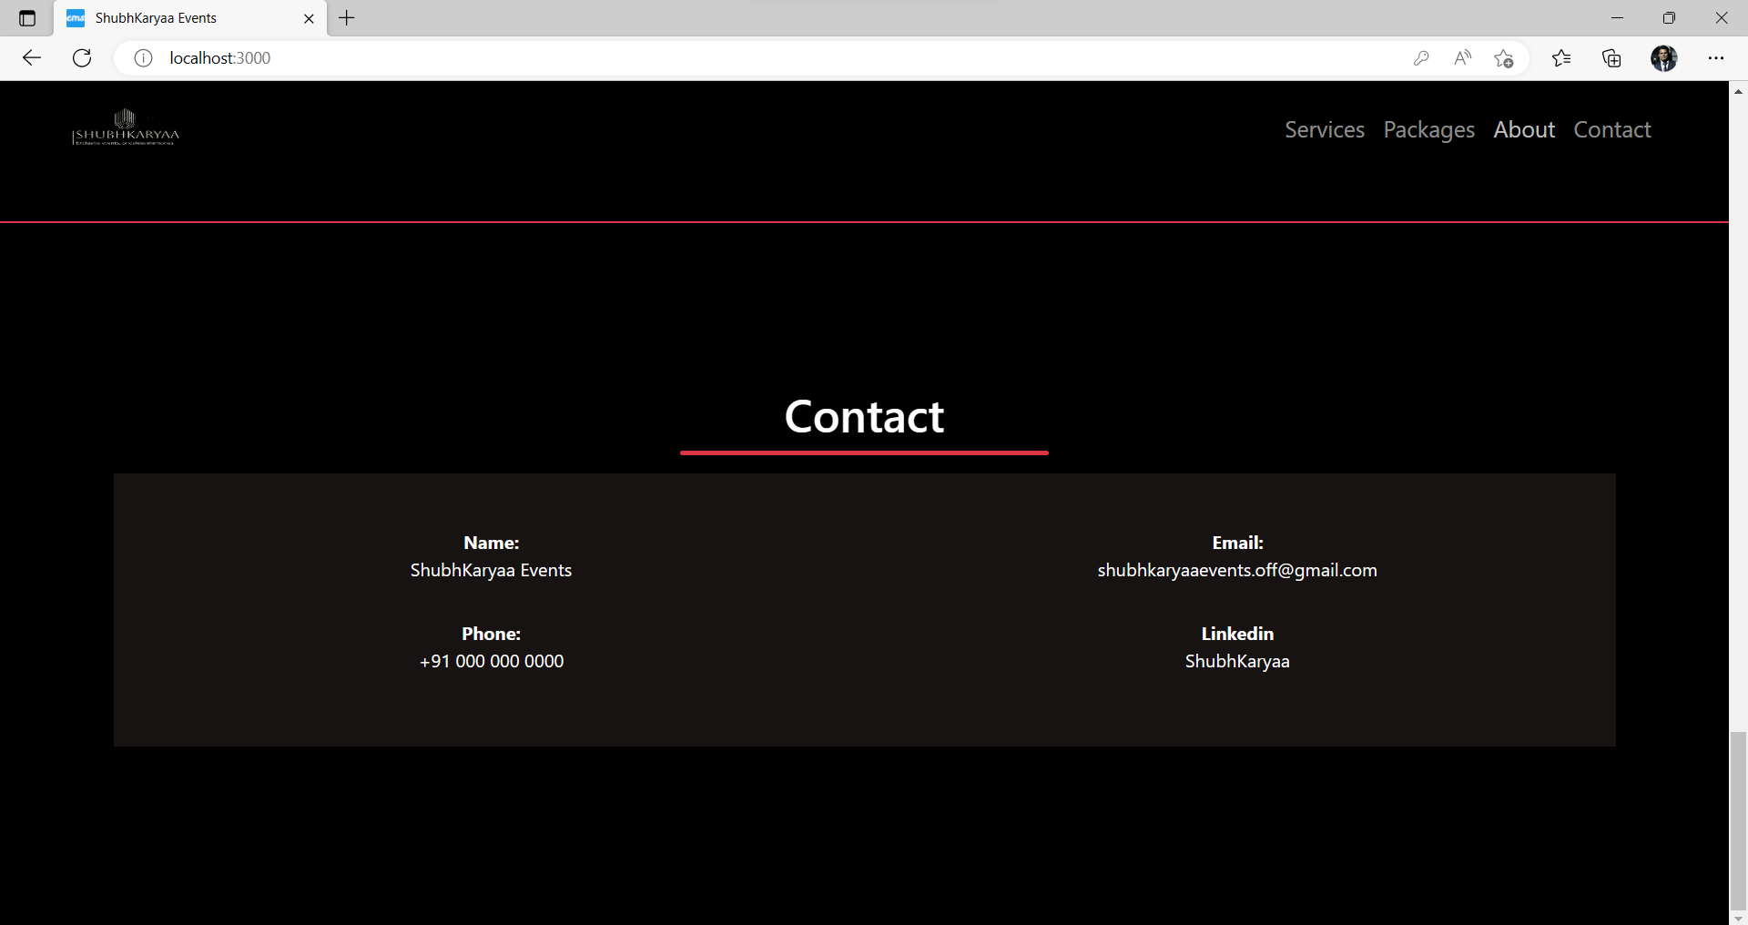
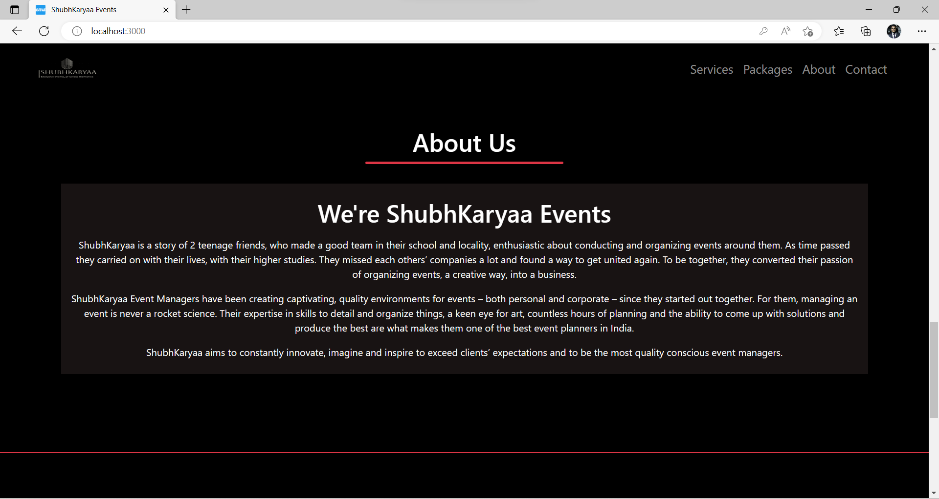
PACKAGES
SERVICE
CONTACT
ABOUT US

Slide 16
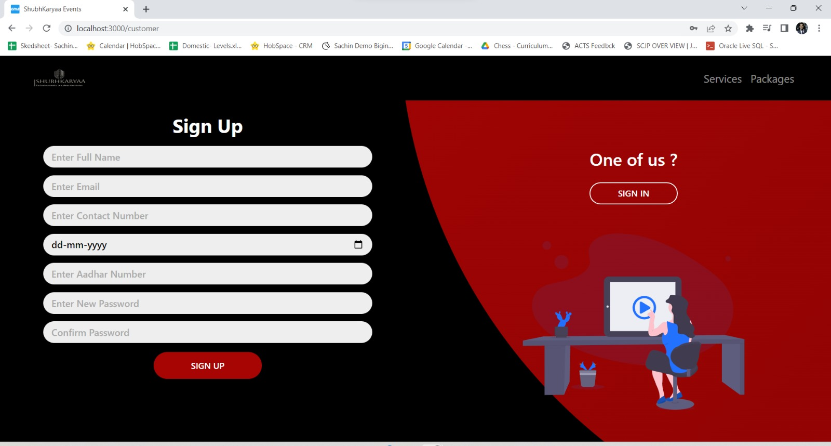
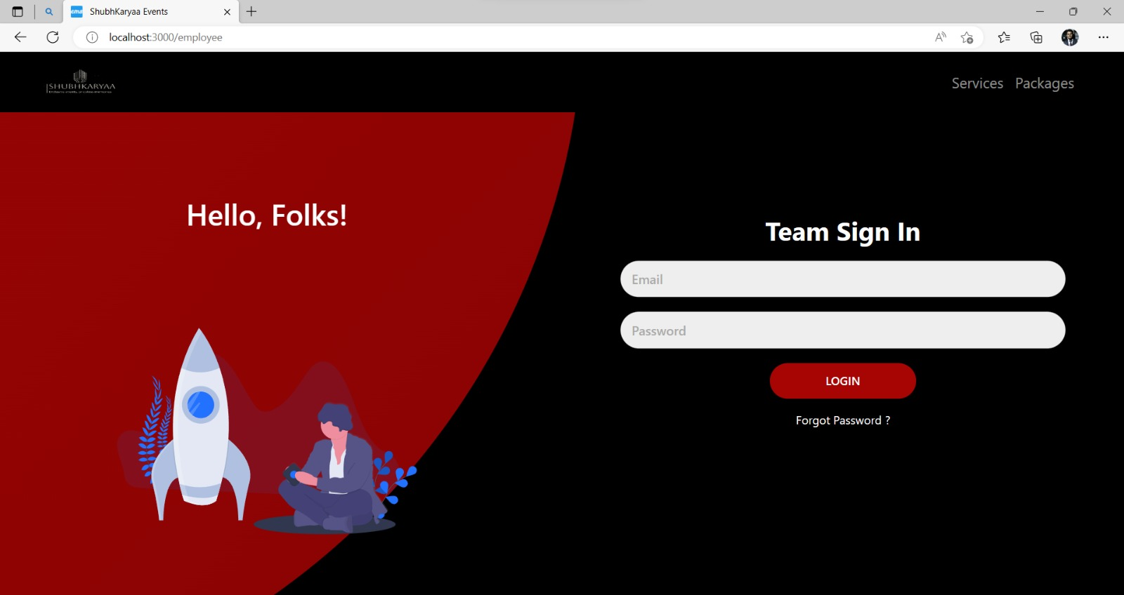
SIGN IN
(CUSTOMER)
SIGN UP

Slide 17
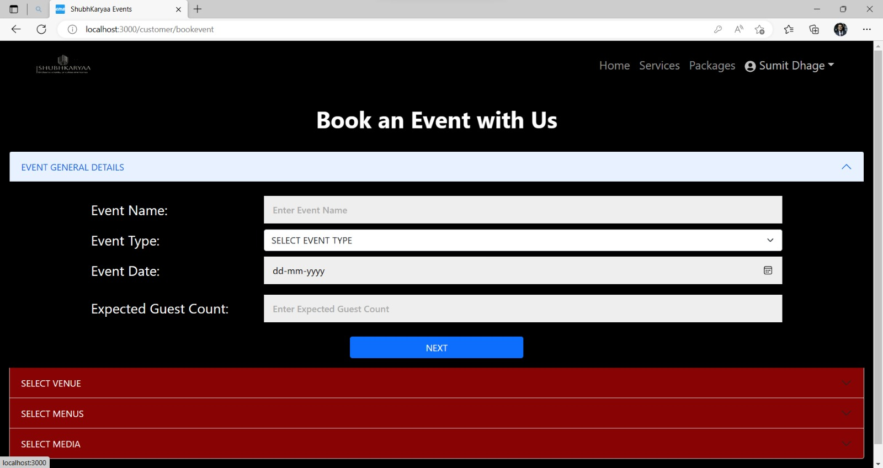
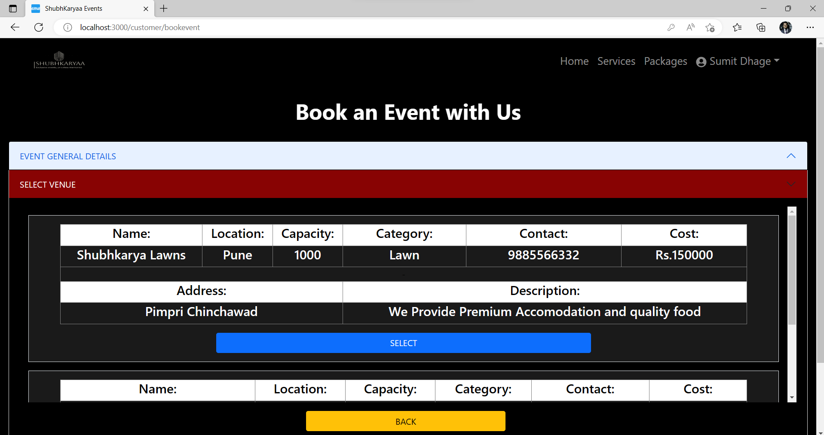
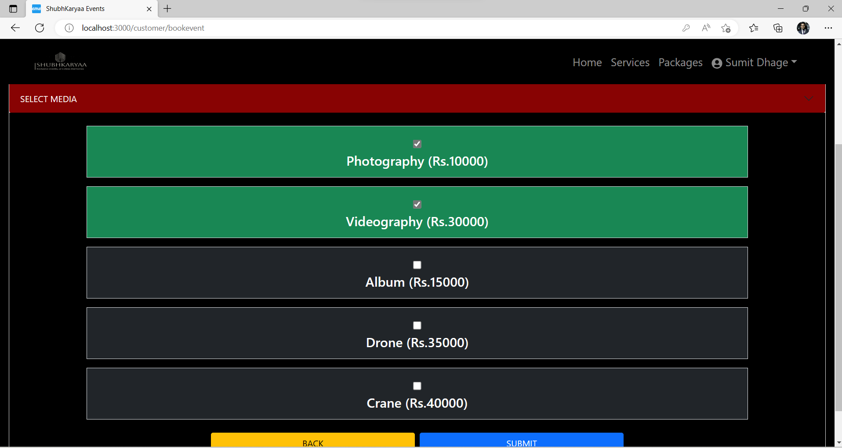
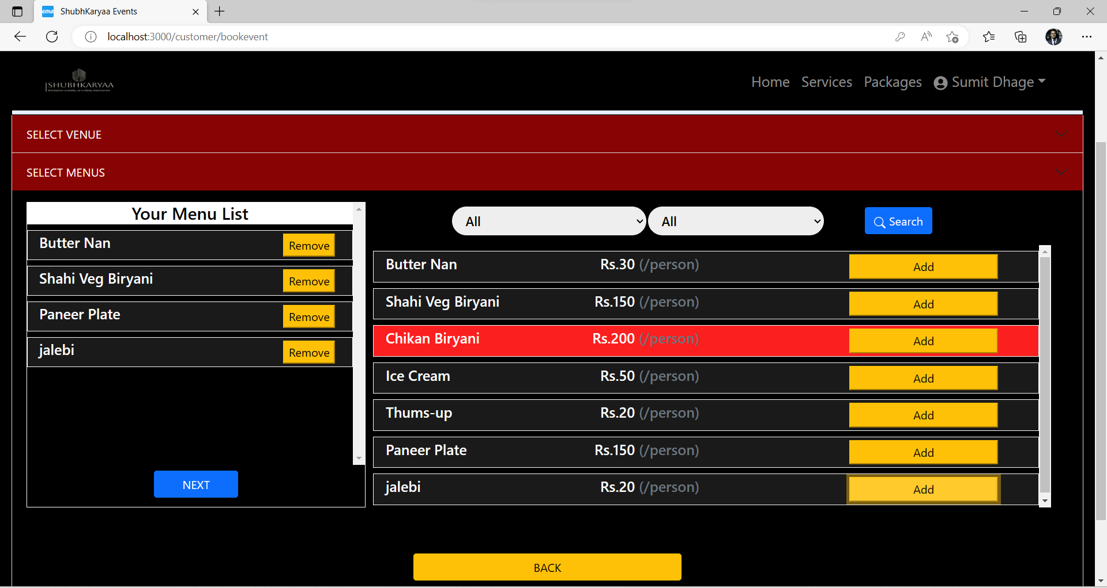
EVENT REGISTRATION FLOW(CUSTOMER)

Slide 18
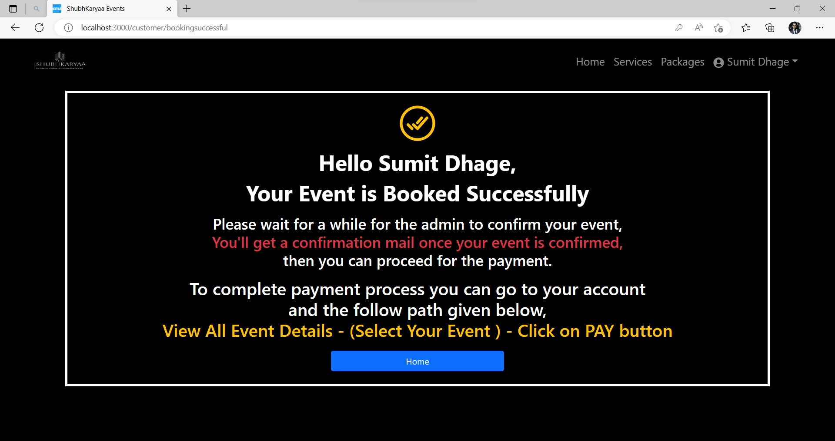
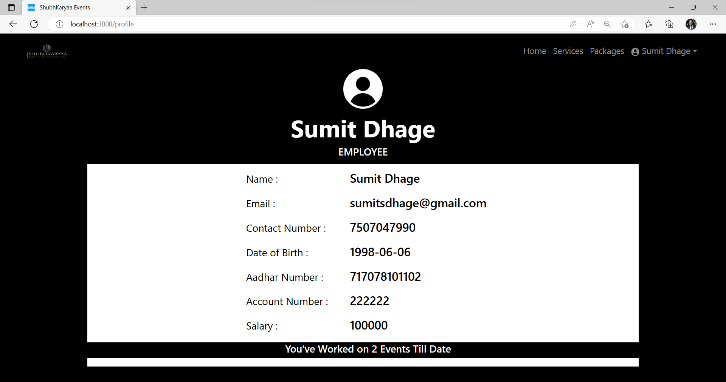
EMPLOYEE PROFILE
SUCCESSFUL MESSAGE
Notes:
Change Karna He

Slide 19
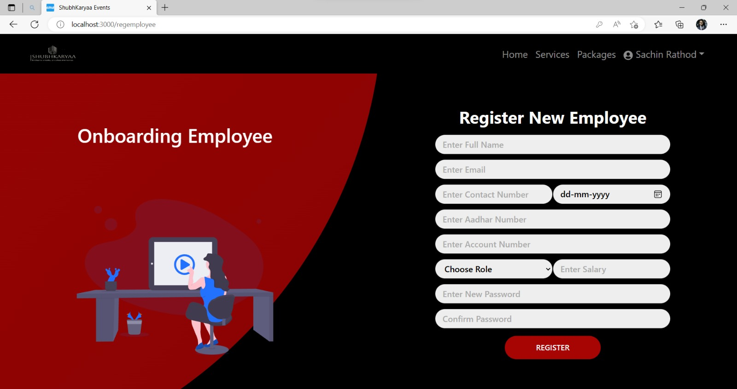
REGISTRATION (EMPLOYEE)
SIGN IN (EMPLOYEE)

Slide 20
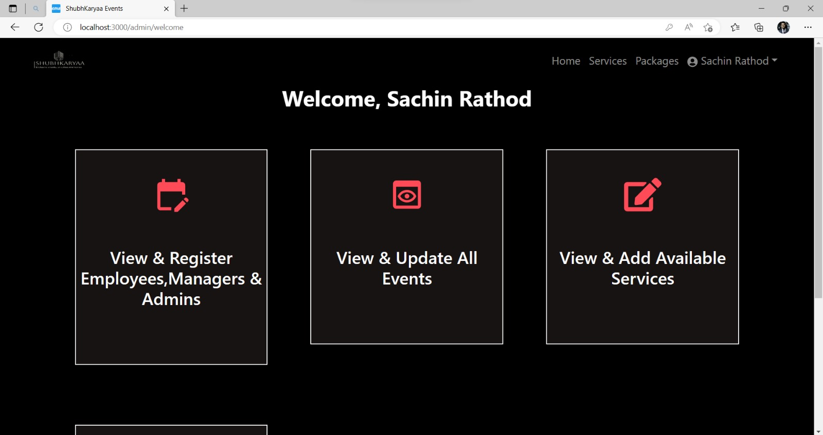
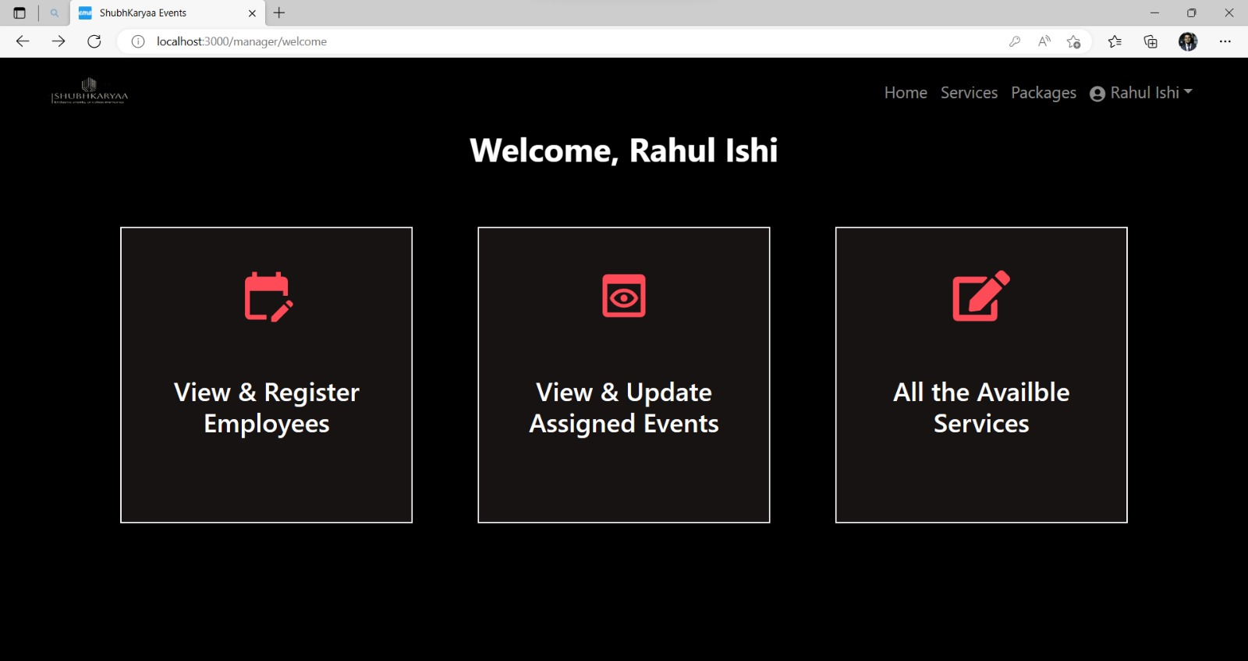
WELCOME PAGE (ADMIN)
WELCOME PAGE (MANAGER)

Slide 21
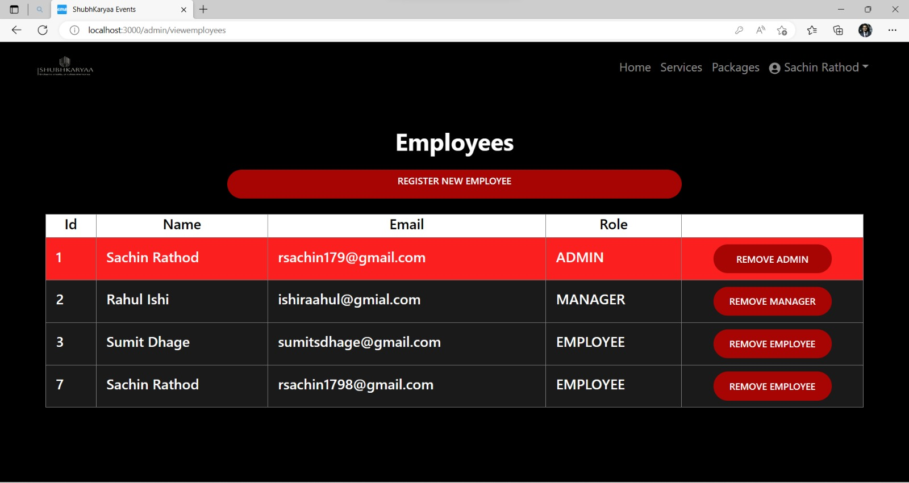
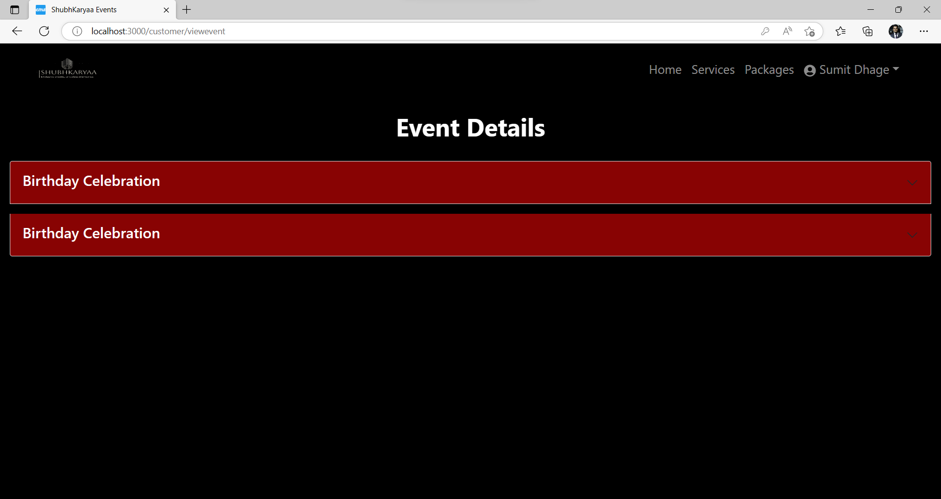
ADMIN/VIEWEMPLOYEE
CUSTOMER/VIEWEVENT

Slide 22
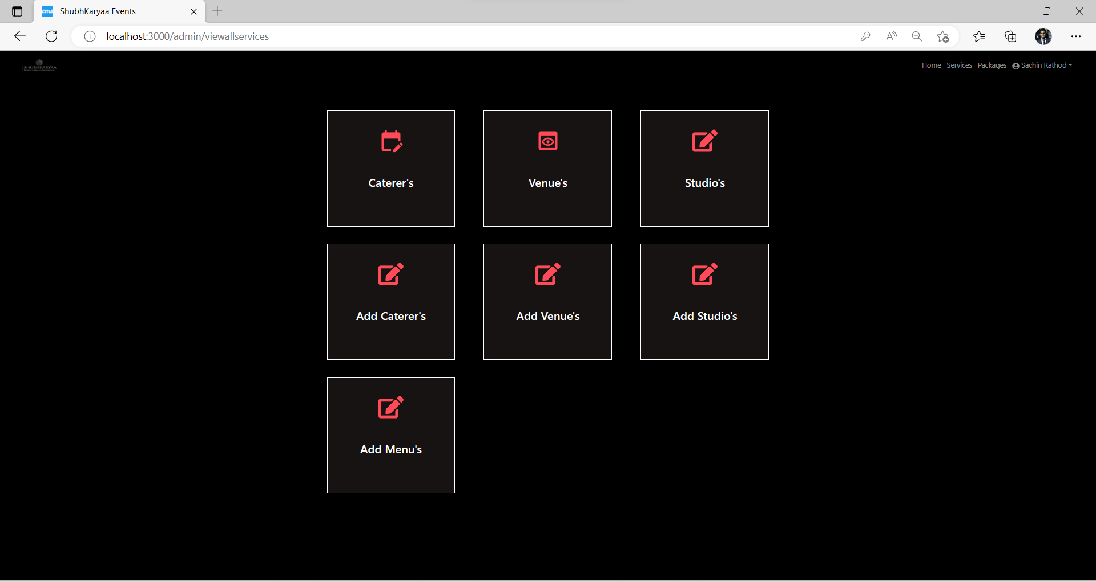
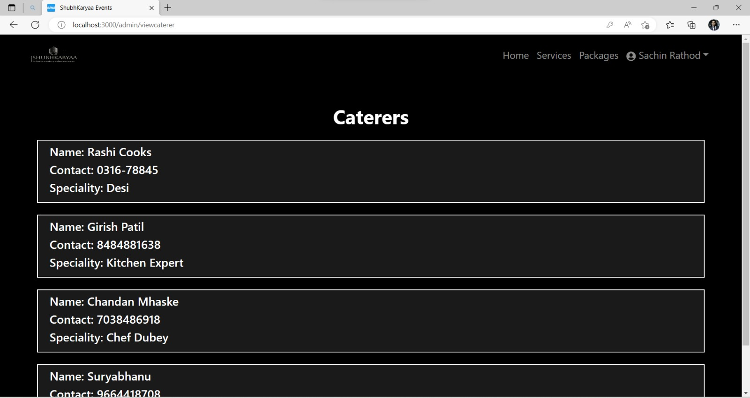
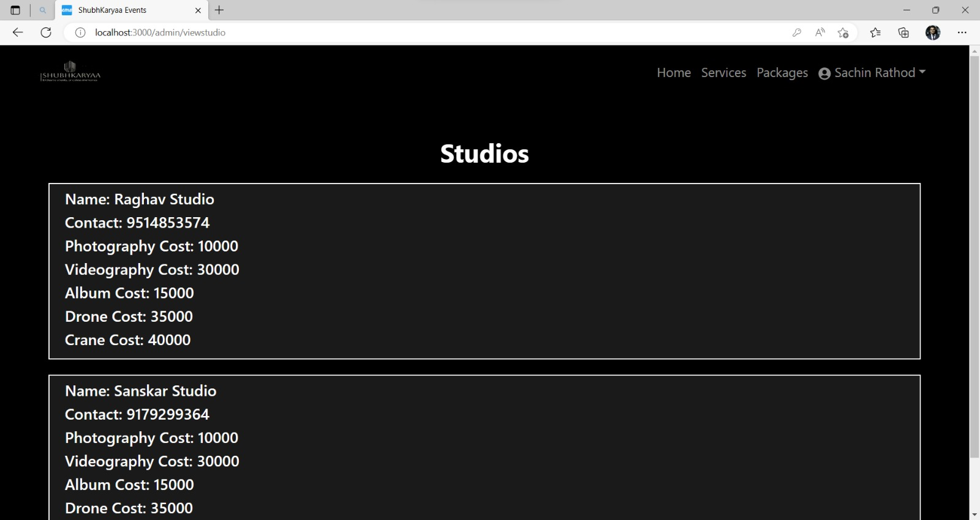
ADMIN/VIEWCATERERS
ADMIN/VIEWSTUDIOS
ADMIN/VIEWALLSERVICES

Slide 23
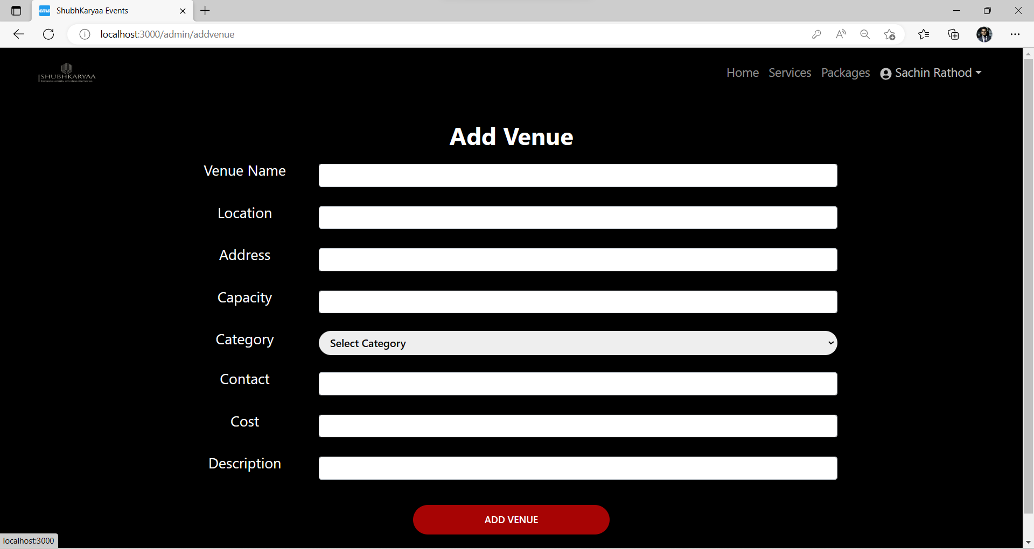
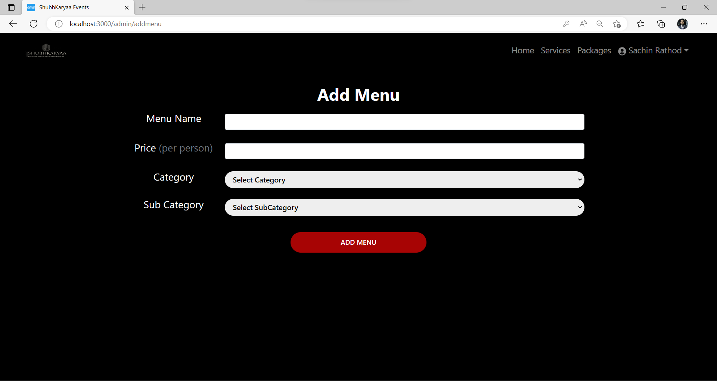
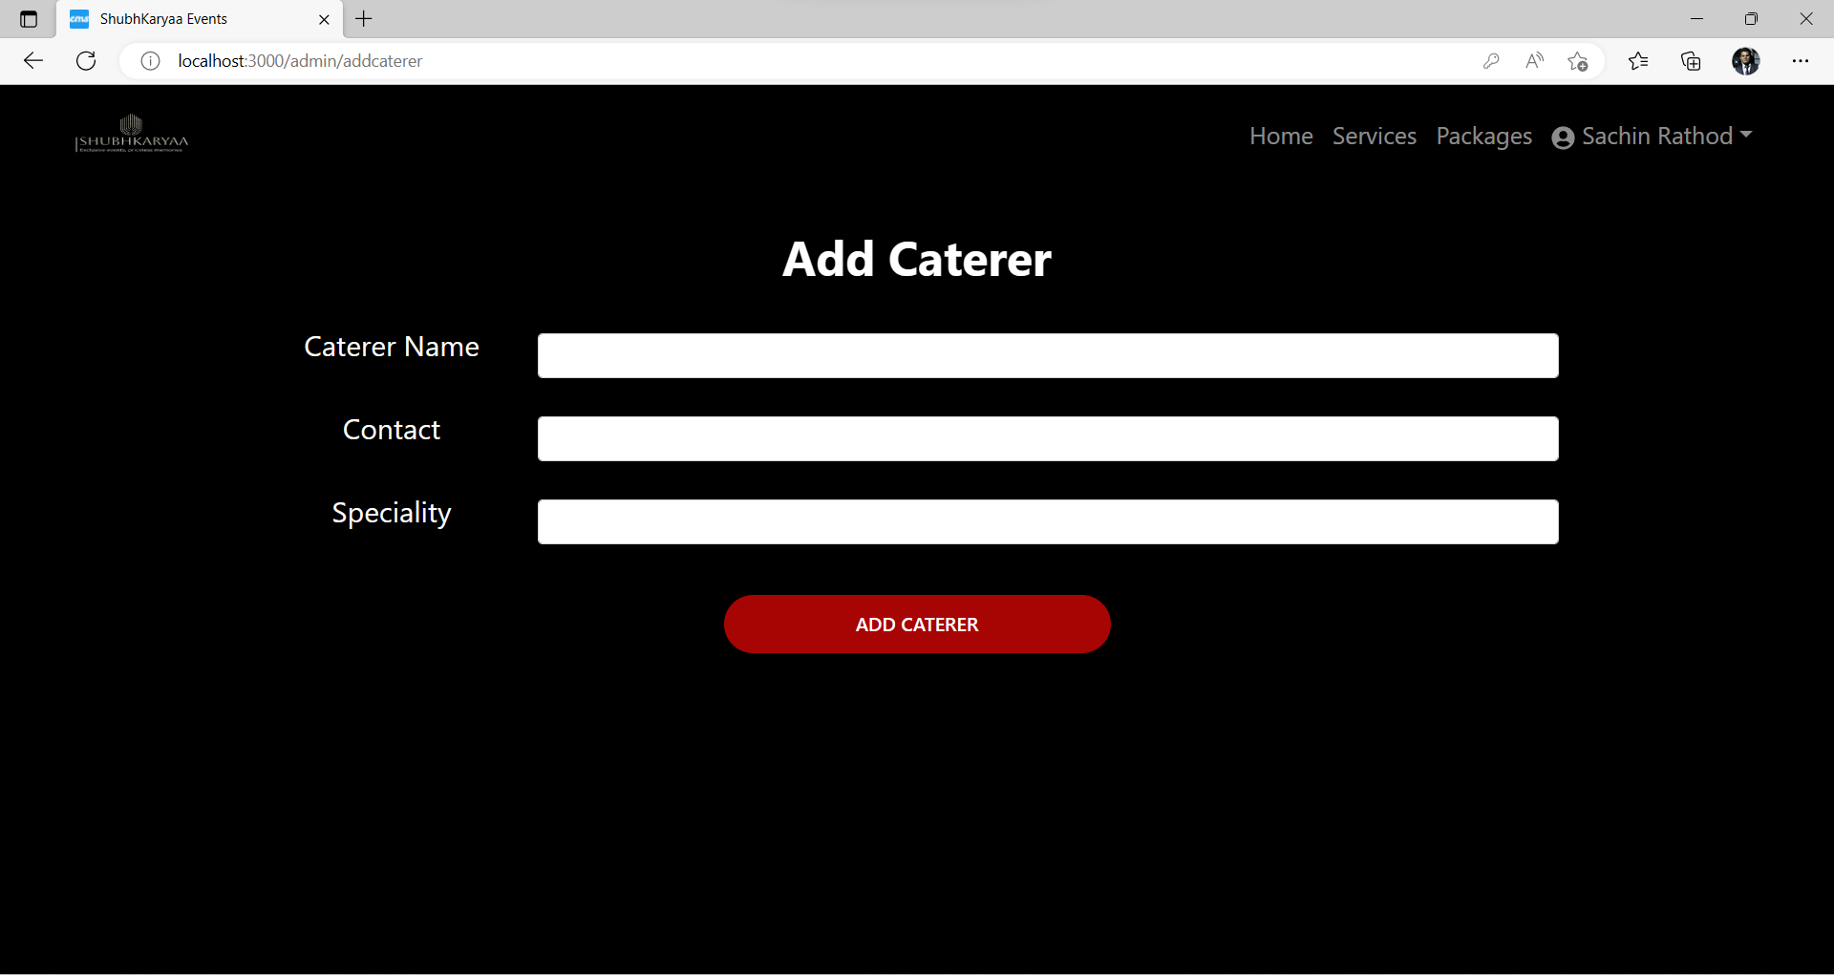
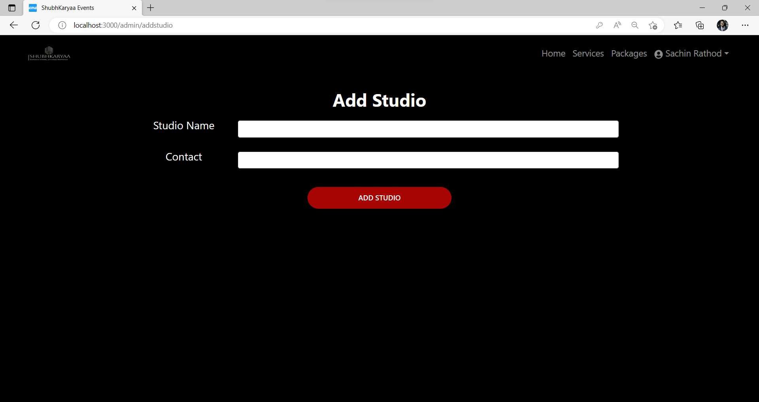
ADMIN

Slide 24
Specification
The application will use JavaScript, jQuery, CSS and Java Spring Boot as main web technologies.
SMTP protocol is used for Email communication.
Several types of validations make this web application a secured one and SQL Injections can also be prevented.
Since Event Management System is a web-based application, internet connection must be established.
The Event Management System will be used on PCs and will function via internet or intranet in any web browser.

Slide 25
S/W and H/W Requirements
Server Side:
Processor: Intel® Xeon® processor 3500 series
HDD: Minimum 500GB Disk Space
RAM: Minimum 4GB
OS: Windows 10, Linux 6
Database: Mysql
Client Side (minimum requirement):
Processor: Intel Dual Core
HDD: Minimum 80GB Disk Space
RAM: Minimum 1GB
OS: Windows 8 and above, Linux

Slide 26
Advantages
This Online Event Management solution is fully functional and flexible.
It is very easy to use.
This Online Event Management System helps in back office administration by streamlining and standardizing the procedures.
It saves a lot of time, money and labour.
Eco-friendly: The monitoring of the Event Management and the overall business becomes easy and includes least paper work.
The application acts as an office that is open 24/7.
It increases the efficiency of management at offering quality services to the customers.

Slide 27
Conclusion
Our project is only a humble venture to satisfy the needs to manage their project work. Several user-friendly coding techniques have also been adopted. This package shall prove to be a powerful package in satisfying the requirements of both the customer and the firm. The objective if software planning is to provide a frame work that enables the manager to make reasonable estimate made within a limited time frame at the beginning of the software project and should be updated regularly.

Slide 28
References
https://www.w3schools.com/ http://www.wikipedia.org
https://getbootstrap.com/
https://docs.spring.io/spring-data/jpa/docs/current/reference/html/#jpa.query-methods.query-creation

Slide 29
Thank You…

