Slide 1
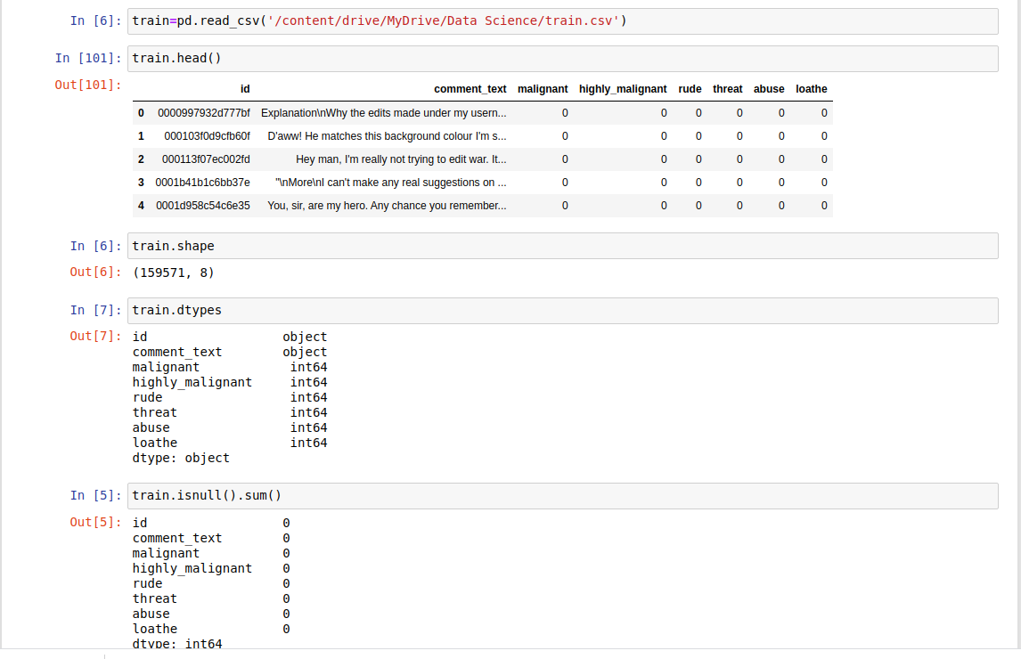

Slide 2
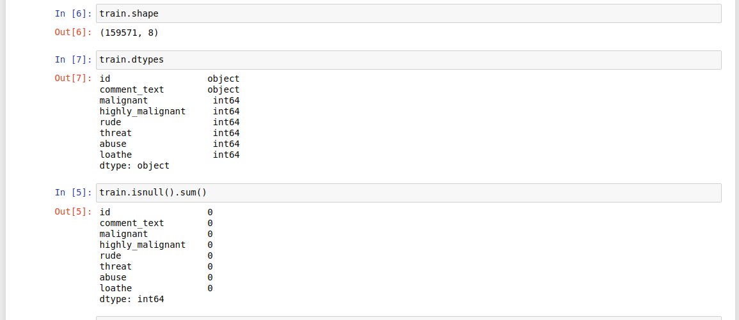
Basic Info about the data

Slide 3

Downloading the required libraries and constructing new features

Slide 4
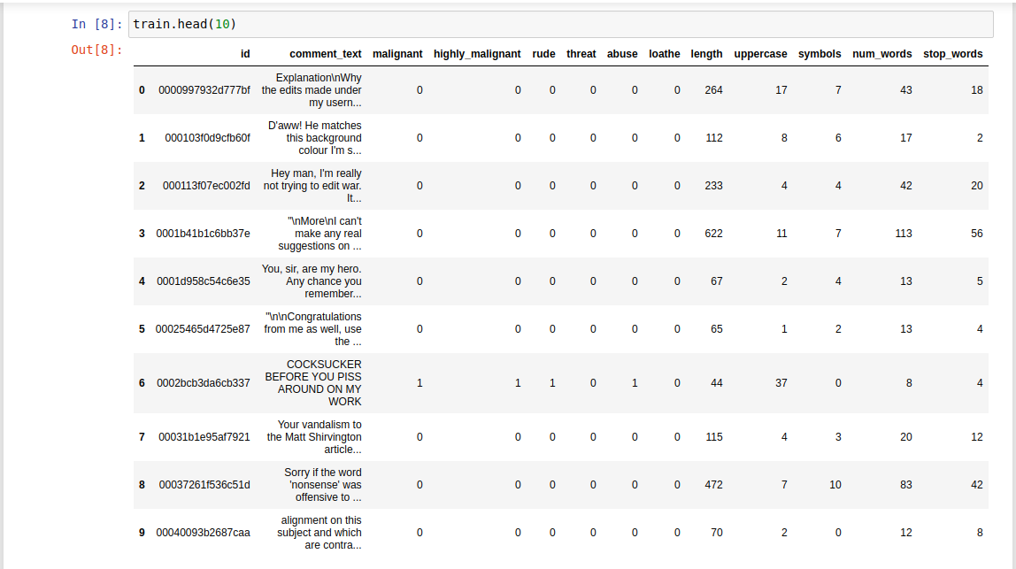

Slide 5
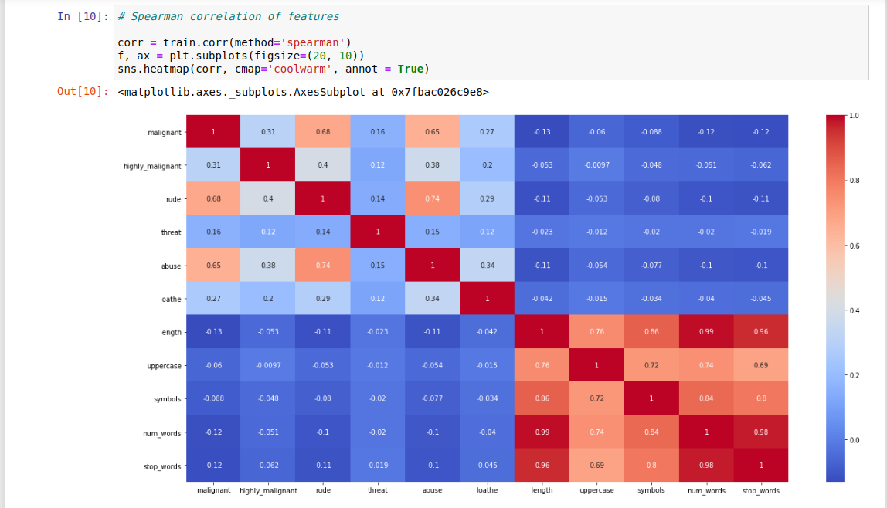

Slide 6

Now, let’s have a look at the distribution of the various class labels

Slide 7

The data is highly imbalanced and there are a lot of comments which are unlabelled.

Slide 8

Basic insights about the new constructed features.

Slide 9
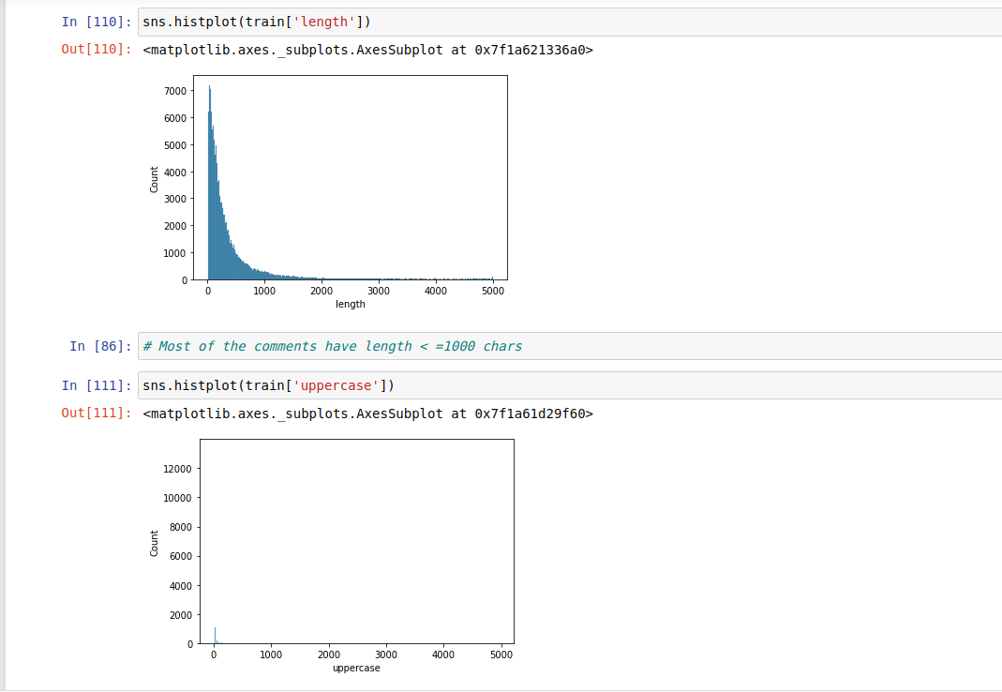

Slide 10
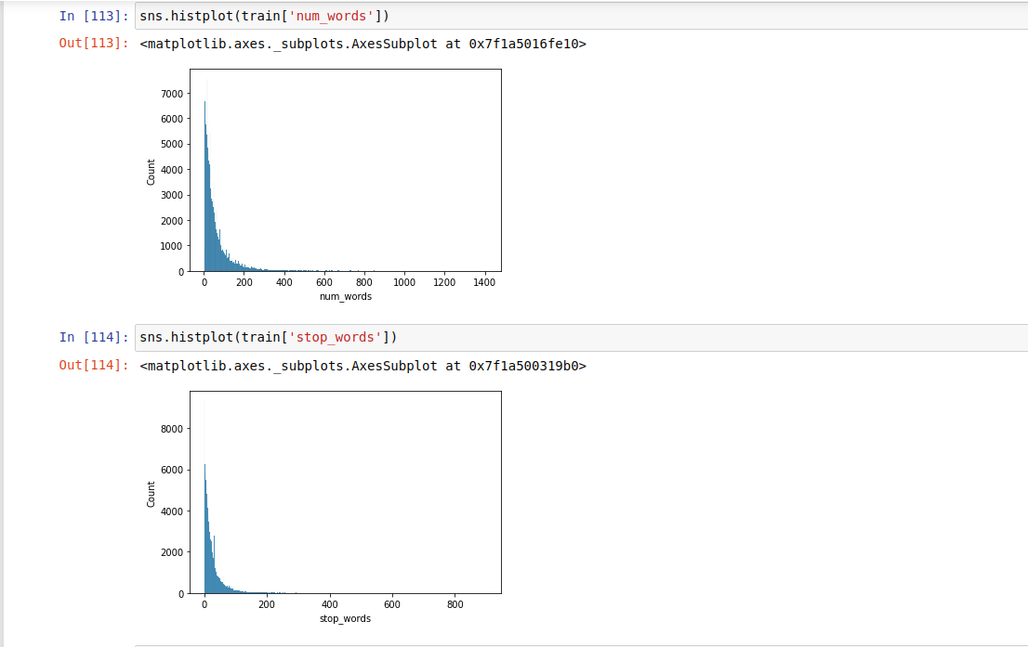

Slide 11
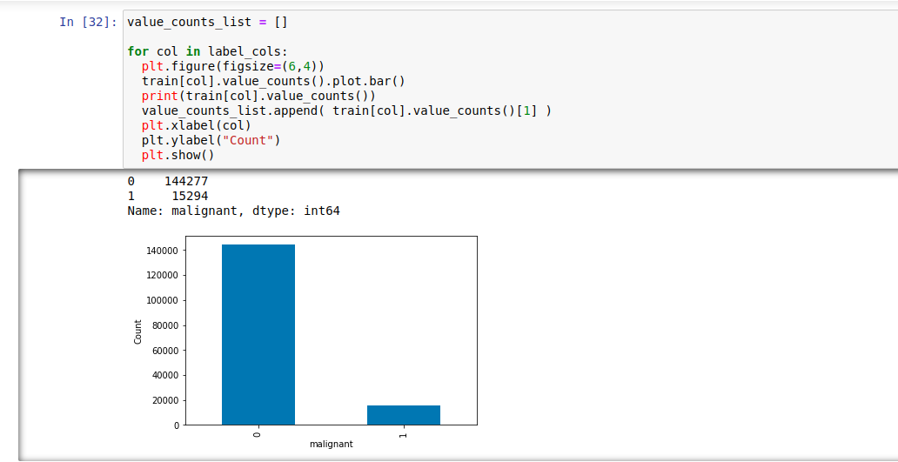
Basic EDA

Slide 12
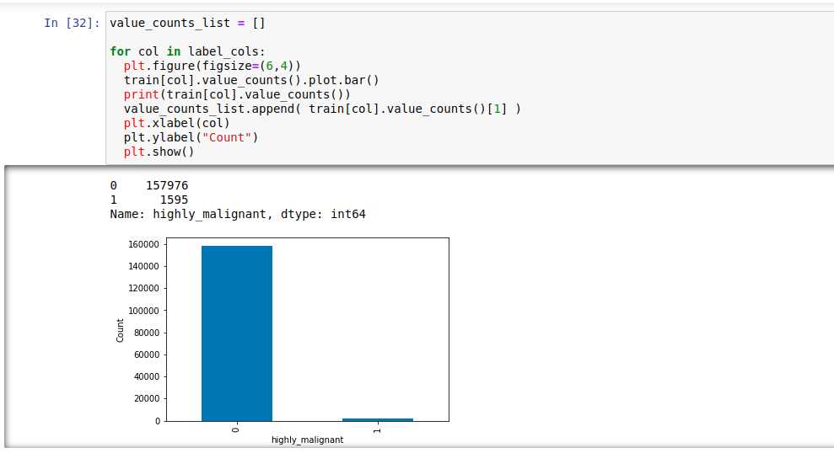

Slide 13
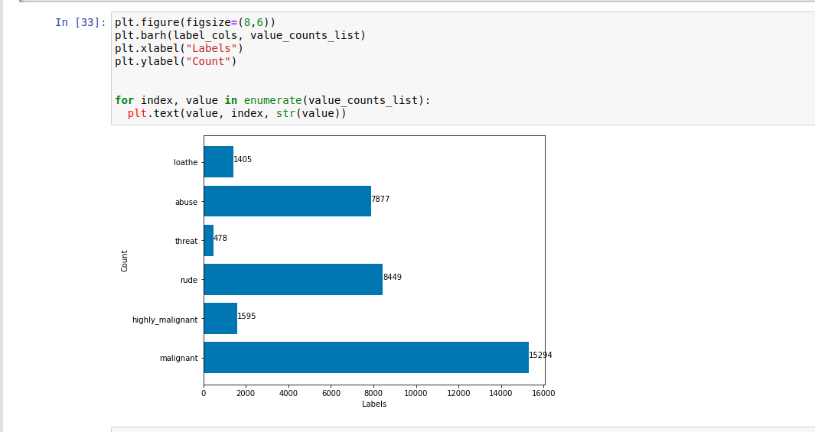
Most number of labelled comments belong to Malignant

Slide 14
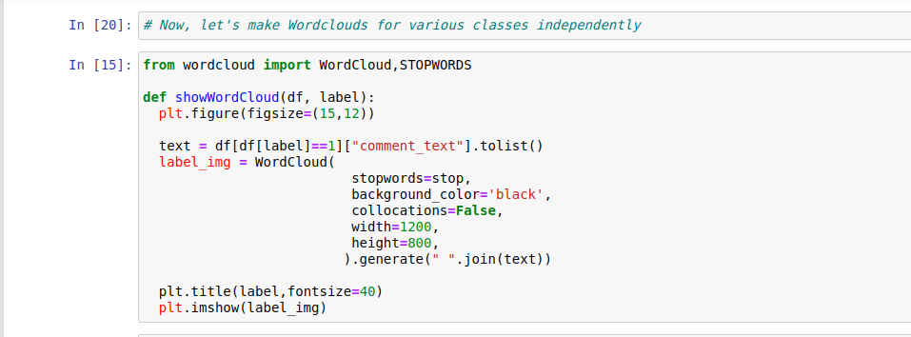
Lets write a function to create Wordclouds of comments belonging to various labels

Slide 15
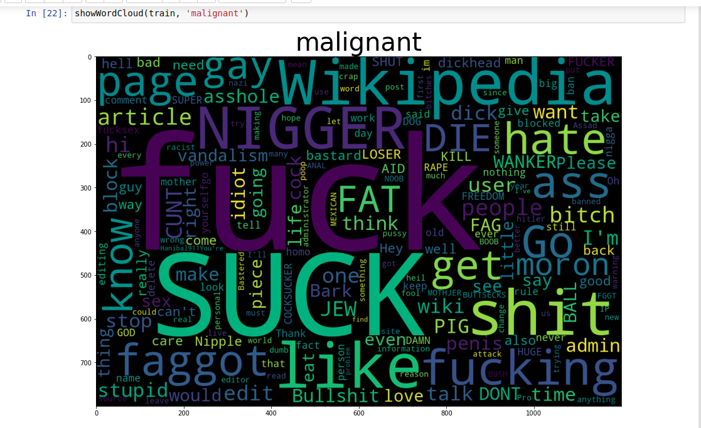

Slide 16
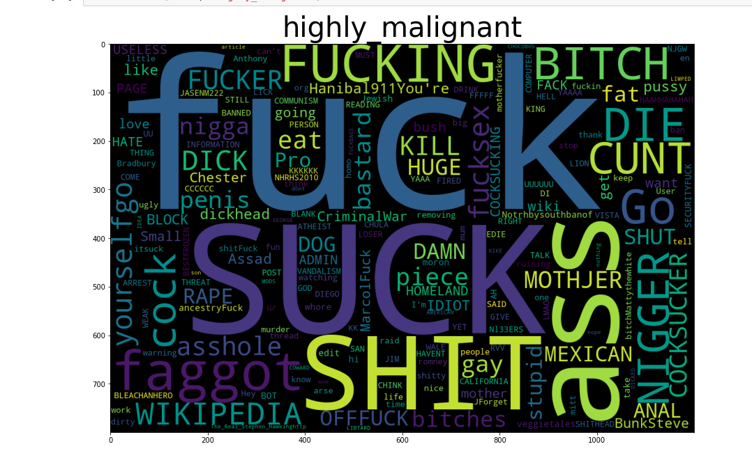

Slide 17
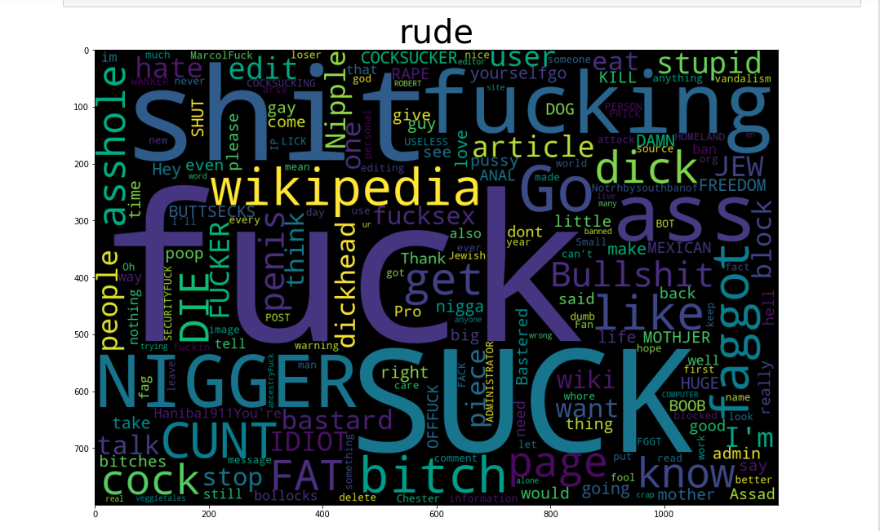

Slide 18
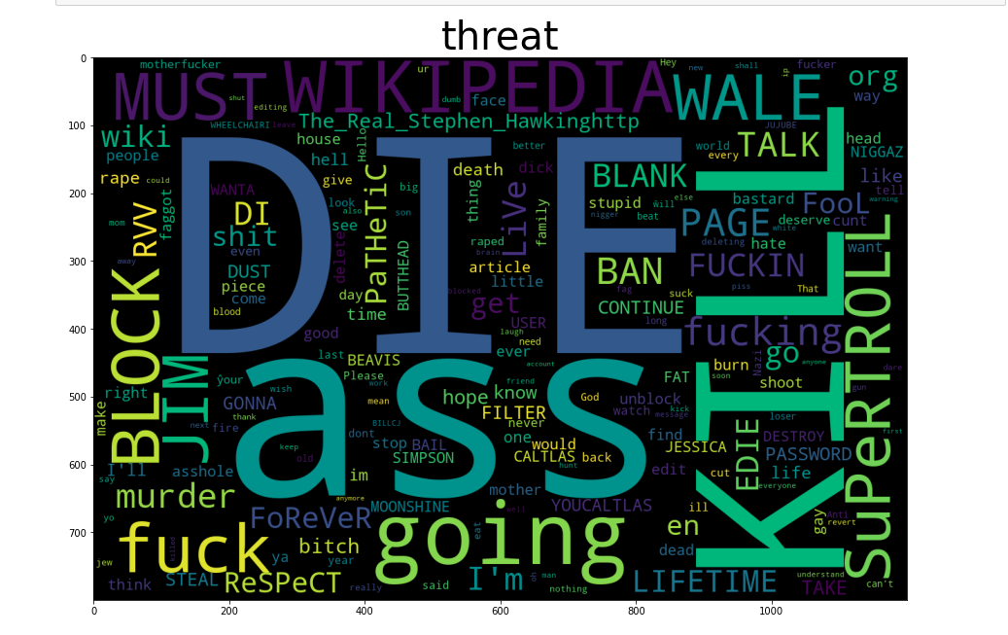

Slide 19
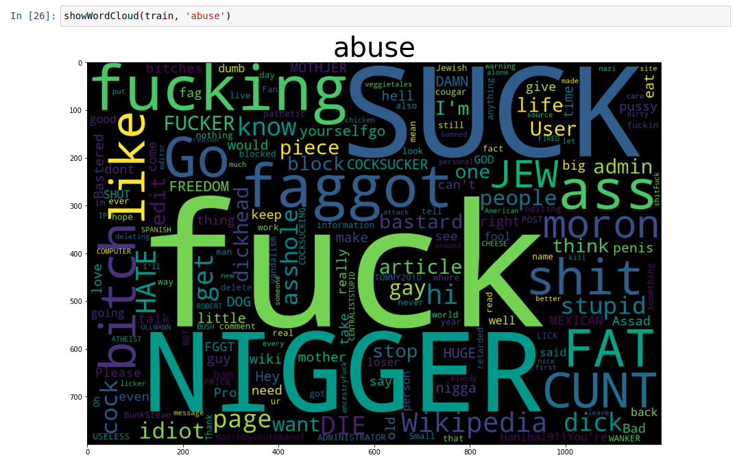

Slide 20
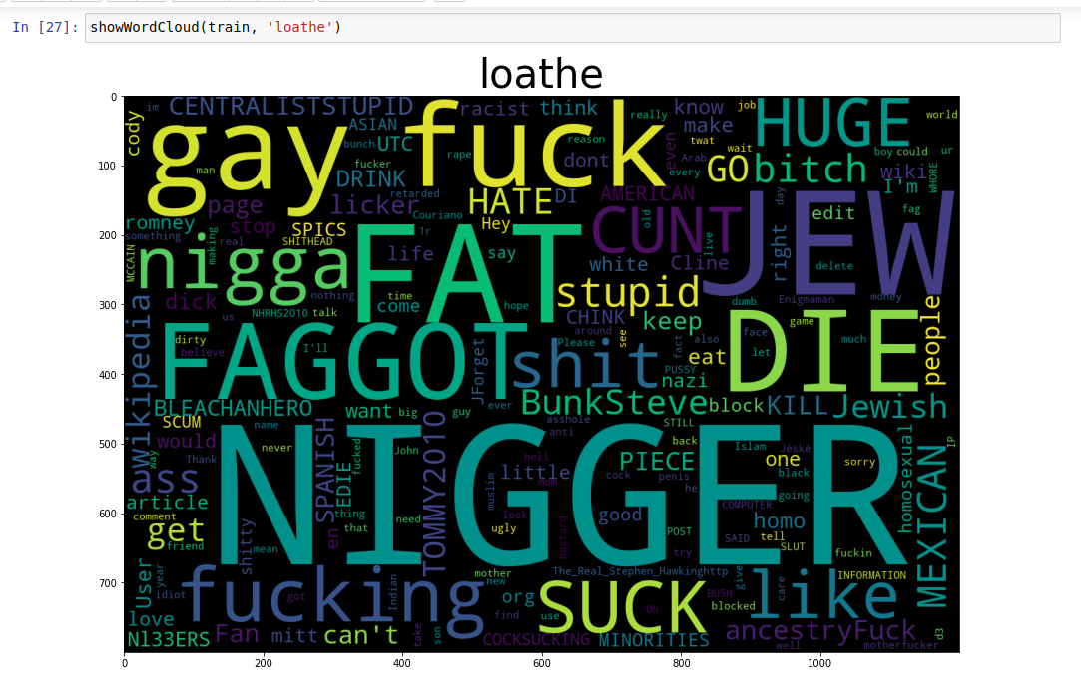

Slide 21

Importing the necessary libraries and creating functions for cleaning the text

Slide 22
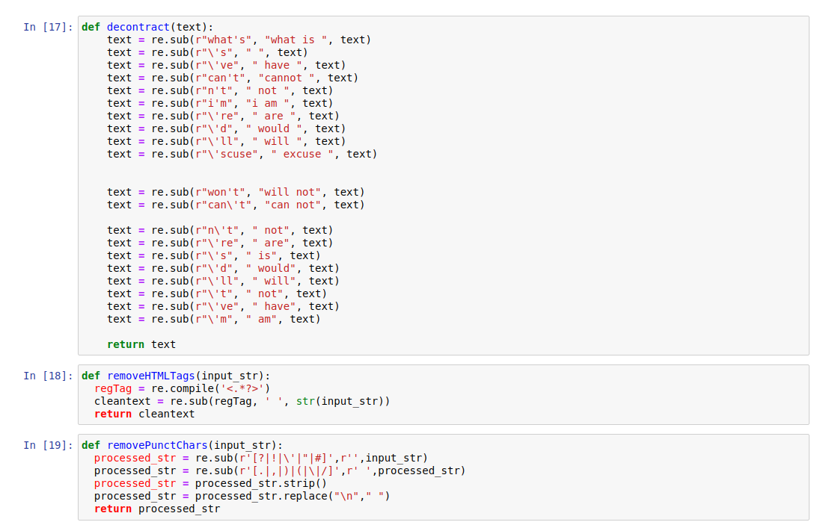

Slide 23
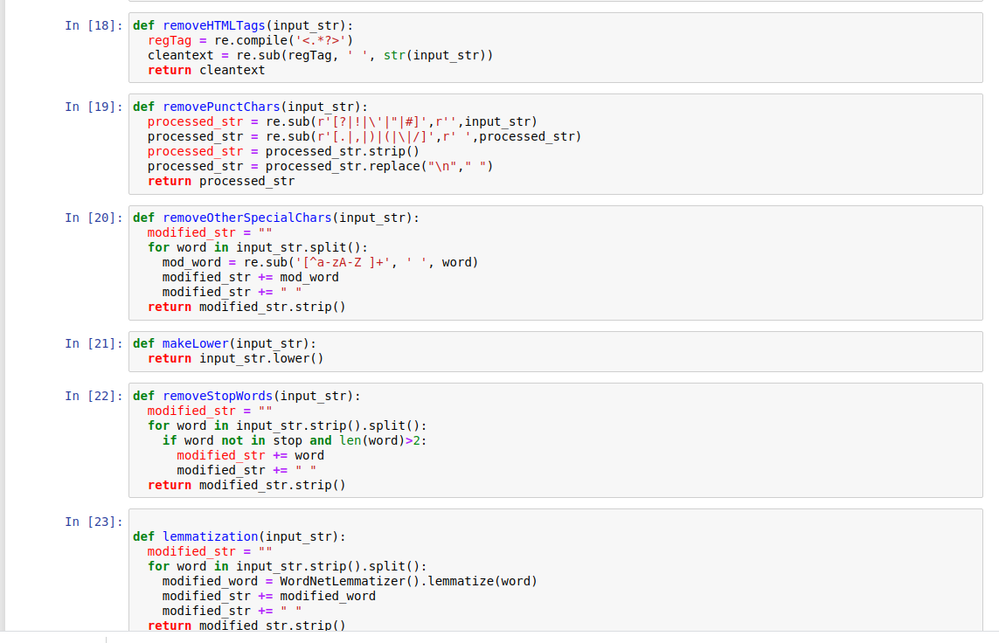

Slide 24

Lets apply text pre-processing

Slide 25
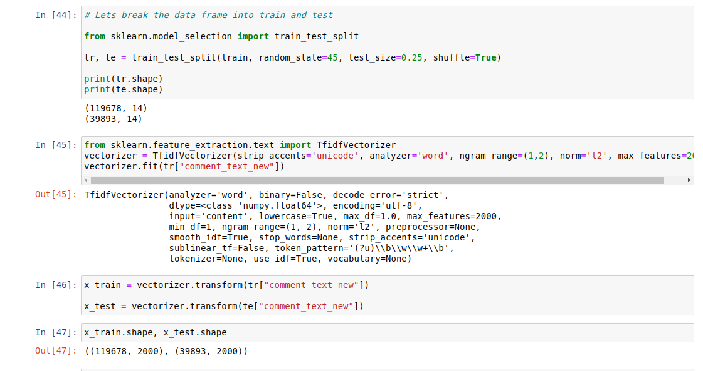
Splitting the data and creating x_train, y_train, x_test, y_test

Slide 26

Visualize the training data with 2005 features after tokenization

Slide 27

Visualize the test data with 2005 features after tokenization

Slide 28
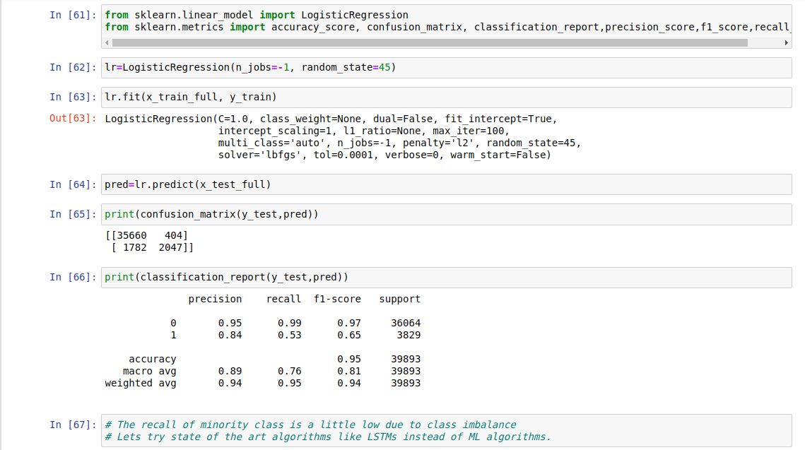

Slide 29
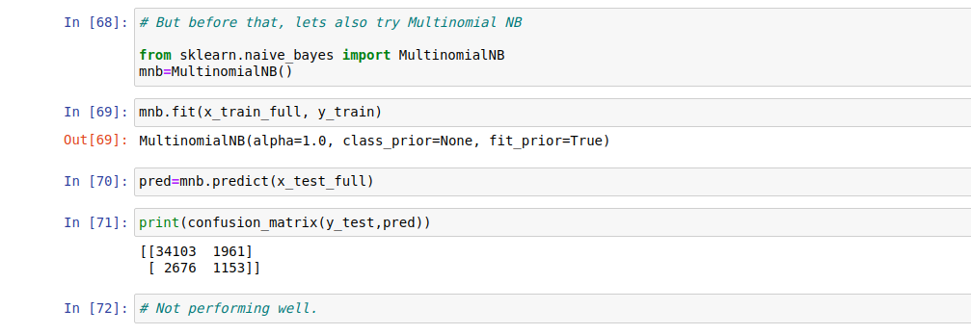
Training Multinomial Naive Bayes on data

Slide 30
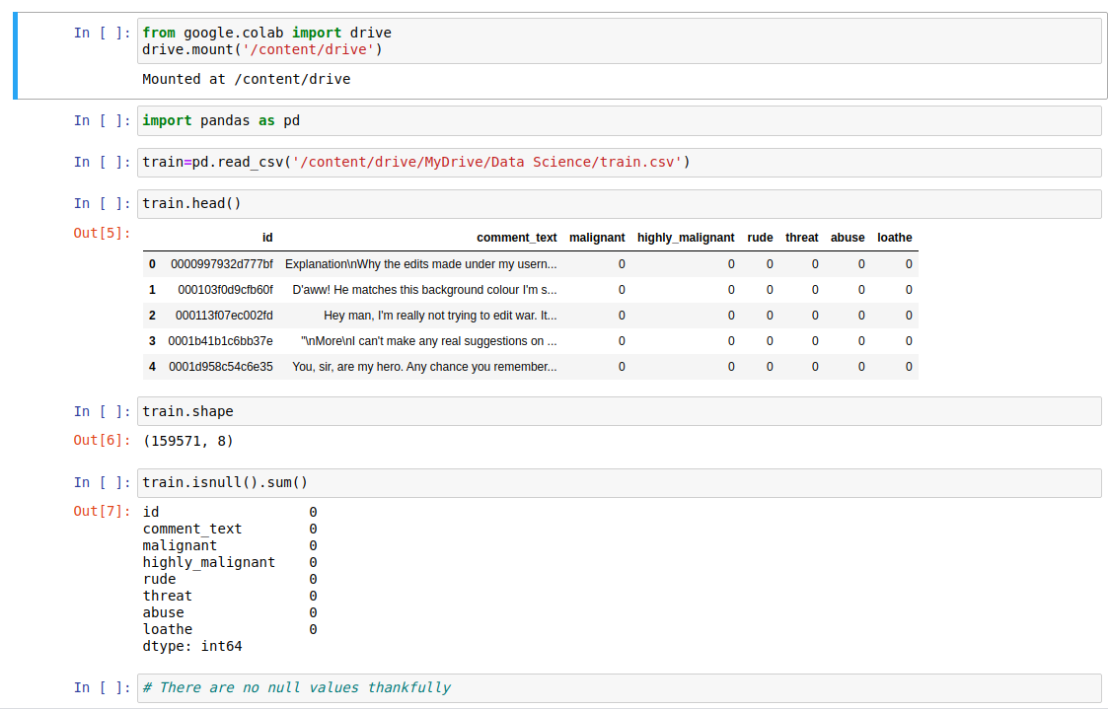

Slide 31
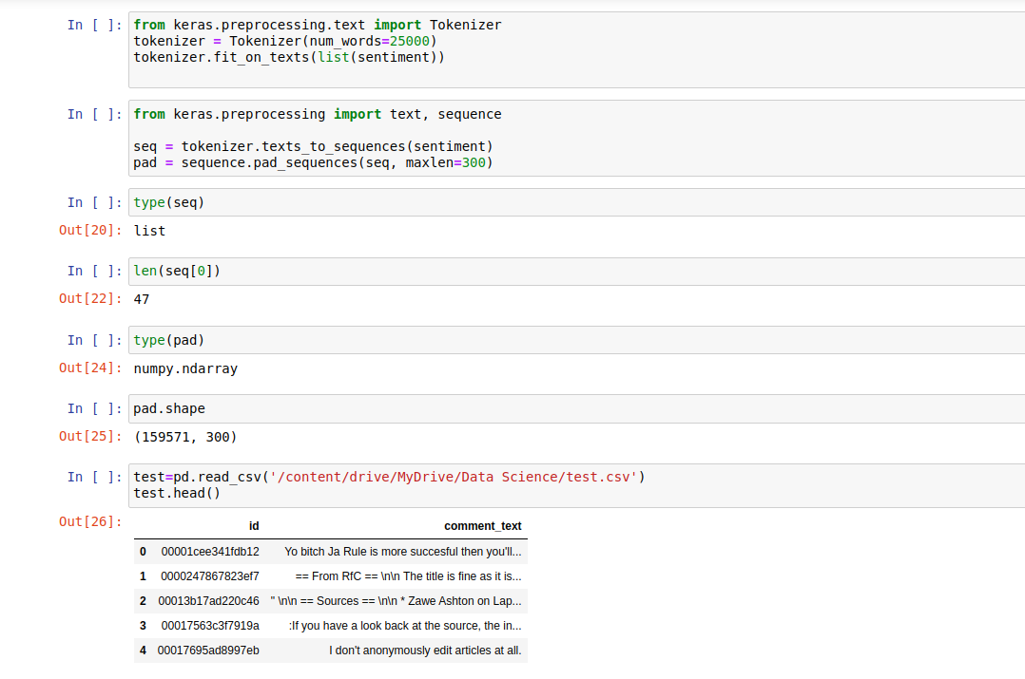

Slide 32
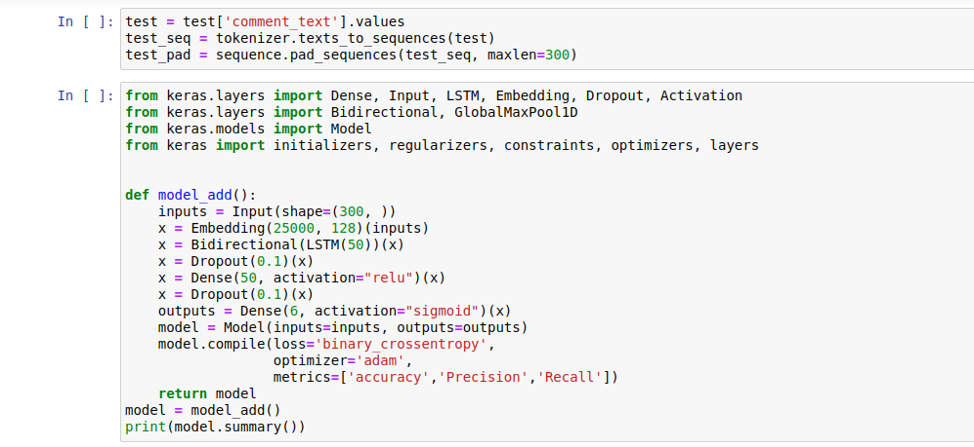
Converting the data in required format and creating LSTM network

Slide 33
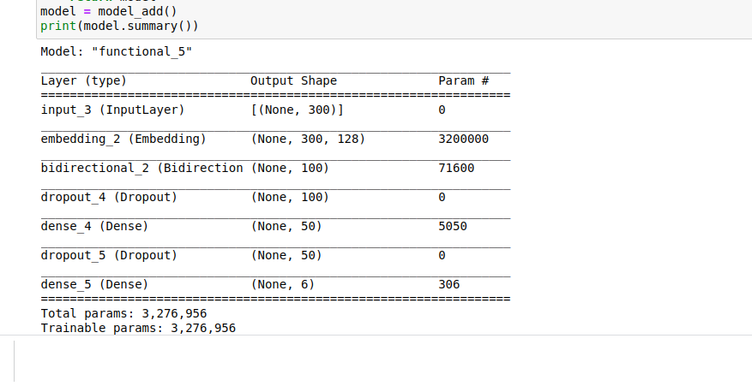

Slide 34

Training the model

Slide 35
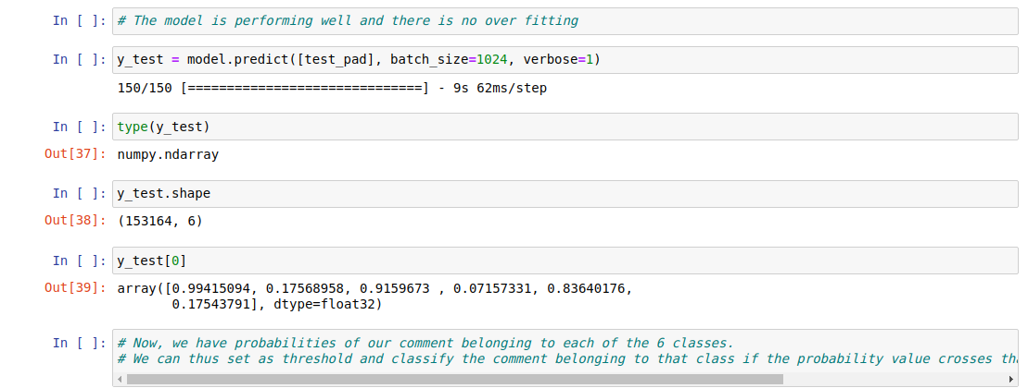
Making Predictions

