Slide 1

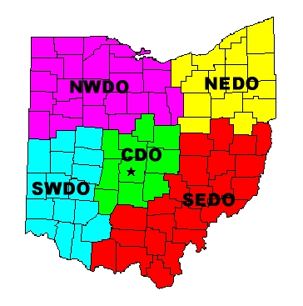

Soil Testing and Analysis for Waste Disposal Facilities
A Presentation to the
November 17, 2005
By
Dr. Andrew G. Heydinger
Department of Civil
Engineering

Slide 2
Introduction
  BSCE University of Cincinnati
  MSCE University of Pittsburgh
  Ph.D University of Houston
  Experience as a consultant and with the U.S. Army Corps of Engineers and
  23 years at the University of Toledo
  I consider myself a ‘Soils Mechanician.’

Slide 3
Purpose of Presentation
  Discuss fundamental concepts pertaining to soil properties and behavior.
  Discuss details of soil testing and analysis of results.
  Discuss geotechnical analysis for waste management facilities.

Slide 4

Some Fundamental Concepts

Slide 5
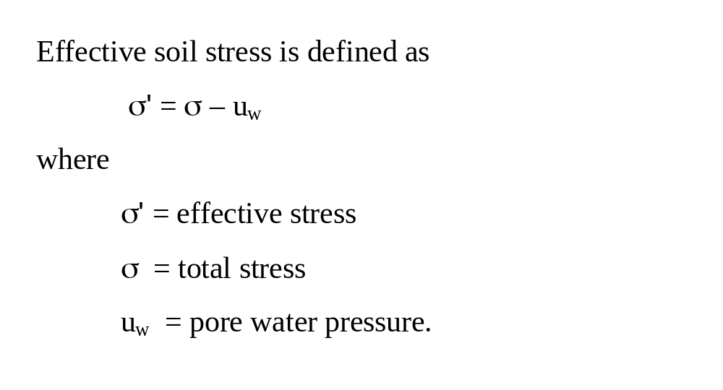
The effective Stress Concept

Slide 6
What Effective Stress Isn’t
  Effective soil stress is not the actual stress acting at the areas of contact between soil particles.

Slide 7
What Effective Stress Is
  Effective soil stress corresponds to the stress transmitted through the soil mineral skeleton.

Slide 8
Why Effective Stress?
  Effective soil stress is a stress state variable that is useful to characterize behavior occurring in saturated soils including volume change, permeability and shear strength.

Slide 9
Pore Water Pressure
  Hydrostatic or geostatic pore water pressure is the pore water pressure in soil due to geologic conditions.
  Excess pore water pressure is the pore water pressure that results when soil is loaded.
  Back pressure is the pore water pressure applied directly to soil specimens during laboratory testing.

Slide 10
Consolidation of Saturated Soil
  When saturated soils are loaded, they develop excess pore water pressures that dissipate over time.
  As water flows from the soil the excess pore water pressures dissipate resulting in settlement.
  This process is referred to as primary consolidation.

Slide 11
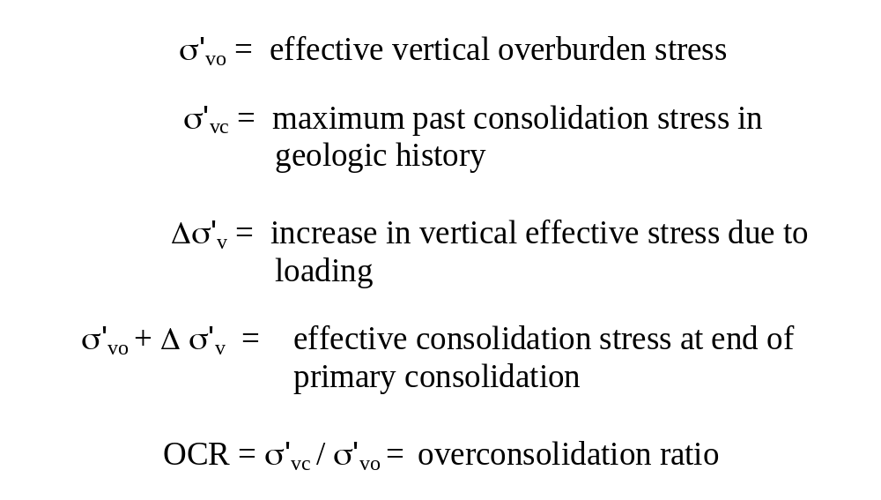
Consolidation Stresses

Slide 12
Settlement and Settlement Rate
  Results from plots of void ratio vs. log of effective stress and the log of time are used to compute primary and secondary consolidation settlement.
  Results from plots of deformation vs. time are used to compute consolidation rate.

Slide 13
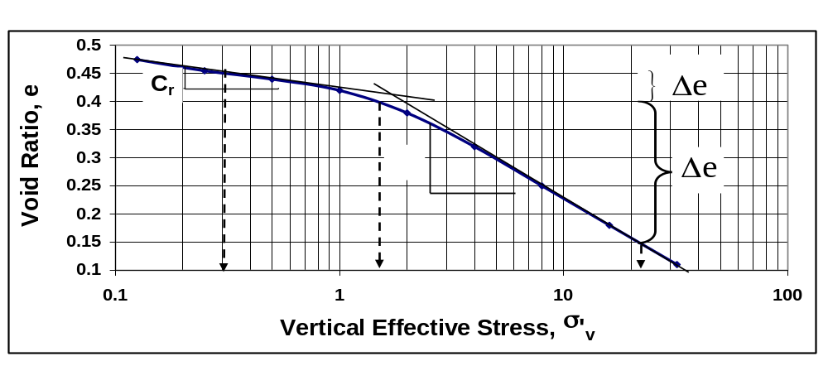
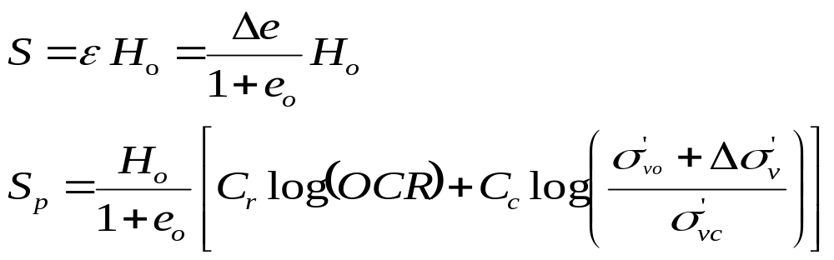
Primary Consolidation Settlement

Slide 14
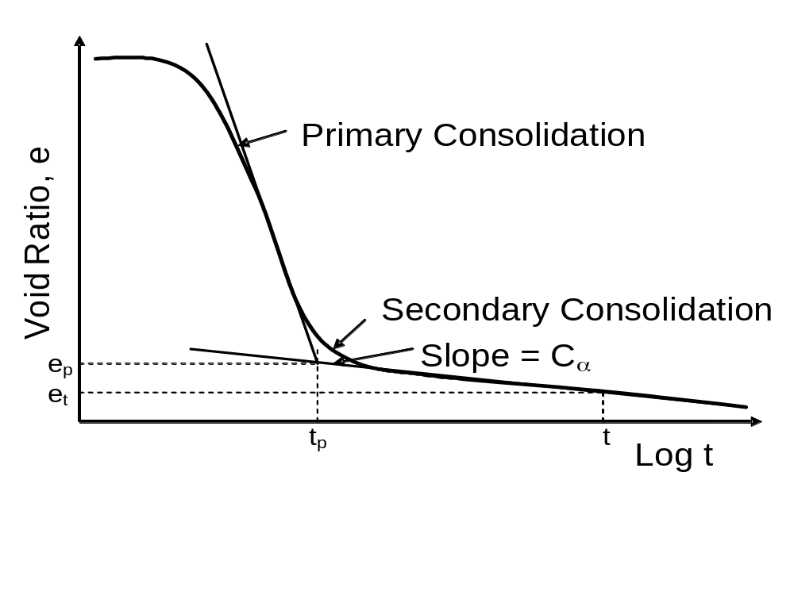
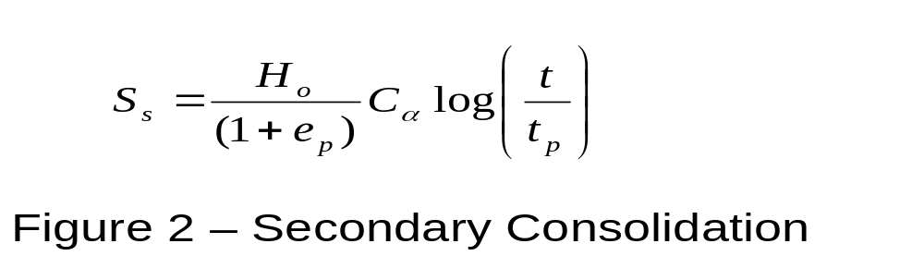
Secondary Consolidation Settlement

Slide 15
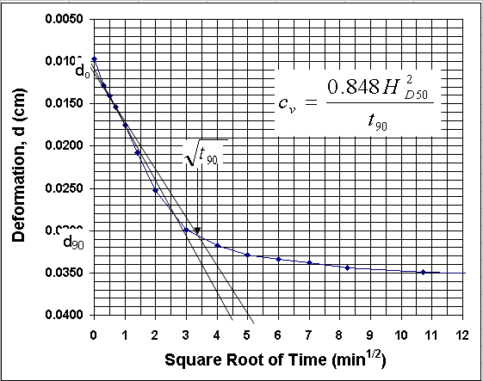
Square Root of Time Method

Slide 16
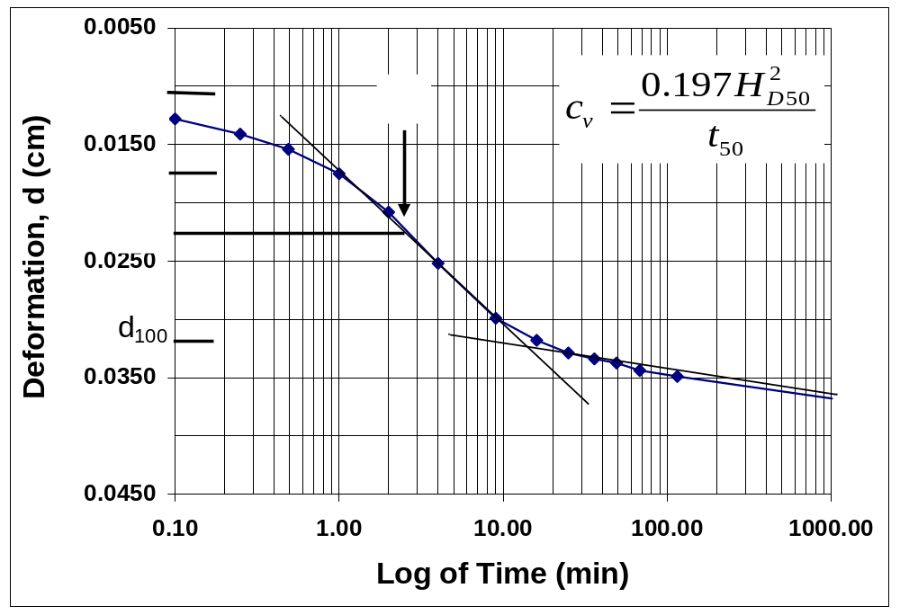
Log of Time Method

Slide 17
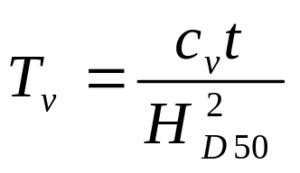
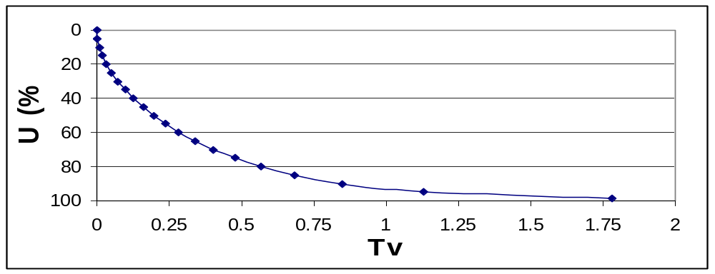
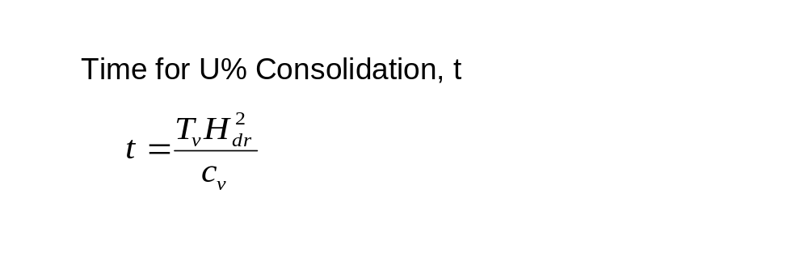
Consolidation Rate
  Dimensionless Time Factor, T
  Average Percent Consolidation, U

Slide 18
Consolidation Theory
  One assumption is that consolidation is one-dimensional.
  Therefore, consolidation settlement is computed assuming vertical strain.
  The solution for consolidation rate is derived assuming vertical pore
  water flow.

Slide 19
Total Head
  The energy potential for water is expressed in terms of total head, where total head is equal to the sum of the elevation head, h_{e}, and the pressure head, h_{p}.
  Flow occurs because of differences in total head.

Slide 20
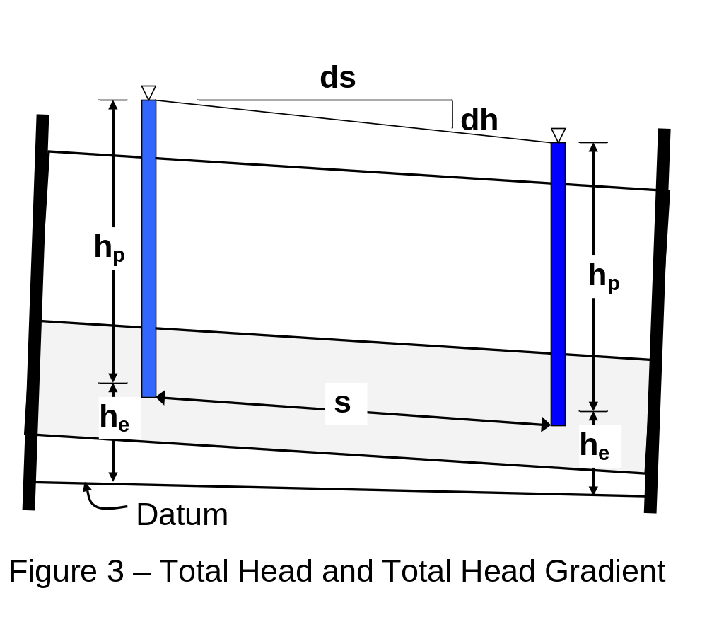
Total Head Illustrated

Slide 21
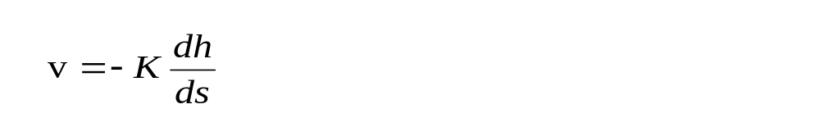
Darcy’s Law for Flow
  The flow law relating the discharge
  velocity, v, to the driving potential (total head or hydraulic gradient).
  where
  K (cm/sec) = permeability
  = total head gradient.

Slide 22
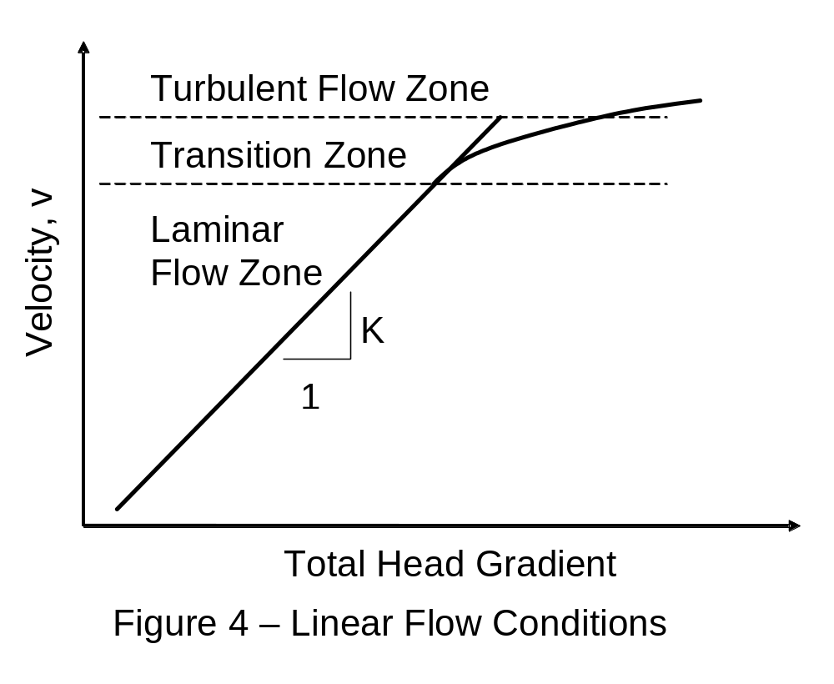
Validity of Darcy’s Law

Slide 23
Soil Shear Strength
  Soil shear strength is the maximum shear stress that a soil can withstand.
  Soil shear strength is determined using Mohr-Coulomb shear strength parameters.

Slide 24
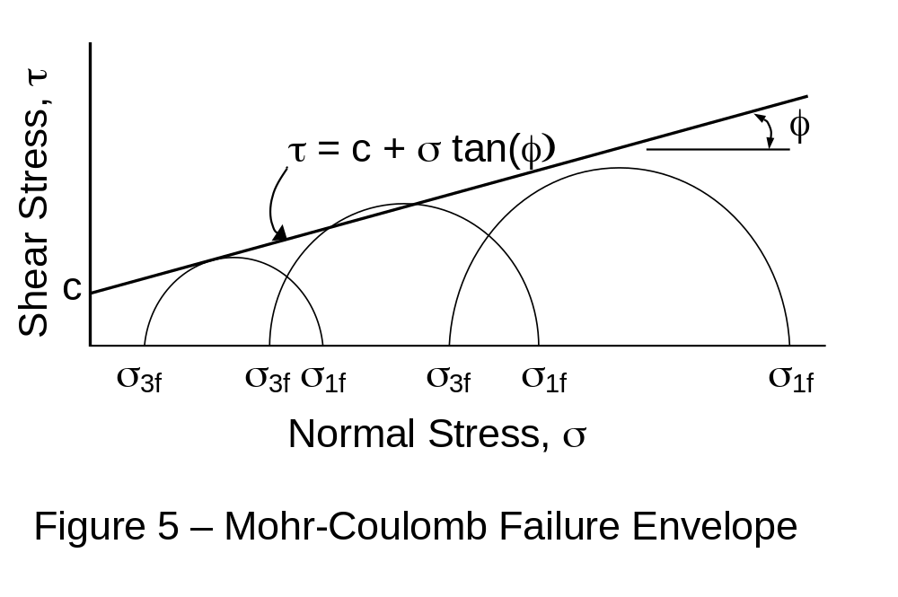
Mohr-Coulomb Failure Envelope

Slide 25
Failure Conditions
  Unconsolidated Undrained (UU or Q)
  – Failure that occurs rapidly during or shortly after construction.
  Consolidated Undrained (CU or R)
  – Failure that occurs rapidly after the soil has had time to consolidate.
  Consolidated Drained (CD or S)
  – Failure that occurs slowly after the soil has had time to consolidate.

Slide 26
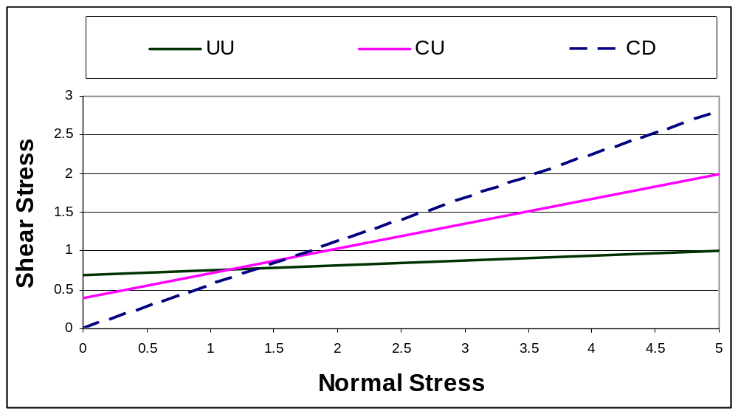
Comparison of Shear Strengths

Slide 27
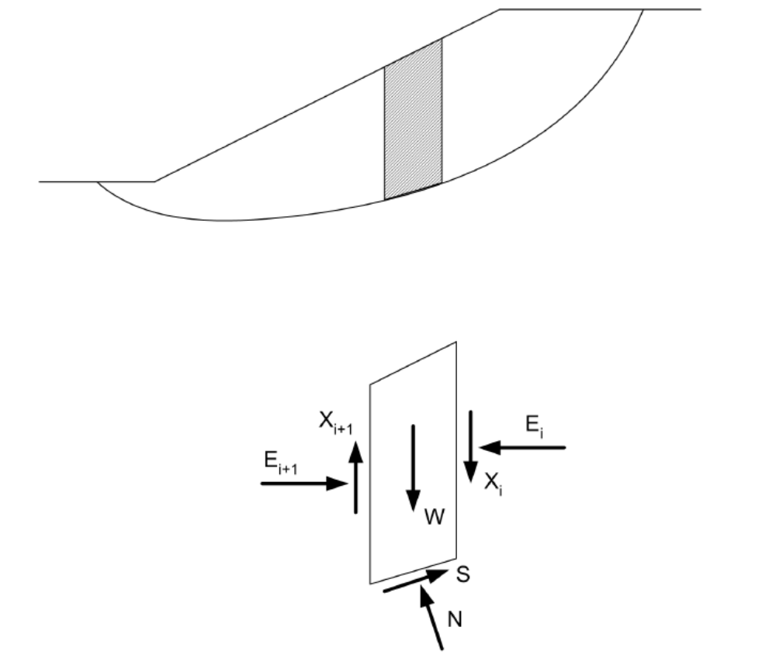
Slope Stability – Method of Slices

Slide 28
Slope Stability Analysis
  The many different analysis methods available differ by the assumptions that are made concerning the side forces and the equilibrium conditions that are used.
  Commercial software programs are capable of analyzing many trial surfaces under many different conditions.

Slide 29

Laboratory Testing

Slide 30
Consolidation Test
  A soil specimen placed in a rigid ring is inundated in water in order to saturate the soil.
  Incremental load test - the total stress is increased by doubling the applied loads and vertical deformations are measured over time for each load increment.
  Reference: ASTM 2435 - 90

Slide 31
Specimen Saturation
  It is difficult to verify that the test specimen is saturated.
  The time rate of consolidation is very sensitive to degree of saturation.
  Small seating pressures should be applied to the specimen during saturation to prevent swelling.

Slide 32
End of Primary Consolidation
  Test results are dependent on the load duration.
  Load increments should be held until primary consolidation is completed.
  It is difficult to verify by measuring
  pore water pressure that the time for primary consolidation is reached.

Slide 33
Load Duration
  Typically loads are applied for equal 24-hour periods and the load time behavior is evaluated to determine if primary consolidation is reached.
  If necessary, apply the loads in equal increments of mulitples of 24-hour periods.

Slide 34
Unload-Reload Cycles
  It may be difficult to estimate the maximum past consolidation pressure or the recompression index because of sample disturbance or if the soil is overconsolidated.
  An unload-reload cycle can be applied to the soil to improve the results.

Slide 35
Deformation-Time Behavior
  The coefficient of consolidation, c_{v}, is used to compute consolidation rate.
  C_{α} is used to compute the secondary consolidation settlement.
  For either calculation, it is necessary to select an appropriate stress range when selecting the coefficient.

Slide 36
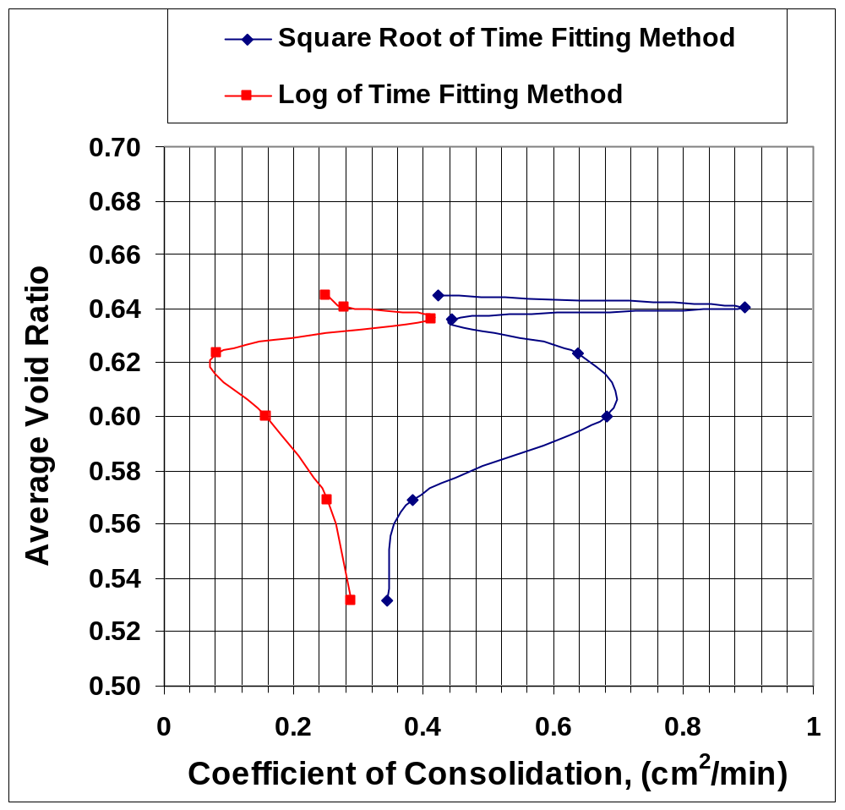
Coefficient of Consolidation

Slide 37
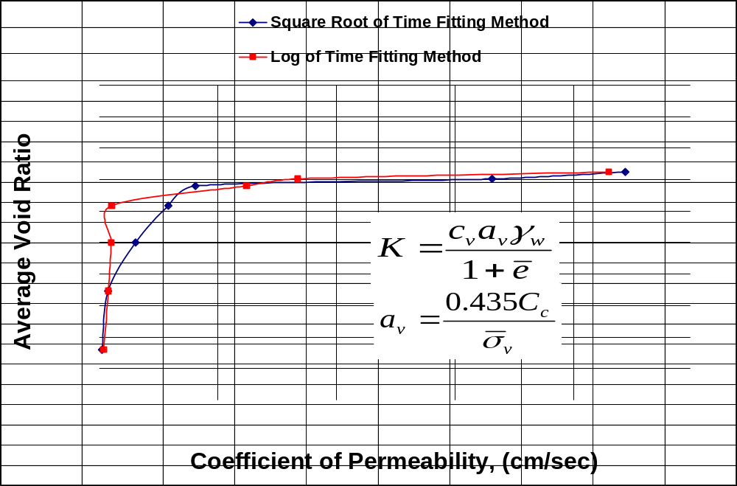
Coefficient of Permeability

Slide 38
Permeability Testing
  Falling head permeability tests are conducted on fine-grained soils using flexible wall permeameters.
  Triaxial compression cells are used instead of permeameters, in which the load piston is used to measure change in length of the test specimen.
  Reference: ASTM D 5084 - 90

Slide 39
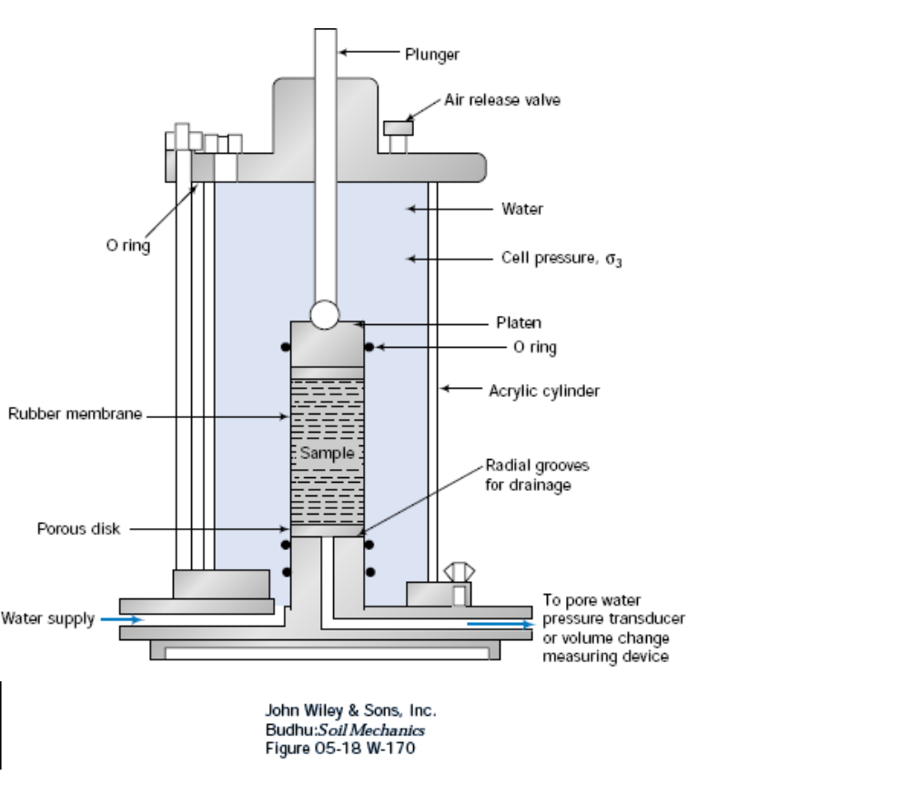
Triaxial Cell

Slide 40
Apparatus Capabilities
  Apply cell pressure to the cell fluid in order to apply total stress, σ₃.
  Apply pore water pressure (back pressure) to top and bottom of test specimen to saturate the specimen and to develop a total head gradient for permeability testing.

Slide 41
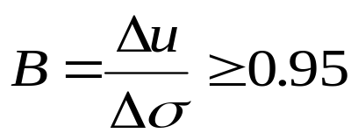
Back Pressure Saturation
  Increase cell pressure in small increments, Δσ, to specimen and measure the change in pore water, Δu.
  Soil is assumed close to saturation if
  Saturation can require several days for fine-grained soils.

Slide 42
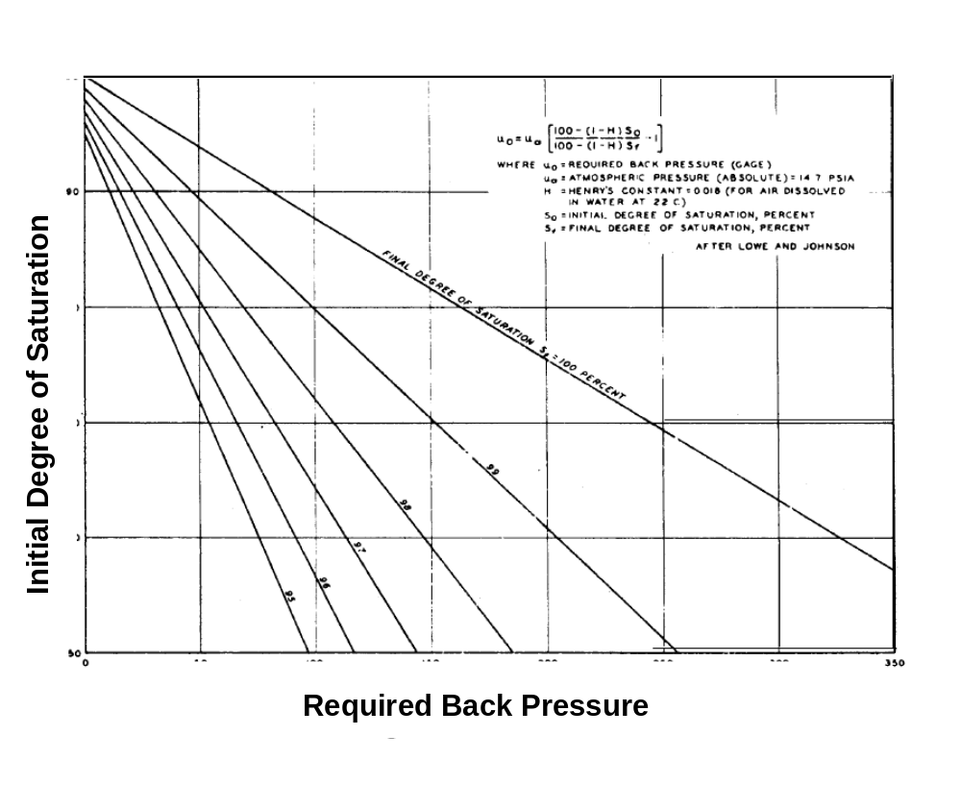
Required Back Pressure

Slide 43
¹Recommened Maximum H.G. To Prevent Soil Disturbance
  K (cm/s) Hydraulic Gradient
  1x10⁻³ to 1x10⁻⁴ 2
  1x10⁻⁴ to 1x10⁻⁵ 5
  1x10⁻⁵ to 1x10⁻⁶ 10
  1x10⁻⁶ to 1x10⁻⁷ 20
  Less than 1x10⁻⁷ 30
  ¹ASTM D 5084 - 90

Slide 44
Check for Validity of Darcy’s Law
  Measure permeability of soil at three hydraulic gradients.
  Values of permeability should be within about 25%.

Slide 45
Accuracy of Permeability Measurements
  Soil permeability is very sensitive to any disturbance or stress change that would affect the soil skeleton.
  Great care should be taken when obtaining undisturbed specimens and when preparing laboratory-compacted specimens.

Slide 46
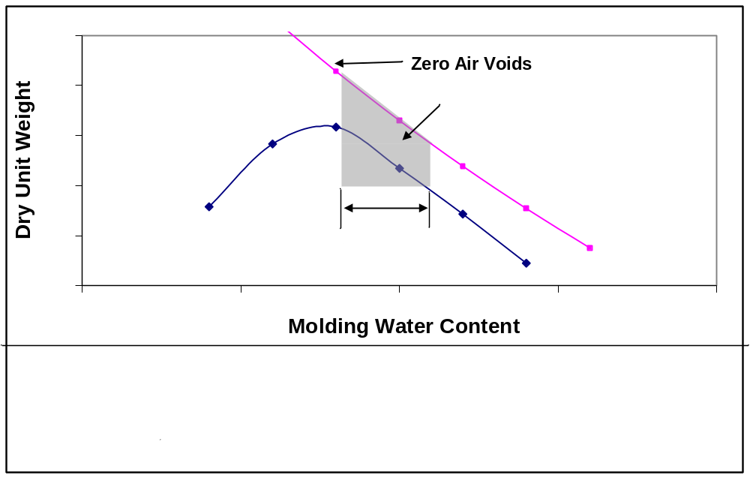
Acceptable Zone for Minimizing Permeability

Slide 47
Triaxial Compression Tests
  Back pressure saturation technique is used for consolidated tests.
  Effective consolidation pressure is equal to the cell pressure minus the applied back pressure.
  Load the specimens at prescribed rates for undrained and drained testing.

Slide 48
Unconsolidated Undrained Triaxial Compression
  Soil specimens are not back pressure saturated before testing.
  If test specimens are not saturated, then the compressive strength will depend on the cell pressure, i.e. φ ≠ 0.
  It is necessary to test representative samples at representative total stress.
  Reference: ASTM D 2850 - 87

Slide 49
Consolidated Undrained Triaxial Compression
  Soil specimens are back pressure saturated, consolidated to a predetermined effective stress and loaded to failure undrained.
  It is possible to determine both total stress and effective stress parameters by measuring pore water pressures.
  Reference: ASTM D 2850 - 87

Slide 50
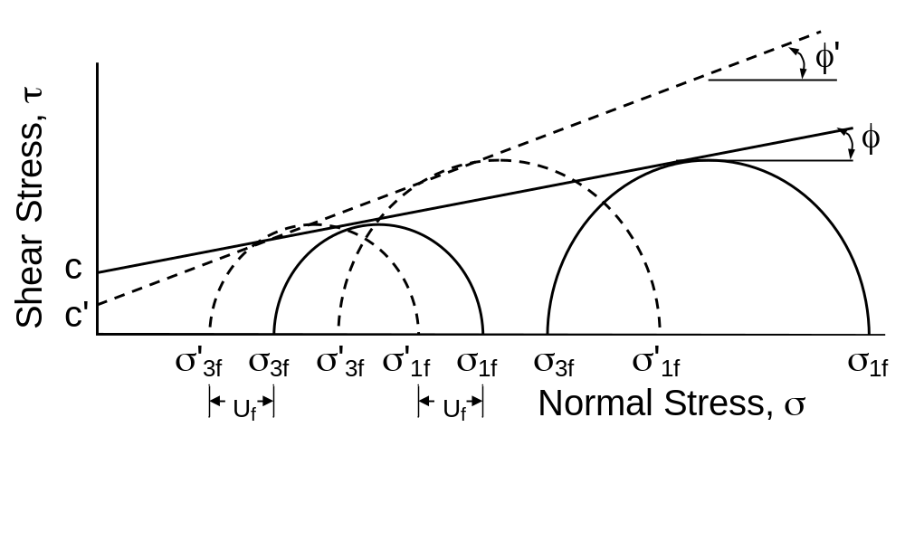
Total and Effective Stress Parameters (CU)

Slide 51
Comparison of Effective Stress Parameters
  The effective stress parameters obtained from the consolidated undrained and consolidated drained tests are not equal.
  It is assumed that c’ = 0 for the consolidated drained test.
  The consolidated undrained test can be loaded to failure in less time.

Slide 52
Other Shear Tests
  Shear strength parameters can be determined from direct shear tests or torsional ring shear tests.
  It is difficult to control drainage conditions with the direct shear apparatus.
  Torsional ring shear tests are not performed very often.

Slide 53


Geotechnical Analysis

Slide 54
Consolidation Settlement
  Primary and secondary consolidation settlement is computed assuming one- dimensional strain.
  The stress increases under landfills are high.
  Foundation soils that are suitable because of low permeability may undergo large settlements making it difficult to accurately predict differential settlements.

Slide 55
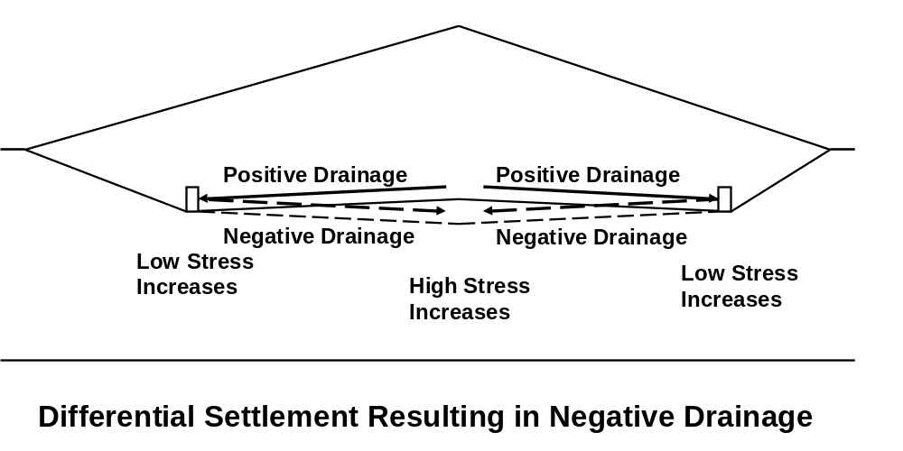
Differential Settlement

Slide 56
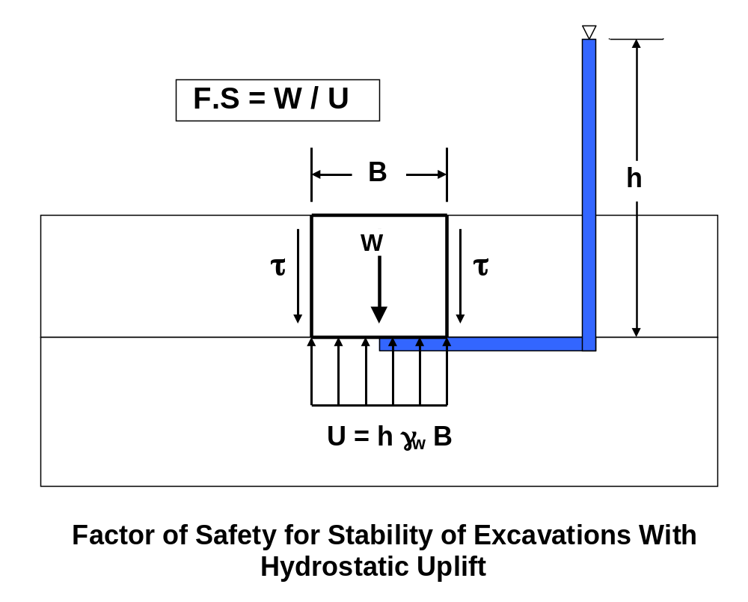
Stability of Excavations with Hydrostatic Uplift

Slide 57
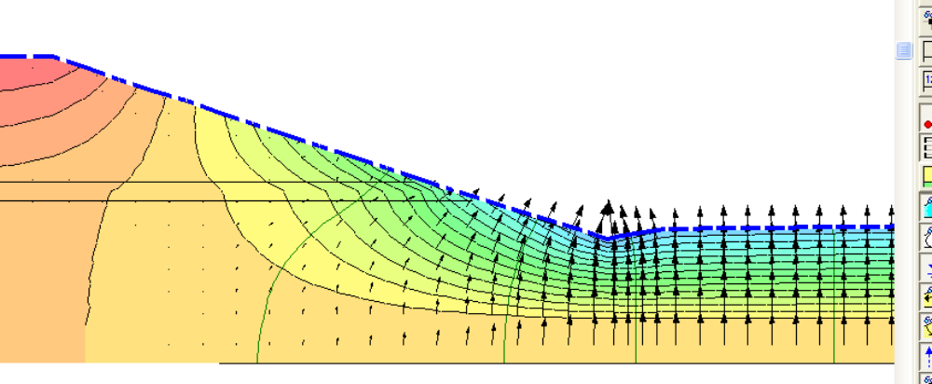
Flow into an Excavation
Velocity Vectors Showing Flow into an Excavation

Slide 58
Hydraulic Gradients
  For sites with artesian pressure, high hydraulic gradients develop which will result in high seepage velocities if the depth of excavation is large.
  Soil erosion occurs if the hydraulic gradients are high enough.
  Generally the hydraulic gradient should be less than 1.

Slide 59
Flow Through Liner Systems
Advection – Movement of leachate
caused by hydraulic gradients.
Diffusion – Movement of leachate
caused by concentration gradients.
For low permeability liner systems,
movement of leachate is governed
by diffusion.

Slide 60
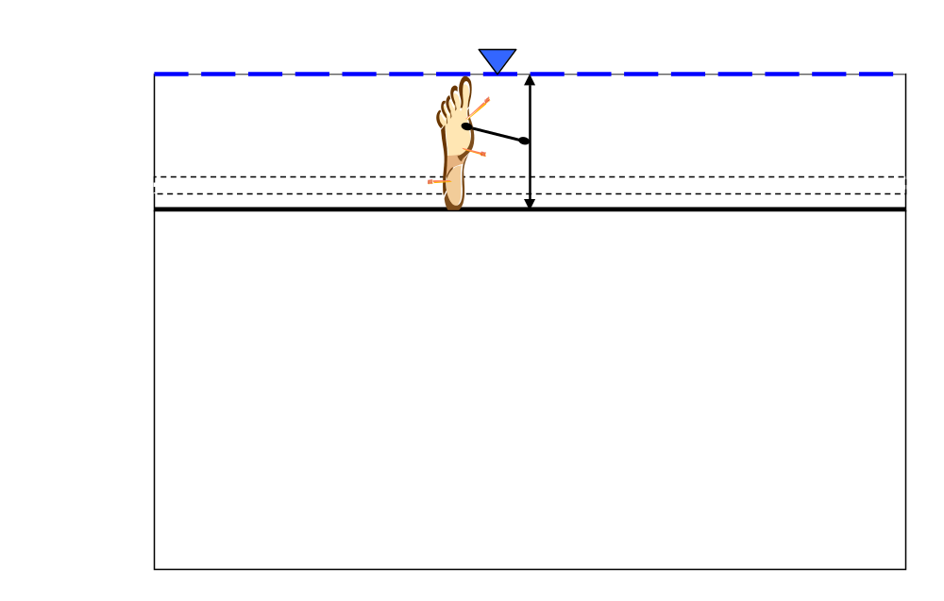
“One Foot of Head of Leachate”

Slide 61
Stability Analysis for Drained Conditions
  Effective stress parameters are used to analyze slopes for long term stability.
  Effective stress parameters obtained from consolidated undrained triaxial compression tests with pore water pressure measurements are used for drained conditions.

Slide 62
Stability Analysis for Construction Conditions
  Total stress parameters are used to analyze slopes for conditions with excess pore water pressure at the onset of loading or unloading.
  Total stress parameters are obtained from unconsolidated undrained triaxial compression tests.

Slide 63
Analysis for Unsaturated Soils
  Stability analysis for shallow failure mechanisms for unsaturated conditions.
  Allow for additional soil shear strength using a shear strength parameter that accounts for the increase of shear strength due to soil matric suction.

Slide 64
Stability Analysis for Earthquake Conditions
  Slopes are analyzed for earthquakes using quasi-seismic analysis.
  Slopes are analyzed for drained and undrained conditons.
  Failures occuring during earthquakes experience undrained failures?

Slide 65
Limitations of Stability Analysis
  Slopes with adequate factors of safety should be safe from large mass movements.
  The analyses, however, do not preclude against deformations within masses or along interfaces.
  Generally, there is less deformation if the factors of safety are higher.

Slide 66
Closure
  Fundamental Soil Mechanics
  concepts were presented.
  Details of soil testing were discussed.
  Various aspects of Geotechnical
  analysis for waste management
  facilities were discussed.

Slide 67

  Thanks for Coming.
  I hope that you enjoy your visit to the University of Toledo
  You are all invited to our Banyas Soil Mechanics Laboratory in NI 1024 for some light refreshments.

