Slide 1
Shear Strength of Soil
τ_{f} = c + σ’ tan φ
τ_{f} = shear strength
c = cohesion
φ = angle of internal friction
σ₁ major principle stress
σ_{n}
σ₃
τ_{f}
σ₃
Minor principle stress
Confining stress
σ₁

Slide 2
Shear Strength of Soil
Consider the following situation:
A normal stress is applied vertically and held constant
A shear stress is then applied until failure
Normal stress σ_{n}
Shear stress σ₃
σ₃
σ₁

Slide 3
Shear Strength of Soil
For any given normal stress, there will be one value of shear stress
If the normal stress is increased, the shear stress will typically increase in sands and stay the same in clays
Normal stress σ_{n}
Shear stress σ₃
σ₃
σ₁

Slide 4
Direct Shear Test
Common lab test in practice
Sample placed in the direct shear device
The base is locked down
Constant normal stress applied
Shear stress increased until failure
Normal stress σ_{n}
Shear stress σ₃
Soil

Slide 5
Direct Shear Test
Plotting 2 or more points provides the following
Shear
stress
φ
c
normal stress

Slide 6
Direct Shear Test
Direct shear test is Quick and Inexpensive
Shortcoming is that it fails the soil on a designated plane which may not be the weakest one

Slide 7
Direct Shear Test
In practice, may run several direct shear tests
Place all the data on one plot
What might you do then to determine c and φ?
Shear
stress
c
normal stress

Slide 8
Direct Shear Test
Typical plot for sands - Drained Condition
Shear
stress
φ
c = 0
normal stress

Slide 9
Direct Shear Test
Typical plot for clays - drained condition
Shear
stress
Overconsolidated
OCR >1
normallyconsolidated
OCR=1
c
φ
normal stress

Slide 10
Residual Shear Strength
The discussion thus far have referenced failure of the soil.
Failure is indicated by excessive strain with little to no increase (even decrease) in stress.
After failure, the soil strength does not go to 0
The soil retains residual strength
Peak Strength
Shear
stress
Residual Strength
Shear displacement

Slide 11
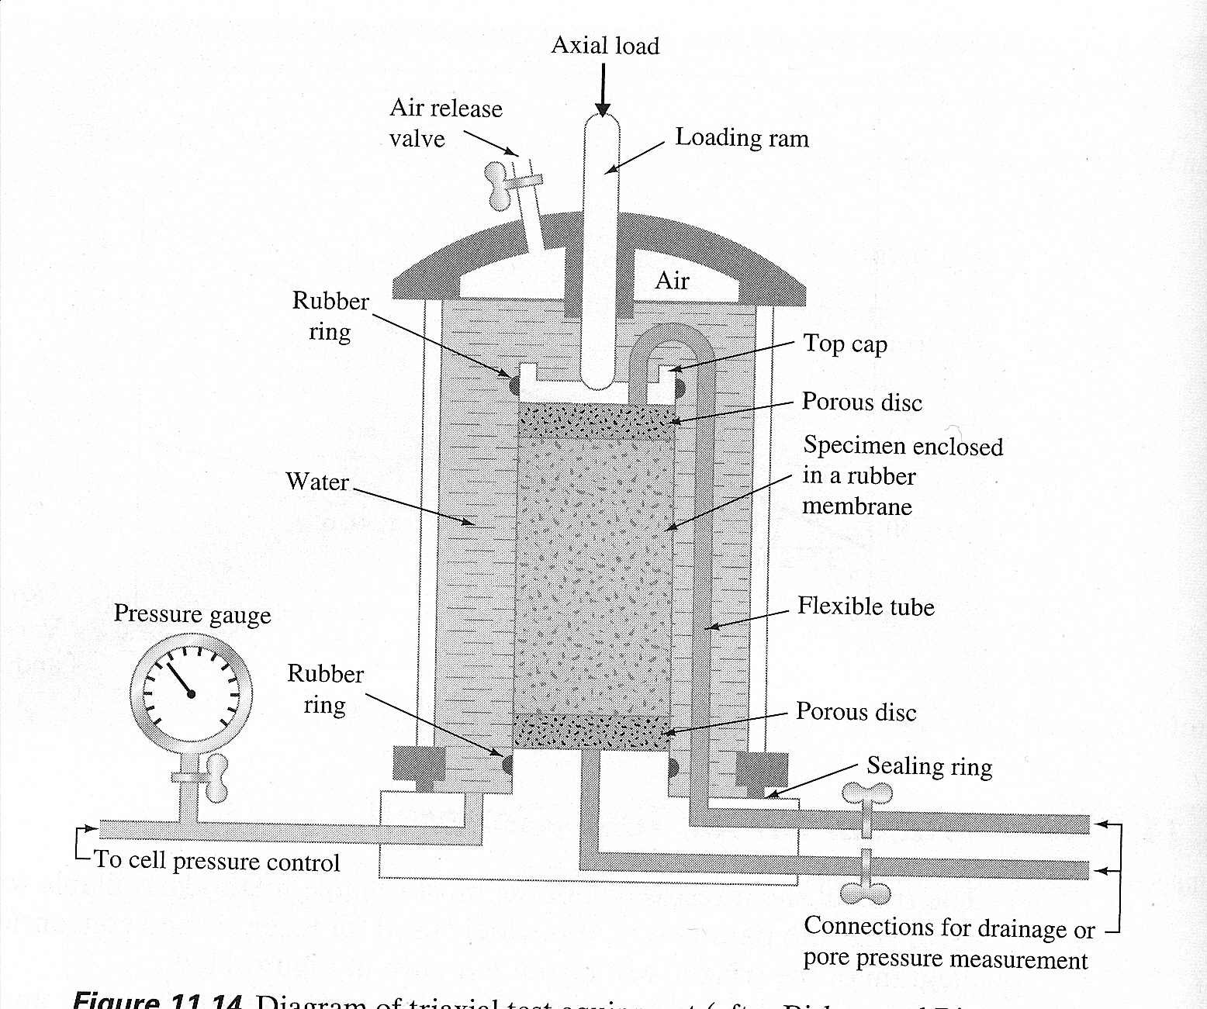
Triaxial Shear Test

Slide 12
Triaxial Shear Test
The test is designed to as closely as possible mimic actual field or “in situ” conditions of the soil.
Triaxial tests are run by:
  saturating the soil
  applying the confining stress (called σ₃)
  Then applying the vertical stress (sometimes called the deviator stress) until failure
3 main types of triaxial tests:
  Consolidated – Drained
  Consolidated – Undrained
  Unconsolidated - Undrained

Slide 13
Consolidated – Drained Triaxial Test
The specimen is saturated
Confining stress (σ₃) is applied
  This squeezes the sample causing volume decrease
  Drain lines kept open and must wait for full consolidation (u = 0) to continue with test
Once full consolidation is achieved, normal stress applied to failure with drain lines still open
  Normal stress applied very slowly allowing full drainage and full consolidation of sample during test (u = 0)
Test can be run with varying values of σ₃ to create a Mohrs circle and to obtain a plot showing c and φ
Test can also be run such that σ₃ is applied allowing full consolidation, then decreased (likely allowing some swelling) then the normal stress applied to failure simluating overconsolidated soil.

Slide 14
Consolidated – Drained Triaxial Test
In the CD test, the total and effective stress is the same since u is maintained at 0 by allowing drainage
This means you are testing the soil in effective stress conditions
Applicable in conditions where the soil will fail under a long term constant load where the soil is allowed to drain (long term slope stability)

Slide 15
Consolidated – Undrained Triaxial Test
The specimen is saturated
Confining stress (σ₃) is applied
  This squeezes the sample causing volume decrease
  Again, must wait for full consolidation (u = 0)
Once full consolidation is achieved, drain lines are closed (no drainage for the rest of the test), and normal stress applied to failure
  Normal stress can be applied faster since no drainage is necessary (u not equal to 0)
Test can be run with varying values of σ₃ to create a Mohrs circle and to obtain a plot showing c and φ
Applicable in situations where failure may occur suddenly such as a rapid drawdown in a dam or levee

Slide 16
Unconsolidated – Undrained Test
The specimen is saturated
Confining stress (σ₃) is applied without drainage or consolidation (drains closed the entire time)
Normal stress then increased to failure without allowing drainage or consolidation
This test can be run quicker than the other 2 tests since no consolidation or drainage is needed. Test can be run with varying values of σ₃ to create a Mohrs circle and to obtain a plot showing c and φ
Applicable in most practical situations – foundations for example.
This test commonly shows a φ = 0 condition

Slide 17
Shear Strength of Soil
Typical UU plot for clays
Shear
stress
c
normal stress

Slide 18
Unconfined Compression Test
The specimen is not placed in the cell
Specimen is open to air with a σ₃ of 0
Test is similar to concrete compression test, except with soil (cohesive – why?)
Applicable in most practical situations – foundations for example.
Drawing Mohrs circle with σ₃ at 0 and the failure (normal) stress σ₃ defining the 2nd point of the circle – often called q_{u} in this special case
c becomes ½ of the failure stress

Slide 19
The Real World
Triaxial tests rarely run
The unconfined test is very common
In most cases, clays considered φ = 0 and c is used as the strength
Sands are considered c = 0 and φ is the strength parameter
Direct shear test gives us good enough data for sand / clay mixes (soils with both c and φ)
Tables showing N value vs strength very commonly used (page 567 for clays for example).

Slide 20
Suggested Problems
11.4
11.5
11.7
11.15

