Slide 1


Centre for Development of Advanced Computing
Project : UpSkill
Address:
C-56/1, Anusandhan Bhawan, Institutional Area, Sector 62, Noida, Uttar Pradesh 201307

Slide 2
UpSkill
Team Member :
Bhushan Kawale
Harshwardhan Kadam
Indrasen Gupta
Shreyash Jadhav
Centre Coordinator :
Mr. Ravi Payal

Slide 3
Objective:
The project is a web-based application where teacher can set online video courses and test related to that courses and student can enroll in that courses by giving very nominal fees.
An online course is any web-based class that can be viewed on a computer, tablet or mobile device.
Exams help every students to understand their mental capacity, preparation level and to rectify their shortcomings.

Slide 4



Technology :
Front end
React
Back end
Spring boot
Database
MySQL
Build Tool
Maven

Slide 5
Module present :
Admin | Lecturer | Student | Other
Remove Lecturer | Add Course | Enrolled-Courses | Home
Delete course | Add Test | Available-Test | Login/Register
Logout | Add video | Give Test | Contact Us
 |  | Review & Feedback | About Us

Slide 6
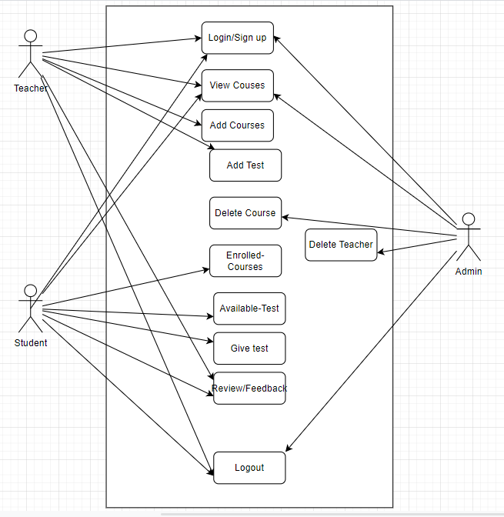
Use Case
Diagram :

Slide 7
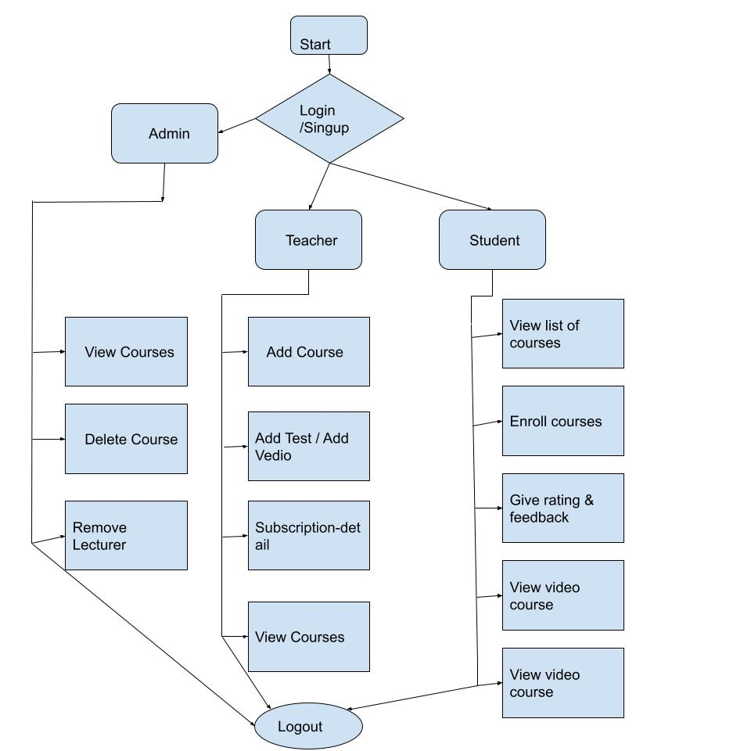
Activity Diagram

Slide 8
Database Tables :
Admin
Course content
Enrollment
Lecturer
Question bank
Rating
Review
Student
Videos

Slide 9
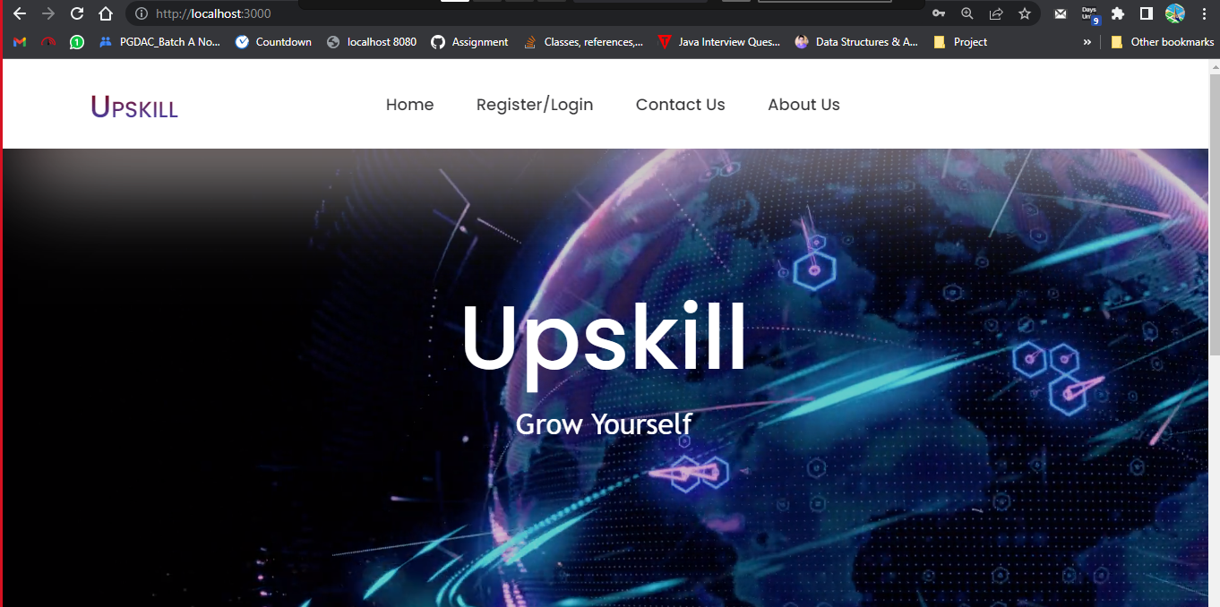

Slide 10
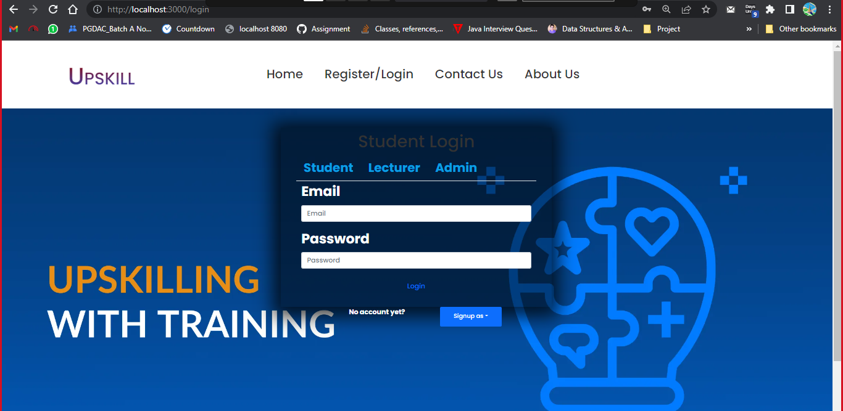

Slide 11
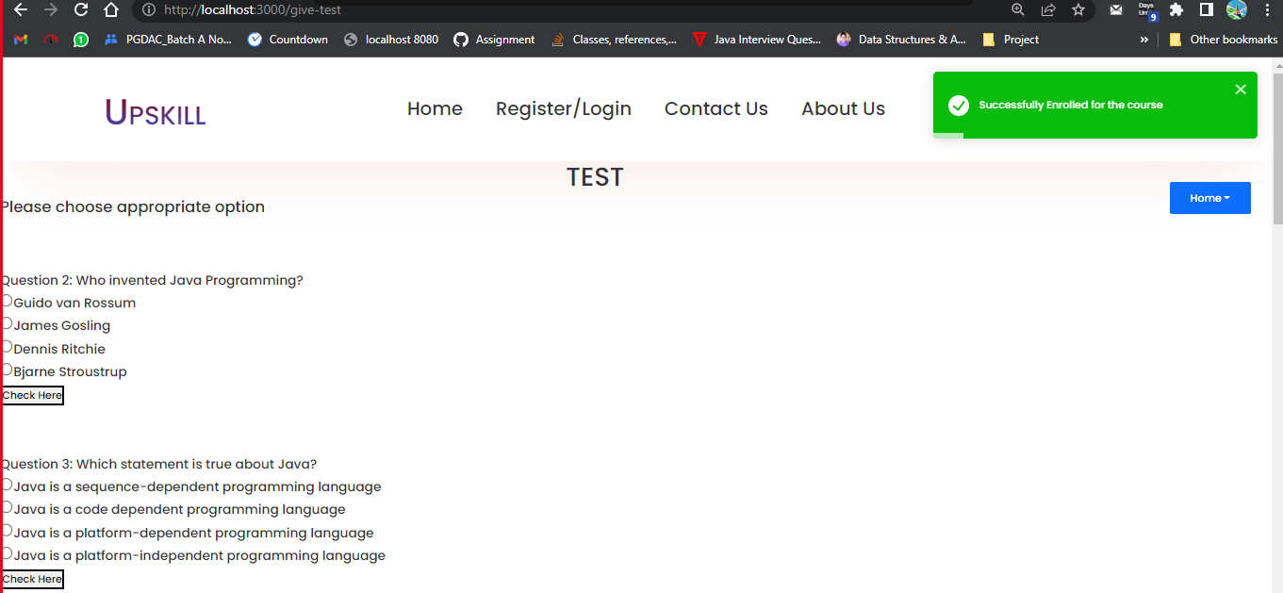

Slide 12
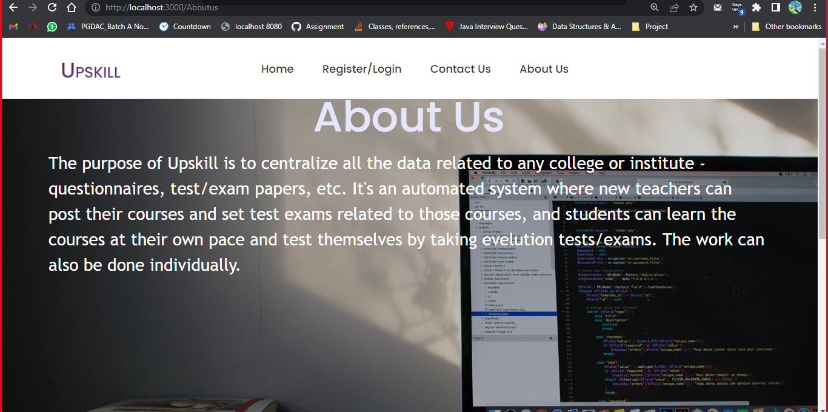

Slide 13
Thank you !

