Slide 1
Data Transmission Using Multi-Tasking-Sockets

Slide 2
Introduction
This article is about a client/server multi-threaded socket class. The thread is optional since the developer is still responsible to decide if needs it. There are other Socket classes here and other places over the Internet but none of them can provide feedback (event detection) to your application like this one does. It provides you with the following events detection: connection established, connection dropped, connection failed and data reception (including 0 byte packet).

Slide 3
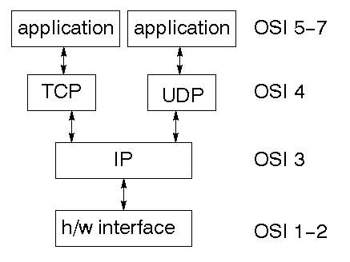
Data Flow Diagram
The TCP/IP stack is shorter than the OSI one:

Slide 4
Module Design Specification
part 1 - Create a server socket that listen for a client to connect
part 2 - send / receive data from client to server
part 3 - Read unknow size of data from client

Slide 5
TCP
TCP supplies logic to give a reliable connection-oriented protocol above IP. It provides a virtual circuit that two processes can use to communicate.
Internet addresses
In order to use a service, you must be able to find it. The Internet uses an address scheme for machines so that they can be located. The address is a 32 bit integer which gives the IP address. This encodes a network ID and more addressing. The network ID falls into various classes according to the size of the network address.

Slide 6
Network address
Class A uses 8 bits for the network address with 24 bits left over for other addressing. Class B uses 16 bit network addressing. Class C uses 24 bit network addressing and class D uses all 32.
Subnet address
Internally, the UNIX network is divided into sub networks. Building 11 is currently on one sub network and uses 10-bit addressing, allowing 1024 different hosts.

Slide 7
Host address
8 bits are finally used for host addresses within our subnet. This places a limit of 256 machines that can be on the subnet.
Total address
The 32 bit address is usually written as 4 integers separated by dots.

Slide 8
THANK YOU !

