Slide 1


Woman Safety
S.N. PATEL INSTITUTE OF TECHNOLOGY AND RESEARCH CENTRE
DESIGN ENGINEERING – 2 (b)
3160001
B.E. SEMESTER – Vi
COMPUTER SCIENCE AND ENGINEERING
Head of the dept. Project guide
BHAVESH PATEL PROF. ritesh k chauhan
Presentation by team Survivors

Slide 2
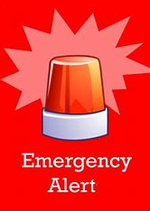
Reporting Group Id: 778483
Sr. No. | Name | PEN No.
01 | Sahil Kayasth | 220490131026
02 | Harsh Galiyawala | 220490131014
03 | Rishabh Nagarkoti | 220490131043
04 | Sahil Patel | 220490131064

Slide 3
Outline: -
Ideation canvas
Product Development Canvas
Design calculations
Implementation
Conclusion / FUTURE WORK
References
Abstract
Introduction
AEIOU Canvas
Mind Mapping canvas
Emphathy canvas

Slide 4

ABSTRACT: In response to the growing need for efficient woman safety process, a group of college students developed a g mobile application aimed at enhancing safety and communication during danger towards women. This application serves as a platform designed to provide PROPER assistance and coordination for harassment towards woman.
0 2
WOMAN SAFETY
2 0 2 5

Slide 5
Introduction
Why is this App required ?
Women's safety is a pressing concern in today's society. With increasing reports of harassment and violence, there is a growing need for effective solutions that ensure the safety and security of women in their daily lives.
This presentation introduces a Women's Safety App — a smart, reliable, and accessible tool designed to provide immediate help, share real-time location, and connect users with trusted contacts and emergency services when needed.
Our aim is to use technology to empower women and create a safer environment for all.
0 3
WOMAN SAFETY
2 0 2 5

Slide 6
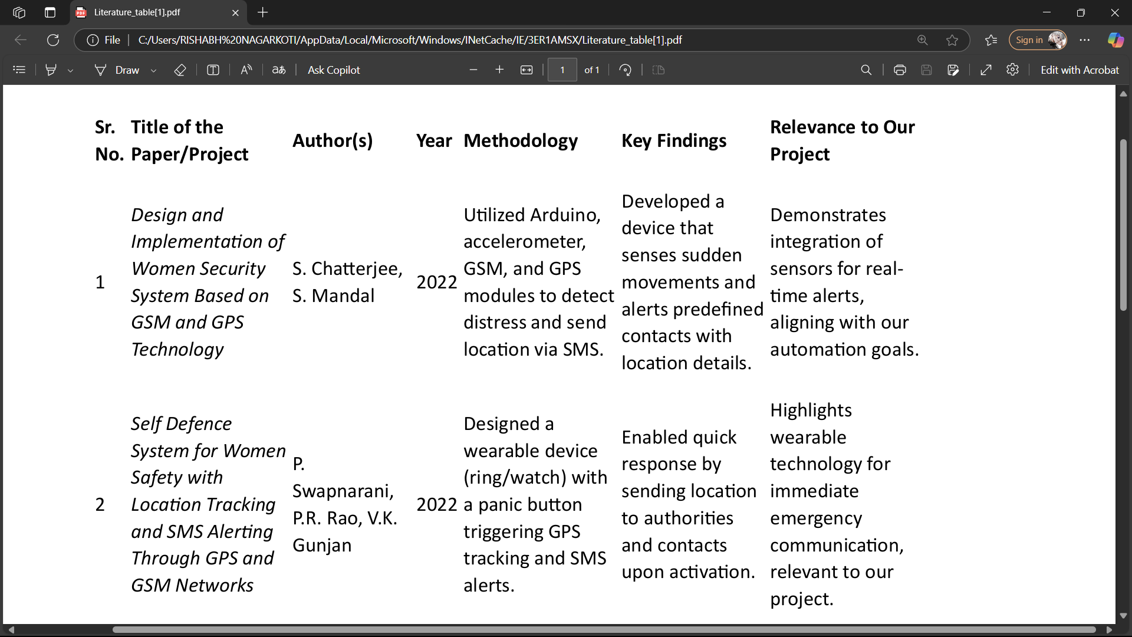
Literature survey

Slide 7
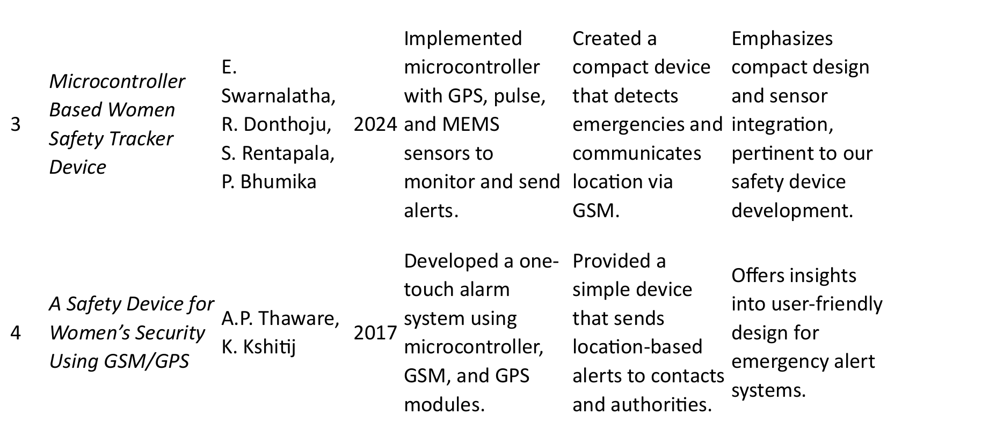
Literature survey Conti…

Slide 8
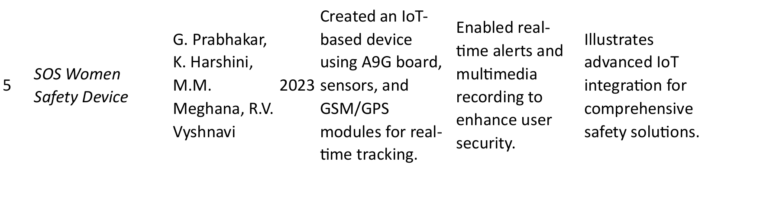
Literature survey conti…

Slide 9
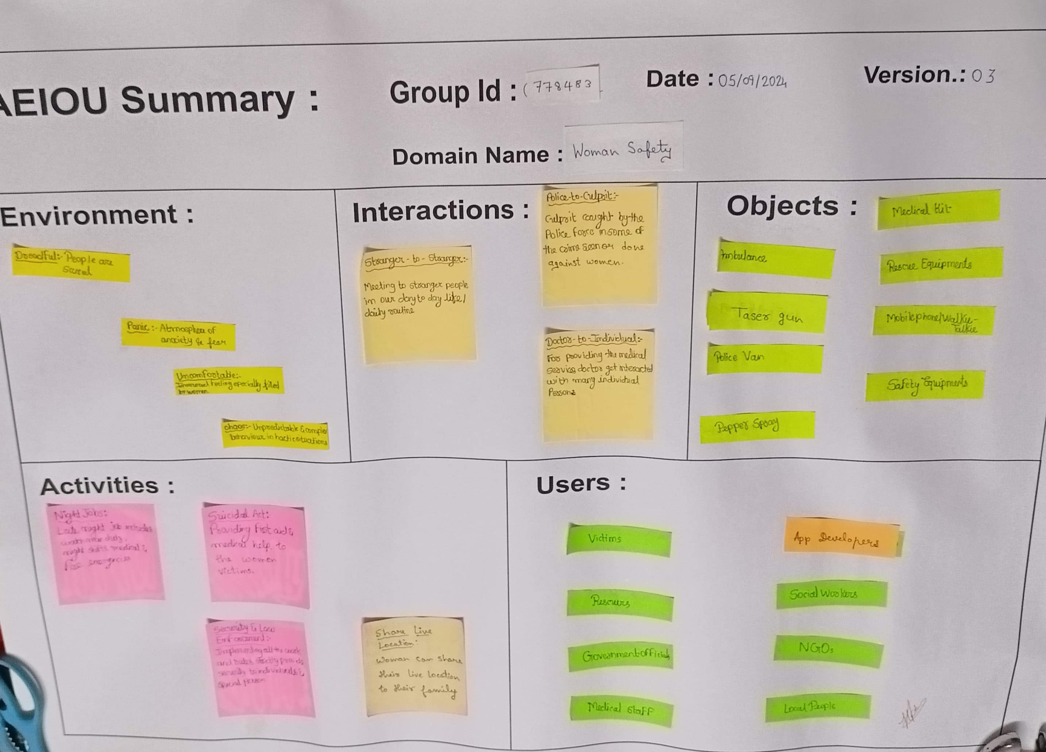
AEIOU CANVASES
Activities
Environment
Interactions
Objects
Users
Emergency

Slide 10
AEIOU CANVAS (continue..)
Activities:
Patrolling by police
Assistance services 24 x 7
Night Jobs
Rescue operations
NGO activity
Environemnt:
Natural environments
Built Environments
Hostile Environments
Remote Environments
Interactions:
Verbal Interactions
Non- verbal Interactions
Technological Interactions
Informational Interactions
Objects:
Safety Equipments
Self Defense Equipments
First Aid
Rescue Equipments
Moblie / walkie-talkie
Users:
Civilians
Authorities
Government officials
Family/ Friends/ Relatives

Slide 11
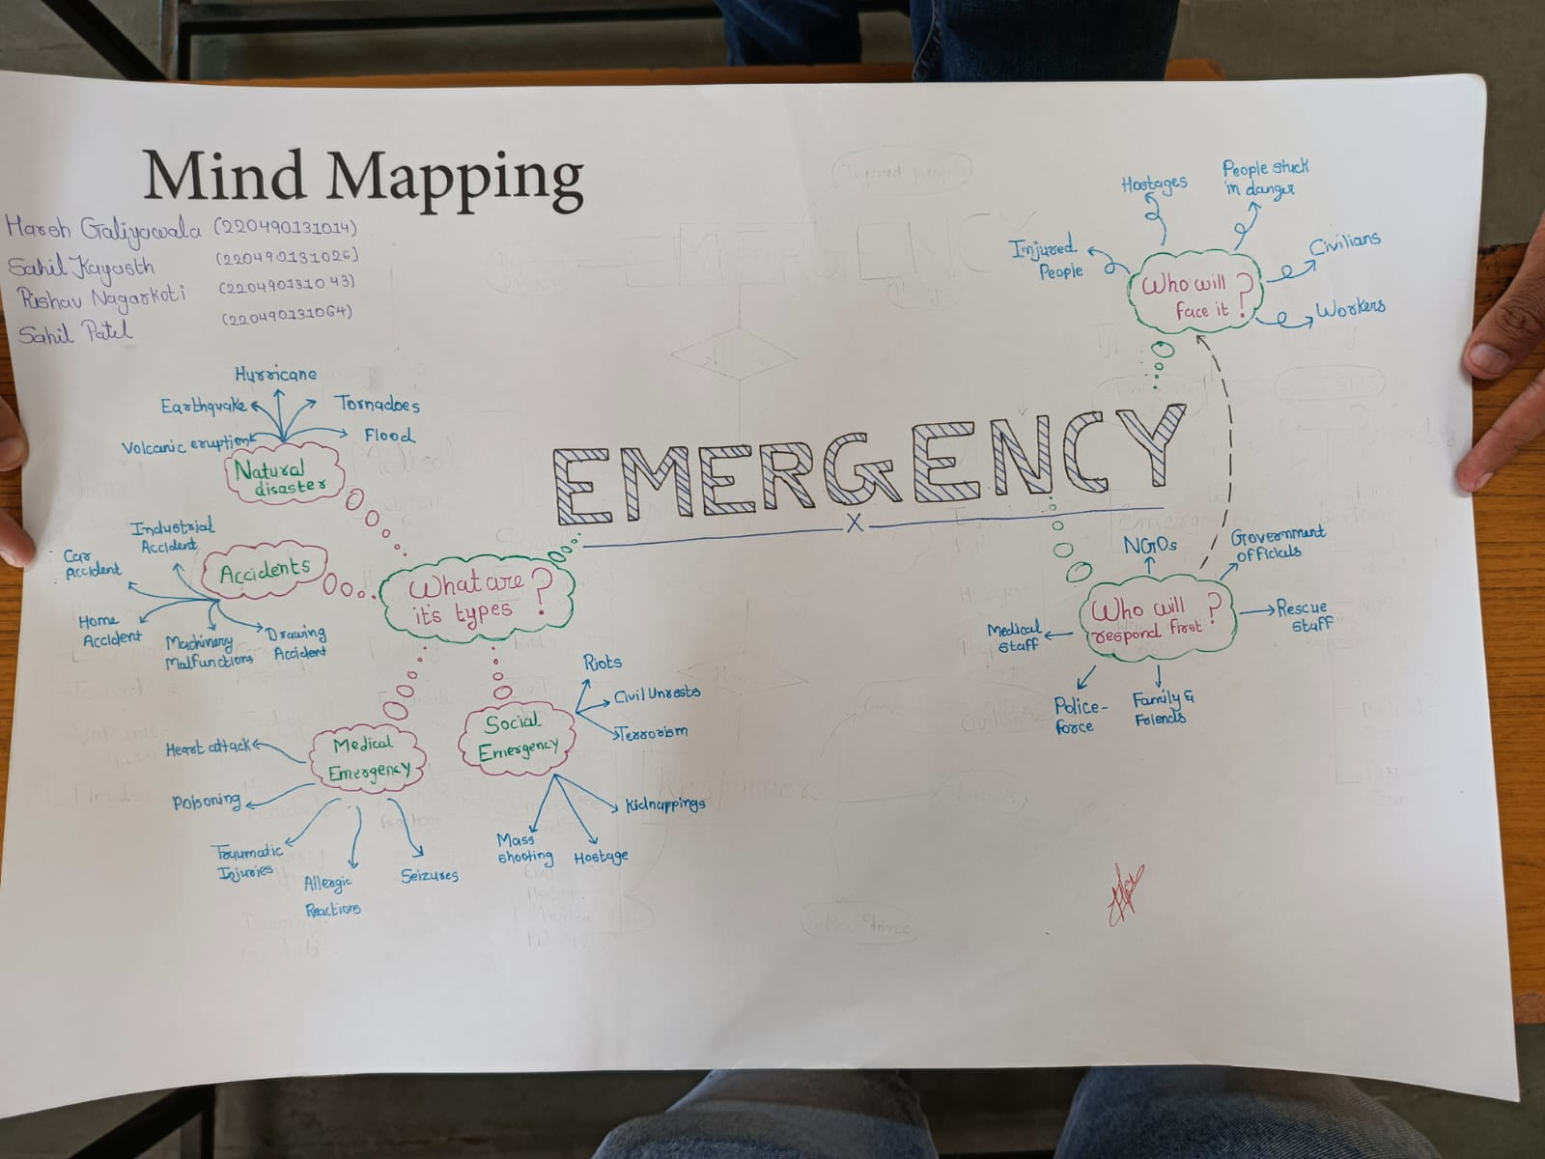
Mind Mapping
EMERGENCY:
What are its types ?
Accidents
app malfunctions
Social emergencies
Who will face it ?
Injured people
Hostages
People in danger
Civilians
Workers
Who will respond it ?
NGOs
Government officials
Medical staff
Family and friends
Police force
Mind mapping canvas help user to visually organize information by creating mind map.

Slide 12
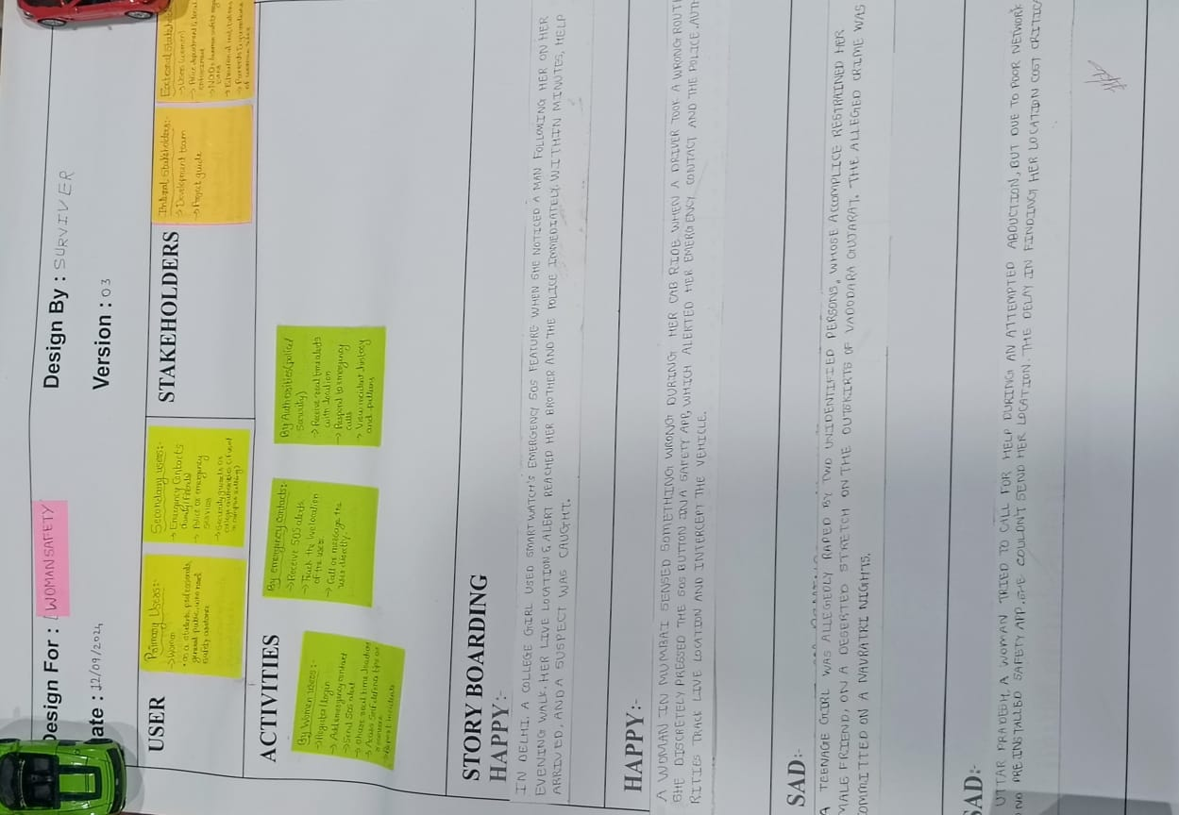
Emphathy canvas
users
Stake holders
Civilians
Authorities
Government officials
Family/ Friends/ Relatives
Primary stakeholders:
Affected individuals & communities.
Assistance Responders
Local authorities
Emergency management agencies
2
4
activity
Secondary stakeholders:
Family members
Media outlets
Community organizations
Volunteer groups
Night Jobs
Rescue operations
NGO activity
1
A visual tool that helps team to understand user’s behaviour & attitudes and develop emphathy for them
3
5

Slide 13


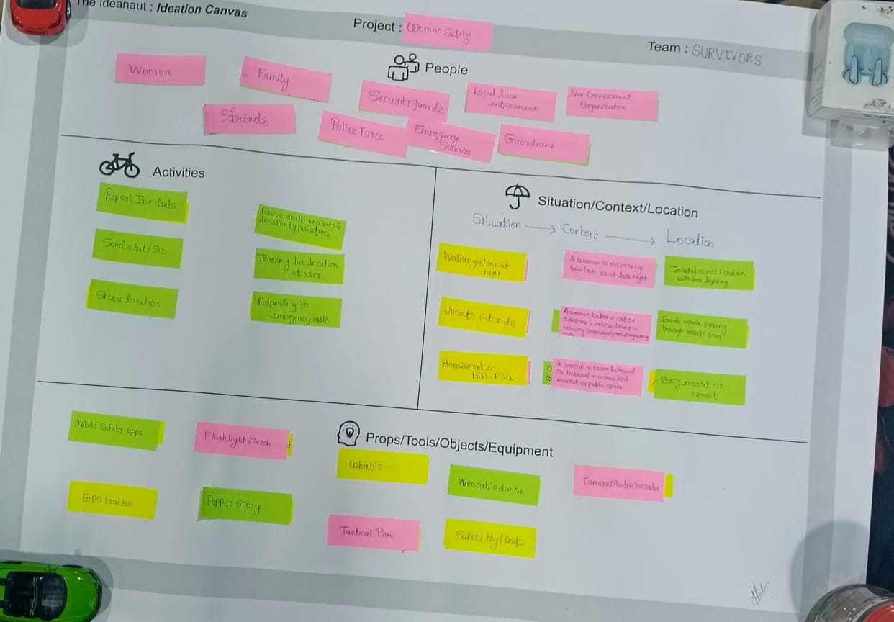


IDEATION CANVAS
Situation
Context
Location
Following a woman
A stalker follows woman
On a street.
Misbehave with a woman
Group of men harassing a woman
Outside of woman’s workplace
Cyber harassment
A guy harassing a woman online
On a social media platform
An ideation canvas is tool that help users generate ideas by organizing concepts in a systematic way.

Slide 14
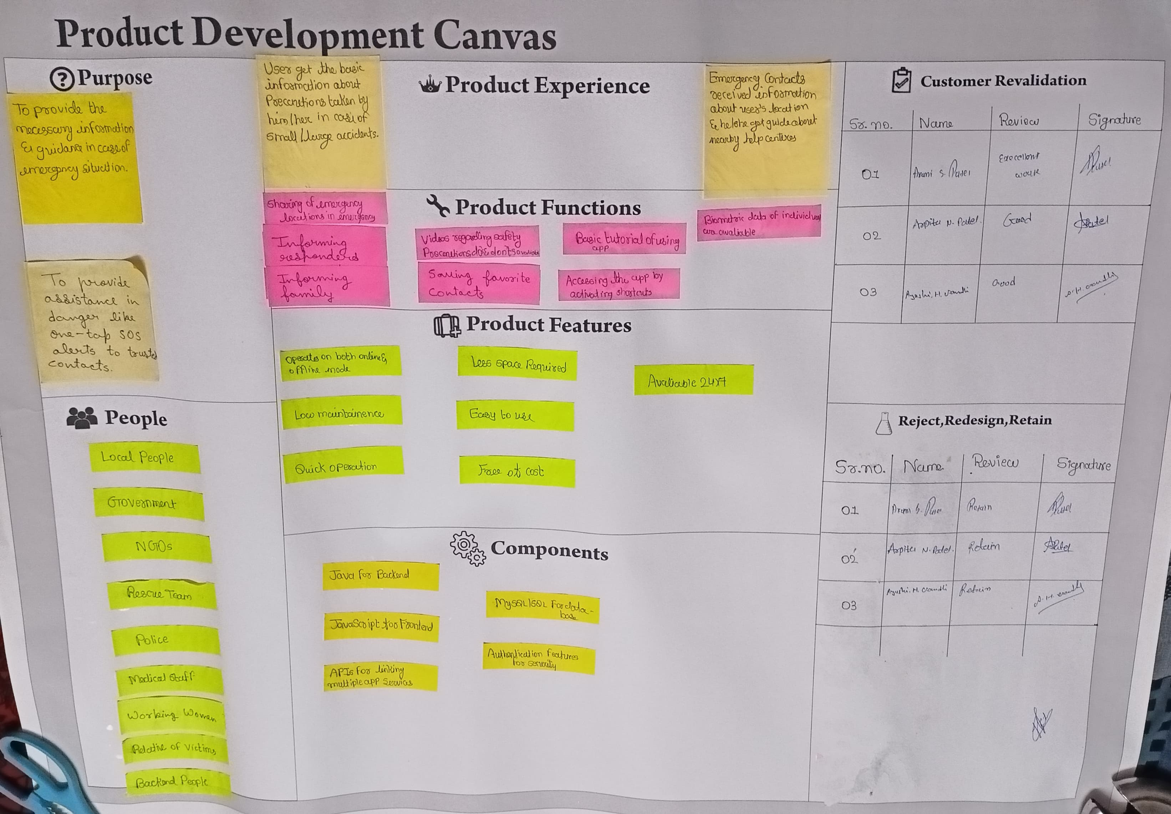
Product development canvas
Purpose:
➢ To provide the necessary information & guidance in any case of emergency involved.
➢ To share the live location of the woman to her family.
Product experience:
➢ User gets the basic information about their close ones in case of small accidents.
➢ Emergency location was shared to all contacts mentioned in it & basic first aid & near by help centre's information is provided.
A product development canvas is a planning tool that helps team to develop product with great user experience.

Slide 15
PRODUCT DEVELOPMENT CANVAS (CONTINUE.)
Product Functions:
➢ Sharing of information in emergency ( location, etc)
➢ Accessing information about their close ones.
➢ Option for saving favorite contacts.
➢ Accessing the app by dialing specific number on dial pad.
➢ Bio data of individuals are avaliable on it.
A product development canvas is a planning tool that helps team to develop product with great user experience.

Slide 16
PRODUCT DEVELOPMENT CANVAS (CONTINUE.)
Product features:
➢ Operations on both online & offline
➢ Low Maintenance
➢ Quick operations
➢ Less Space required
➢ Userfriendly interface
➢ Easy to use
➢ Avaliable 24 * 7
➢ Free of cost
A product development canvas is a planning tool that helps team to develop product with great user experience.

Slide 17
PRODUCT DEVELOPMENT CANVAS (CONTINUE.)
Components:
➢ Android Studio (platform)
➢ Cotlin
➢ APIs for linking multiple app services
➢ Firebase for database
➢ Authentication features for security
A product development canvas is a planning tool that helps team to develop product with great user experience.

Slide 18
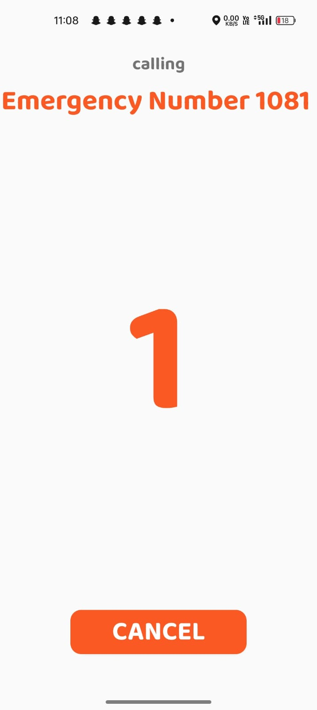
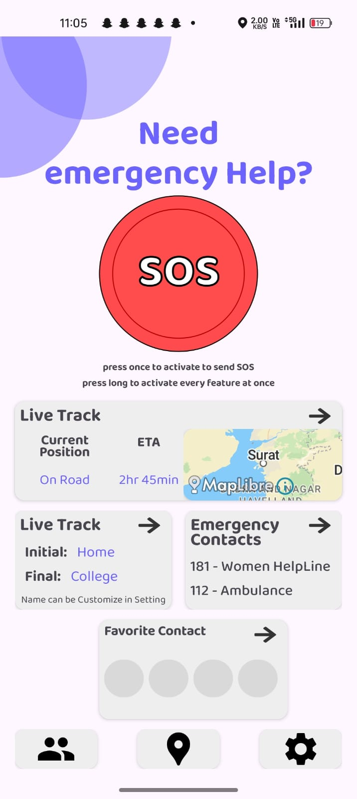
IMPLEMENTATION
Home
Screen
SOS Screen

Slide 19
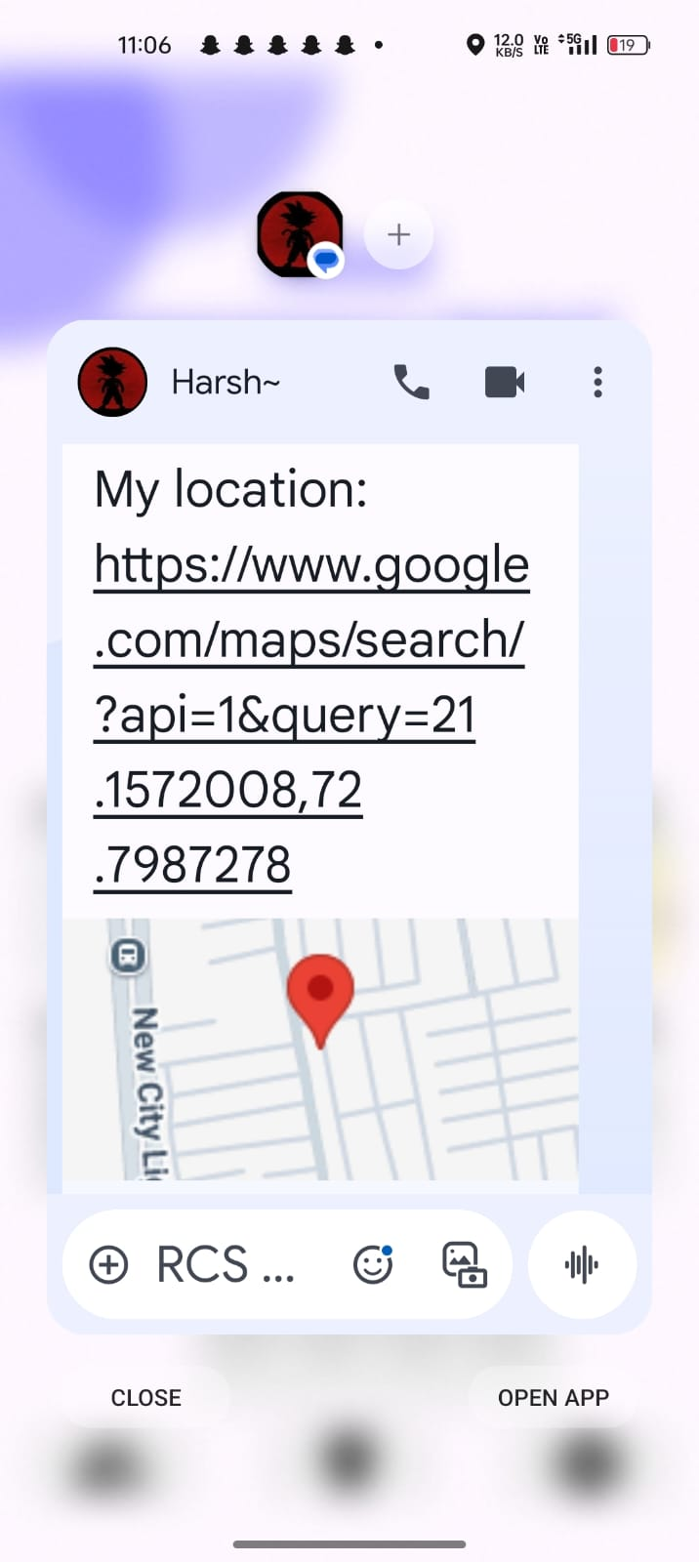
IMPLEMENTATION (CONTINUE.)
Location share :

Slide 20
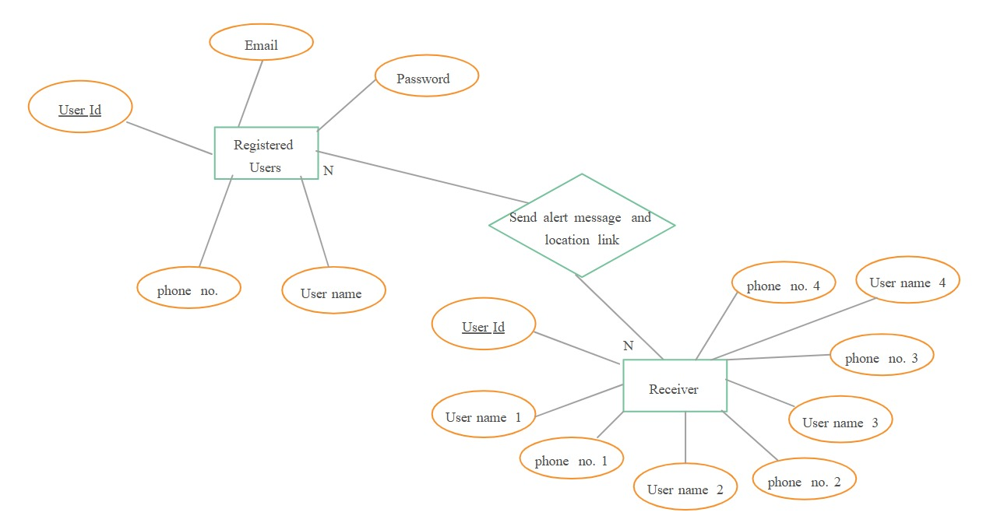
Er Diagram

Slide 21
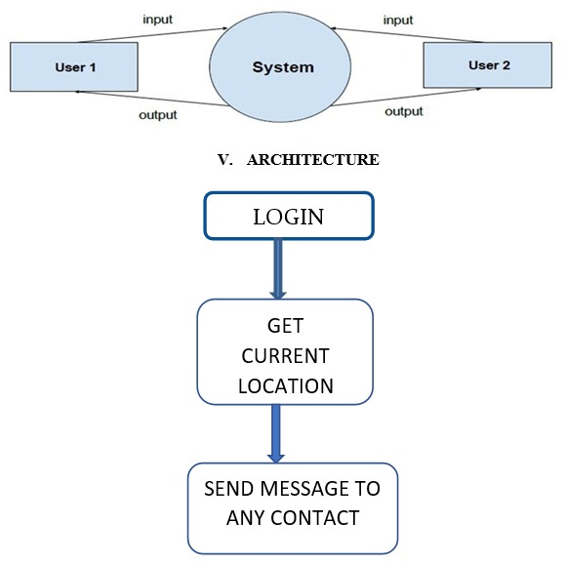
SEQUENCE DIAGRAM

Slide 22
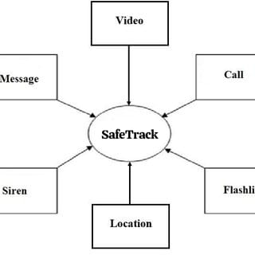
DFD-0 DIAGRAM

Slide 23
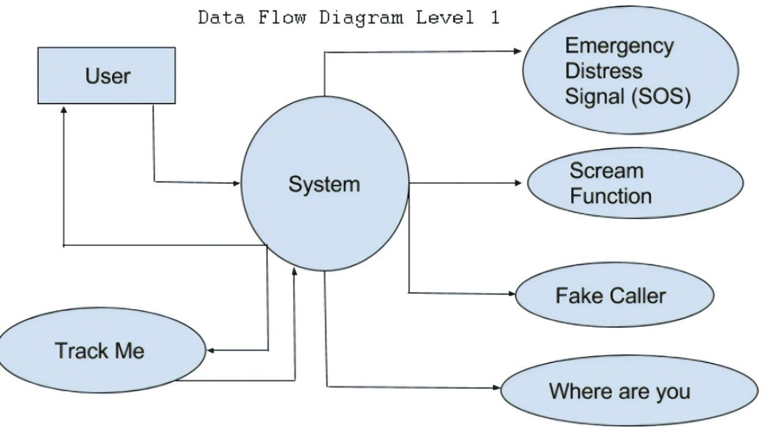
DFD-1 DIAGRAM

Slide 24
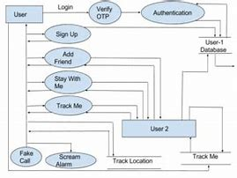
DFD-2 DIAGRAM

Slide 25
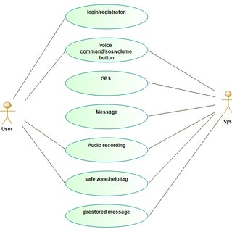
USE CASE DIAGRAM

Slide 26
Conclusion & future work
Conclusion:
➢ Innovative and user-friendly, the student-developed app is a lifeline in emergencies, providing swift guidance and support. With its intuitive interface and comprehensive features, it ensures quick access to essential information and services, fostering safety and security for users. A testament to youthful ingenuity, it stands as a beacon of hope in crisis.
Future work:
➢ In the future, the student-developed emergency guidance app aims to enhance its capabilities by integrating for real-time analysis and personalized assistance. With a focus on continuous improvement and adaptability, it strives to become an indispensable tool for individuals facing various emergencies, ensuring swift and effective support.

Slide 27
references
GEMINI
RESEARCH GATE
NEW PAPERS
IRJET ARTICLES

Slide 28
THANK YOU

