Slide 1
Secure Data Hiding in Image Using Steganography
CAPSTONE PROJECT
Presented By:PILLI HARSHAVARDHINI
Student Name : PILLI HARSHAVARDHINI
College Name & Department : DR.LANKAPALLI BULLAYYA COLLEGE FOR PG (MCA)

Slide 2
OUTLINE
Problem Statement
Technology used
Wow factor
End users
Result
Conclusion
Git-hub Link
Future scope

Slide 3
Problem Statement
With increasing cybersecurity threats, ensuring secure data transmission is crucial. Traditional encryption methods can attract attention, making steganography a better alternative. This project focuses on securely hiding data within images using advanced steganographic techniques, ensuring high imperceptibility and robustness against detection. The solution will enhance security while maintaining image quality, enabling safe and covert communication.

Slide 4
Technology used
The following libraries are used in the given code:
1. cv2 (OpenCV) – Used for reading, modifying, and saving images.
2. os – Used for interacting with the operating system, specifically to open the encrypted image.
3. string – Imported but not used in the code. It can be removed unless needed elsewhere.
Windows – Fully supported, especially with os.system("start encryptedImage.jpg") to open the image.

Slide 5
Wow factors
This "Secure Data Hiding in Image Using Steganography" project stands out due to the following unique features:
1. Pixel-Level Data Embedding – The message is embedded directly into pixel values, making detection difficult.
2. Custom Character Mapping – Uses a dictionary-based encoding technique rather than standard steganographic methods.
3. Password-Protected Encryption & Decryption – Ensures only authorized users can retrieve the hidden message.
4. Minimal Dependencies – Uses only `cv2` and `os`, making it lightweight and easy to implement.
5. Cross-Platform Execution – Can be run on Windows, Linux, or cloud platforms with minor modifications.

Slide 6
End users
The end users of this "Secure Data Hiding in Image Using Steganography" project include:
1. Cybersecurity Professionals – To securely communicate sensitive information.
2. Journalists & Whistleblowers – To hide confidential messages from unauthorized access.
3. Forensic Experts – For secure data storage in digital investigations.
4. Military & Intelligence Agencies – To transmit classified data covertly.
5. Privacy-Conscious Users – For personal data protection in images.
6. Developers & Researchers – To explore and enhance steganographic techniques.

Slide 7
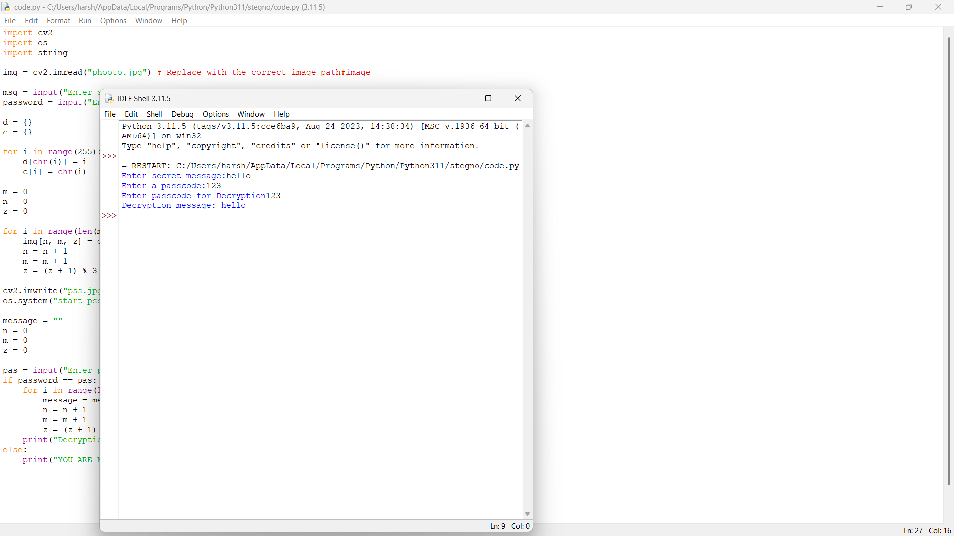
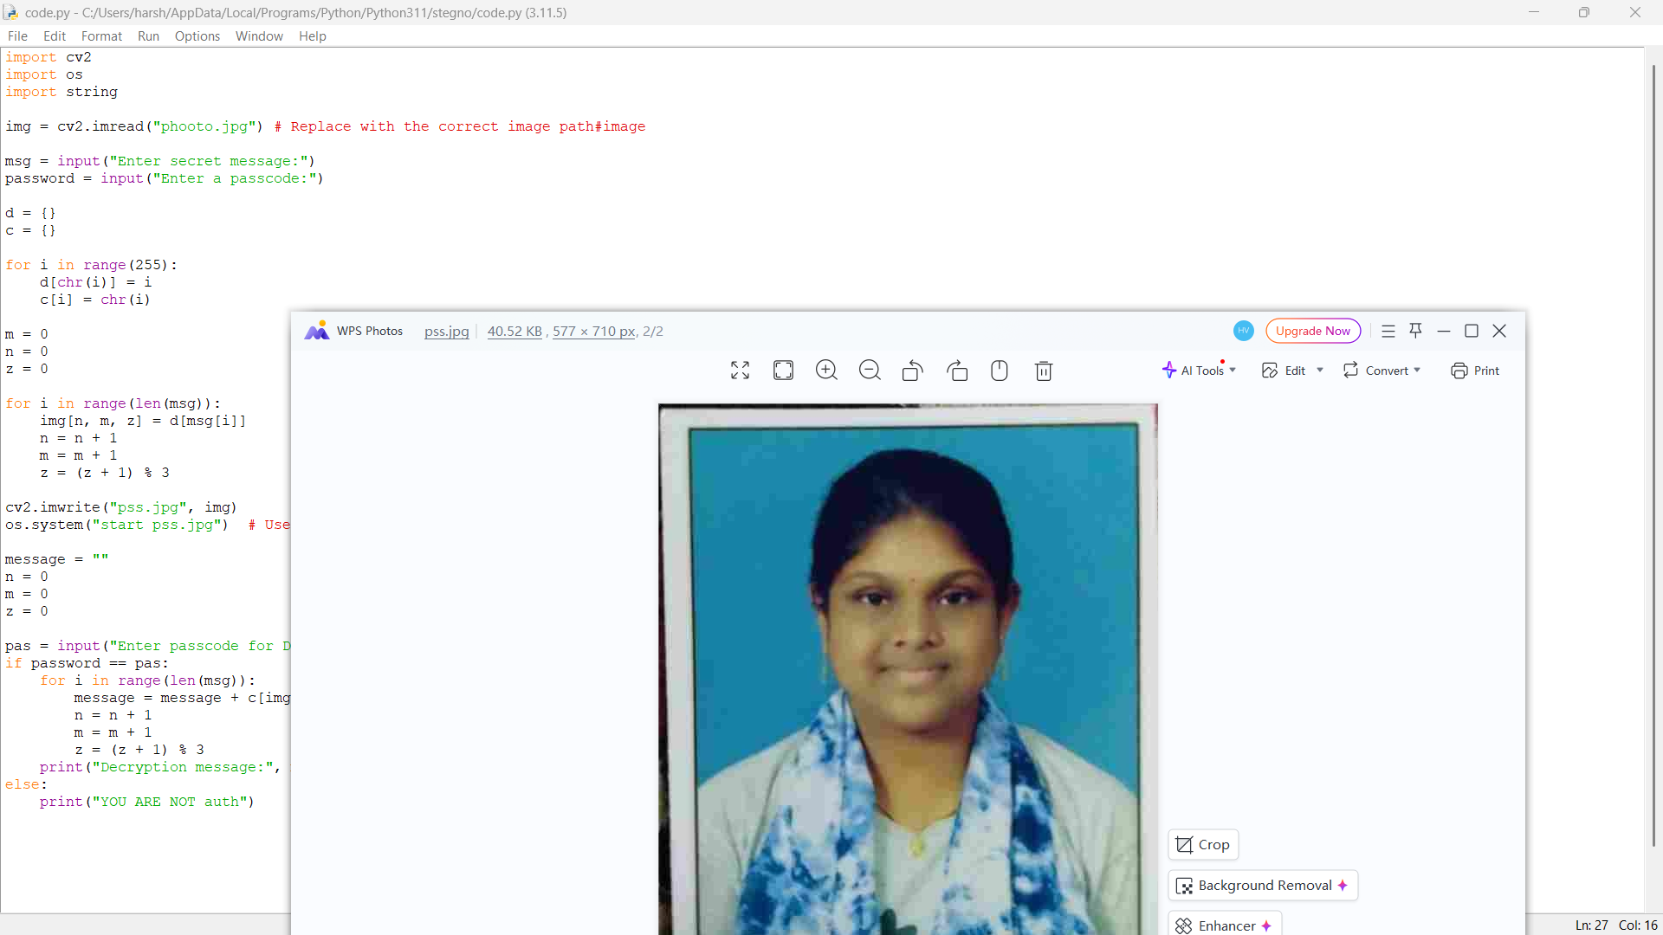
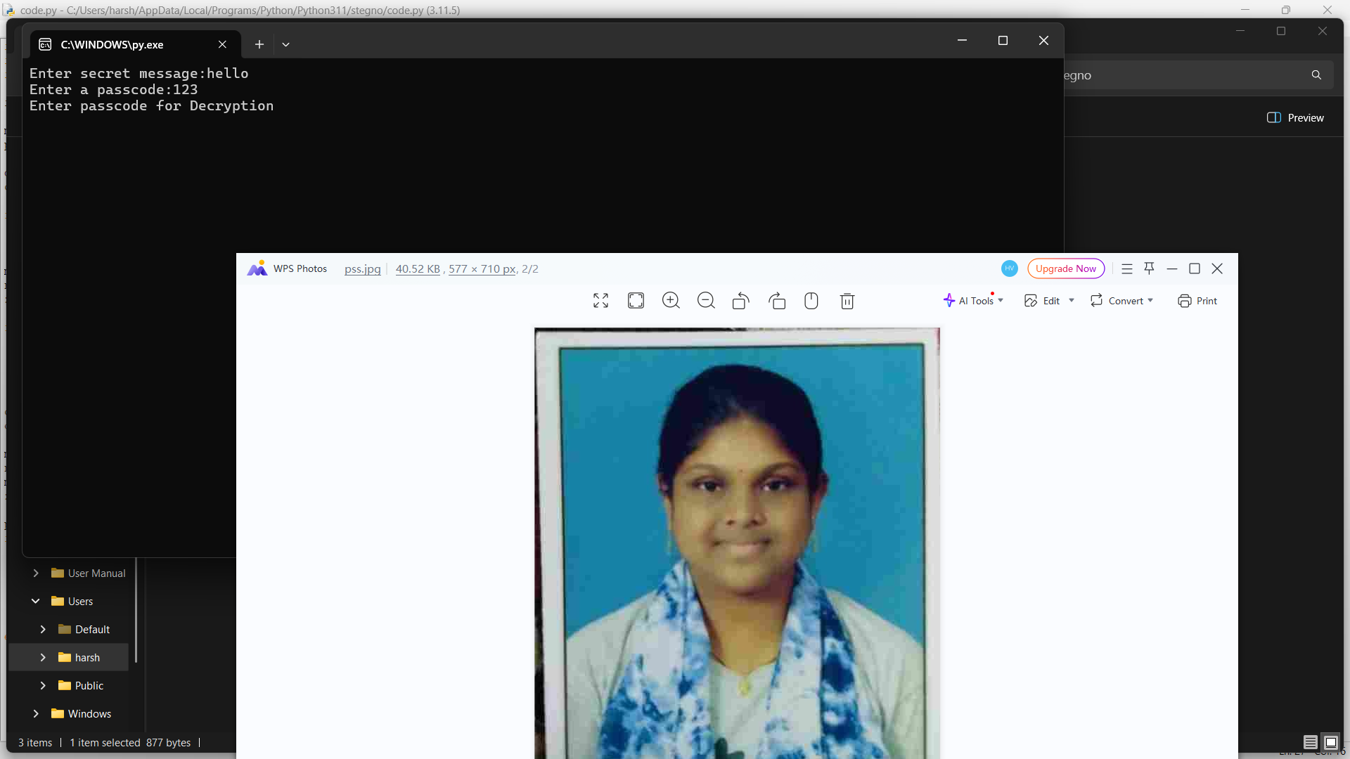
Results
Screenshots of the outcome (min 3)

Slide 8
Conclusion
The "Secure Data Hiding in Image Using Steganography" project successfully addresses the challenge of covertly transmitting sensitive information while ensuring data security. By leveraging image-based steganography, the project embeds encrypted messages within image pixels, making the data nearly undetectable to unauthorized users. With the integration of OpenCV (cv2) and OS libraries , this solution provides a practical approach to secure communication, ensuring confidentiality and integrity. The project is valuable for cybersecurity, digital forensics, and privacy protection, making it a robust and efficient method for secure data exchange.

Slide 9
GitHub Link
https://github.com/harsha-0329/harsha.git

Slide 10
THANK YOU

