Slide 1
BCSP786 – Major Project Phase - II
Review - 2
Submitted By
1CR23CS165 – Sanjana P Sutrave
1CR23CS135 – R Harsha
Guidance of
Dr. D. Sumathi, Associate Professor
31-08-2026

Slide 2
Outline
Problem Statement
Objective
Base Paper – Journal Paper Reference
Progress After Review 1
Proposed Methodology
Intermediate Results

Slide 3
Problem Statement
Satellites depend on their Electrical Power System (EPS) — solar array, battery, regulator, bus, load — and undetected faults here can directly compromise the mission.
Existing GNN-based fault diagnosis methods (including our base paper) model the EPS as a graph with a FIXED adjacency matrix, assumed constant for the entire diagnosis process.
Gap: a fixed graph cannot represent how component importance shifts with orbital state — e.g. the EPS depends almost entirely on the battery during eclipse and on the solar array in sunlight — a shift no static graph can express. Existing methods also target binary anomaly detection, not multi-class fault diagnosis.
Proposed solution: a Dynamic Graph Neural Network (Dynamic-GNN) that learns a time-varying adjacency matrix A(t) directly from telemetry at every timestep, enabling accurate, interpretable, multi-class EPS fault diagnosis.

Slide 4
Objectives
Construct a physically grounded simulation of a satellite EPS that generates labeled multivariate telemetry under nominal and four fault conditions.
Design a GNN-based fault diagnosis model whose graph structure is learned from telemetry at every timestep, instead of being fixed in advance.
Quantitatively establish, under identical training conditions and a matched parameter budget, whether a dynamic graph improves diagnostic accuracy over a fixed-topology GNN and non-graph (CNN, LSTM) baselines.
Evaluate the interpretability of the learned graph/attention and the model's robustness under noisy or missing telemetry.

Slide 5
Novelty of Proposed System
All prior GNN-based fault/anomaly diagnosis work — including the base paper — constructs its graph ONCE and holds it fixed for the entire process.
Proposed Dynamic-GNN instead computes a fresh adjacency matrix A(t) at every timestep, from a small learned attention scorer over the current node embeddings, before propagating through GCN + GAT layers and a GRU.
This lets the model adaptively reweight which components matter most as orbital conditions change (e.g. battery-dominant in eclipse → solar-array-dominant in sunlight) — a shift a fixed graph has no mechanism to express.
To the best of our knowledge, the first model to apply timestep-wise dynamic graph construction specifically to satellite EPS fault diagnosis, directly addressing a limitation the base paper leaves as future work.

Slide 6
Base Paper
Reference Paper — Journal Paper (Expert Systems With Applications, Elsevier):
Y. Di, F. Wang, Z. Zhao, Z. Zhai, and X. Chen, “An interpretable graph neural network for real-world satellite power system anomaly detection based on graph filtering,” Expert Systems with Applications, vol. 254, p. 124348, 2024.
Base paper uses an interpretable GNN with an adaptive graph filter for satellite power-system anomaly detection — but explicitly states the graph is STATIC (“inter-coupling relationship among the sensors... remains unchanged over time”) and targets binary anomaly detection, not multi-class fault diagnosis.

Slide 7
Progress After Review 1
EPS physics simulator built and validated — governing equations for solar power, battery state-of-charge, bus voltage regulation, and system-wide power balance; sanity-checked for zero NaN/Inf and physically consistent behavior.
Dataset finalized: 1,500 labeled orbit episodes, 300 each across 5 balanced fault classes, split stratified 70:20:10.
All four models implemented and trained under identical conditions: CNN, LSTM, Static-Graph GNN (fixed-topology baseline), and the proposed Dynamic-GNN.
Full evaluation completed — Dynamic-GNN reaches 97.3% test accuracy vs. 76.0–82.7% for the three baselines, with matched parameter budgets.
Interpretability analysis added: per-class attention weights, and visualization of the learned adjacency A(t) across an eclipse→sunlit orbital transition.
Robustness stress-tested under noisy/missing telemetry; found and partially fixed a real weakness via noise/dropout-augmented training.
Live interactive web demo built (FastAPI backend + browser frontend) that runs the simulator and all four trained models on demand.
Base paper identified and a full IEEE-format conference paper drafted (6 pages, 20 references).

Slide 8
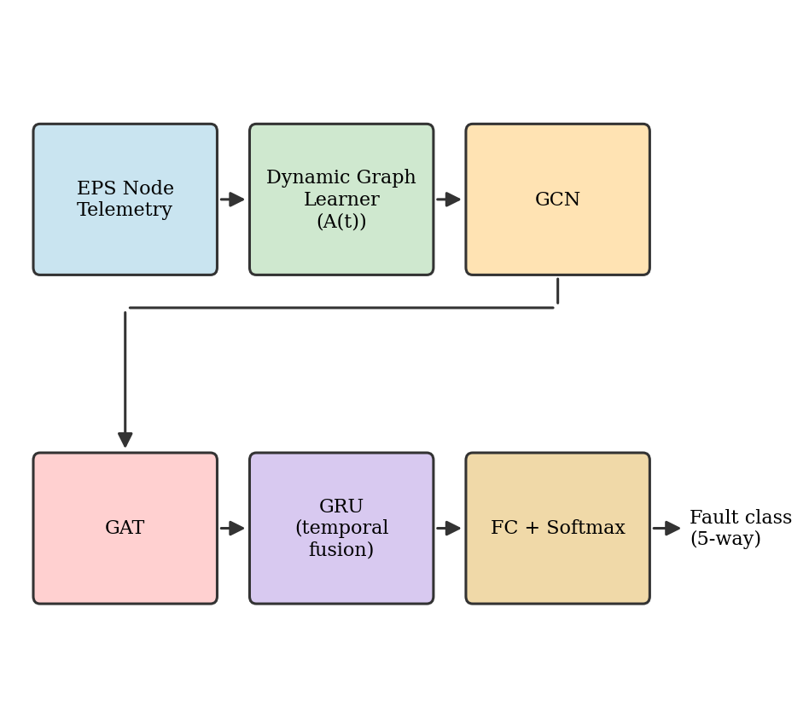
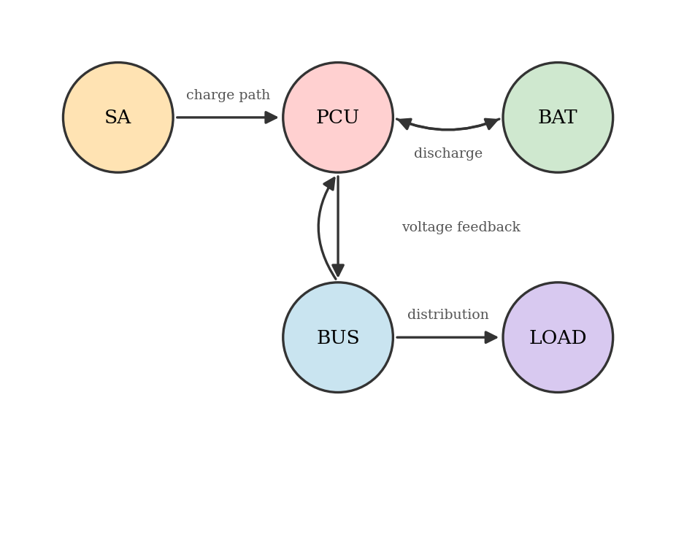
System Architecture
Dynamic-GNN pipeline (left): node telemetry → learned dynamic graph A(t) → GCN → GAT → GRU (temporal fusion) → FC + Softmax classifier.
Fixed EPS power-flow topology (right): used only by the Static-GNN baseline for comparison — the proposed model learns its own graph instead.

Slide 9
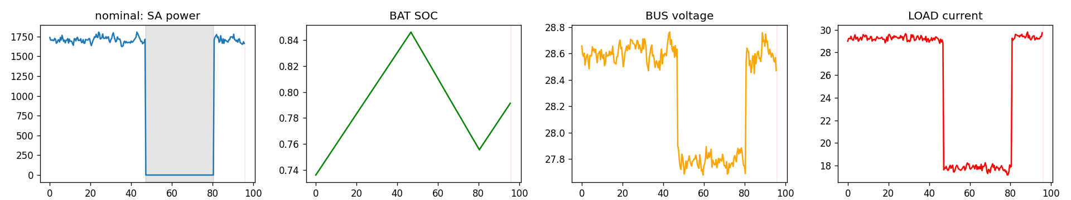
Dataset Description
Source: custom-built physics simulator (not third-party) implementing governing equations for solar power, battery SOC, bus voltage regulation, and system-wide power balance for a 5-node satellite EPS.
Size: 1,500 labeled samples — 300 per class, exactly balanced across 5 fault classes; split stratified 70:20:10 (train/val/test).
Each sample: one full 96-minute orbit, 240 timesteps (24s apart), 5 nodes × 5 features (voltage, current, power, temperature, state-of-charge) — guaranteeing a full eclipse→sunlit cycle per sample.
Classes: nominal, sa_degradation, battery_over_discharge, pcu_regulator_fault, bus_distribution_fault.

Slide 10
Proposed Methodology – Modules
Modules / Block Diagram of Proposed System
Module 1 – EPS Physics Simulation & Dataset Generation
Module 2 – Dynamic Graph Construction (learned A(t))
Module 3 – GCN + GAT Structural & Attention Propagation
Module 4 – Temporal Fusion (GRU) & Classification
Module 5 – Training, Robustness Augmentation & Evaluation

Slide 11
Methodology – Module 1: EPS Simulation & Dataset Generation
Input: physical parameters (P_max, orbit period 5760s, fault type & severity, seed).
Expected Output: labeled (240 × 5 nodes × 5 features) telemetry tensor + one fault-class label.
Algorithm:
  Solar power: P_sa = P_max · cos(θ) · (1 − k_d·t), zeroed during eclipse.
  Battery SOC: dSOC/dt = (P_charge,eff − P_discharge − P_extra) / E_bat − k_sd·SOC.
  Bus voltage: V_bus = V_nom − k·(P_load − P_source), clipped to regulator limits.
  Power balance (enforced every step): P_sa + P_bat,out = P_bus,load + P_losses.

Slide 12
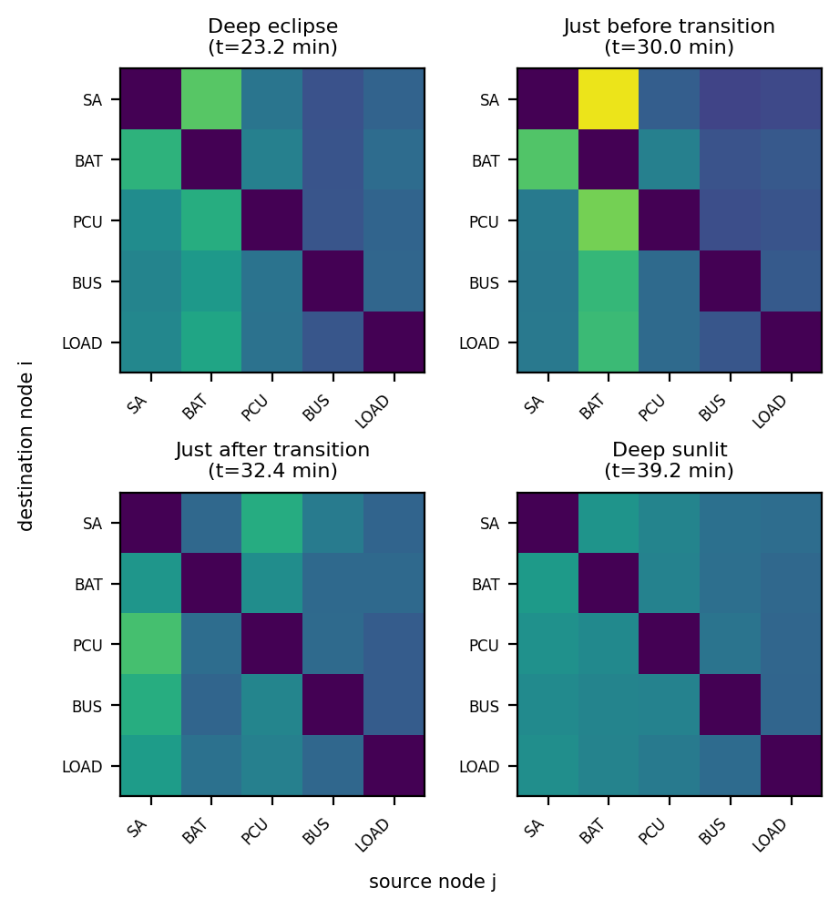
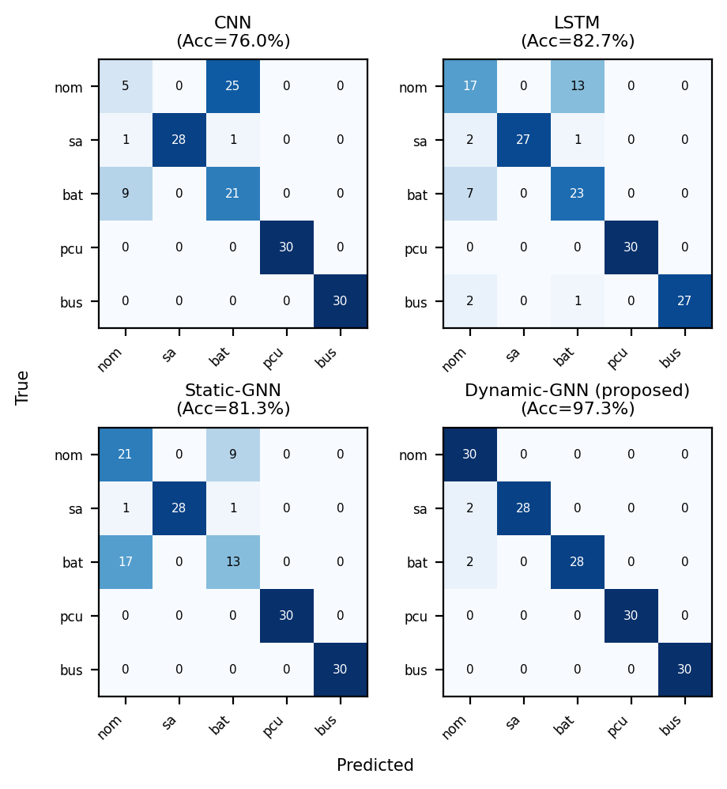
Intermediate Output Screenshots
Data flow: Simulated Telemetry → Learned Dynamic Graph A(t) → Fault Classification (shown below for a real run of the trained model).

Slide 13
Conclusion & Future Enhancements
Presented a Dynamic Graph Neural Network for satellite EPS fault diagnosis, learning the adjacency matrix from telemetry at every timestep instead of holding it fixed — directly addressing a limitation left as future work by the base paper.
Achieved 97.3% accuracy, 97.4% F1-score, and 0.996 AUC-ROC, outperforming a same-architecture static-graph baseline (81.3%) and non-graph CNN (76.0%) / LSTM (82.7%) baselines under identical training conditions.
Interpretability analysis confirmed the learned graph tracks real physical state — the dominant power source in A(t) shifts from battery to solar array within minutes of the eclipse-to-sunlit transition.
Found and partially fixed a real robustness weakness: the dynamic graph's advantage collapses under heavy sensor corruption because its structure depends on the same corrupted inputs it classifies; noise/dropout-augmented training substantially closed this gap.
Future Enhancements: multi-seed statistical validation, ablation studies isolating individual design choices, fault localization in time, and validation against real spacecraft telemetry.

Slide 14
References
[1] Y. Di, F. Wang, Z. Zhao, Z. Zhai, and X. Chen, “An interpretable graph neural network for real-world satellite power system anomaly detection based on graph filtering,” Expert Systems with Applications, vol. 254, p. 124348, 2024.
[2] Z. Wu, K. Zou, Y. Liu, and L. Zhu, “Graph Neural Network-Assisted Fault Diagnosis for Satellite Attitude Control Systems,” in Proc. 2025 5th Int. Conf. Electronic Information Engineering and Computer Technology (EIECT), 2025.
[3] B. L. H. Nguyen et al., “Spatial-Temporal Recurrent Graph Neural Networks for Fault Diagnostics in Power Distribution Systems,” IEEE Access, vol. 11, 2023.
[4] V. Pozdnyakov, I. Makarov, and A. Kovalenko, “Graph Neural Networks With Trainable Adjacency Matrices for Fault Diagnosis on Multivariate Sensor Data,” IEEE Access, vol. 12, pp. 152860–152872, 2024.
[5] M. Jin et al., “A Survey on Graph Neural Networks for Time Series: Forecasting, Classification, Imputation, and Anomaly Detection,” IEEE Trans. Pattern Anal. Mach. Intell., vol. 46, no. 12, pp. 10466–10485, 2024.
Full 20-reference IEEE-format list is included in the accompanying project report.

Slide 15
Methodology – Module 2: Dynamic Graph Construction
Input: node features x_t ∈ R^(5×5) at each timestep t.
Expected Output: dynamic adjacency A(t) ∈ R^(5×5) + sparsified top-3 mask M(t).
Algorithm:
  Encode node features via a 2-layer MLP: h_t = MLP(x_t).
  Scaled dot-product attention scoring: A_soft(t) = softmax(h_t · h_tᵀ / √D).
  Sparsify: keep each destination node's top-3 highest-weighted sources + a self-loop → binary mask M(t) used by the GAT layer.

Slide 16
Methodology – Module 3: GCN + GAT Propagation
Input: learned adjacency A(t), mask M(t), and node features x_t.
Expected Output: per-node embeddings (32-dim × 5 nodes), mean-pooled into one graph embedding.
Algorithm:
  GCN (structural propagation): H_gcn = W_gcn · (D(t)⁻¹(A_soft(t) + I) · x_t).
  GAT (attention-weighted importance), restricted to M(t): α_ij = softmax_j(LeakyReLU(a_dstᵀh_i + a_srcᵀh_j)), 2 attention heads.
  Node embeddings mean-pooled over the 5 nodes → one graph embedding per timestep.

Slide 17
Methodology – Module 4: Temporal Fusion & Classification
Input: sequence of 240 per-timestep graph embeddings (one full orbit).
Expected Output: probability distribution over the 5 fault classes.
Algorithm:
  GRU (80 hidden units) processes the 240-step sequence.
  Final hidden state → Dropout → Fully-Connected layer.
  Softmax classifier: ŷ = softmax(W_c · h_T + b_c).

Slide 18
Methodology – Module 5: Training, Augmentation & Evaluation
Input: labeled training batches (optionally noise/dropout-augmented).
Expected Output: trained model weights + test-set performance metrics.
Algorithm:
  Loss: categorical cross-entropy L = − Σ yᵢ log(ŷᵢ); Adam optimizer, early stopping (patience 10), matched ~18k–32k parameter budget across all models.
  Robustness augmentation: 70% of batches get Gaussian noise (0–0.5× per-channel std) and/or dropout (0–30%, replaced with channel mean).
  Evaluated on 150 held-out test episodes across 6 metrics: Accuracy, Precision, Recall, F1, AUC-ROC, Log Loss.

