Slide 1
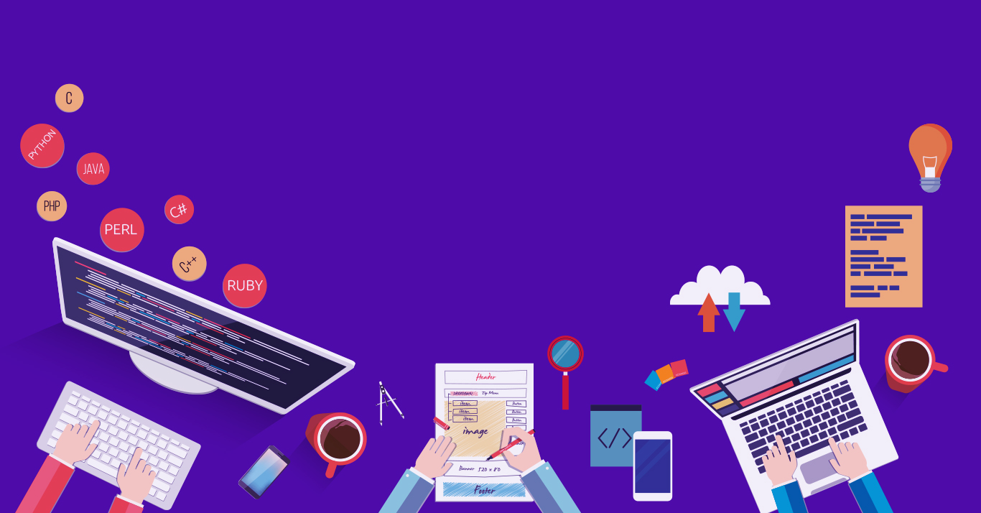

Introduction to
Robotic Process Automation
DRUG SEEKER
BOT
220701314
Vellanki Chandra Harsha
Ms. U.Farjana, M.Tech.
Supervisor
Department of Computer Science and Engineering

Slide 2
Abstract
The 'Drug Seeker Bot' is an advanced RPA application designed using UiPath to automate the retrieval of pharmaceutical data efficiently. This bot serves as a user-friendly tool that accepts drug names as input and leverages web browser activities to extract critical details such as brand names, prices, and other related information from reliable online pharmaceutical platforms. The bot is designed to simplify and speed up the process of obtaining drug information, eliminating the time-consuming and error-prone task of manual searches. This project demonstrates the effective use of robotic process automation in the healthcare sector, offering a scalable solution for pharmacists, healthcare providers, and consumers to access accurate drug details instantly. It ensures enhanced accuracy, operational efficiency, and convenience while highlighting the practical applications of automation in addressing real-world challenges. By providing timely and precise information, the 'Drug Seeker Bot' promotes informed decision-making and supports improved healthcare outcomes..

Slide 3
Need for the Proposed System
Time Efficiency
The bot quickly finds drug details, avoiding the long process of manual searches.
Easy to Use
The bot is simple and convenient for anyone to get drug details quickly.
Handles Large Requests
It can manage multiple searches at once, making it useful for busy pharmacies or clinics.
Better Decisions
It helps users make informed choices about drugs, improving healthcare outcomes.
Improves Accuracy
It reduces human errors and provides correct, up-to-date information.
Cost-Effective Solution
By automating the search process, the bot reduces the need for additional resources or manual effort, saving costs for users and organizations.

Slide 4
Advantages of the Proposed System
Time-Saving
Automates drug searches, providing quick results without manual effort.
User-Friendly
Simple interface makes it accessible to pharmacists, healthcare providers, and
consumers.
Increased Efficiency
Handles multiple queries simultaneously, improving productivity.
Scalability
Can be used for both small-scale and large-scale operations in healthcare.
High Accuracy
Ensures precise and up-to-date information, reducing the chances of errors.
Informed Decision-Making
Provides reliable data to help users choose the right drugs, enhancing healthcare quality.

Slide 5
Literature Survey
Title:
Review of Automation Applications in Healthcare: Enhancing Drug Information Retrieval Using Robotic Process Automation
ADVANTAGES
DISADVATAGES
Saves Time
Quickly finds drug details, reducing search
efforts.
Accurate Information
Provides correct and reliable drug data.
Easy to Use
Simple and convenient for everyone.
Limited to Online Sources
The bot depends on internet access
and available websites for data.
Cannot Handle Complex Queries
It may struggle with uncommon or
highly detailed requests.

Slide 6
Main Objective
The main objective of the 'Drug Seeker Bot' is to automate the process of retrieving drug information efficiently. It aims to provide accurate details like brand names and prices quickly. This ensures ease of use, saves time, and supports better healthcare decisions.

Slide 7
Architecture

Slide 8
System Requirements
Hardware Requirements
Processor: Intel Core i5 or higher (or equivalent)
RAM: 8 GB or higher
Storage: 256 GB SSD or more
Software Requirements
Operating System: Windows 10 or later
UiPath Studio.
Any Web:Google chrome,Microsoft edge,Firefox

Slide 9
Functional Description
The 'Drug Seeker Bot' allows users to input a drug name, and it automatically retrieves relevant details such as brand names, prices, and other information from trusted online sources. The bot simplifies the search process, providing accurate and up-to-date data quickly, ensuring users can access drug information efficiently and with minimal effort.

Slide 10
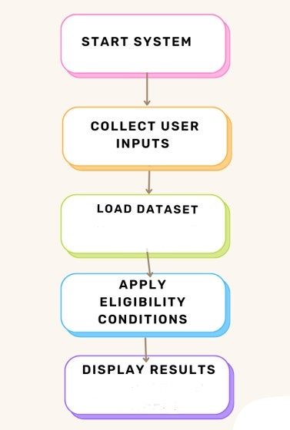











System Flow Diagram
Name of medicine
In website
Select information

Slide 11
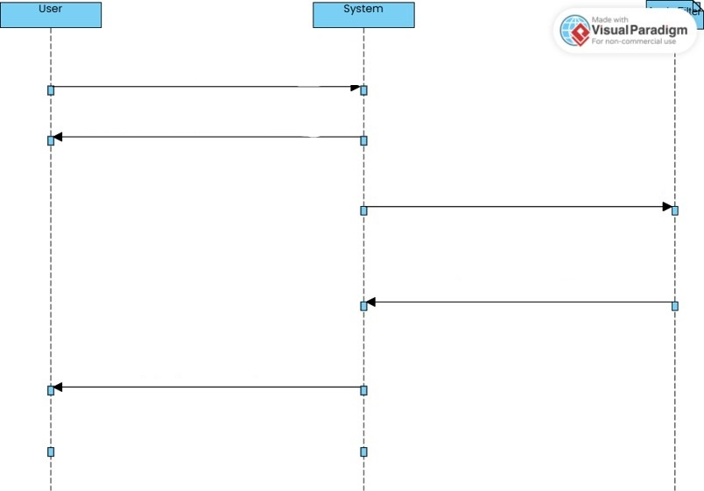
Sequence Diagram
User provides input(name of medicine)
Loads the data to website
Loads input data and processes
Returns the matched information about medicine
Display’s the output (info. About medicine)

Slide 12
Process Design
Collect Email
The bot prompts the user to enter their email address.
Collect Drug Name
The bot then asks the user to provide the drug name.
3.Web Automation
Using the drug name, the bot searches online pharmaceutical websites.
4.Data Extraction
The bot retrieves details like brand names and prices.
Display Results
The extracted information is shown to the user in their Chrome browser.
Main Process:

Slide 13
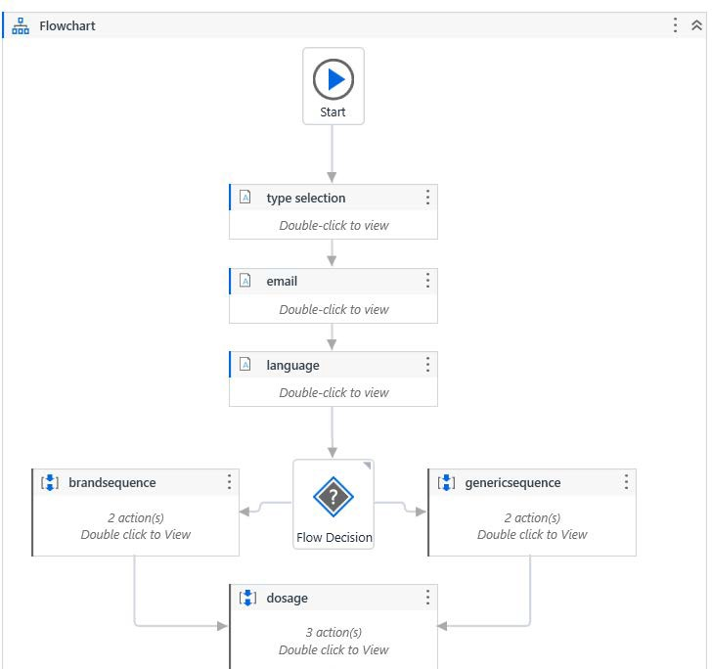
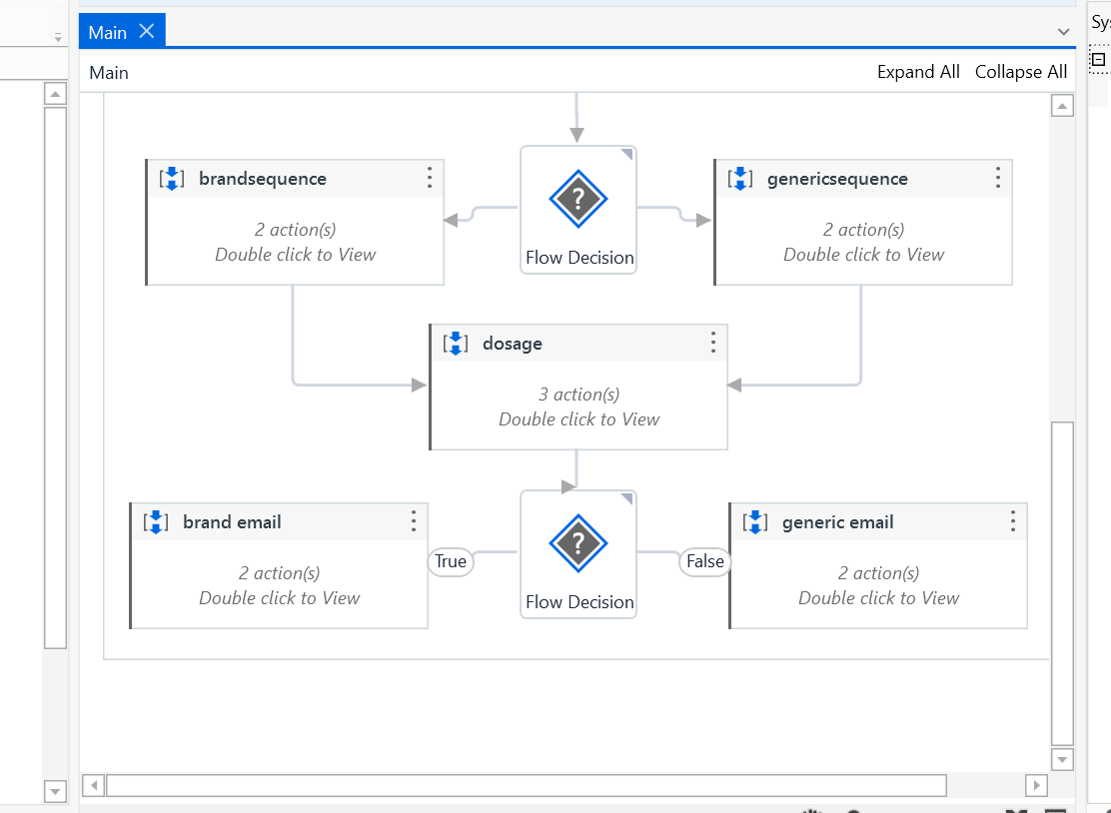

Slide 14
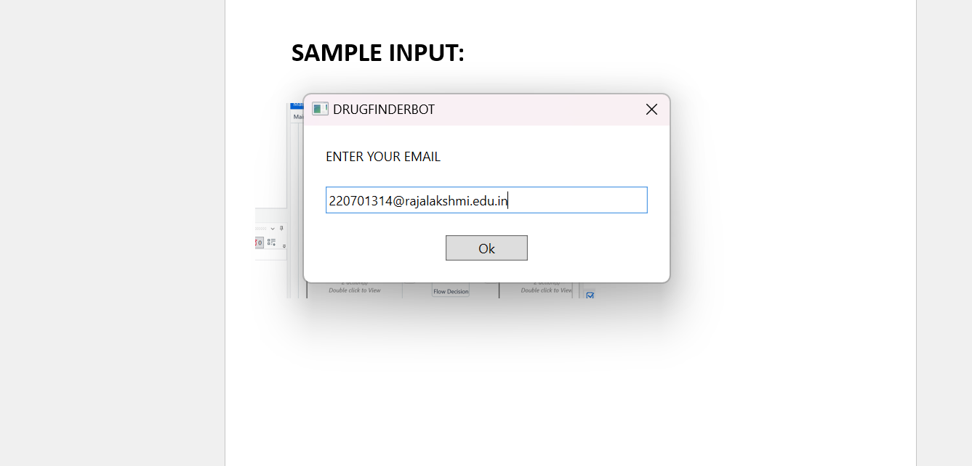
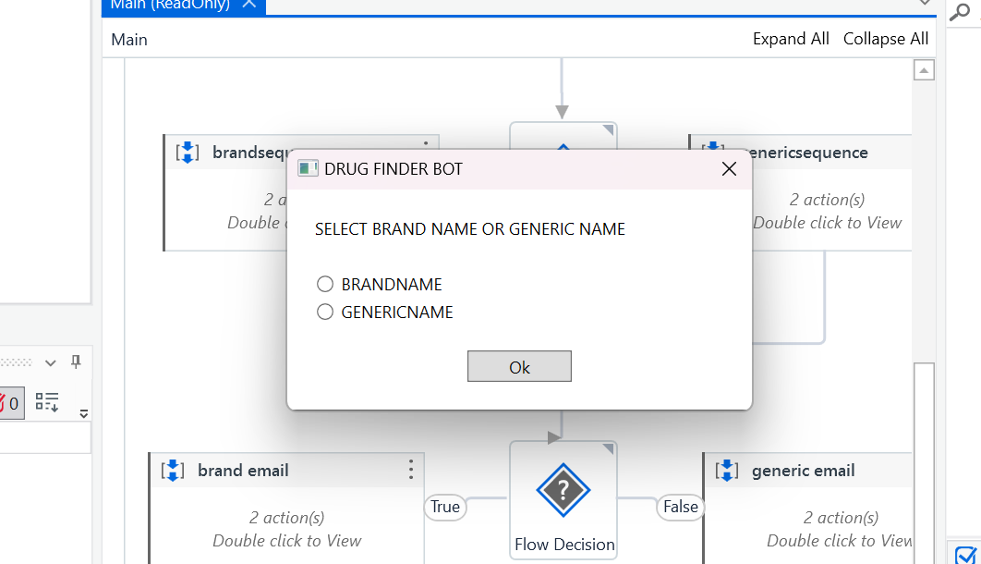

Slide 15
SAMPLE OUTPUT:

Slide 16
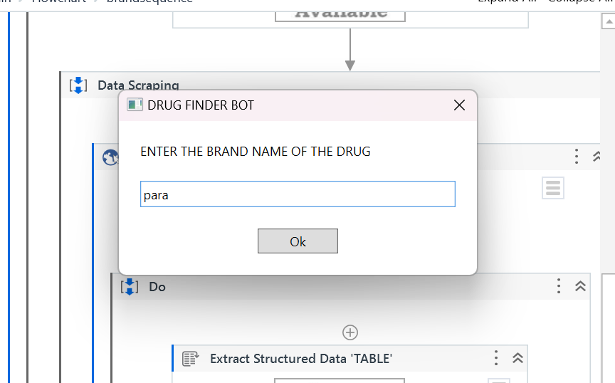
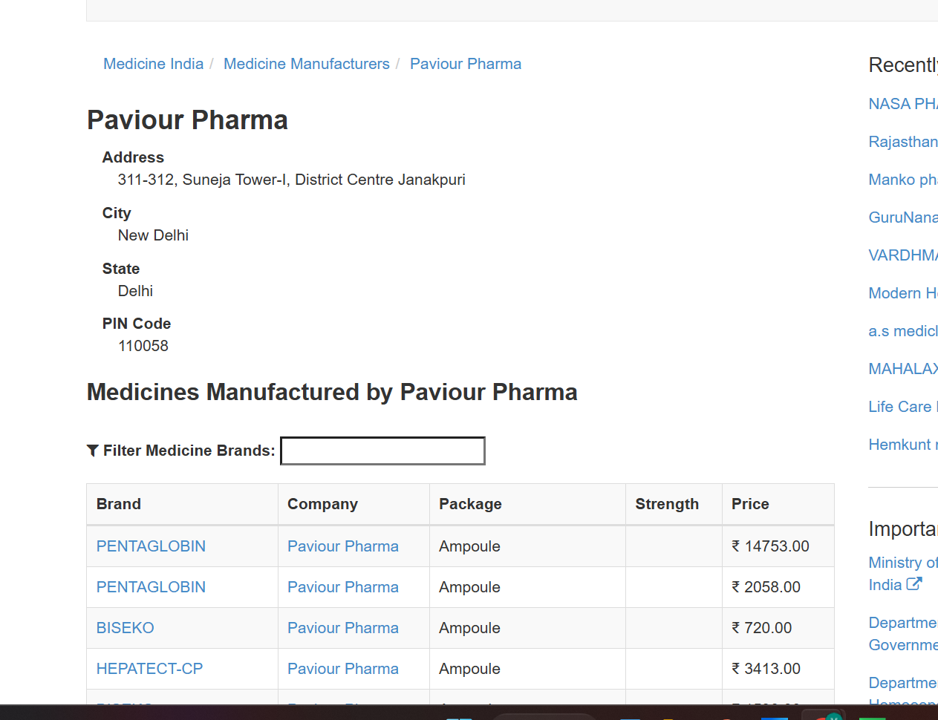

Slide 17
Conclusions
The 'Drug Seeker Bot' is an efficient tool for retrieving drug-related information, such as brand names, prices, and availability, by leveraging web scraping and natural language processing (NLP). It successfully provides users with accurate and relevant drug details based on their inputs, improving accessibility to pharmaceutical data.
However, the bot faces limitations such as dependency on external websites, handling dynamic content, and scalability issues under high demand. Despite these challenges, the bot has shown strong potential for real-world applications in assisting users with quick and easy access to drug information. Future improvements could focus on expanding data sources, enhancing NLP capabilities, and optimizing for scalability and real-time data updates. Overall, the project successfully demonstrates the capabilities of RPA and AI in the healthcare and pharmaceutical domains, with room for growth and refinement.

Slide 18
Future Enhancement
    Expanding Data Sources:
Integrate additional pharmaceutical websites, databases, and e- commerce platforms to provide a wider range of drug information, ensuring more comprehensive results for users.
Include government and regulatory sites for verified drug details, improving
the bot's credibility.
    Real-time Data Updates:
Implement mechanisms for real-time updates on drug prices, availability, new drug launches. This could be done by scheduling regular scraping intervals or using APIs from trusted sources for real-time information.

Slide 19
References
      UiPath Documentation: [https://docs.uipath.com/activities/other/latest/integration-service/uipath-uipath- airdk-about]
      Machine Learning and Deep Learning Textbooks:
        Goodfellow, I., Bengio, Y., & Courville, A. (2016). Deep Learning. MIT Press.
        Bishop, C. M. (2006). Pattern Recognition and Machine Learning. Springer.
      Online Tutorials and Resources:
        UiPath Official Documentation
        YouTube Tutorials
        UIPath Online Forums
        REDDIT
        WIKIPEDIA
        GITHUB

Slide 20
Queries

Slide 21
Demonstration

Slide 22
Thank You

