Slide 1

EnBioCrypt
A Secured File Sharing Mechanism over Internet.
-“We Secure Your Files...”
-www.enbiocrypt.com

Slide 2

Introduction
Basically we store Huge data over cloud and share but how far is it secured,
Without actually sharing huge files directly over public domain , we are providing a encryption layer which is efficient as There is a huge risk involved while directly storing into Cloud.
Where can it be used?
Corporate as well as by general Users.

Slide 3
Introduction
Why we?
we provide 2-Factor Authentication as well as a solution to store data in encrypted manner which ensures protection even after the data breach OR any of the above attacks or threats.
Our Encryption obeys symmetric encryption as well division of files into chunks with different unique key assigned to each chunk and then gets stenganographed in the form of image. Which Ensures Dual Layering.
The more no. of chunk generated each time = more the tough approach required to break modules(as each module has different unique Key)
What will the Receiver Receive?
Receiver will receive a steganographed Image of size(200kb) holding the parameters of File like Module Name , corresponding verification hash , Extension of the File.

Slide 4
Cloud Threats
Data Breaches
Hijacking of Accounts
Malware Injection
Abuse of Cloud Services
Insecure APIs
Denial of Service Attacks
Shared Vulnerabilities
Data Loss
‘man-in-the-cloud’ attack is said to be a common flaw in most cloud-based file synchronization services.

Slide 5
Introduction
The File Sharing has been a great threat these days. We have Come with our Unique Solution to it, we have introduced a concept of storing encrypted file(in form of Chunks) over file storages instead of storing raw/plain data. This will not only avoid data breaching but also diminish data leakage when reached on wrong hands and will reduce unnecessary audiences to the file . The Multilayered Encryption algorithm is used to ensure the toughest composition to decrypt a file.
With Nearly least of lower bound C(91,32) = 3704945605651136829552570 Combinations to break the key String.
With Nearly of C(256,64) = 19043804482465115087135154178239332442459580600054810211401500 Combinations to break the File Encoding Pattern.

Slide 6
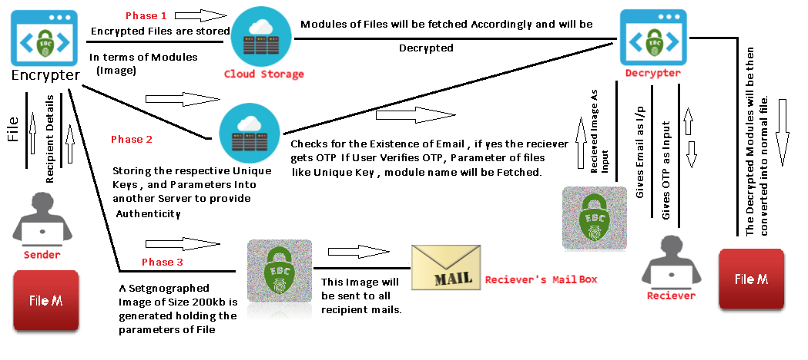
Flow Chart

Slide 7

Introduction
Nowadays People Are more concerned about security , and eventually due to drastic developments in Technology and Great demand For IOT (Internet Of Things), we everyday relay on Clouds Directly or indirectly.
But The Question is are Data Stored over Cloud Safe?
Answer: Not Really!! , After Witnessing Some Famous Data Breaches over Time , which do show how insecurely the files are being Stored. In fact There is no proper Authenticity involved while fetching Data.

Slide 8
Comparision
IPFS(Inter Planetary File Sharing) | Our Method
->Uses Blockchain Technology | ->Similar but with more Ease
->Bound to Module Traversing | ->Same
->Asymmetric Encryption | ->Symmetric Encryption
->Generates Public Key to access File. | ->Checks for authenticity , which makes direct Interaction OF file without the use of KEY.
->Whole File is Encrypted using single Key and generates Public Key | ->Chunks of File is Encrypted using Different Unique Key.
->The usage of Main Memory(RAM) is more as whole file has to be placed on RAM. | ->The Usage of RAM is less as Chunks of File is Encrypted Individually.

Slide 9
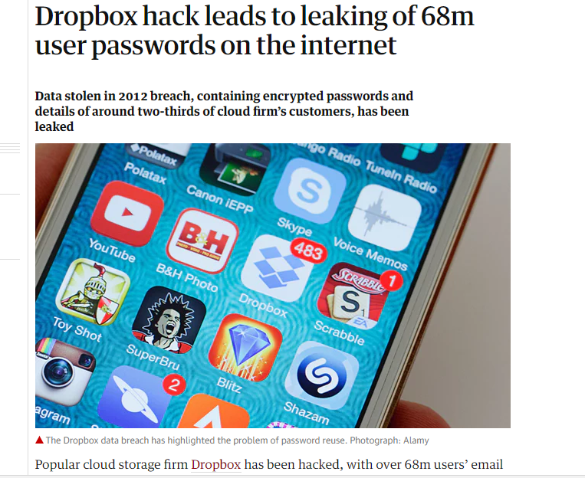
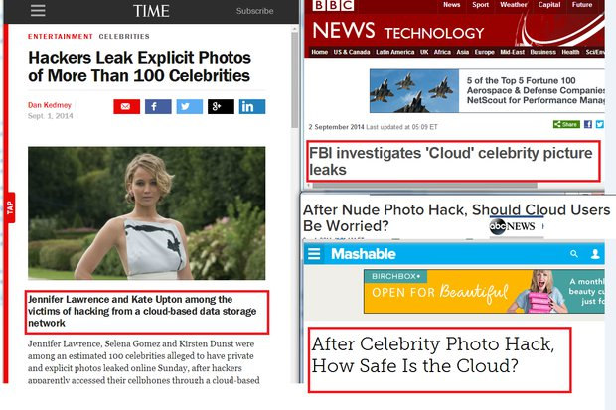
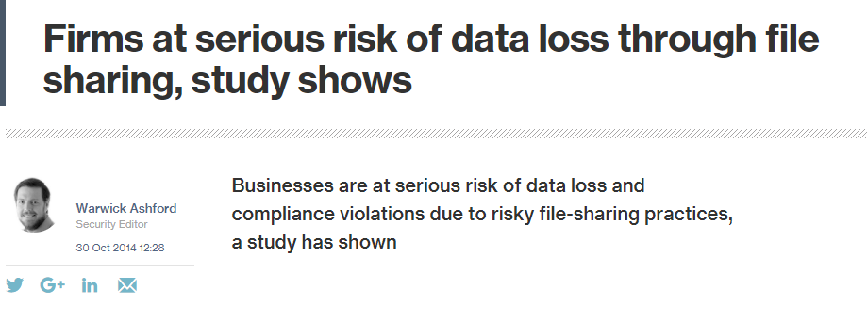
Introduction
2014
2012
2015

Slide 10
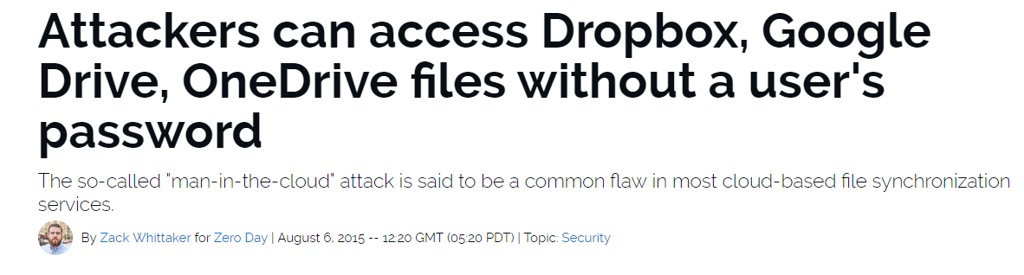



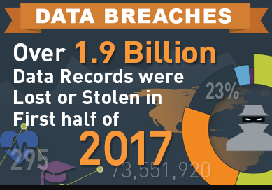
Introduction
2015

Slide 11
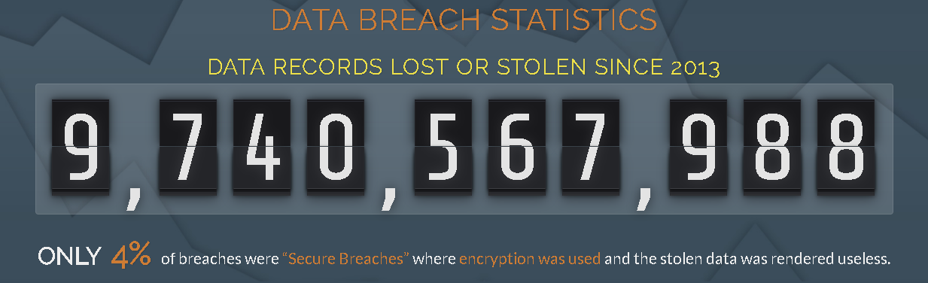
Introduction
The Question is , Is your Data Secured even if Data Breach Happens?
From the Recent Analysis of Data Breach it is clear that 96% of Breaches were “Unsecured Breaches” where Encryption was not Used , Only remaining 4% of Breaches were “Secured Breaches” where Encryption was used. There is Drastic Improvement in technology everyday, Yet no one knows how to stop the increasingly sophisticated hacking.

Slide 12

Our Solution
We Instead Of Actually Focusing on IOT(Internet Of Things) , gave priority to EOT(Encryption If Things).
Our Aim is to Reduce No. of Unsecured Breaches by providing Security itself while storing Files, by using encryption at premature Level itself.
Cloud
File(Unsecured)
Encrypted
Authenticity, Smaller Chunks
Secure
Usage of Diverse Algorithms
E2E

Slide 13
How It Works?
Taking It From SENDER point of View
The File along with recipient List is First inserted and then file is divided into ‘n’ different Modules(Say ‘n’=9).
Each Module is then Assigned With Unique KEY String of Length (Say Ranging From 32-50 Characters).
Each Modules Then Undergoes Encryption using Few different Algorithms involving a Unique File Encoding ASCII Pattern Values , which Makes it more Stronger.
These Modules Are Linked Internally in Sequential Manner and then are separately Steganographed in the Form of Image.
5
6
These Steganographed Images Of Encrypted Modules are then stored over Cloud.
The Final EBC Card is then Obtained as output. Irrespective of the Input File Size , It’s Size Will be always Fixed i.e 165KB(approx.) which can be carried Anywhere quite similar to QR Code but With Different Approach. Eg:
4
3
2
1
1
2
3
4
5
6

Slide 14
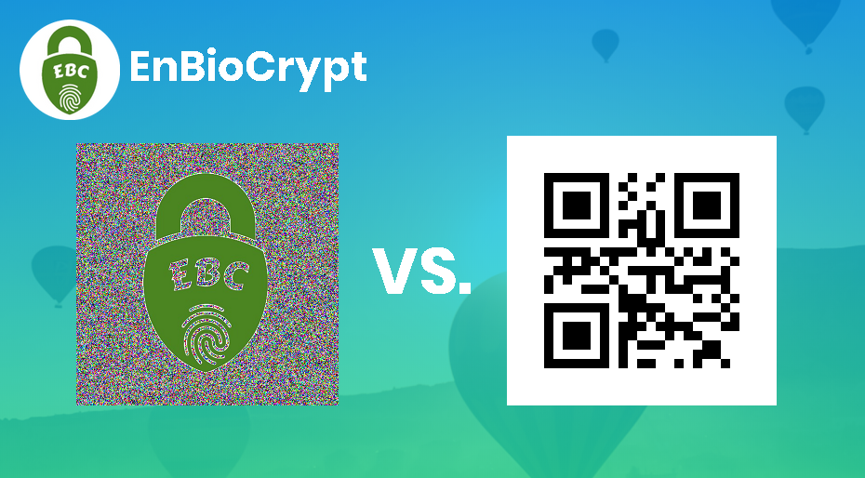
How It Works?
NOTE: These Steganographed image of Modules are Formed in RAM and are not stored in Secondary Memory/Temp Folder Which will not let Sender Know about The Existence of Modules.
EBC Card
Attempts to Make Final
Image Scannable over
phone(camera) or
webcam is prior to
future Developments.

Slide 15


Stages Explanation
Each Module Undergoes Encryption
Usage of Diff. Algorithm and Unique Key
Gen. of Steganographed Image Modules
3
2
M1
1
M2
4
File M
M3
M1
M2
M3
M4
M5
M6
M7
M8
M9
6
EBC Card
M9
5
Architecture of Encrypter

Slide 16

Elaboration of Stages and
2
3
In Between the above two stages the values Like Unique Key for every Modules , Recipient Details and ASCII Key Pattern are being stored Over Backend , as the matter of fact to provide Authenticity to file.
2
Record Managing File’s Modules Keys
Record Managing Recipient Details
Record Managing File ASCII Encoding Pattern
3

Slide 17
Why moduling?
Dividing a file into modules is always safer as it enhances to lower risk factor of man in middle attack.
In addition each module is assigned with its own unique key making the File More Secured .
Modulation Also helps in less consumption of RAM while Encrypting, thereby letting other tasks run as normal.

Slide 18
How It Works?
Taking It From RECIEVER point of View
NOTE: These Steganographed image of Modules are Retrieved in RAM and are not stored in Secondary Memory/Temp Folder Which will not let Receiver Know about The Existence of Modules.
1
The Received EBC Card is Placed along with receiver’s email address as Input.
2
The Recipient List is Checked to ensure whether the provided email has access to the shared File.
3
If Recipient’s Email Address has access to the file , the OTP will be sent to corresponding receiver's Phone Number provided by the Sender.
4
5
When approved, All the Values Stored subjected to Files will be retrieved from the backend Records, corresponding Modules will be called from cloud and then will Undergo Decryption accordingly.
The Decrypted File will be Saved in “Decrypt Dumps” Folder.
1
2
3
4
5

Slide 19

Stages Explanation
1
2
Email
Record Managing File’s Modules Keys
Record Managing Recipient Details
Record Managing File ASCII Encoding Pattern
EBC Card
Fetch of Steganographed Image Modules
Usage of Diff. Algorithm and Respect. Key
Each Module Undergoes Decryption
3
4
OTP Approval
5
File M
Architecture of Decrypter

Slide 20
Why EnBiocrypt ?
A more ROBUST and RELIABLE model of file sharing via Google Drive , Dropbox (or) Any Other Cloud Storage.
It is a light weighted digital card is obtained which is shareable, modifiable and provides authenticity.
Most importantly It is more like carrying key which opens/executes after successful authentication.

Slide 21
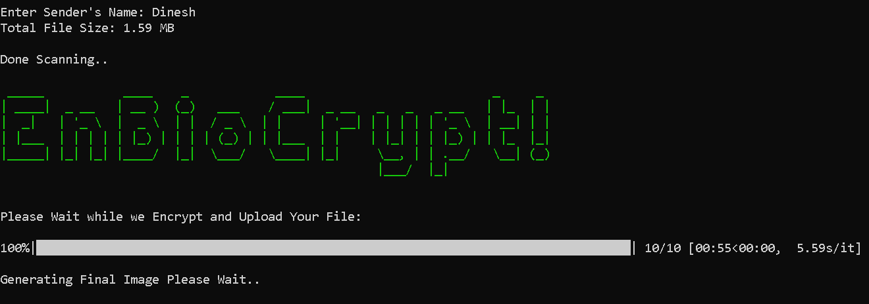
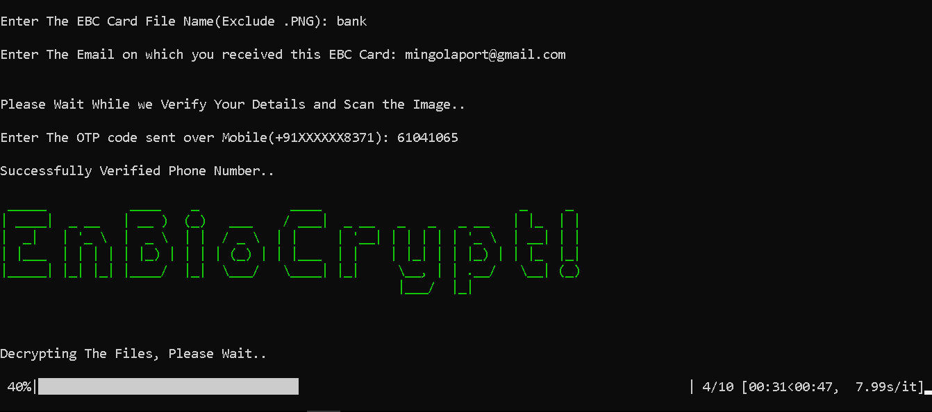
Screenshots
Encrypter:
Decrypter:

Slide 22
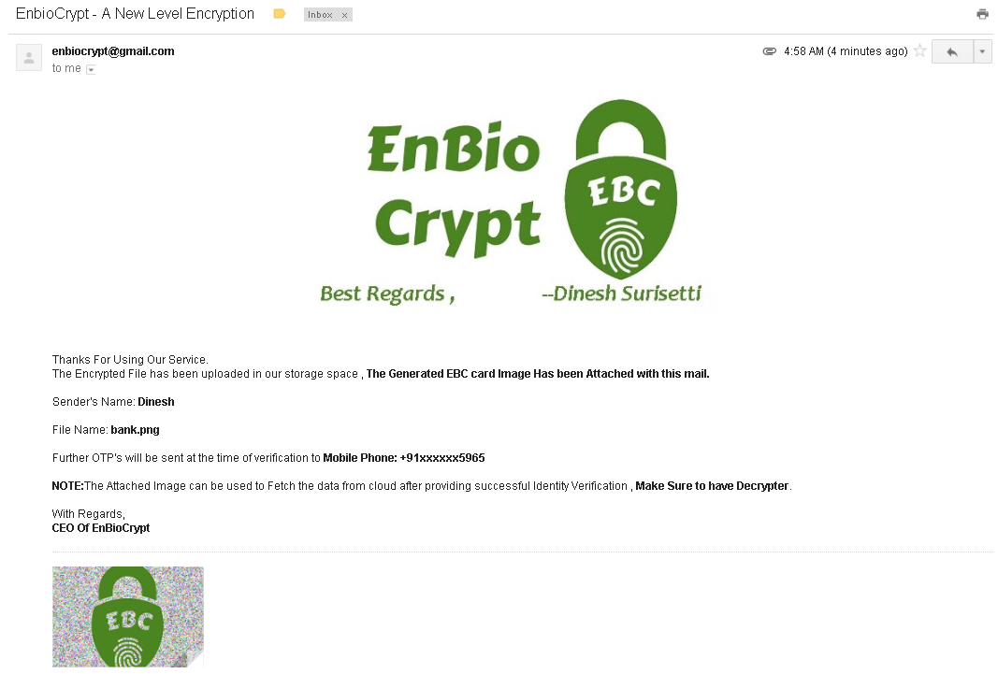
Screenshots
EBC Card

Slide 23
Thanks For Watching.
-This Presentation is Brought to you By EnBioCrypt Family
-www.enbiocrypt.com

