Slide 1
Zero Shot Learning for Code Education: Rubric Sampling with Deep Learning Inference
Harshavardhan Sivadanam
hsivadan@buffalo.edu
CSE 705: Recent Advances in Deep Learning & Reinforcement Learning
Instructor: Dr. Alina Vereshchaka, Summer 2023
Recent Advances in Deep Learning & Reinforcement Learning
Date : 06/28/2023
1/ 13

Slide 2
Introduction and Problem Statement
The importance of providing personalized feedback to students in computer science education, as it helps students learn more effectively and efficiently. However, the growing demand for computer science education has made it challenging for instructors to provide personalized feedback on code submissions.
Recent Advances in Deep Learning & Reinforcement Learning
Date : 06/28/2023
2 / 13

Slide 3
Problem Statement
This paper addresses the challenge of providing automated feedback for students in code education using rubric sampling approach to tackle the zero shot feedback challenge.
Recent Advances in Deep Learning & Reinforcement Learning
Date : 06/28/2023
3 / 13

Slide 4
Background
Zero Shot Feedback Challenge:
The “Zero-Shot” Feedback Challenge is to infer the misconceptions that led to errors in a student’s answer using zero historical examples of student work and zero expert annotation
Zero Shot Learning:
Zero-shot learning is a type of machine learning where a model is trained to recognize or classify objects or tasks it has never seen before during training. In other words, the model is expected to generalize its knowledge from the training data to make predictions or classifications on completely new, unseen classes or instances.
Recent Advances in Deep Learning & Reinforcement Learning
Date : 06/28/2023
4 / 13

Slide 5
Background
Rubric sampling:
a deep learning model generates a diverse set of potential feedback messages for a given student's code submission. Then, a human expert, such as a teacher or teaching assistant, reviews the generated feedback options and selects the most appropriate one for the student's submission.
Related work:
Original work found that latent patterns in how students solve programming assignments have signal as to how he or she should proceed. Applying a neural network improved prediction of feedback but models were (1) too far from human accuracy, (2) weren’t able to explain its predictions and (3) required massive amounts of data.
Recent Advances in Deep Learning & Reinforcement Learning
Date : 06/28/2023
5 / 13

Slide 6
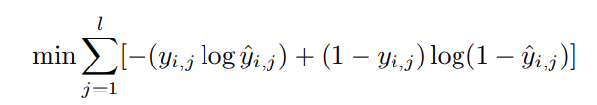
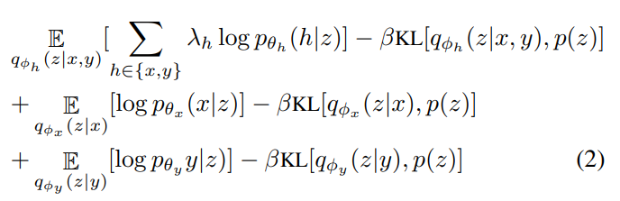
Methods
D = {xi , yi} n i=1 where xi = [xi,1, ..., xi,Ti ], yˆi = f(xi), yi = [yi,1, ..., yi,l],xi
Feedforward Neural Network:
Trajectory Prediction:
Deep Generative Model:
Recent Advances in Deep Learning & Reinforcement Learning
Date : 06/28/2023
6 / 13

Slide 7
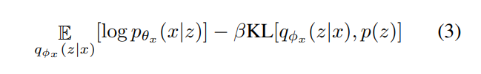
Methods
Rubric Sampling:
Further Learning from Unlabeled Programs:
Rubric Sampling with MVAE:
Recent Advances in Deep Learning & Reinforcement Learning
Date : 06/28/2023
7 / 13

Slide 8
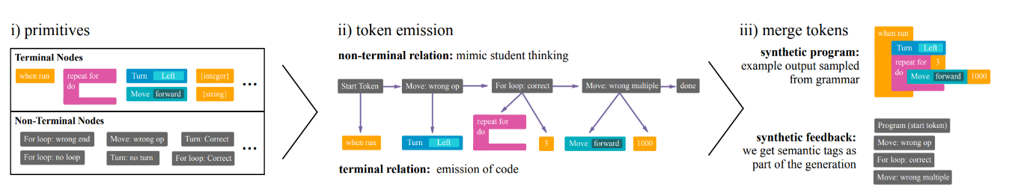
Methods
Recent Advances in Deep Learning & Reinforcement Learning
Date : 06/28/2023
8 / 13

Slide 9
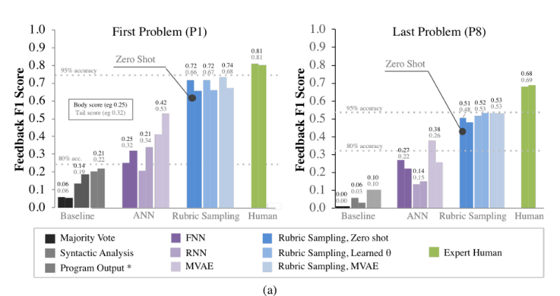
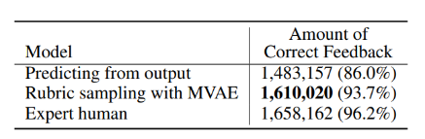
Results
Recreation of Human Labels:
Recent Advances in Deep Learning & Reinforcement Learning
Date : 06/28/2023
9 / 13

Slide 10
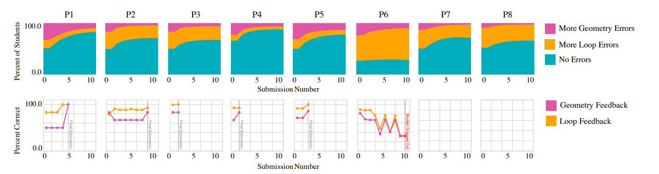
Results
Tracing Knowledge Across Curriculum:
Recent Advances in Deep Learning & Reinforcement Learning
Date : 06/28/2023
10 / 13

Slide 11
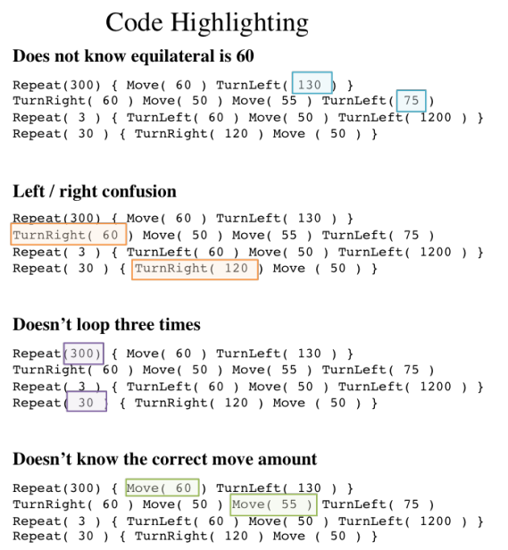
Results
Fine-grain Feedback: Code Highlighting :
Recent Advances in Deep Learning & Reinforcement Learning
Date : 06/28/2023
11 / 13

Slide 12
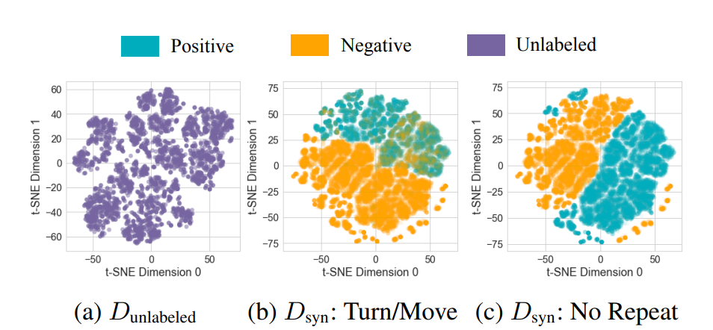
Results
Clustering Students by Level of Understanding:
Recent Advances in Deep Learning & Reinforcement Learning
Date : 06/28/2023
12 / 13

Slide 13
Summary
The paper presents a novel approach to code education using zero-shot learning and rubric sampling, which has the potential to improve the quality and efficiency of feedback for student-written code. The method's success in generating accurate and helpful feedback, as well as its positive reception by programming instructors, highlights its potential for practical application in code education.
Recent Advances in Deep Learning & Reinforcement Learning
Date : 06/28/2023
13 / 13

Slide 14
Thank you
Recent Advances in Deep Learning & Reinforcement Learning
Date : 06/14/2023
14 / 13

