Slide 1

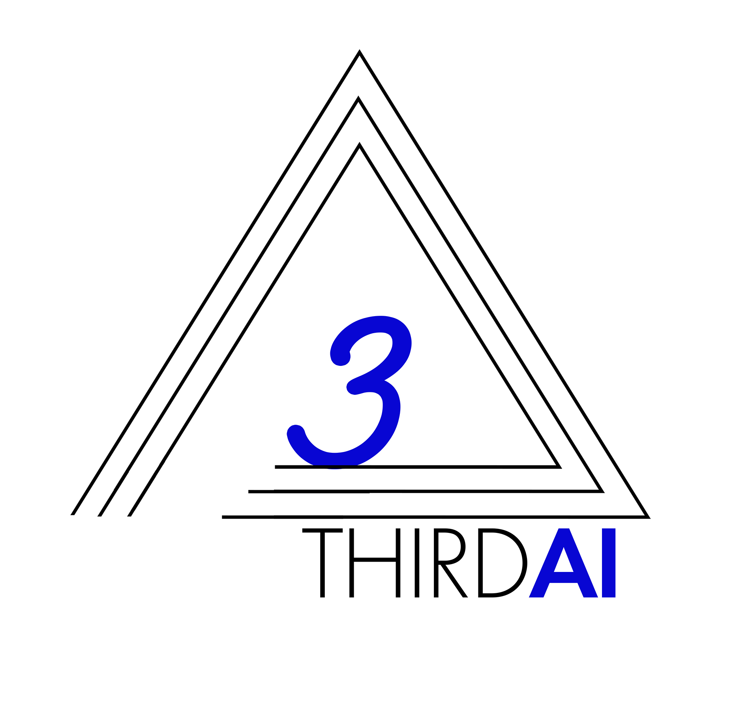
Iterative Repartitioning for Learning to Index and the Power of k-Choices 8th DEC 2021 NeurIPS billion-scale ann challenge
Anshumali Shrivastava
Associate Professor, Computer Science Rice University
Founder and CEO, ThirdAI Corp.
anshumali@rice.edu
Joint with
Tharun Medini (Rice → ThirdAI Corp.)
Gaurav Gupta (Rice )
Beidi Chen (Rice → Stanford)
Alex Smola (AWS)

Slide 2
What are we aiming for?
Generic Efficient Solution for Any Search Problems: Given a query, find the “best” among a very large set of options.
Approximate Near Neighbor Search (ANN) is a special case. Best is defined in terms of a distance or similarity.
Large Output space prediction is another special case
Given a dataset of (query, relevant item) pairs, learn to map from query to items. Best is defined by the data.
Scalable to any dimensions
From hundreds of dimensions to Millions or higher
HNSW etc. wont work.
Sparse vectors are fine.
Model and Data Parallel (Distributed)
Can scale to billions of samples or higher.
Leverage Multi-GPU (or Multi-Node Clusters).
If we are assuming data will reside on one machine, then it is prohibitive for many commercial applications

Slide 3
Current Landscape and Shortcomings
Convert every embedding to a few hundred dimensions (less than 500)
Requires a neural network.
Assume inference is cheap and affordable. Neural Network Inference is first step for the query.
Concerns: Near-neighbor in low dimensional space on a fixed standard metric.
Low dimension is restrictive. BERT is 768 D and HNSW becomes slower with large D.
Many images are now embedded to 4000 D (YFCC dataset) → worse for HNSW.
Major Concern: Disconnect between learning and inference.
Inference assumes an approximate oracle which training has no idea about
What is the accuracy loss if we only find approximate near-neighbor.
Always beneficial if during training we know what approximation we are doing for inference.
Near-Neighbor Oracle should be optimized as a part of the training process

Slide 4
The Hardness of the Problem
Large Output space prediction
Mapping from a query to relevant item is at least O(N), without data structures.
Any Neural networks with K outputs will need at least K inner products.
First step is to map query to a bucket (or region) with << O(N) items.
If we have B buckets, then mapping takes O(B) time (whether learned or not). So B must be << O(N)
Trees and Graphs are not parallel and distributed computations friendly. Also hard to leverage GPUs.
Most Promising Solution: Load Balanced Hash Tables. If we have B buckets they better be balanced (want to argue otherwise?)

Slide 5
Framework: Learning to Index into (Several) load-balanced partitions.
Use neural network to map query (input vector) to B outputs (B class classification).
We need R independent repetitions, as neural networks are imperfect. .
Data and Model Parallel.
Load Balancing:
Popular Option: Regularization (Doesn’t really work)
Surprising Easy Option: Start with Fixed balanced partition
Sufficient?
Almost Yes!

Slide 6
Two Sided Learning Mathematical Equivalent to One Sided with Orthogonality.
Random Assignment to Buckets (B buckets with R repetition) is equivalent to very sparse (R non-zeros) in B x R dimensional near-orthogonal embeddings.
Learning both query and item embedding then orthogonalizing item embeddings is same as starting with any orthogonal item embeddings and learning the query embedding.

Slide 7
Learning to Hash Vs Learning to Index
Learning to Hash
Convert vectors to binary embedding or some other quantized embeddings
Cons: It is assumed that near-neighbor is easier after conversion.
Most lower bounds for near-neighbor search are on binary vectors!
The indexing part is assumed to be easier which is seldom true unless the embeddings are just a few bits (not very expressive).
Learning to Index
Close to reality as indexing is part of the optimization.

Slide 8
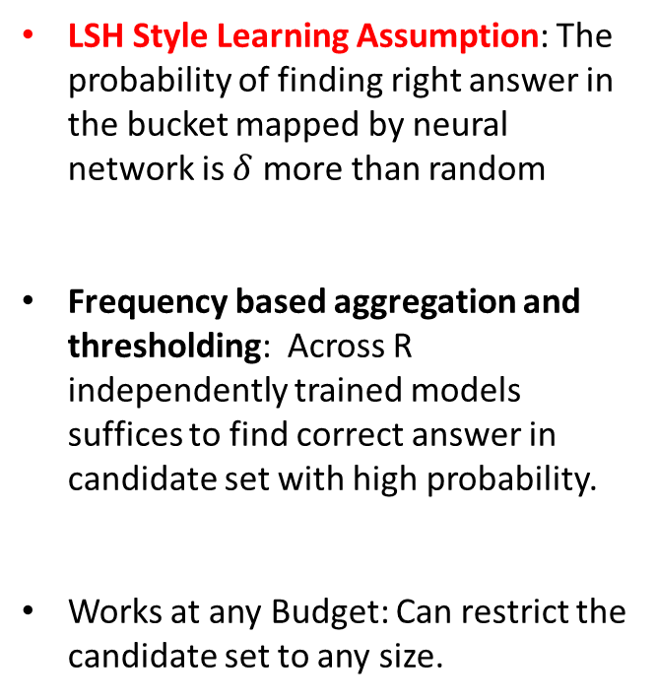
Candidate Set Generation
LSH Style Learning Assumption: The probability of finding right answer in the bucket mapped by neural network is $δ$ more than random
Frequency based aggregation and thresholding: Across R independently trained models suffices to find correct answer in candidate set with high probability.
Works at any Budget: Can restrict the candidate set to any size.

Slide 9
Reduce the Chance of Miss and Better Load Balancing: Repartitioning with K-Choices
Label (neighbor) affinity of a Bucket: Total score to bucket given by neural networks on data samples labeled with label l.
- Simple Repartitioning: Assign label to bucket with most affinity. (Likely kill load balancing)
- Power of K-Choices: Assign label to least heavy bucket chosen form the top-k buckets based on label affinity.

Slide 10
Task 1: Extreme Classification
Learns the embeddings as well as efficient search (inference).
Both higher accuracy and faster inference.
Even outperforms several tree based methods in inference speed.

Slide 11
Task 2 (Single Machine): Near Neighbor Search (Exact Same Framework as Task 1!)

Slide 12
Load Balancing: Better than uniform!

Slide 13
Distributed GPU (8 V100 GPU (DGX))

Slide 14
Distributed CPUs (8 CPU nodes)

Slide 15
References
Medini, Tharun, Beidi Chen, and Anshumali Shrivastava.
"SOLAR: Sparse Orthogonal Learned and Random Embeddings.“
International Conference on Learning Representations. 2020.
Gupta, G., Medini, T., Shrivastava, A., & Smola, A. J. (2021).
“IRLI: Iterative Re-partitioning for Learning to Index.”
arXiv preprint arXiv:2103.09944.

