Slide 1
Learning to Partition Robustly, with guarantees
Alex Andoni
(Columbia University)
Based on work with Daniel Beaglehole (UCSD)
https://arxiv.org/abs/2108.05433
This talk NOT about: what’s the fastest algorithm?
Is about: what questions to ask to guide development of such algorithms?

Slide 2
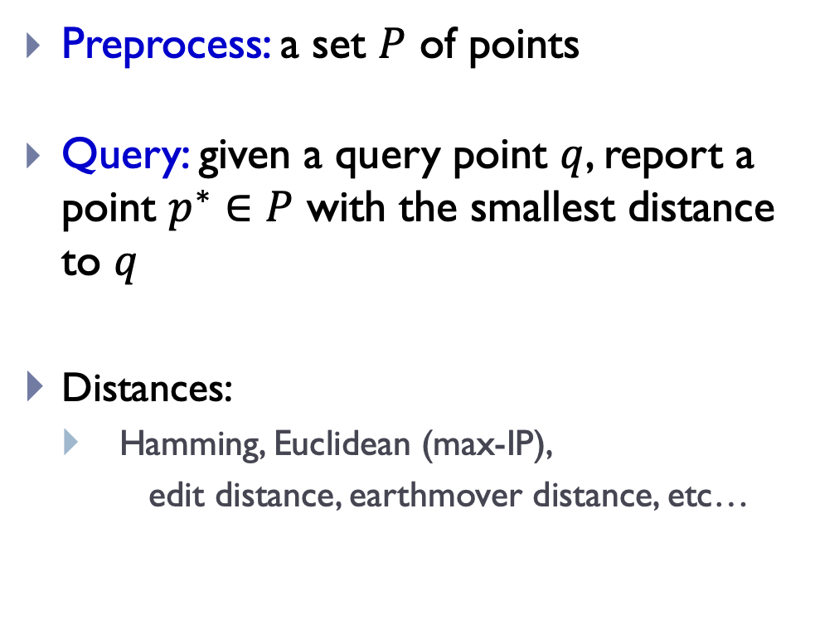
Nearest Neighbor Search (NNS)
Preprocess: a set $P$ of points
Query: given a query point $q$, report a point $p^{∗}∈P$ with the smallest distance to $q$
Distances:
Hamming, Euclidean (max-IP),
edit distance, earthmover distance, etc…
$$p^{∗}$$
$$q$$

Slide 3
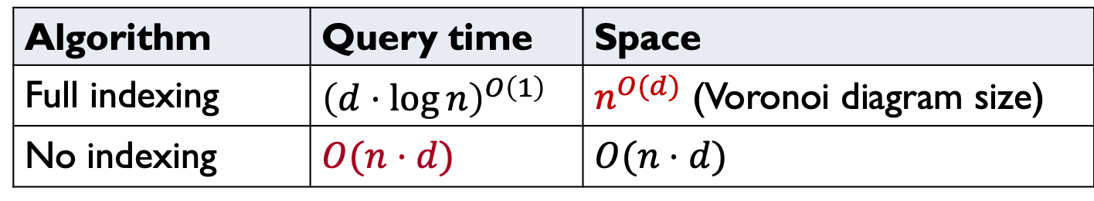
Curse of Dimensionality
Hard when $d≫\log{n}$
Algorithm | Query time | Space
Full indexing | $${\left(d⋅\log{n}\right)}^{O\left(1\right)}$$ | $n^{O(d)}$ (Voronoi diagram size)
No indexing | $$O(n⋅d)$$ | $$O(n⋅d)$$
Refutes Strong ETH
[Wil’04]
$$n^{0.99}$$ | $$n^{O\left(1\right)}$$

Slide 4
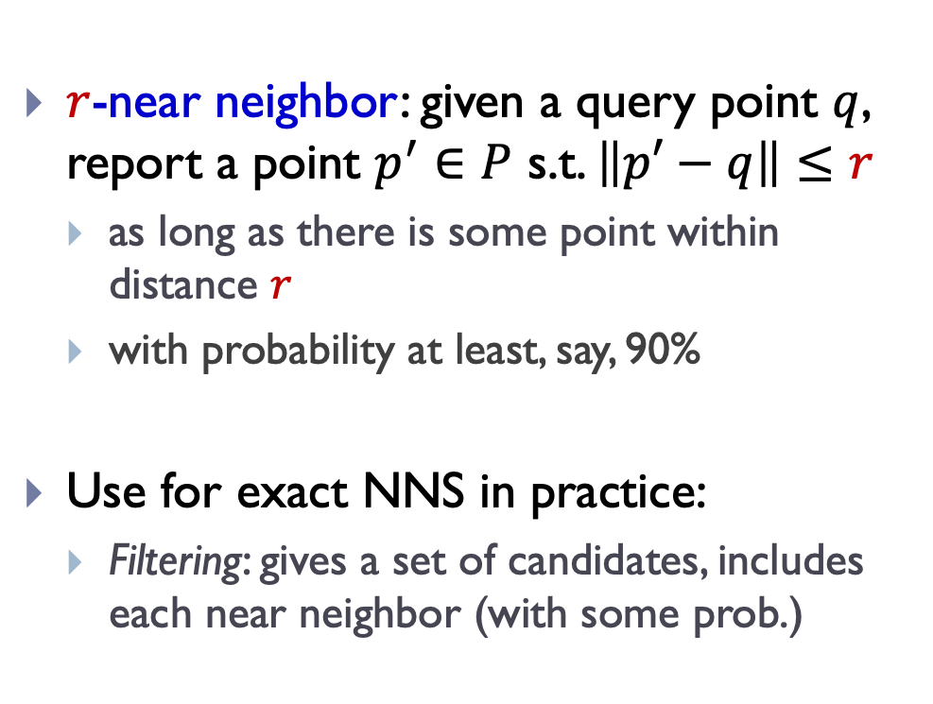
Approximate NNS
$c$-approximate
$r$-near neighbor: given a query point $q$, report a point $p^{′}∈P$ s.t. $\left\|p′−q\right\|≤r$
as long as there is some point within distance $r$
with probability at least, say, 90%
Use for exact NNS in practice:
Filtering: gives a set of candidates, includes each near neighbor (with some prob.)
$$cr$$
$$r$$
$$p^{∗}$$
$$cr$$
$$q$$
$$p^{′}$$

Slide 5
Indexing algorithms: space partitions
kd-trees
Performance degrades with dimension
Disclaimers:
Not all are indexing:
Sketch (hash) + linear scan
Not all are space partitions:
Graph-based [MY’18]

Slide 6
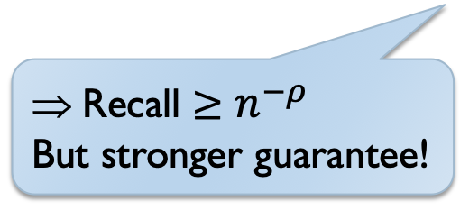

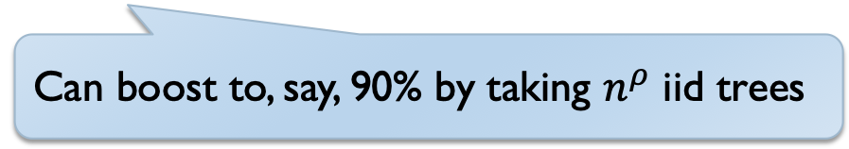
Locality-Sensitive Hashing (LSH)
Random space partitions: oblivious of the dataset
E.g., random hyperplane, simhash [IM’98, Cha’01,DIIM’04]
Guarantees:
$E_{tree}$[# far points in bucket] = 1
Prob. query collides with a r-near neighbor: Pr[success] $≥n^{−ρ}$
Recall $≥n^{−ρ}$
But stronger guarantee!
Can boost to, say, 90% by taking $n^{ρ}$ iid trees

Slide 7
LSH Algorithms
Space | Time | Exponent | $$c=2$$ | Reference
Hamming
space
$$n^{1+ρ}$$ | $$n^{ρ}$$ | $$ρ=1/c$$ | $$ρ=1/2$$ | [IM’98]
 |  | $$ρ≥1/c$$ |  | [MNP’06, OWZ’11]
Other space/time trade-off possible:
multi-probe [LJWCL’07,…]
Euclidean
space
$$n^{1+ρ}$$ | $$n^{ρ}$$ | $$ρ=1/c$$ | $$ρ=1/2$$ | [IM’98, DIIM’04]
 |  | $$ρ≈1/c^{2}$$ | $$ρ=1/4$$ | [AI’06]
 |  | $$ρ≥1/c^{2}$$ |  | [MNP’06, OWZ’11]
Notes:
Other ways to use LSH

Slide 8
vs Practice
My dataset is not worse-case
Data-dependent: optimize the partition to your dataset
PCA-tree [S’91, M’01, VKD’09,…]
randomized kd-trees, RP, deep-learned [SAH08, ML09, DS13,KS’18,DIRW’20,…]
Quantization/clustering [JDS11, GLGP13,JDJ’17…]
spectral/semantic/WTA hashing [WTF08, CKW09, SH09, YSRL11,…]

Slide 9
Practice vs Theory
Data-dependent partitions often outperform random partitions
But no guarantees (correctness or performance)
Hard to measure progress, understand trade-offs
What’s the right question to ask for the next step?
Data-independent often optimal in worst-case, e.g., for dimension reduction [A’03, JW’13, AIP’06]
Why do data-dependent partitions outperform random ones ?

Slide 10
How to study phenomenon:
Answer 1: further special structure in the dataset
“Intrinsic dimension” is small
[Cla’99,KR’02, KL’04, BKL’06, IN’07, DS’13,…,DK’21]
Data generated from a model [AAKK’14,…]
Answer 2: have access to distribution of the queries
“Recall” assumes this by default
Why do data-dependent partitions outperform random ones ?
Algorithms with no explicit structure assumptions?
Adversarial queries?

Slide 11
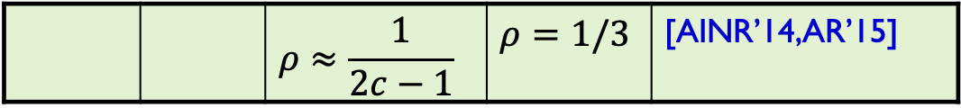
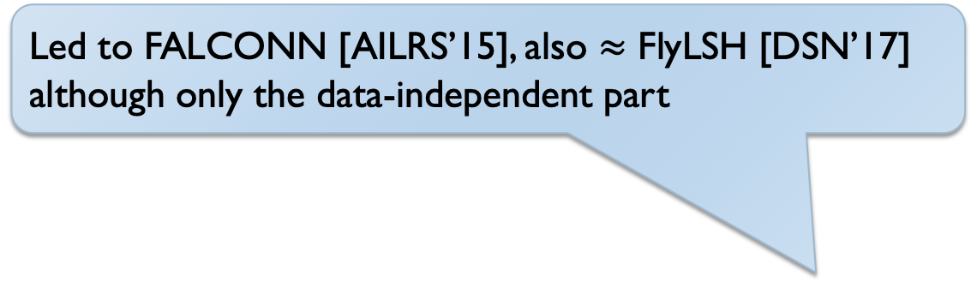
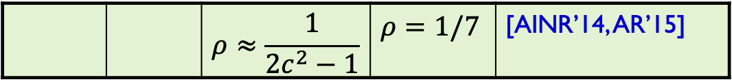
Answer 3: DD helps even in worst-case!
Space | Time | Exponent | $$c=2$$ | Reference
Hamming
space
$$n^{1+ρ}$$ | $$n^{ρ}$$ | $$ρ=1/c$$ | $$ρ=1/2$$ | [IM’98]
LSH
 |  | $$ρ≥1/c$$ |  | [MNP’06, OWZ’11]
 |  | $$ρ≈\frac{1}{2c−1}$$ | $$ρ=1/3$$ | [AINR’14,AR’15]
Led to FALCONN [AILRS’15], also $≈$ FlyLSH [DSN’17]
although only the data-independent part
Euclidean
space
$$n^{1+ρ}$$ | $$n^{ρ}$$ | $$ρ≈1/c^{2}$$ | $$ρ=1/4$$ | [AI’06]
LSH
 |  | $$ρ≥1/c^{2}$$ |  | [MNP’06, OWZ’11]
 |  | $$ρ≈\frac{1}{2c^{2}−1}$$ | $$ρ=1/7$$ | [AINR’14, AR’15]

Slide 12
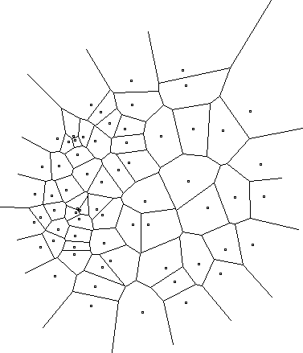
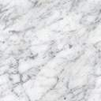
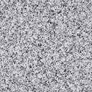
Data-dependent LSH
A random space partition, chosen after seeing the given dataset
Efficiently computable
Ingredient is a “regularity lemma”:
Can always decompose a data-set into “random-looking” data-set, plus a few clusters
Notes:
Example: Voronoi diagram
but expensive to compute the hash function

Slide 13
Answer 4: Instance optimality?
Goal: best possible algorithm for the given dataset
Guaranteed worst-case performance,
but better performance for “nicer” dataset
Focused goal:
“Best possible” in a class: here, tree-based space partition
Quality measure: here, Pr[success] of worst-case query
Alternative: average Pr (if we know the query distribution) = Recall
[AB’21]: for Hamming space
Class = bit sampling/coordinate cut
Includes optimal worst-case LSH [IM’98],
minhash [Bro’97,BGMZ’97]
coor 3
coor 2
coor 5

Slide 14
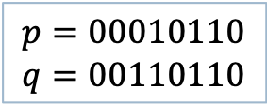
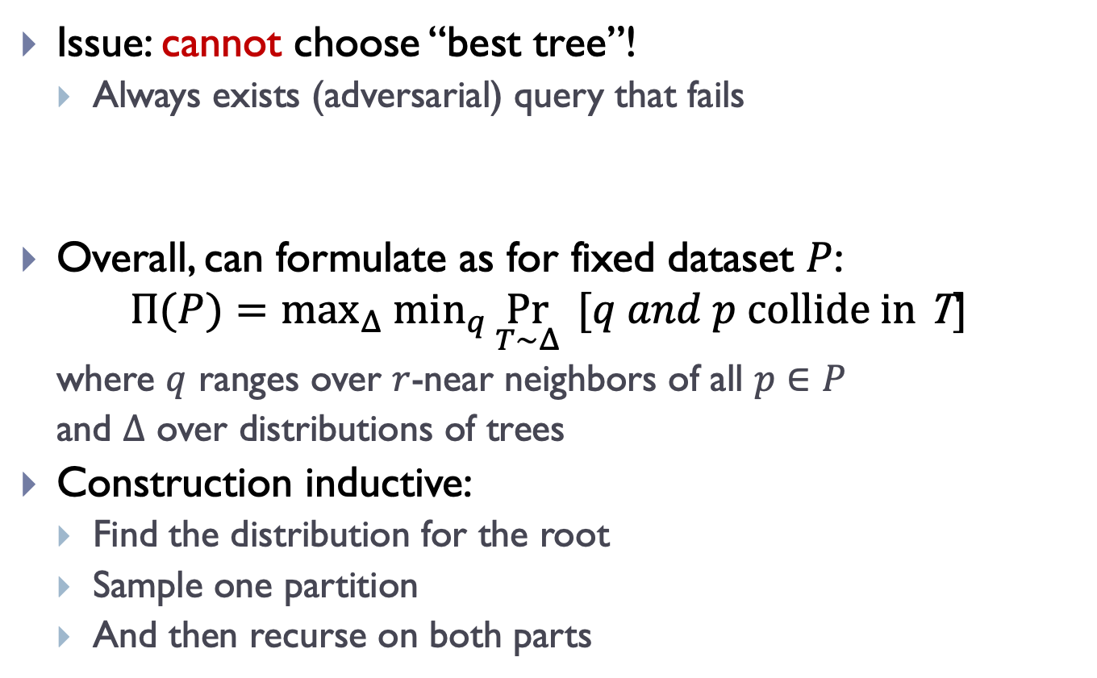
Instance Optimal LSH for Hamming
Issue: cannot choose “best tree”!
Always exists (adversarial) query that fails
Overall, can formulate as for fixed dataset $P$:
$$Π(P)=max_{Δ} min_{q}{\underset{T∼Δ}{Pr}{ [q and p collide \text{in} \text{T}]}⁡}$$
where $q$ ranges over $r$-near neighbors of all $p∈P$
and $Δ$ over distributions of trees
Construction inductive:
Find the distribution for the root
Sample one partition
And then recurse on both parts
Need to find best distribution over trees
$$p=00010110$$
$$q=00110110$$
coor 3
coor 2
coor 5
coor 7

Slide 15

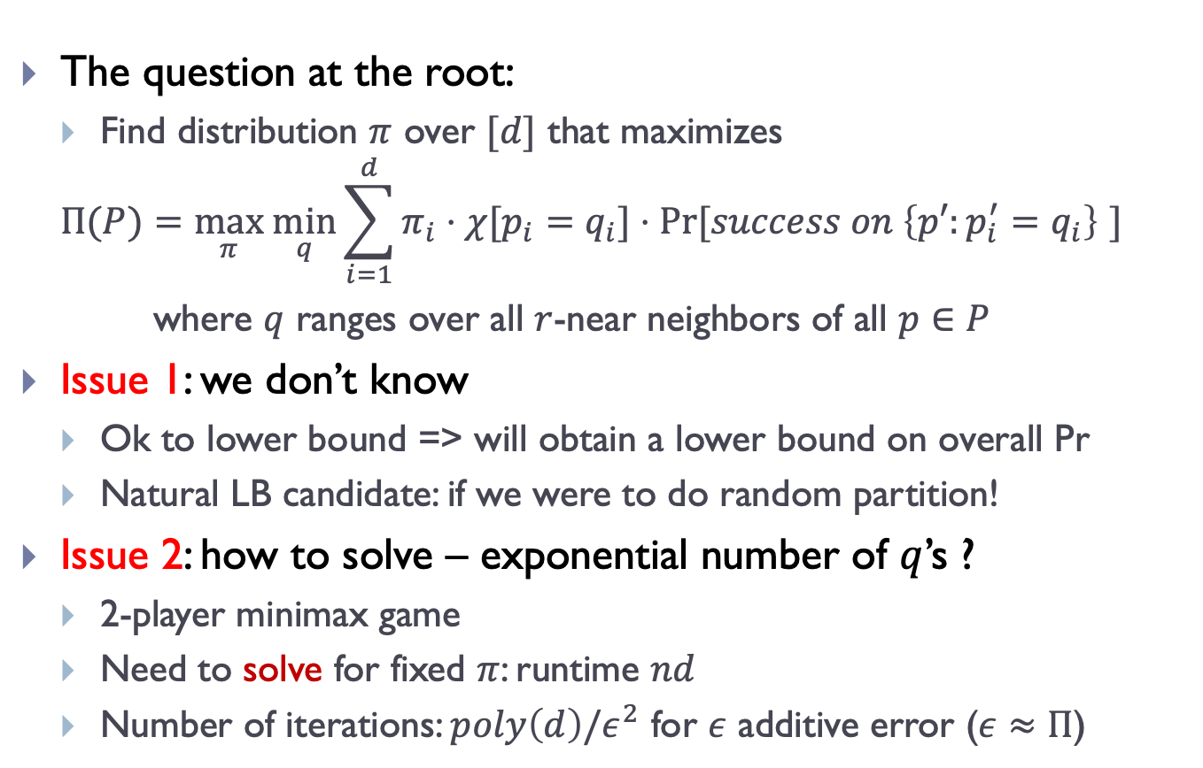
Finding optimal distribution of split
coor $i$
The question at the root:
Find distribution $π$ over $[d]$ that maximizes
$$Π(P)=\max_{π} \min_{q}\sum_{i=1}^{d}{π_{i}⋅χ[p_{i}=q_{i}]⋅Pr[success on \left\{p′:p_{i}^{′}=q_{i}\right\} ] }$$
where $q$ ranges over all $r$-near neighbors of all $p∈P$
Issue 1: we don’t know
Ok to lower bound => will obtain a lower bound on overall Pr
Natural LB candidate: if we were to do random partition!
Issue 2: how to solve – exponential number of $q$’s ?
2-player minimax game
Need to solve for fixed $π$: runtime $nd$
Number of iterations: $poly\left(d\right)/ε^{2}$ for $ε$ additive error ($ε≈Π$)

Slide 16
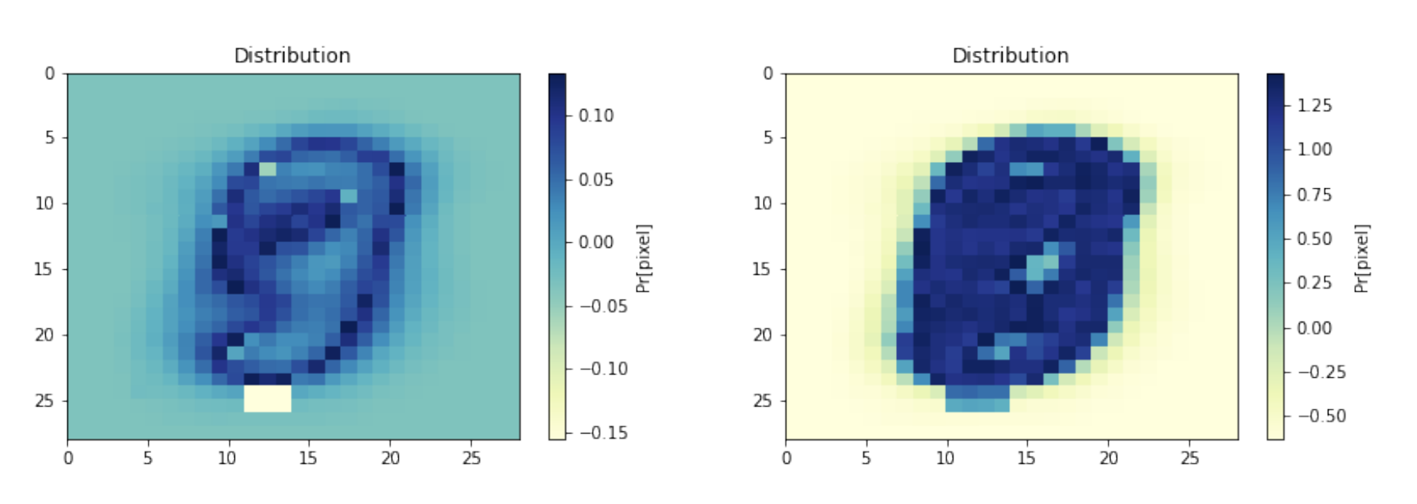
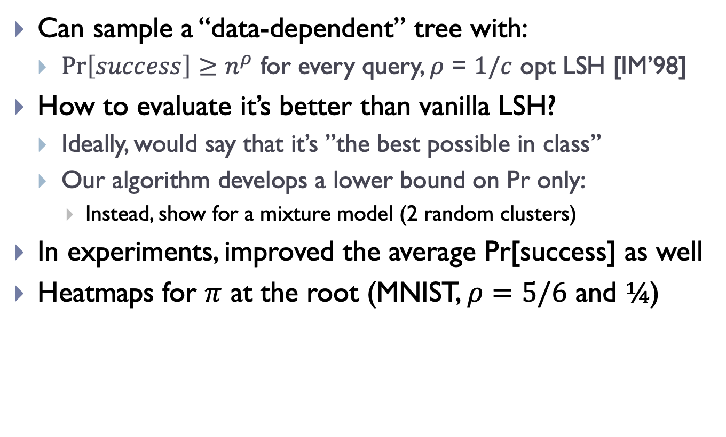
Results
Can sample a “data-dependent” tree with:
$Pr\left[success\right]≥n^{ρ}$ for every query, $ρ$ = $1/c$ opt LSH [IM’98]
How to evaluate it’s better than vanilla LSH?
Ideally, would say that it’s ”the best possible in class”
Our algorithm develops a lower bound on Pr only:
Instead, show for a mixture model (2 random clusters)
In experiments, improved the average Pr[success] as well
Heatmaps for $π$ at the root (MNIST, $ρ=5/6$ and $¼$)

Slide 17
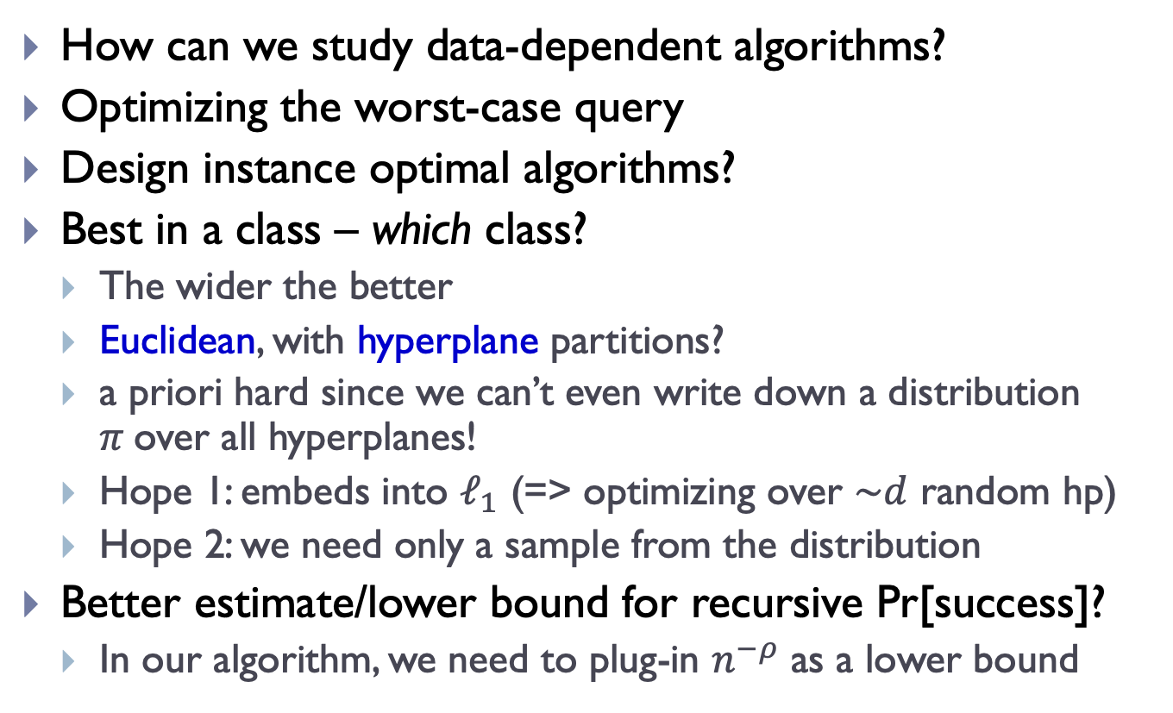
Finale: data-dependent space partitions
How can we study data-dependent algorithms?
Optimizing the worst-case query
Design instance optimal algorithms?
Best in a class – which class?
The wider the better
Euclidean, with hyperplane partitions?
a priori hard since we can’t even write down a distribution $π$over all hyperplanes!
Hope 1: embeds into $ℓ_{1}$ (=> optimizing over $\sim d$ random hp)
Hope 2: we need only a sample from the distribution
Better estimate/lower bound for recursive Pr[success]?
In our algorithm, we need to plug-in $n^{−ρ}$ as a lower bound
Lifting all the queries
Captures simhash, PCA-, RP- trees…

