Slide 1
OPtANNe: Optane Persistent Memory-based Approximate Nearest Neighbors
Sourabh Dongaonkar¹, Mark Hildebrand^{1,3}, Mariano Tepper², Cecilia Aguerrebere², Ted Willke², Jawad Khan¹
¹Intel Corporation, ²Intel Labs, ³UC Davis

Slide 2
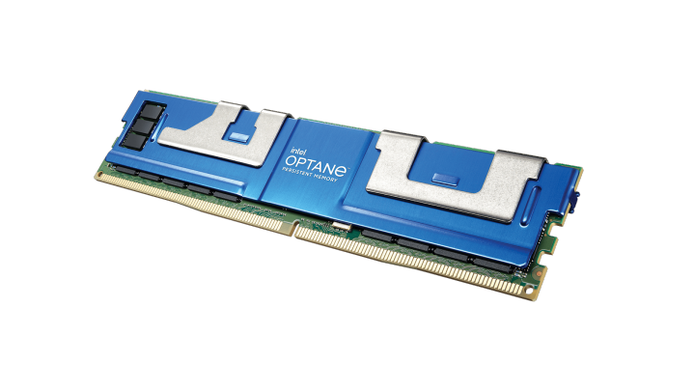
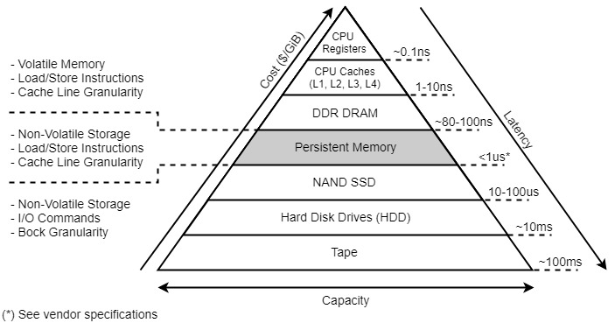
Optane Persistent Memory
Accessed as memory on the DDR bus
DIMM form factor
High capacity (up to 512GB per DIMM)
Nonvolatile memory based on 3DXP
Optane occupies a previously empty position in the memory/storage hierarchy

Slide 3
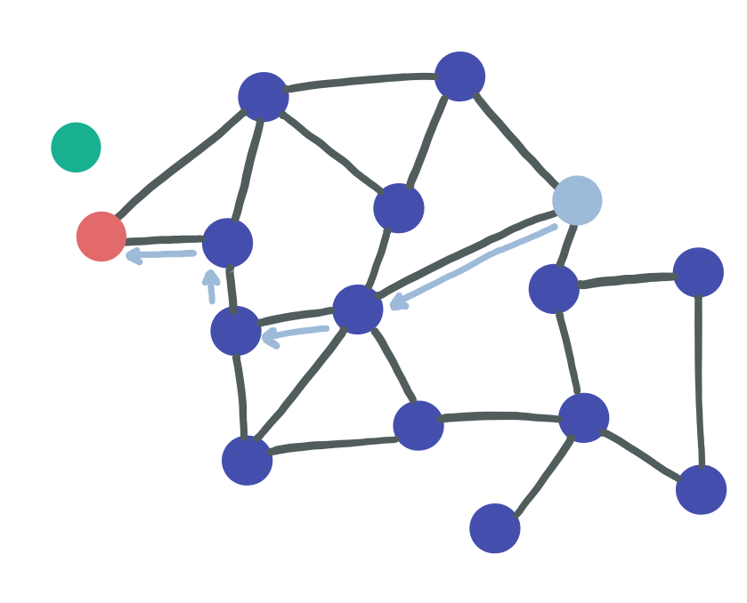
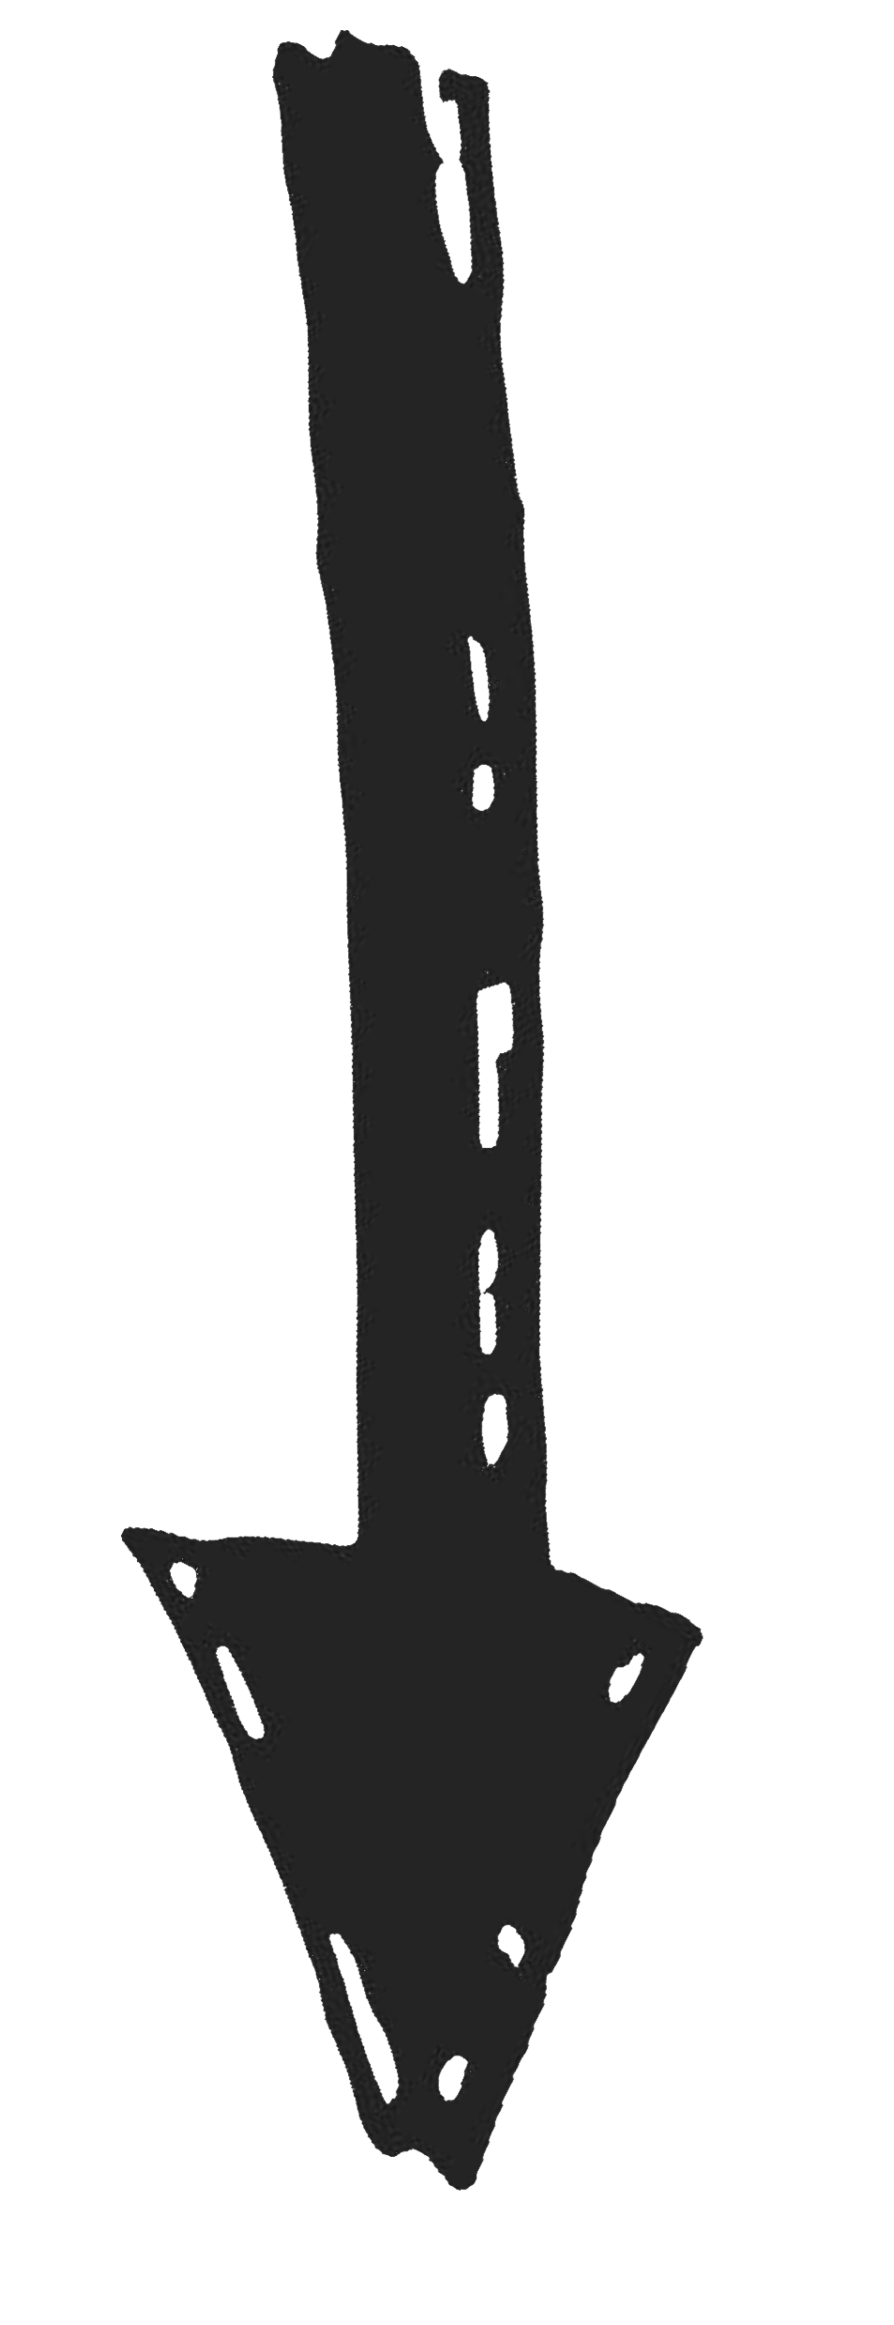
Why Optane for Graph-based ANN?
Greedy graph search:
Retrieve list of neighbors of the current node.
Find the closest neighbor p to the query.
Set current node = p
query
entry point
nearest neighbor
Data vectors
Frequent random accesses of small chunks of data
Graph index
Less frequent random accesses
+ large graph for high recall
Place in DRAM
Place in Optane PMem
Graph | HD vectors | Speed | Capacity | Cost
DRAM | DRAM | ✓ | ✓ | ✗
Optane | DRAM | ✓ | ✓ | ✓
SSD | DRAM | ✗ | ✓ | ✓
Two main data structures, with different memory access patterns
Icons: "https://www.freepik.com"

Slide 4
OptANNe offers exceptional value across all 5 key axes
Accuracy
A multifaceted problem needs multifaceted measures
Scaling
Performance
ANN
Value stemming from:
Solid SW engineering
Optane offers GB/$ to store large graphs
Optane offers fast random load/store access
Power
Cost
(CAPEX+OPEX)
Improvement over next-best solution (CAPEX+OPEX)
Deep1B | BigANN | MSTuring | MSSpace | Text2Image
~20x | ~20x | ~10x | ~10x | ~4x to ~9x

Slide 5
Future work and call to action
Next-gen algorithms
Improve graph navigability
Fewer hops for faster search
Sparser graphs for “BIGGER-ANN”
Reduce DRAM usage with better compact representations (PQ, ScaNN & new methods)
Next-gen hardware
More parallelism with more CPUs
PMem pooling with CXL
Next-gen software
Even the algorithmic playing field with new SOTA SW
Next-gen scaling
Highly proficient solutions for 1B
Extend the scope of future challenges to 10B, 100B, 1T

