Slide 1




Big ANN @ NeurIPS’23 Practical Vector Search Challenge
Harsha Simhadri*, Martin Aumüller¤, Dmitry Baranchuk‡, Matthijs Douze†,
Amir Ingber*, Edo Liberty*, Frank Liu §, George Williams**
*Microsoft, ¤IT University of Copenhagen, †Meta AI Research, *Pinecone, ‡Yandex Labs, §Zilliz, **Ansible AI
Thanks to support from

Slide 2
Why Approximate Nearest Neighbor Search?
Semantic Search
Recommendation Systems
Security and threat analysis
…
RAG (Retrieval Augmented GenAI)
Ground the models in “facts”
Adapt to private and real-time data

Slide 3
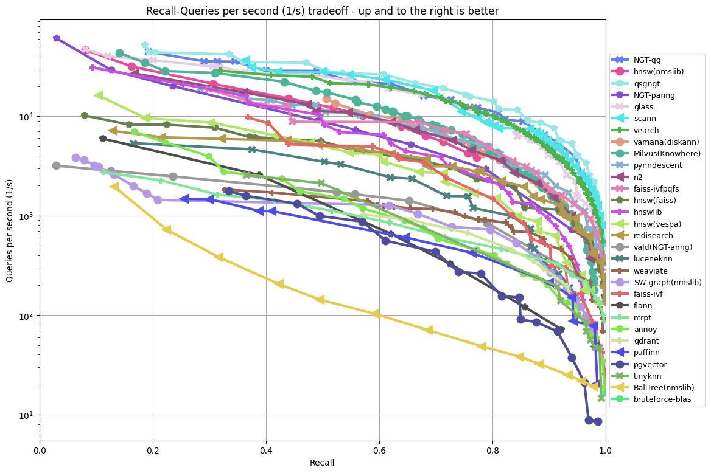
Many Algorithms. How to measure?
Queries/sec(QPS)vs Recall@k
Latency, interactive & batch
Average Precision
DRAM and Disk Space
Power consumption
Indexing space and time
ann-benchmarks.com; glove-100-angular

Slide 4
Big ANN @NeurIPS’21: Billion-Scale Challenge
Step up from ~1M scale (ann-benchmarks.com)
6 billion scale datasets from IRISA, Meta, Microsoft, Yandex
3 tracks
Standard VM with 64GB DRAM. Measure QPS vs recall.
Standard VM with 64 GB DRAM + 4TB SSD. Measure QPS vs recall.
Any hardware: Cost- and Power-normalized QPS
https://big-ann-benchmarks.com/neurips21.html

Slide 5
This year: Practical Variants + Smaller Datasets
Practical Variants
Filtered search
OOD
Sparse
Streaming
Smaller Scale
10M datasets
Laptop-sized (16GB DRAM)
$1000 AWS credit, sponsored by Pinecone.

Slide 6




Filtered Search: Nearest vector matching tags
Dataset: 10M images from YFCC-100M
CLIP embeddings
"bag" of tags (200386 total):
words extracted from the description
camera model,
year
100,000 queries:
image embeddings
one or two tags
Baseline: Filter-FAISS

Slide 7
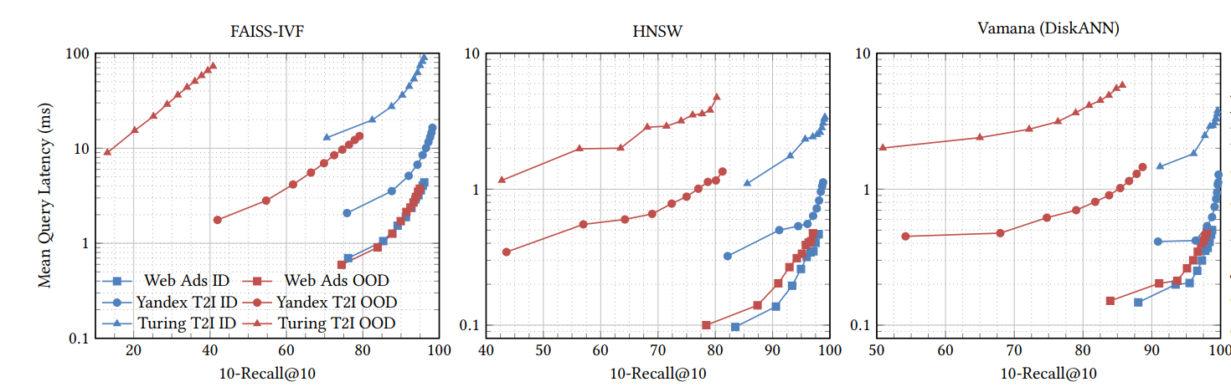
Out of Distribution Queries
Index: 10M subset of the Yandex visual search database
200D Se-ResNext-101 image embeddings
Queries: user-specified text search
embeddings a variant of the DSSM model.
Baseline: DiskANN (in-memory version)
[Image credit: OOD-DiskANN, Jaiswal et al.]

Slide 8
Sparse track
MS MARCO + SPLADE sparse neural embeddings
8,841,823 text passages from MS MARCO
encoded in ~30,000D, average ~120 nonzeros.
Query set:
6,980 text queries + SPLADE encoding.
~49 nonzero elements per query vector
Distance metric: Max inner product
Baseline: Linear scan

Slide 9
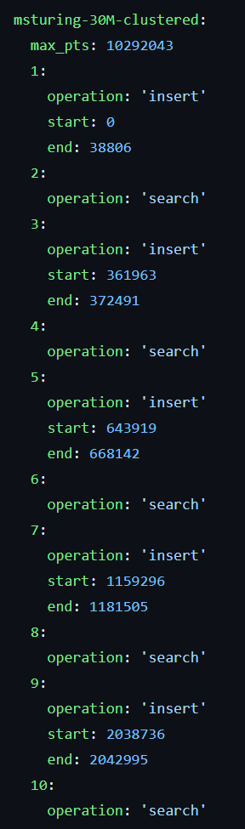
Streaming track
Sequence of inserts, deletes and search
Dataset: MSTuring-30M-clustered
Cluster with k-means, k=64
5 rounds of
insert a sample from one of 64 clusters
search
Delete a sample from one of 64 clusters
search
Complete all 1280 steps in 1 hour
maximize recall over all searches.
Baseline: DiskANN (in-mem dynamic version)
…1280 steps

Slide 10
Summary of datasets and baselines
Track | Dataset | Dimensions | Data type | Baseline algo | QPS @ 90% recall | Release terms
Filtered | YFCC-10M + CLIP | 192 | uint8 | filter-FAISS | 3200 | CC BY 4.0
OOD | Text2Image-10M | 200 | float32 | diskann | 4882 | CC BY 4.0
Sparse | MS MARCO / SPLADE | ~30K | float32, sparse format | Linscan | 101 | MS-MARCO: Free NC SPLADE: CC BY NC SA
Streaming | MSTuring-30M-clustered | 100 | float32 | fresh-diskann | 0.883 recall@10 (45mins) | O-UDA

Slide 11
The competition
Participation
60 expression of interests
26 code submissions
Universities + Industry
Hardware
Azure D8lds v5
AWS EC c6i.2xlarge
8 vCPUs
16GB DRAM (limit to 8GB DRAM with docker)

Slide 12
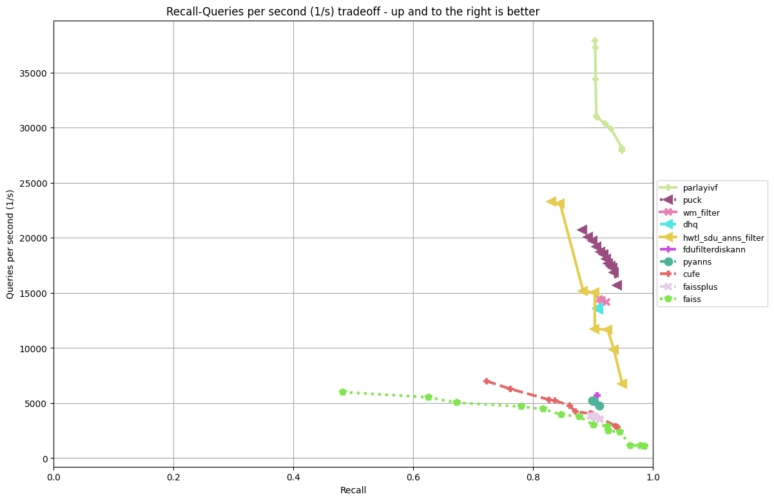
Filter Track Results

Slide 13
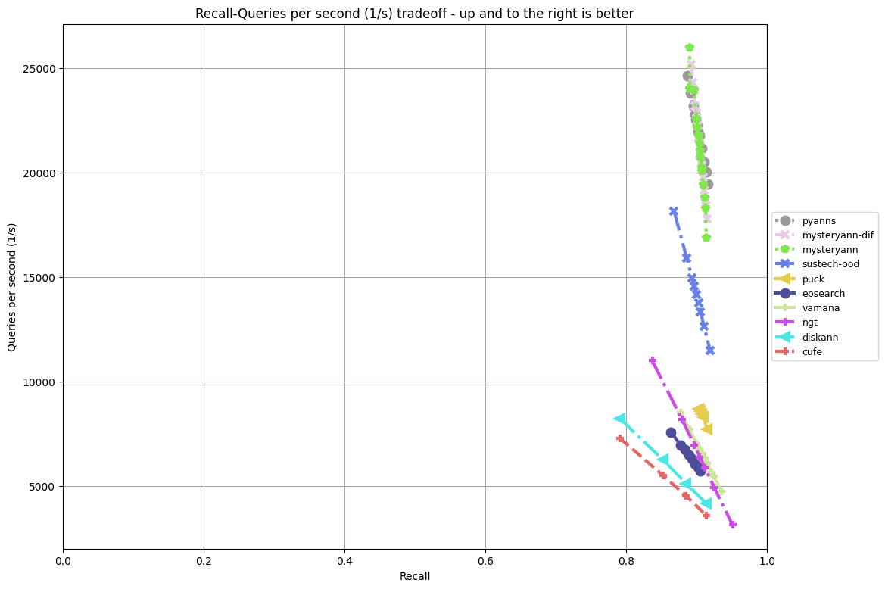
OOD Track Results

Slide 14
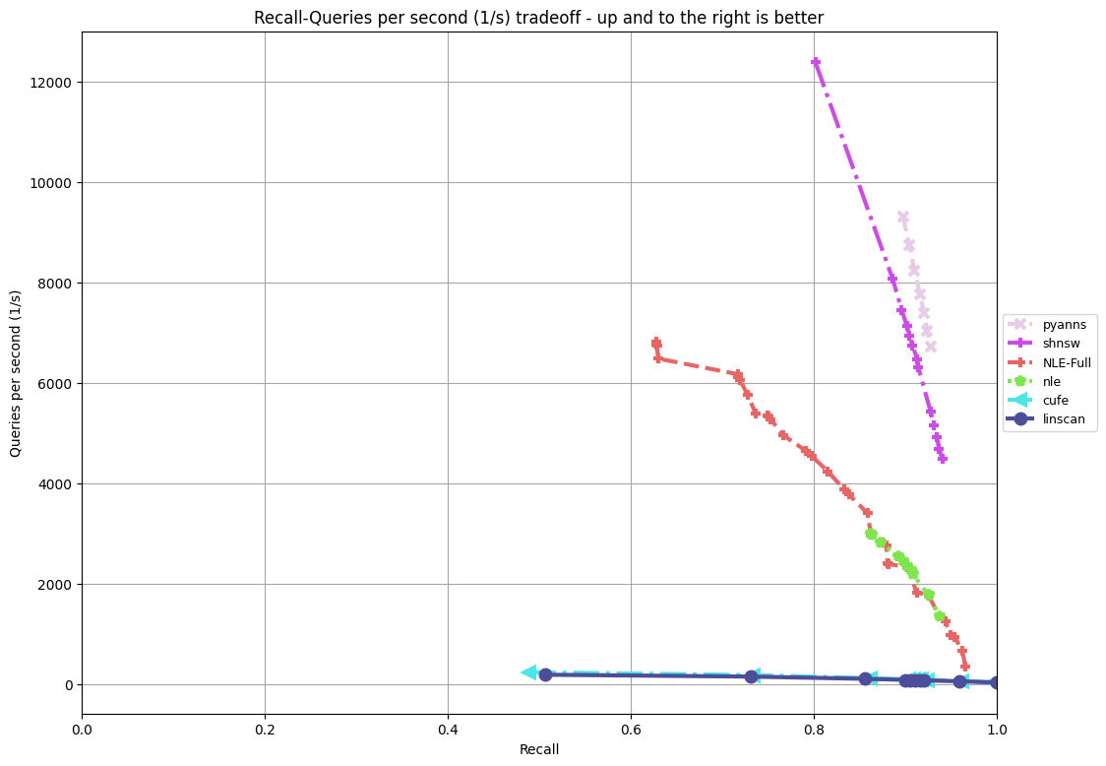
Sparse Track Results

Slide 15
Streaming Track Results
Recall@10 over averages over all queries, runtime<1 hour
Entry | Recall@10
Puck | 0.9849
Hwtl_sdu_anns_stream | 0.9675
PyANNS | 0.9597
cufe | 0.819
Baseline | 0.883

Slide 16
Track Winners
Filter | ParlayANN IVF²: Fusing Classic and Spatial Inverted Indices for Fast Filtered ANNS Ben Landrum (UMD), Magdalen Dobson Manohar (CMU), Mazin Karjikar (UMD), Laxman Dhulipala (UMD)
OOD | RoarANN: Projected Bipartite Graph for Efficient Cross-Modal ANNS Meng Chen, Yue Chen, Rui Ma, Fudan University, Kai Zhang, Yuzheng Cai, Jiayang Shi, Yizhuo Chen, Weiguo Zheng. Fudan University PyANNS** Zihao Wang, Shanghai Jiao Tong University.
Sparse | PyANNS** Zihao Wang, Shanghai Jiao Tong University. GrassRMA: GRAph-based Sparse Vector Search with Reducing Memory Accesses Meng Chen, Yue Chen, Rui Ma, Kai Zhang, Yuzheng Cai, Jiayang Shi, Yizhuo Chen, Weiguo Zheng. Fudan University.
Streaming | Puck: Efficient Multi-level Index Structure for ANNS in Practice Jie Yin, Ben Huang, Baidu.
**Zihao Wang is also an employee of Zilliz. However, he declares that the PyANNS entry was created on his time off, without any involvement from Zilliz or any of the other organizers. This entry did not declare conflict with organizers before participating.

Slide 17
Invited Speakers
Corey Nolet [NVIDIA]: Accelerating vector search on GPU with RAPIDS RAFT
Yury Malkov [OpenAI]: ANNS in Recommender Systems

Slide 18
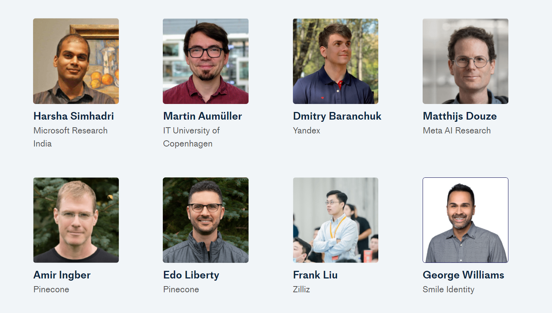
Organizers

