Slide 1

Puck : Efficient Multi-level Index Structure for Approximate Nearest Neighbor Search in Practice
Author : Jie Yin, Ben Huang
GitHub : https://github.com/baidu/puck

Slide 2

01
Open Source Search Engine Puck
2019
2021
Visual search ten billion identical image project switches to Puck, single instance QPS increases by 1.5 times, time consumption decreases by 50%, recall rate increases by 4.6%, and partitioned data size increases by 1 times
Internal open source
Participated in BigANN , achieved better performance for all 4 datasets (1B).
Content understanding video fingerprint trillion-scale retrieval library, switch to Puck. The QPS of a single instance is increased by 50%, and the scale of sharded data is increased by 9 times
2017
2023
~
Initiate research
First launch
Launched in multiple projects, recall rate significantly improved
Open source externally
Widely used in more than 30 product lines within Baidu, including search and recommendation

Slide 3
01
Open Source Search Engine Puck
Puck algorithm
Tinker algorithm
non-orthogonal two-level inverted Index
+ multi-level quantification
non-orthogonal two-level inverted Index + graph
Building a high-performance, high-accuracy, highly flexible search algorithm that can support ultra-large-scale datasets
The larger the data scale, the more obvious the performance advantage.
Build a retrieval algorithm with extremely high performance, high accuracy, and high flexibility, suitable for small and medium-sized datasets
Suitable for application scenarios with extremely high recall, high throughput, and sufficient memory available.

Slide 4
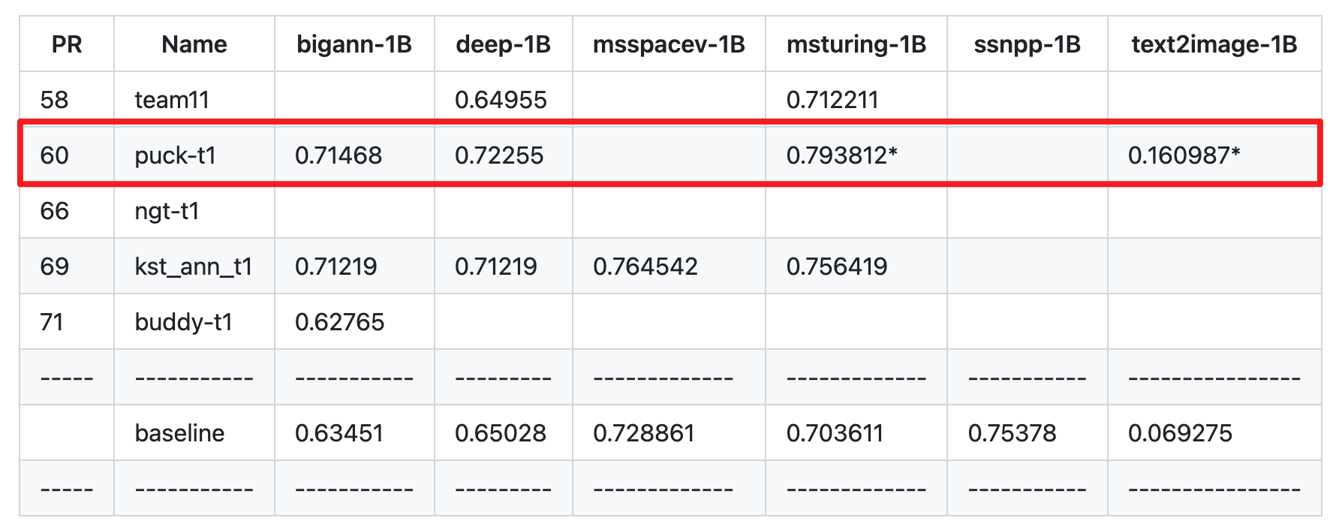
01
Open Source Search Engine Puck
NeurIPS 2021 competition: Billion-Scale ANN
NeurIPS 2023 competition: Practical Vector Search
Support retrieval of datasets with a scale of 1 billion on a machine with 64G memory.
Streaming: The index starts with zero points and must implement a sequence of insertion, deletion, and search operations
Task | Highest QPS with 90% recall | Ranking
Streaming | 0.984 (recall@10) | 1
Filter | 19153.425169 | 2
OOD | 8699.573200 | 5

Slide 5
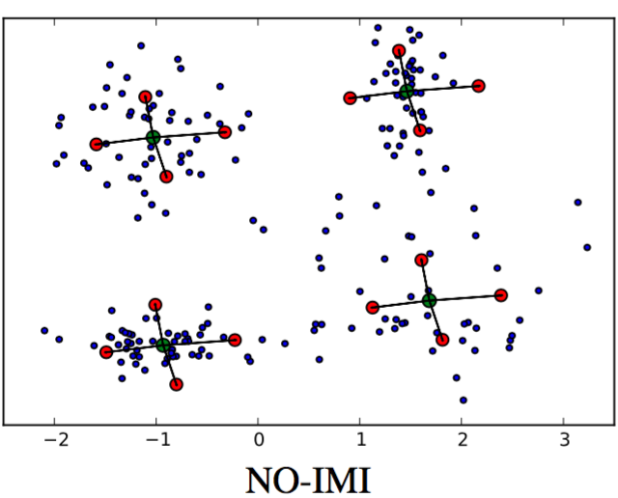
02
Puck Algorithm
Puck
High-performance, high-accuracy, highly flexible search algorithm that can support ultra-large-scale datasets
New index structure
multi-level quantification
Heuristic training
Optimization of construction speed
Completely new retrieval process
Filter level for computational acceleration
PQ level for memory compression
Performance optimization
Function expansion
1B
40K
2K
100
Multi-level residual +unifying PQ-table
dynamic trimming
…
Distributed dataset construction
Real-time dataset construction
Incremental dataset construction
Conditional search
…
All points
nearest subspaces.
candidate set(Filter)
Top-100(PQ)

Slide 6
03
ANN Benchmark
Computational Environment within the company
60G for searching & 160G for indexing
top-100
Algorithm
Nmslib: The best overall performance expression across multiple datasets.
ours-quant-4: Puck
ours-quant-3: 2 VQ levels, 1 PQ levels and original feature layer
ours-hybrid: Tinker
IVF & IVFPQ: Classic algorithm
Datasets
SIFT: 10M & 100M
DEEP: 10M & 100M

Slide 7
03
ANN Benchmark
100M
Deep-100M，96 dimension, top100
Bigann-100M，128 dimension, top100

Slide 8
03
ANN Benchmark
10M
Deep-10M，96 dimension, top100
Bigann-10M，128 dimension, top100

Slide 9
THANKS
GitHub : https://github.com/baidu/puck

