Slide 1
The DiskANN Vector Indexing Library:
From Ideas to Microsoft Scale
Harsha Simhadri

Slide 2
Outline
Why DiskANN?
New algorithms to solve challenges of scale and missing features
A new architecture to bring these ideas to any database or store

Slide 3
Semantic retrieval with embeddings + ANNS
Obj
Doc
Embed
Doc
Doc
Doc
Doc
Doc
Doc
Doc
Obj
Embed
Query
Database
N = 10⁶ or 10⁹ or 10¹² points
K=4 nearest neighbors (l₂)
R^{d} d~100-1000
Exact retrieval might need exhaustive scan, settle for approximate retrieval.
Measure Recall@k: fraction of output candidates that are true top-k nearest neighbors

Slide 4
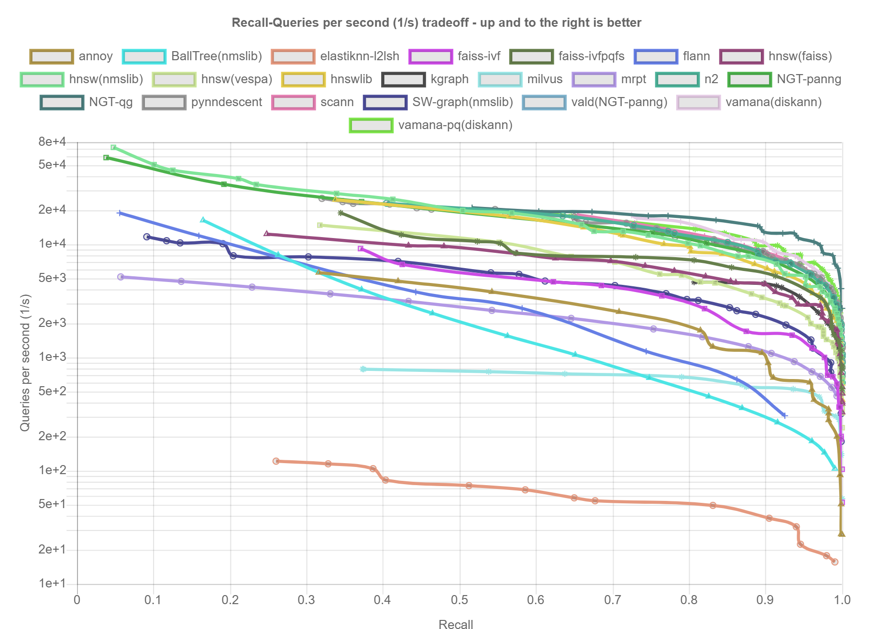
Long history of work..
In academia and industry
ann-benchmarks.com
SIFT Image descriptors
1M points, 128 dimensions, L2 distance
Trees: k-d trees [Bentley, C.ACM’75], cover trees [Beygelzimer, Kakade, Langford, ICML’06]…
Clustering: IVF [FAISS, Babenko & Lempitsky, CVPR 2012, Tavenard et al., ICASSP’11], …
Hashing: LSH[Indyk, Motwani, STOC’98; Charikar, STOC’02], Data dependent hashing [Andoni, Razenshteyn, STOC’15],…
Graph based: NSW, HNSW[Malkov, Yashunin, T.PAMI’18], NSG [Fu et al, VLDB’19], NGT [Iwasaki], SPTAG[Wang et al., CVPR’12], HCNNG[Muñoz et al., Pattern Recognition 96], …
Compression techniques
  PQ [Jegou et al., PAMI’11], OPQ [He et al., CVPR’13],.. for l₂
  ScANN[Guo et al., ICML’20] for maximum inner product
Domain specific:
  Sparse high-dimensional
  Geospatial
Notes:
At 1m scale, in-memory , single threaded, static builds

Slide 5
The scale and scope of vector search at Microsoft
@Microsoft | Cloud |  |  | Edge
 | Web Search, Ads & Recommendations | Enterprise Email Search | Enterprise Doc search | Windows Copilot Runtime
Index Size | 100s of billions of pages | Millions of indices 10¹⁴+ sentences | Thousands of indices Trillions of paragraphs | ~10⁶ files, images, text
Update Rate | ~ billion /day real-time updates | new email, clean up deleted emails | ~1% change/day | As new content as created
Search latency and throughput | ~10ms latency 10⁴-10⁵ queries/sec | <100ms, <100 queries/day | <100ms, 100 queries/sec | <100ms, <100 queries/day
Very large range of sizes, ingest and query throughput.

Slide 6
The DiskANN project: Algorithmic Innovations
Problem 1: Serving O(100B) indices with <10ms latency and high throughput requires in-mem indices requires 10,000s of machines with O(100GB) DRAM
DiskANN [NeurIPS’19]:
Index ~1B vecs/machine using SSDs;
5-10x higher density than in-mem;
<10ms query latency, 10000+ QPS.
Problem 2: Hard to update, deletes with stable recall is hard. Rebuilt from scratch periodically. 10,000s of machines to periodically rebuild indices every 6/12/24 hours.
Fresh-DiskANN[arXiv:2105.09613]
IP-DiskANN[arXiv:2502.13826]
DiskANN + Real-time freshness + 1000s updates/sec/node
Problem 3: Not designed for filtered/hybrid queries. Low recall and high query complexity.
e.g., ORDER by L2 distance
  AND (date > Aug 2023)
  AND (brand = x OR y OR z)
Filtered-DiskANN [WWW’23]:
Order(s) of magnitude higher QPS and lower query latency;
High recall for rare predicates.

Slide 7
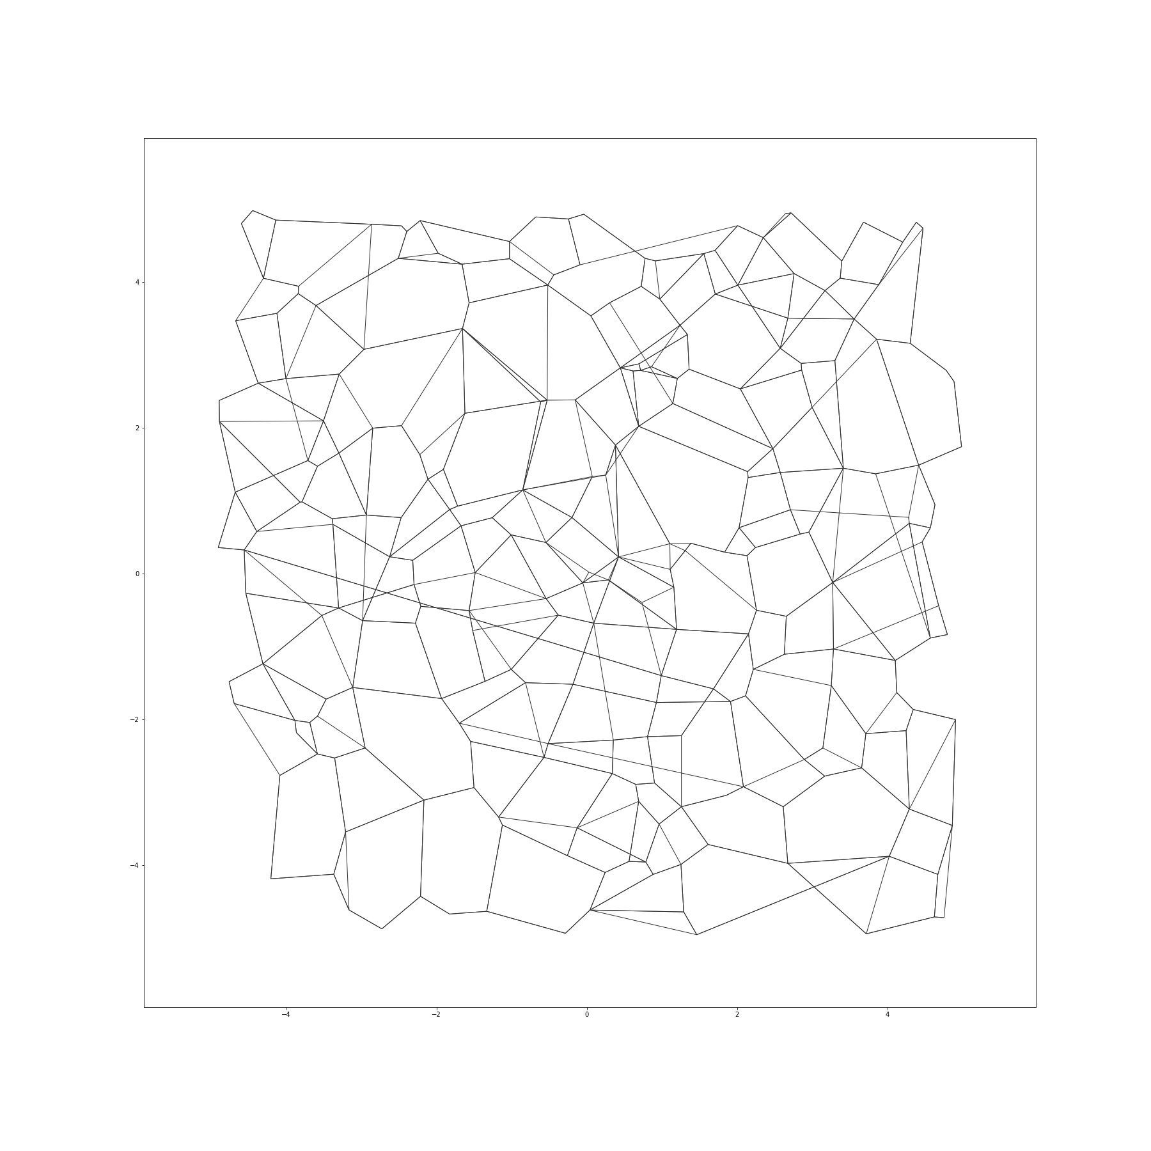


Graph-based ANN indices: A Primer
[Malkov, Yashunin’16, arXiv: 1603.09320 ]
Index: One graph vertex per vector/embedding. Carefully add a small number of directed edges between vertices so that:
Greedy search for query q:
Start at designated start s, and iterate:
compute dist. from q to neighbors
hop to node closest to q,
as long as distance improves
s
High recall and low latency
Data and graph in memory
Only ~100M points/machine
q

Slide 8
LSH, Clustering and Graph-based indices at 100M scale
Cross-polytope LSH from FALCONN library [Razenshteyn’16]
number of tables = {10 15}, probe width = {25 50 100 200}, dimension of last polytope = {4 8 16 32}, cross polytope number = 4, number of rotations = 3

Slide 9
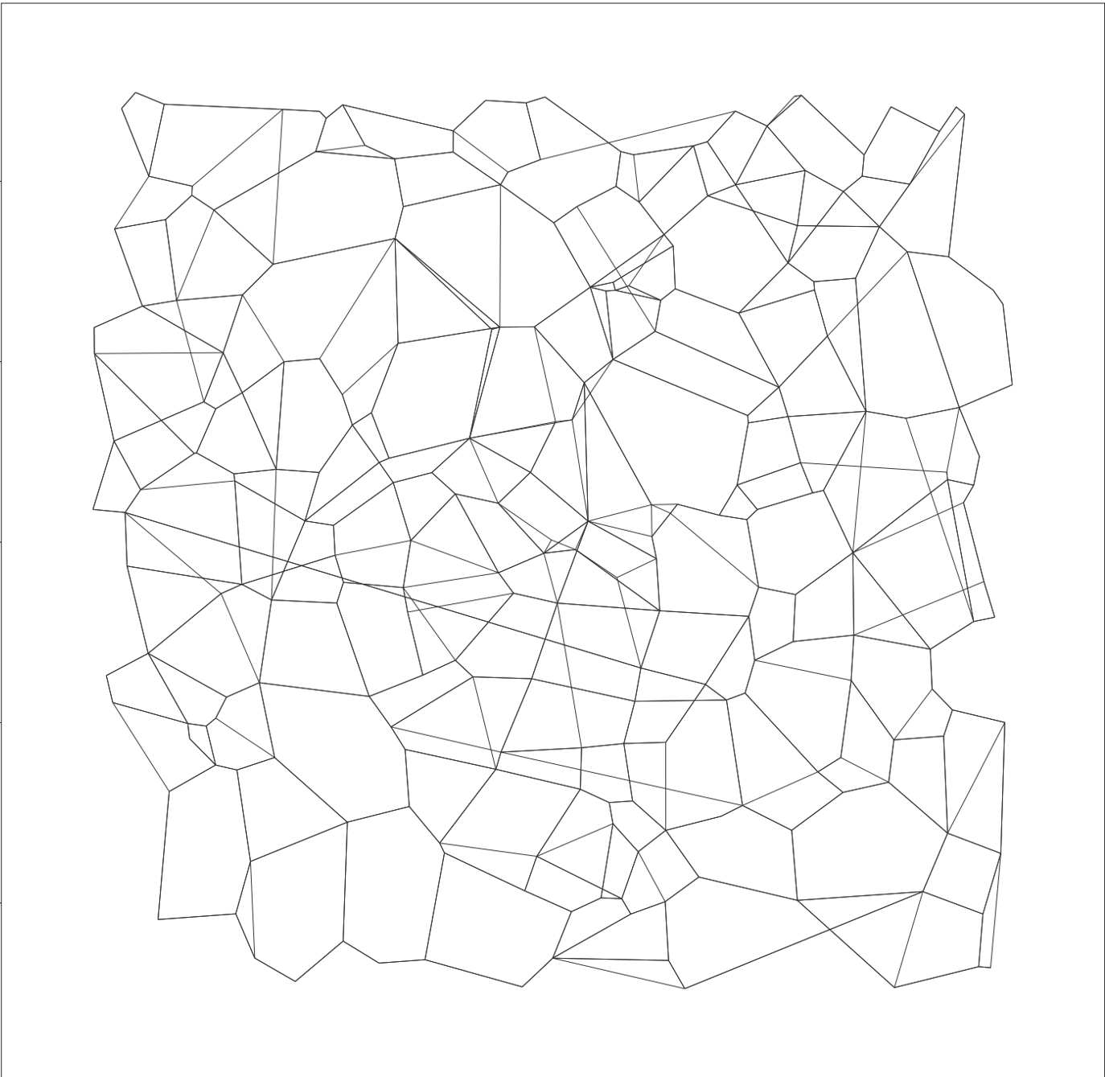
DiskANN: High recall, low latency via hybrid DRAM+SSD index
[Subramanya, Devvrit, Kadekodi, Krishnaswamy, Simhadri’19]
Compressed vectors (~32B)
DRAM
1B Vectors (100-1000d) + Graph(~100 degree) ~ 500GB-1TB
Low Diameter (<10 hops)
SSD
s
GreedySearch(q)
Let p := s (start node)
Fetch neighbors of p from SSD
Use compressed representation of points to find neighbor p closest to q
q

Slide 10
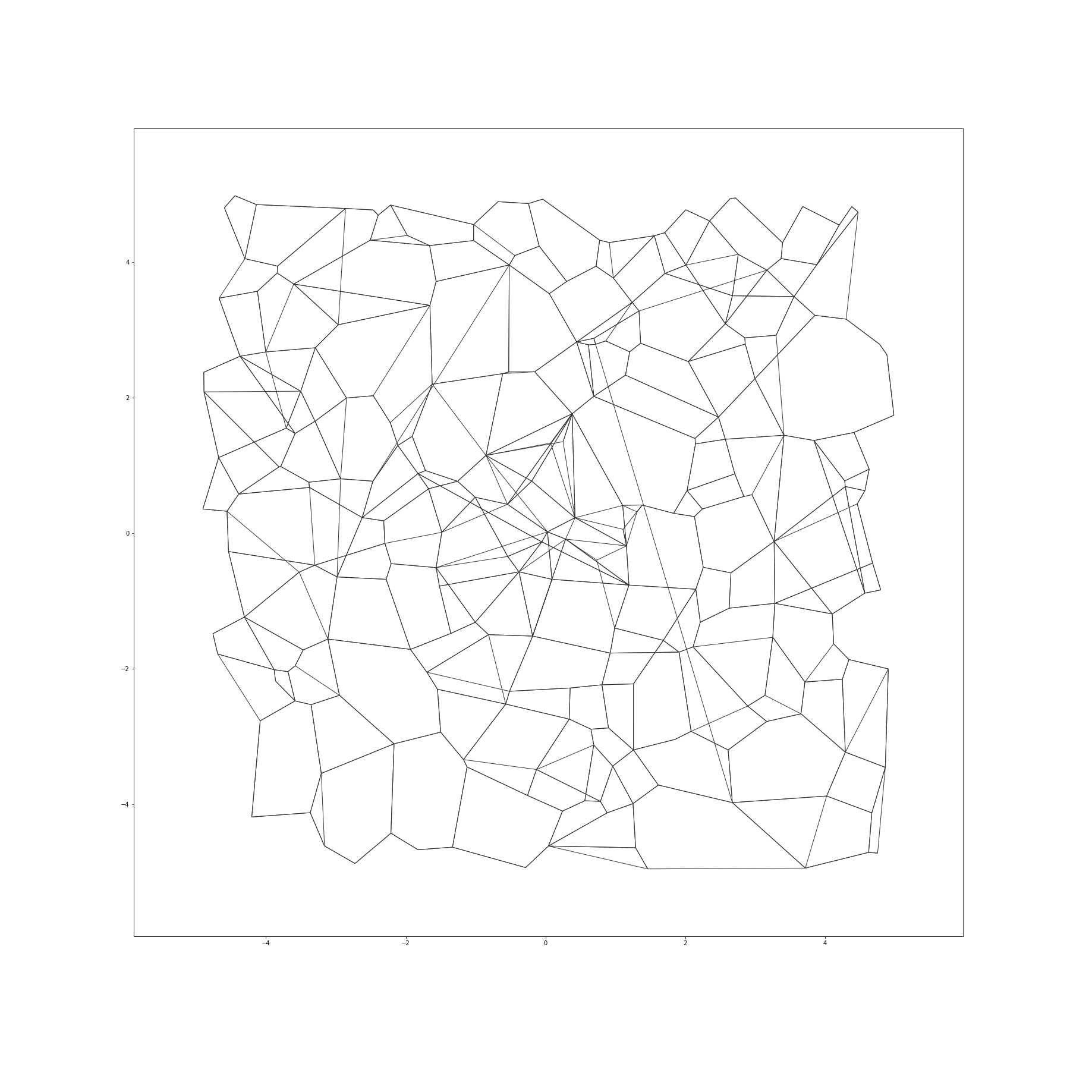
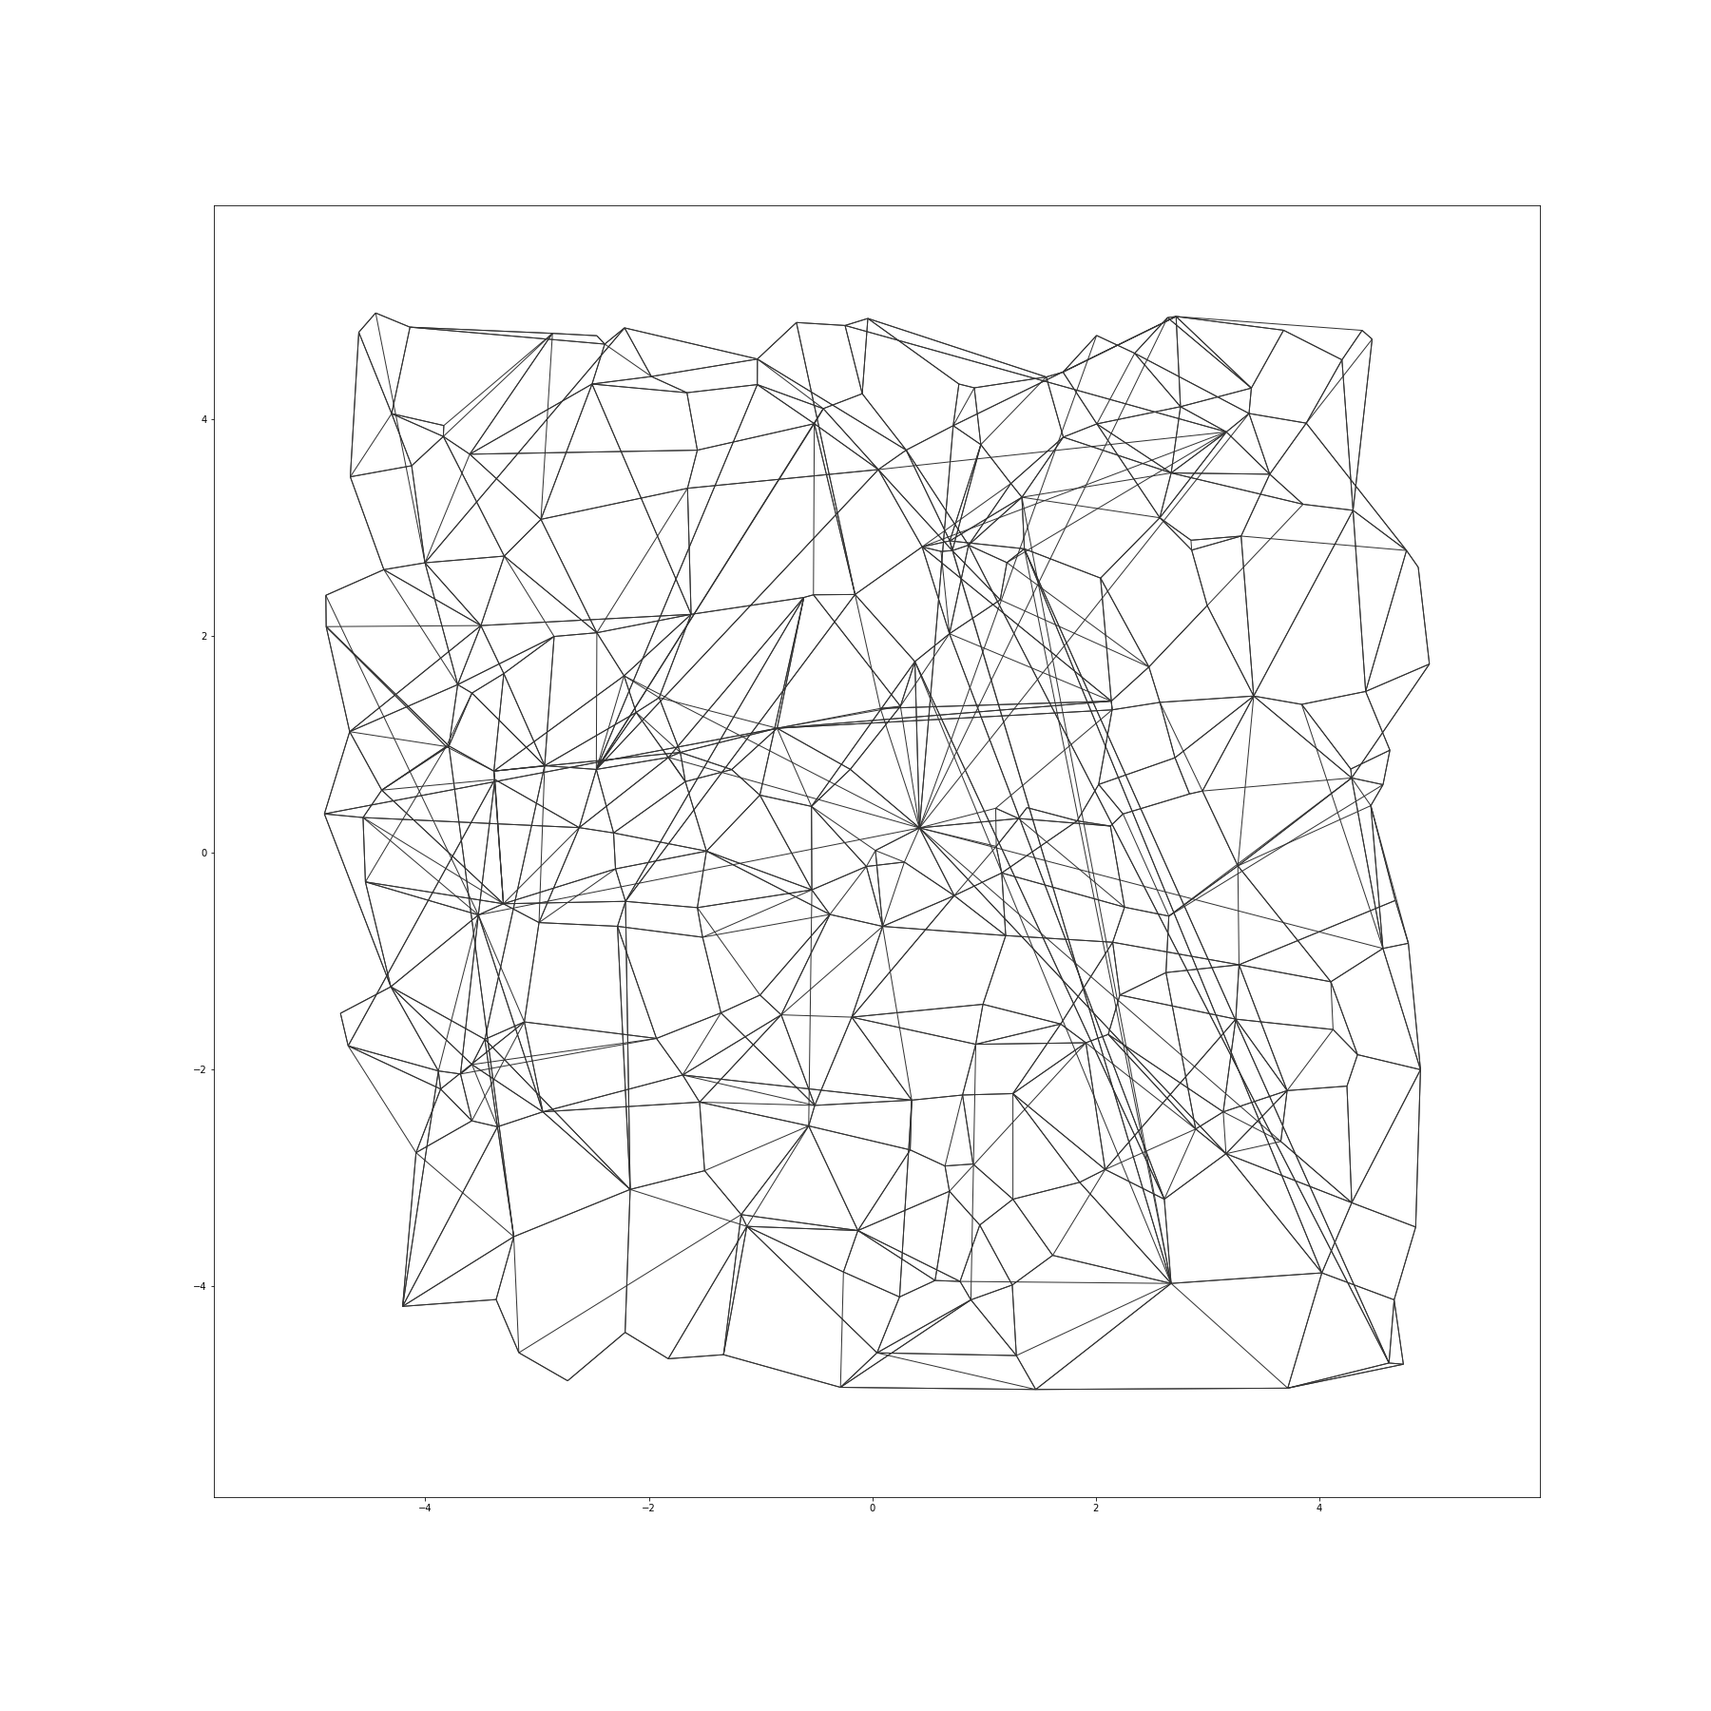
DiskANN graph (right) has a mix of nearest neighbors and diverse long-range edges for fast navigation
α=1
α=1.2

Slide 11
90+% points 6-hops from start → Fewer SSD Round Trips
BFS level (from designated start point) | # points at BFS level i (1billion point MS SPACEV dataset)
1 | 100
2 | 9946
3 | 891273
4 | 52050789
5 | 682738849
6 | 252099714
7 | 11835439
8 | 190225
9 | 104202
10 | 47656
11 | 11095
12 | 1536
13 | 212
14 | 24
15 | 1
BFS level (from designated start point) | # points at BFS level i (1billion point MS BIGANN dataset)
1 | 73
2 | 3868
3 | 213058
4 | 10864635
5 | 226069439
6 | 673168120
7 | 88167475
8 | 1487493
9 | 6645
10 | 798
11 | 131
12 | 16
13 | 1
98% of points <= 6 hops from start
90% of points <= 6 hops from start

Slide 12
Recall, latency, QPS and IO/s for 100-degree graph
BIGANN dataset: 1Billion points in 128 dimensions
Memory footprint = 32GB + 250K adjacency lists cached in memory ~ 33GB
In comparison, in-memory graph indices (e.g. HNSW) would need 500GB+ DRAM

Slide 13
Scale further to 50B vector index
[Adams, Li, Zhang, Tan, Chen, Li, Li, Risvik, Simhadri’25]
Graph-based indices have highly sublinear query complexity →One logical 50B index better than 100shards X 500M indices
A single distributed graph spanning ~1000 machines
  in-storage index
  100,000 QPS, 26ms p50 latency
  6x higher QPS than previous partitioning and selective routing systems

Slide 14
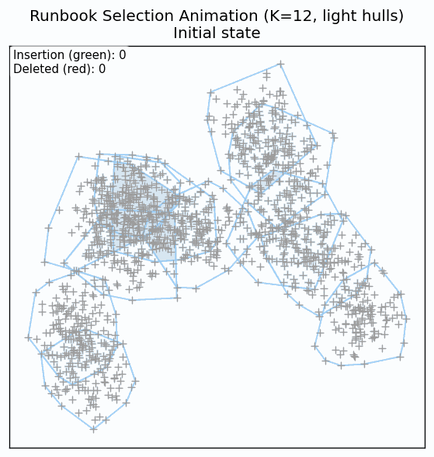
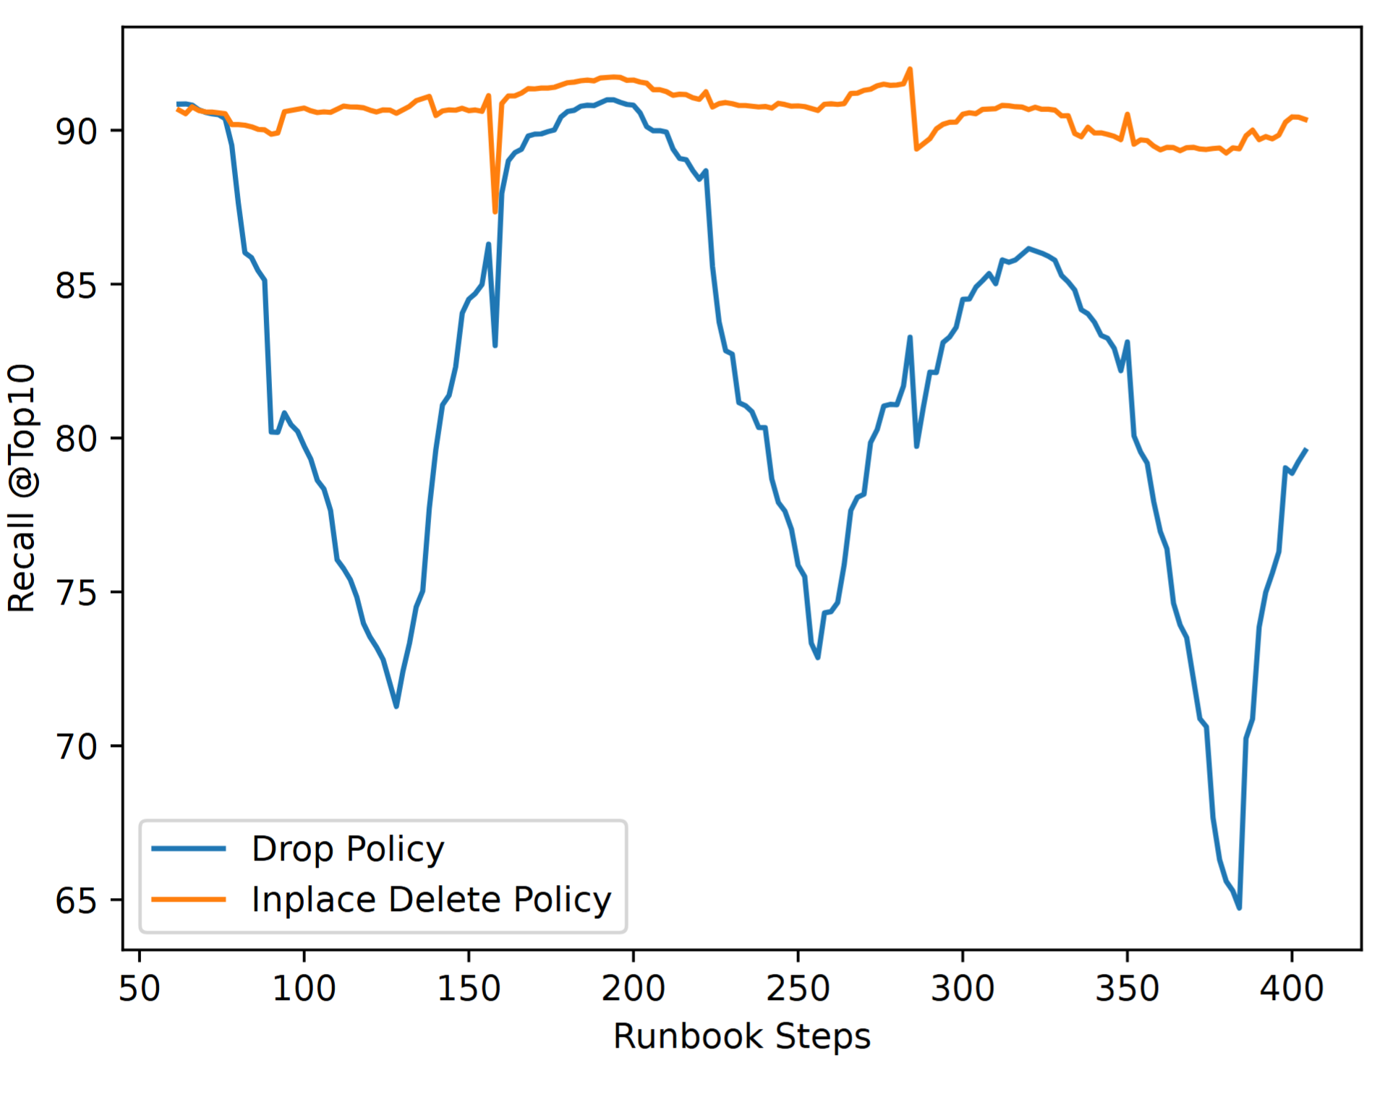

Problem 2: Recall with deletes and distribution drift
Recall comparison between simple drop policy vs DiskANN in-place deletes that locally repair the graph
[Xu, Manohar, Bernstein, Chandramouli, Wen, Simhadri’25].
[https://github.com/harsha-simhadri/big-ann-benchmarks/tree/main/neurips23/runbooks]

Slide 15
In place Updates for DiskANN with Stable Recall
[Xu, Manohar, Bernstein, Chandramouli, Wen, Simhadri’25]
Before Deletion
After Deletion
u₁
v₁
u₁
v₁
u₂
p
v₂
u₂
p
v₂
u₃
v₃
u₃
v₃

Slide 16
Fresh-DiskANN System reduces write amplification [Singh, Subramanya, Krishnaswamy, Simhadri’21]
append
Delete List
Delete (v)
Delete List
Insert
RW-Short-Term Index
Insert (v)
RW-Short-Term Index
Memory
RW-Short-Term Index
RO-Short-Term Index
Search (v)
RO-Short-Term Index
Snapshot
: 2-pass streaming algorithm
DRAM footprint proportional to #new points, not overall index
Periodically invoked in the background
Merge
SSD
New Long-Term Index
Long-Term Index
With 1 machine (128GB RAM, 48 cores, 1 PM1725a SSD)
1B vectors steady state
1800 inserts/sec, ~5ms insert latency
2000 searches/sec
50x smaller RAM and 16x fewer cores than PLSH [VLDB’13]

Slide 17

Problem 3: Vector queries with predicates are slow and inaccurate
Examples:
Documents accessible to a subdomain (eecs.berkeley)
Ads relevant to a market
E-commerce search with price, brand and rating filters
One Formulation
Given
Point Set P = {p_{1,} p_{2,} p_{3, …,} p_{n}} in R^{d},
A set of labels {L_{1,} L_{2,}…, L_{k}},
An association p_{i} → {L_{i1}, L_{i2}, ..} of labels to each poin
Construct an efficient index for queries that filters on the label..
For query <q, L_{q}={L_{q1}, L_{q2}, …}>, find points in P nearest to q associated with any of the labels in L_{q}
Vectors {p_{i}}
Labels {L_{i}}
1
1
2
Query and its labels
2
3
3
3
4
4
4
5
5
9
6
7
8

Slide 18
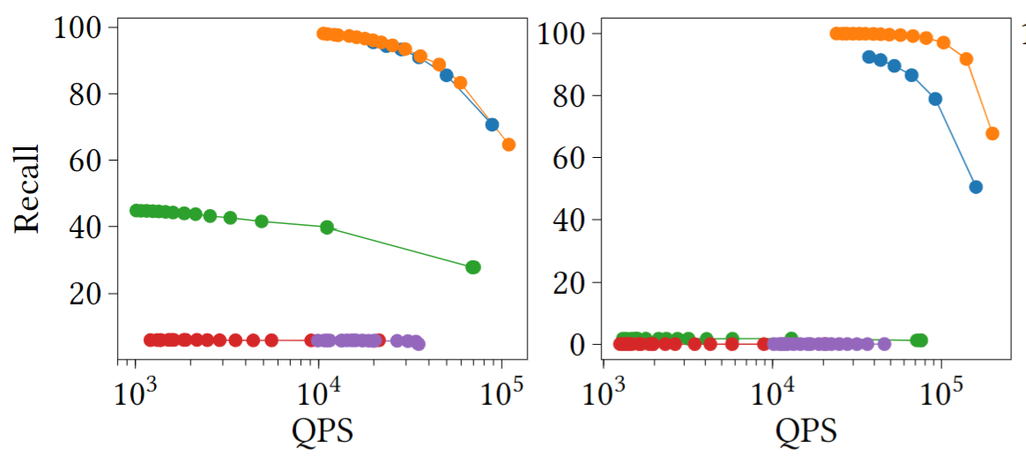
Index using filter information + vector geometry
Index of enterprise text data.
Predicate = domain within enterprise.
Specificity = % data in the domain.
10% specificity
0.1% specificity
New Indexing algorithms that use filter information + vectors in construction
recall@10
Approaches with standard vector index
Clustering and Graph-based post-processing
Inline filtering with clustering-based indices

Slide 19
OSS Release (~2023) and Industry Impact
Microsoft
Bing web search, real-time index
Advertisements
Microsoft 365
Windows
Relevance lifts, new scenarios enabled, and hardware saved
Adoption in other databases
Postgres-> TimescaleDB/Pgvectorscale
Cassandra ->IBM/Datastax
SQLite -> Turso
Milvus and other vector DBs.
Hardware/Accelerator
Kioxia AiSAQ for storage-only solution
Intel OptaNNE for Optane pmem
NVIDIA cuVS library

Slide 20
Lessons learnt from deployments
Re-implemented for different stacks – difficult to maintain
Library does not have the availability and durability of DB
Monolithic and tiered to specific storage tiers
Research ideas on stand alone code slows adoption
Separate Index logic from storage systems
Inherit elasticity, multi-tenancy, and durability of host DB
Operate at multiple storage tiers
One branch for Research and Production

Slide 21
Emergence of Specialized Vector Databases
Vector DB
For vectors
OR
Operational
Database
Operational DB as primary
Vector Index

Slide 22
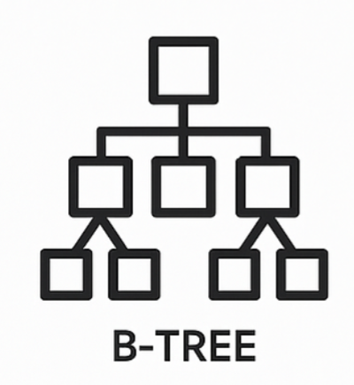







DiskANN as in-process stateless library for any DB
One branch for Research and Production;
Amplifies reach of new ideas;
As fast as monolithic in-mem & on-disk libs
Quantized VectorProvider
Operate at multiple storage tiers
Vector Provider
User/ Indexer/ Query Engine
Update
DiskANN indexing and search algorithms
(stateless)
Update
Encode
Edge List
Provider
Query
Read
Read
Label/Metadata Provider
DiskANN library provides advanced index & query logic and quantizers
Delegate storage of index terms to DB and access/mutate via Provider abstractions
Inherit elasticity, availability and durability of host DB
Notes:
Amplifies the impact of new algorithms

Slide 23
New Algorithmic Challenges
One Graph – incrementally updated, no merges, no rebuilds
  [Xu, Manohar, Bernstein, Chandramouli, Wen, Simhadri’25]
Minibatch updates for parallel, deterministic single-writer update
  [Manohar, Shen, Blelloch, Dhulipala, Gu, Simhadri, Sun’24]
Ingest in quantized space for low cost and high performance
Faster algorithms for vectors + arbitrary predicates that work closely with the database’s query planner

Slide 24
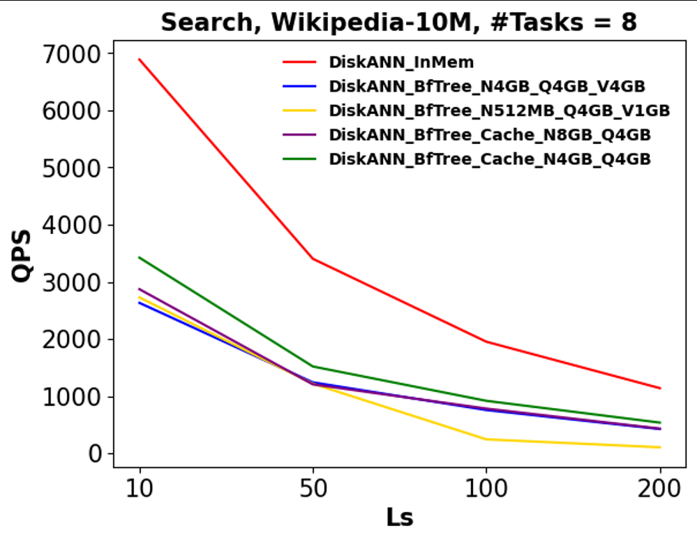
DiskANN + Bf-tree
Bf-Tree: A Modern Read-Write-Optimized Concurrent Larger-Than-Memory Range Index [Hao, Chandramouli, ‘24]

Slide 25
DiskANN + Cosmos DB NoSQL
Serverless vector index in an operational database with:
<20ms query latency on 10M vectors
Native multi-tenancy and low p99 latency for filtered queries
Up to 43x,12x lower query cost than Pinecone and Zilliz serverless
More at Industry Track session this afternoon…

Slide 26
Conclusion
Graph-based indices and algorithms are efficient and versatile for ANNS
  Adapted to different storage tiers, variations of ANNS, streaming workloads, sparse and multi-Vectors
Systems built with graph-indices are deployed at Microsoft scale
  Web search, Ads, doc/email search, Windows, Copilots, Azure Databases
Working with real scenarios catalyzed new directions in research and created a positive feedback
  We maintain one branch for research & deployments to enable this
Datasets and benchmarks are often bottlenecks for research
  We created and organized NeurIPS’21 and ’23 Big ANN Benchmarks [https://big-ann-benchmarks.com]
  Let’s create more datasets and maybe run a 2025 benchmark?
Possible to build system that works with many databases and offers best-in-class perf
  abstract logic away from storage details to allow instantiation cross N algorithms X M stores/DBs

Slide 27

aka.ms/Microsoft_VLDB25 for papers, demos, talks, job openings

Slide 28
BigANN@ NeurIPS’21: Six 1B scale Datasets from INRIA/IRISA, Meta, Microsoft, Yandex
Software and Hardware Tracks with baselines
Dataset | Source | Size | Encoder/Task | Other notes
BIGANN-1B | CNRS/IRISA http://corpus-texmex.irisa.fr/ | 128 dims uint8 L2 | SIFT descriptors for image similarity
SSNPP-1B* | Facebook | 256 dims uint8 L2 | SimSearchNet++ image encoder | Range search
SpaceV-1B* | Microsoft https://github.com/microsoft/SPTAG/tree/master/datasets/SPACEV1B | 100 dims int8 L2 | Docs and queries encoded by Microsoft SpaceV Superior model to capture generic intent representation.
Turing-ANNS-1B* | Microsoft Turing | 100 dims float L2 | Bing queries encoded by Turing AGI v5 encoder.
Text2Image-1B* | Yandex https://research.yandex.com/datasets/biganns | 200 dims float Inner-product | Images encoded by Se-ResNext-101 model, queries are text encoded by a variant of DSSM | Cross-modal; Query distribution different from index set
DEEP-1B | Yandex https://www.cv-foundation.org/openaccess/content_cvpr_2016/app/S09-38.pdf | 96 dims float L2 | GoogLeNet pretrained for Imagenet classification task + PCA + l2 normalized
[ * new datasets released for the competition]

Slide 29
Big ANN @ NeurIPS’23: Variations in Vector Seach
Harsha Simhadri*, Martin Aumüller¤, Dmitry Baranchuk‡, Matthijs Douze†, Amir Ingber*, Edo Liberty*, Frank Liu §, George Williams**
*Microsoft, ¤IT University of Copenhagen, †Meta AI Research, *Pinecone, ‡Yandex Labs, §Zilliz, **Ansible AI
Track | Dataset | Dimensions | Data type | Baseline algo | QPS @ 90% recall | Release terms
Filtered | YFCC-10M + CLIP | 192 | uint8 | filter-FAISS | 3200 | CC BY 4.0
OOD | Text2Image-10M | 200 | float32 | diskann | 4882 | CC BY 4.0
Sparse | MS MARCO / SPLADE | ~30K | float32, sparse format | Linscan | 101 | MS-MARCO: Free NC SPLADE: CC BY NC SA
Streaming | MSTuring-30M-clustered | 100 | float32 | fresh-diskann | 0.883 recall@10 (45mins) | O-UDA
https://big-ann-benchmarks.com

Slide 30
Index build, point by point
G
s
  G.insert(p, R, α) // R is degree bound, α>=1 constant
  V ← vertices visited by G.search(p) // |V|~5-10K
  V’← Prune(p, V, R, α)
  For all v ∈ V’
    add edges (p,v) and (v,p) to G
    if |N_{out}(v)| > R
  N_{out}(v) ← Prune(v, N_{out}(v), R, α)
p

Slide 31
G
Index build: prune candidates to size
s
  G.insert(p, R, α) // R is degree bound, α>=1 constant
  V ← vertices visited by G.search(p) // |V|~5-10K
  V’← Prune(p, V, R, α)
  For all v ∈ V’
    add edges (p,v) and (v,p) to G
    if |N_{out}(v)| > R
  N_{out}(v) ← Prune(v, N_{out}(v), R, α)
p
v₇
v₃
Prune(p, V, R, α) returns V’ // |V’|<R is degree, α typically 1.2
Sort V in increasing order of distance from p
V’← {v₁}
for i ∈ {2, …, |V|} while |V’| < R
  if for any v_{j} ∈ V’, d(v_{j},v_{i}) < d(p,v_{i})/α, skip i & continue
  else, add v_{i} to V’
v₄
v₁
p
v₆
v₂
v₅

Slide 32

Upper Bound on Query Complexity
[Indyk, Xu’23, arXiv:2310.19126]
For a data set with doubling dimension d ,
and aspect ratio $Δ$ (ratio of diameter to the distance between closest pair)
Greedy Search provides
$\left(\frac{α+1}{α−1}+ε\right)−approximation$
$0\left(\log_{α}{\frac{Δ}{\left(α−1\right)ε}}\right)−steps$
$0\left({\left(4α\right)}^{d}\log{Δ}\right)−degree$

Slide 33
Delete (p)
u
For all u, that are in-neighbors of p,
N(u) ← N(u) U N(p)
If |N(u)| exceeds budget
prune N(u) with α>1
p
u
u
Eager execution requires in-graph, which doubles memory footprint
In practice, do lazily, to avoid in-graph and amortize cost better

