Slide 1
IBM University Engagement Project Submission
"AI Lab Manual & Experiment Generator — RAG-Powered STEM Education Assistant"

Slide 2

Project Title – AI Lab Manual & Experiment Generator
Domain of Project – Education / STEM / AI-Powered Learning
Student Name | Recent Passport Photo | Email ID | Mobile number [WhatsApp]
 |  | arleharsha@gmail.com | 7075001755
Harsha Vardhan Arle

Slide 3
Problem Statement
Problem Statement: AI Lab Manual & Experiment Generator
The Challenge
STEM educators and students spend hours manually creating lab manuals, designing rubrics, and sourcing safety instructions. Content is scattered across textbooks, PDFs, and online resources. There is no unified, intelligent system that can generate curriculum-aligned, educator-ready lab content on demand. Remote and virtual lab support is limited, and assessment rubrics lack alignment to learning objectives and Bloom's Taxonomy.
The Objective
Build an AI-powered Lab Manual & Experiment Generator that delivers complete, curriculum-aligned STEM lab content instantly, including:
• Step-by-Step Lab Manuals – Generate full lab manuals with objectives, theory, procedure, data tables, safety notes, and discussion questions.
• Virtual Experiment Simulations – Produce guided virtual lab instructions linked to PhET, Labster, CircuitLab, and other platforms.
• Evaluation Rubrics – Generate Bloom's Taxonomy-aligned grading rubrics with grade conversion scales.
• Safety Instructions – Generate comprehensive PPE, hazard, and emergency protocol documents.
• RAG-Powered Accuracy – Retrieve and ground all content in uploaded course syllabi stored in a ChromaDB vector store.
• Complete Package Generation – Produce all four deliverables in a single API call.

Slide 4
Proposed Solution
Proposed Solution: AI Lab Manual & Experiment Generator
The proposed solution is a Flask-based REST API backend powered by IBM Granite models and IBM watsonx.ai, using a Retrieval-Augmented Generation (RAG) pipeline to generate complete STEM lab content grounded in course curricula.
At its core, the system uses a RAG pipeline where course syllabi are embedded using IBM Granite Embedding 278M and stored in a ChromaDB vector store. At generation time, relevant curriculum chunks are retrieved and injected into prompts sent to IBM Granite 4.0 (granite-4-h-small) for grounded, curriculum-aligned content generation.
The system provides four generation modules:
• Lab Manual Generator – Produces 11-section educator-ready lab manuals (objectives, theory, procedure, safety, data tables, discussion questions).
• Virtual Experiment Simulator – Generates step-by-step simulation guides with platform recommendations (PhET, Labster, CircuitLab) and synthetic trial datasets.
• Evaluation Rubric Generator – Creates Bloom's Taxonomy-aligned rubrics with four performance bands and grade conversion scales.
• Safety Instruction Generator – Produces PPE requirements, chemical hazard warnings, first aid procedures, and emergency protocols.
The frontend is a single-page IBM Carbon Design UI served directly by Flask. The Curriculum Manager allows educators to ingest custom syllabi via text or PDF upload, which are chunked, embedded, and stored for retrieval.
The Complete Package endpoint generates all four deliverables in a single request, making it a one-click lab prep tool for educators.

Slide 5
Technology Used
• IBM watsonx.ai – Cloud AI platform for model deployment, embeddings, and AI governance. Provides the foundation for all LLM inference and embedding calls.
• IBM Granite 4.0 Small (ibm/granite-4-h-small) – 30B-parameter instruction-following LLM used for lab manual, rubric, simulation, and safety generation. Supports RAG, summarization, and structured output.
• IBM Granite Embedding 278M (ibm/granite-embedding-278m-multilingual) – Multilingual embedding model used to vectorise curriculum documents for semantic retrieval.
• ChromaDB – Persistent local vector store for storing and retrieving embedded curriculum chunks using cosine similarity search.
• Flask 3.x + Flask-CORS – Lightweight Python web framework powering the REST API backend with 10 endpoints.
• ibm-watsonx-ai SDK – Python SDK for connecting to IBM watsonx.ai, using APIClient, Embeddings, and ModelInference classes.
• Vanilla HTML/CSS/JavaScript (IBM Carbon Design) – Single-page frontend UI with tabbed navigation, markdown rendering, and real-time health status display.
• python-dotenv – Environment variable management for secure credential loading.

Slide 6
REST API Endpoints Used
1) POST /api/generate/manual – Accepts topic, course code, equipment, duration, and student level. Returns a complete 11-section lab manual generated by IBM Granite 4.0.
2) POST /api/generate/simulation – Accepts topic, course code, and subject. Returns a virtual simulation guide with platform recommendations and synthetic trial data.
3) POST /api/generate/rubric – Accepts topic, rubric type (lab_report / virtual_lab / practical_exam / group_project), and learning objectives. Returns a Bloom's Taxonomy-aligned rubric with grade conversion scale.
4) POST /api/generate/safety – Accepts topic, chemicals, and equipment. Returns detailed PPE, hazard, first aid, and emergency protocol instructions.
5) POST /api/generate/complete – Single-call endpoint that invokes all four generators and returns the complete lab package (manual + simulation + rubric + safety).
6) POST /api/curriculum/ingest – Ingests plain-text curriculum documents into the ChromaDB vector store for RAG retrieval.
7) GET /api/health – Returns system health status, missing configuration, and active model IDs.

Slide 7
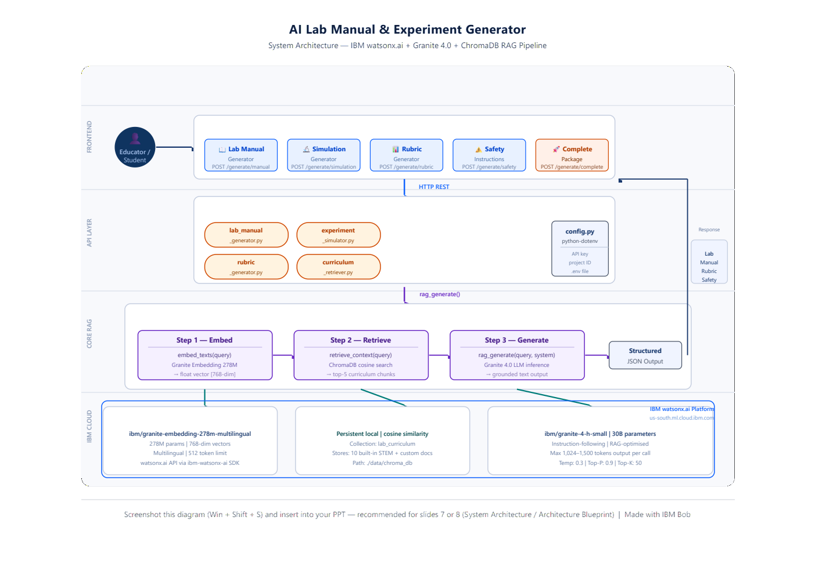
System Architecture

Slide 8
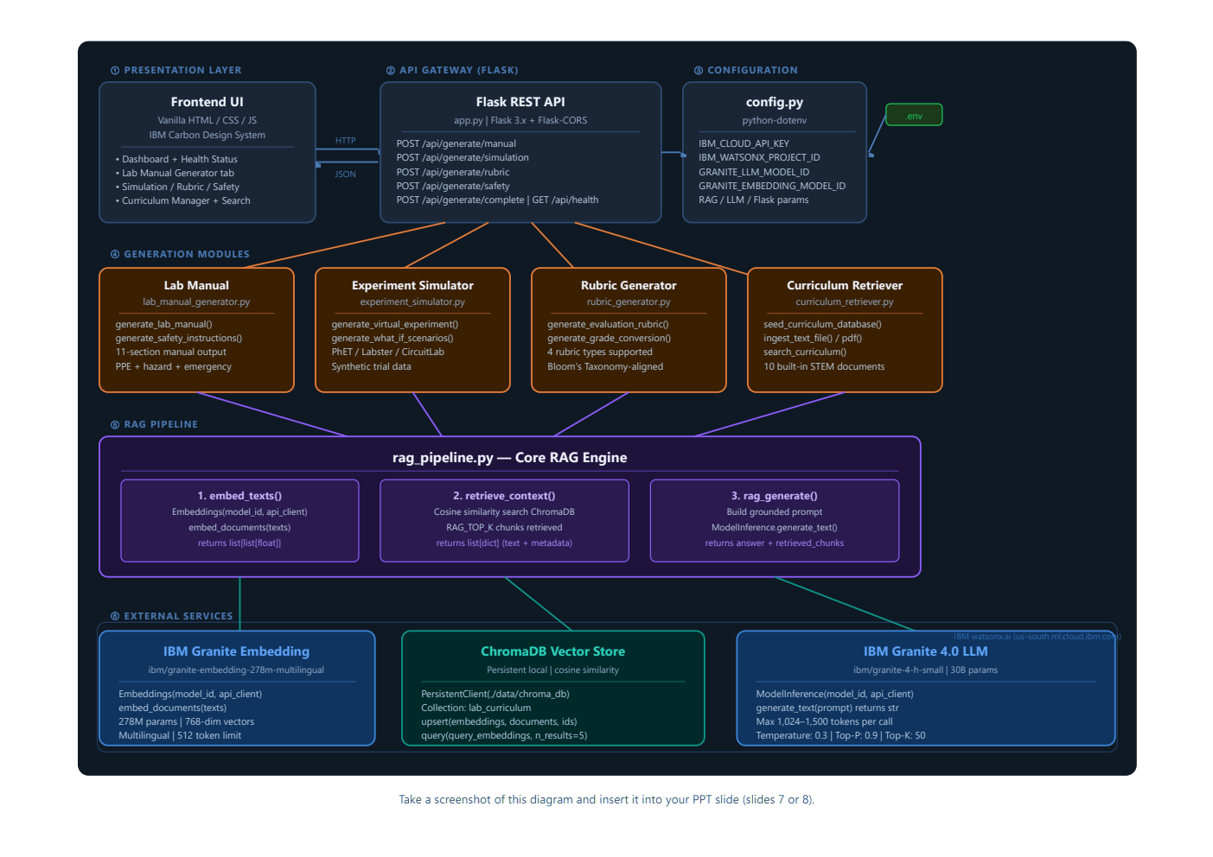
Architecture Blueprint

Slide 9

Role of IBM Granite AI in the Solution
Role of IBM Granite AI in the Lab Manual Generator
IBM Granite 4.0 Small (granite-4-h-small) serves as the core reasoning engine, transforming structured prompts and retrieved curriculum context into complete, educator-ready STEM documents.
Grounded Generation via RAG – All outputs are grounded in retrieved curriculum chunks from the ChromaDB vector store. Granite never generates generic content — it reads the actual course syllabus before responding.
Structured Document Creation – Granite follows complex multi-section prompt templates to produce 11-section lab manuals, detailed rubrics, and simulation guides with consistent formatting, numbered steps, and markdown tables.
Contextual Understanding – Granite interprets course code, student level, lab duration, and available equipment to tailor content appropriately — an undergraduate CHM101 acid-base titration manual differs from a high school one.
Cross-Domain Coverage – A single model handles Physics, Chemistry, Biology, Computer Science, Electrical Engineering, Environmental Science, and Mathematics labs without domain-specific fine-tuning.
Safety Reasoning – Granite generates accurate PPE requirements, chemical hazard warnings, and emergency protocols specific to the reagents and equipment listed — demonstrating strong domain knowledge and safety awareness.
Overall, IBM Granite acts as the intelligent content engine: context-aware, curriculum-aligned, and capable of producing publication-quality educational documents on demand.

Slide 10
Token Usage & Performance
~1,024 – 1,500 tokens generated per request (configurable via LLM_MAX_NEW_TOKENS)
Prompt Input (RAG context + query)
Generated Output (lab manual / rubric / simulation)
Input tokens per request: ~500–800 (system instruction + retrieved curriculum chunks + user query)
Output tokens per request: 1,024–1,500 (full lab manual section, rubric table, or simulation guide)
Complete package (4 calls): ~6,000–8,000 total tokens per full lab package generation

Slide 11
Novelty and Uniqueness
The AI Lab Manual Generator stands out by combining RAG, IBM Granite, and a full four-deliverable generation pipeline into a single, educator-ready system.
• Complete Lab Package in One Click – Instead of generating one document at a time, the Complete Package endpoint produces a full lab manual, virtual simulation guide, evaluation rubric, and safety instructions in a single API call — unique among AI education tools.
• Curriculum-Grounded Output – Unlike generic AI assistants, all content is grounded in retrieved course syllabus chunks via ChromaDB RAG, ensuring outputs are specific to the actual course being taught, not generic STEM content.
• Multi-Format Generation – Produces structured markdown documents, numbered procedures, data recording tables, grade conversion scales, and virtual platform recommendations in one coherent output.
• Seven STEM Domains Covered – Physics, Chemistry, Biology, CS, Electrical Engineering, Environmental Science, and Mathematics — all from a single model and pipeline.
• Safety-First Design – Dedicated safety instruction generator with PPE, chemical hazard, first aid, and emergency protocol sections — not an afterthought added to a manual, but a standalone professional-grade deliverable.
• Scalable & Enterprise-Ready – Built on IBM watsonx.ai with IBM Granite 4.0, Flask REST API, and ChromaDB, with configurable RAG parameters and model IDs via environment variables.
This makes the solution a complete, intelligent lab preparation assistant — not just a text generator.

Slide 12
GitHub Repository
Please create public github repository (Enable Add README button while creating repository) with format –
Please test and Paste the working Github URL –
Make sure you have Uploaded following three files into your github repository
1) app.json file , 2) yourproblemstatement.pdf file 3) your projectpresntation.pptx file 4)any other files
·
·
·

Slide 13
Future Scope
1. PDF Export & LMS Integration
Generate lab manuals and rubrics as formatted PDF documents and integrate with Learning Management Systems (Moodle, Canvas, Blackboard) so educators can push generated content directly into their course pages — no manual copying required.
2. Student-Facing Lab Assistant Chatbot
Build an interactive Q&A chatbot powered by IBM Granite 4.0 that students can query during a live lab session. It answers procedure questions, troubleshoots errors, and provides real-time guidance — grounded in the specific lab manual already generated for their course.
·
·
·

Slide 14
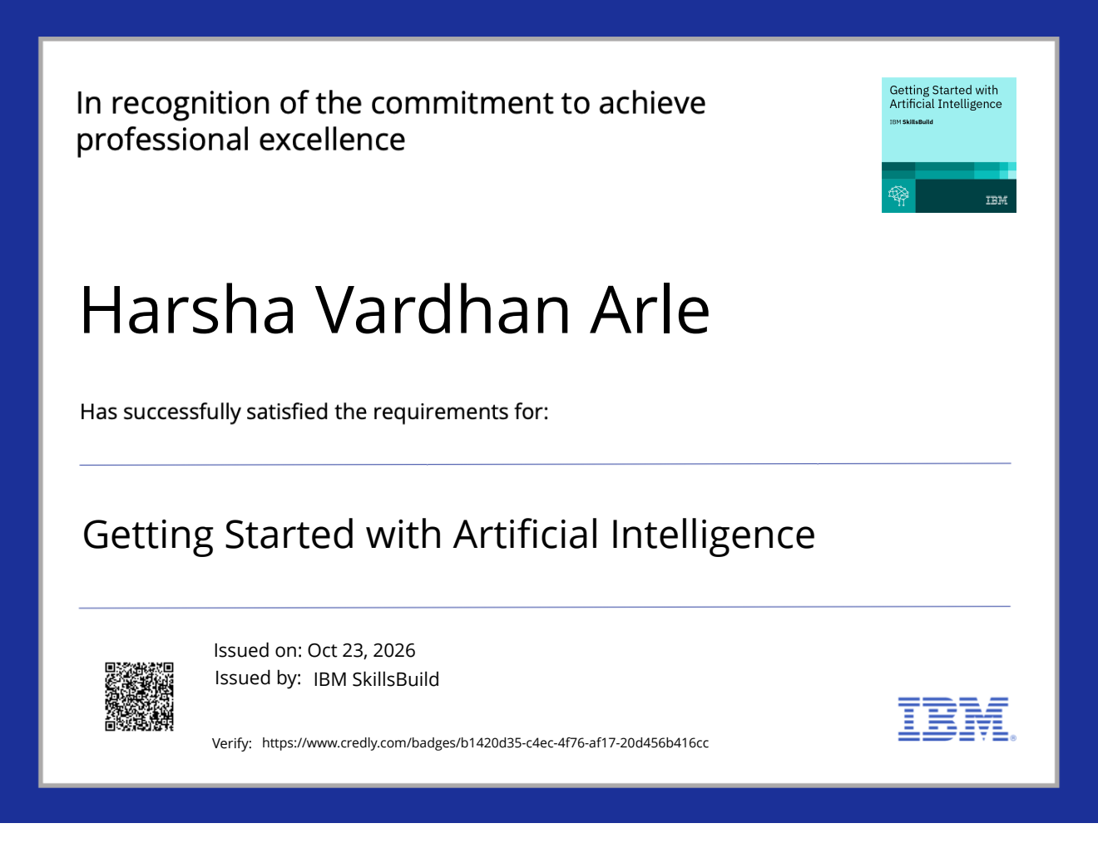
Certificates Earned:
Please add your credly certificate

Slide 15
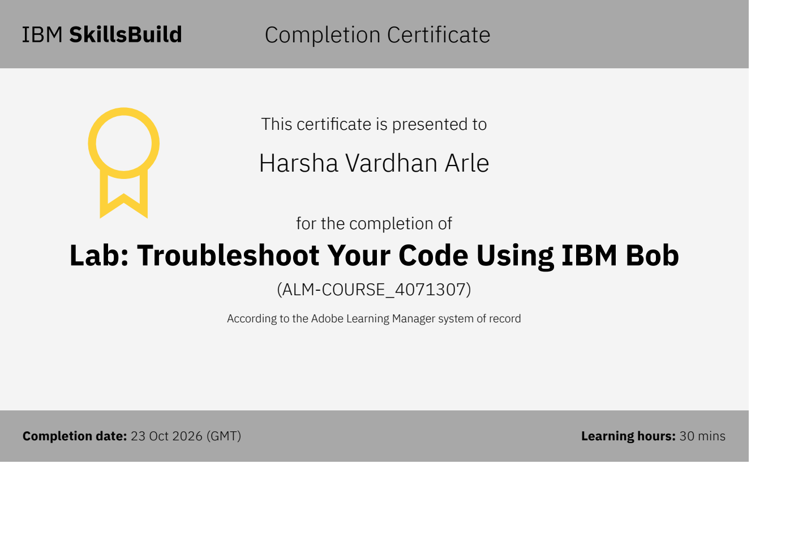
Certificates Earned:​
Add your IBM BOB Certificate

Slide 16


