Slide 1
PF
PolicyForge
PAYMENT POLICY INTELLIGENCE
Compiling Written Payment Policy
into Governed, Executable Rules
A generative-AI opportunity for Cotiviti — the model authors the rule, a deterministic engine applies it.
Harsha Venkateshwara
Cotiviti Intern Assessment · Topic 3: Content Management in Health Care · June 2026

Slide 2
EXECUTIVE SUMMARY
Author the rule with AI. Apply it with code.
PolicyForge turns written payment policy into a transparent, executable claim edit — and keeps an expert accountable for every one.
Applying rules to claims is solved. Authoring the rule from written policy is the slow, manual, costly step — and that is exactly where generative AI helps today without surrendering control.
Days → minutes
100% reproducible
Every clause cited
Human-gated
policy published to working edit
deterministic engine, not the LLM
verbatim phrase + confidence score
low-confidence rules route to review
PolicyForge · Cotiviti Intern Assessment
02

Slide 3
THE TOPIC
Turning written policy into executable logic
Topic 3 names a stubbornly manual task — converting written policy into rules, features, or models.
Policy compilation
APPLYING a rule
The act of turning a written payment or coding policy into a transparent rule a deterministic engine can apply to claims — with every rule traceable back to the exact clause that produced it.
Today a payment policy is authored in prose for a human to read. Before a claims system can act on it, a clinician or certified coder translates that prose into precise logic, line by line.
Mature and solved. Rule engines have run claim edits for decades — the heart of Cotiviti's Payment Policy Management.
AUTHORING a rule
Still done by hand. For the first time a capable model can read prose and emit structured output a schema validates — making this step a candidate for assistance.
PolicyForge · Cotiviti Intern Assessment
03

Slide 4
THE PROBLEM
The constraint is human effort, not the engine
A national plan maintains thousands of policies that change constantly. Each change starts a slow manual chain.
Policy revised
Expert re-reads
Re-writes logic
Tests the edit
Deploys
Slow · expensive · inconsistent between authors · every day of lag is a day of incorrect payments
100+
99.90%
Thousands
payers served, including 23 of the top 25 health plans
measured policy-administration accuracy Cotiviti stakes its reputation on
of payment policies, changing as codes, evidence & regulation move
PolicyForge · Cotiviti Intern Assessment
04

Slide 5
WHY NOW
Four trends make this the right moment
The capability is newly feasible, the savings are enormous, and the payer-side authoring task is still open.
Structured generation is reliable
Hundreds of billions at stake
Models now emit validated, typed output instead of free text — the precondition for safe rule authoring.
McKinsey ties generative AI in claim review, edits & recovery to a savings opportunity of that scale.
Production adoption is here
The payer-side gap is open
Gartner forecasts most organizations running generative-AI models in production within a short horizon.
Early commercial activity clusters on the provider / revenue-cycle side. Authoring the governed rule itself is largely unclaimed.
PolicyForge · Cotiviti Intern Assessment
05

Slide 6
THE IDEA
PolicyForge
A working demonstrator of the full compile → apply → govern loop, built for this assessment.
The model authors the rule. A deterministic engine applies it.
Typed, cited rule
Reproducible adjudication
A governance gate
Every compile returns a logic type, target codes, firing conditions, exceptions, an outcome and a confidence score — each condition tied to the verbatim policy phrase.
A plain Python engine returns pay / flag / deny. The same claim always yields the same result once the rule is fixed — auditable by design.
Any rule below the confidence threshold, plus boundary cases, routes to a human review queue instead of deciding on its own.
PolicyForge · Cotiviti Intern Assessment
06

Slide 7
ARCHITECTURE
One governed loop: compile, apply, govern
Written policy
LLM compiler
Typed rule
Deterministic engine
prose authored for a human
Groq · drafts a typed rule
conditions · cited clauses · confidence
applies the rule to claims
Pay
Flag
Deny
+ firing condition & cited clause
Governance gate
confidence below threshold or a boundary case → human review queue
Secrets stay server-side · in-memory store swaps to Postgres in one class change · heuristic fallback when no key is set, so nothing is ever faked.
PolicyForge · Cotiviti Intern Assessment
07

Slide 8
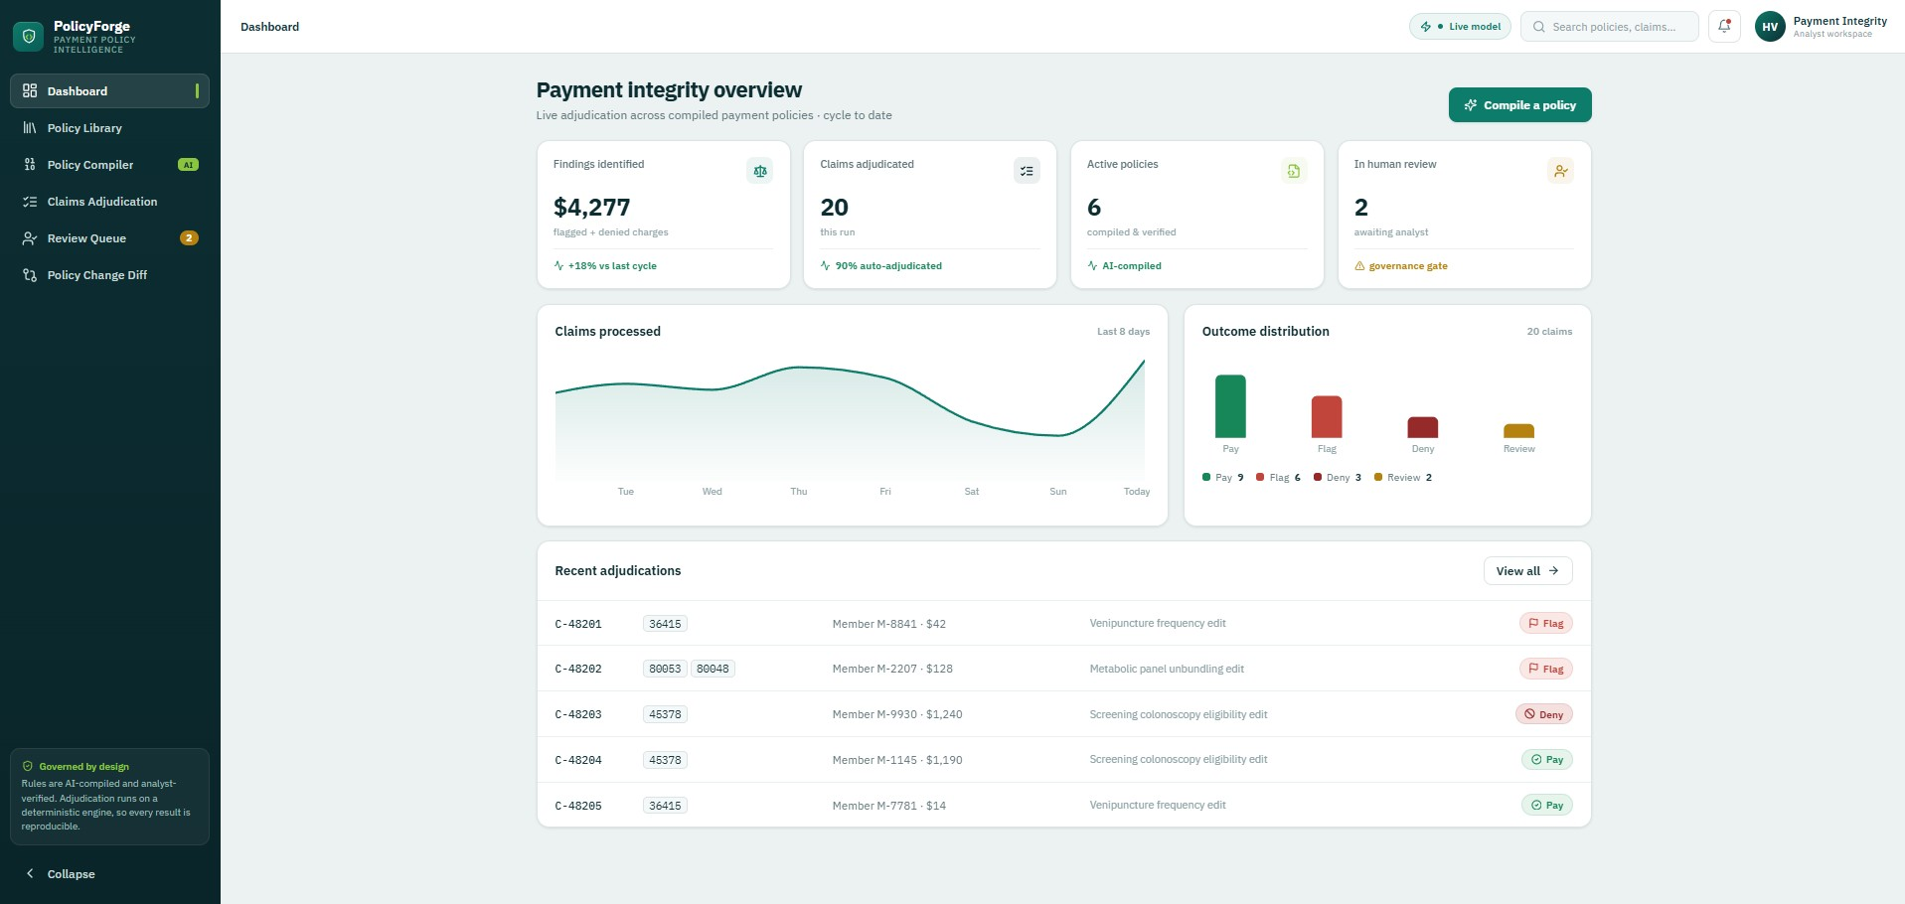
FEATURE · 1 OF 5
Dashboard — the operations view
Opens like a product already in production: the headline numbers a payment-integrity team watches.
Findings identified · auto-adjudication rate · active policies · review queue — the compile-apply-govern loop running end to end.
PolicyForge · Cotiviti Intern Assessment
08

Slide 9
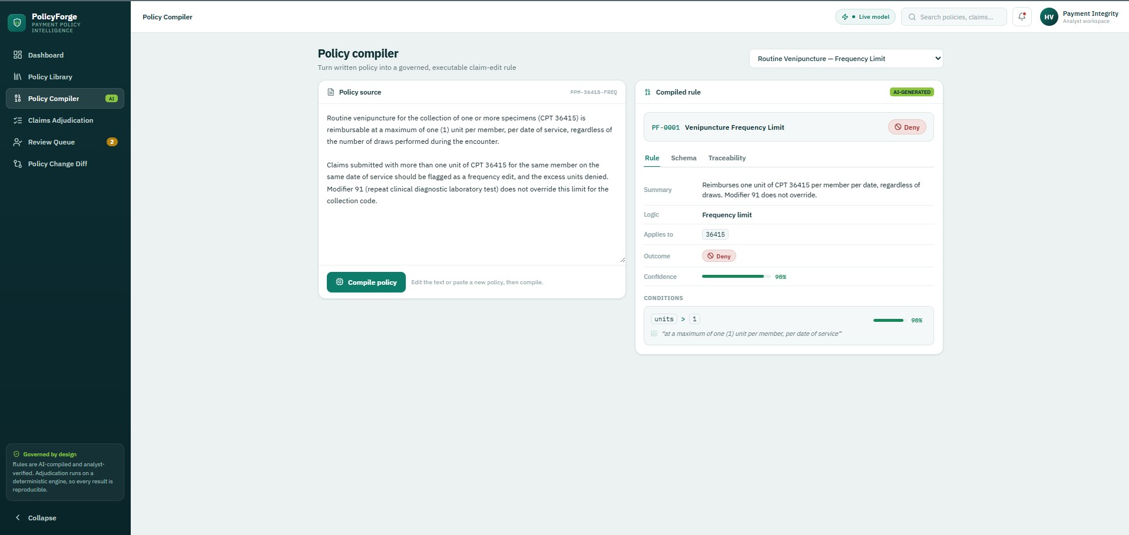
FEATURE · 2 OF 5
Policy Compiler — the heart of the product
Pick a policy, hit Compile, and the model returns a typed, executable rule with self-scored confidence.
Every condition carries the verbatim phrase that justifies it; the Traceability tab highlights it back in the source text.
PolicyForge · Cotiviti Intern Assessment
09

Slide 10
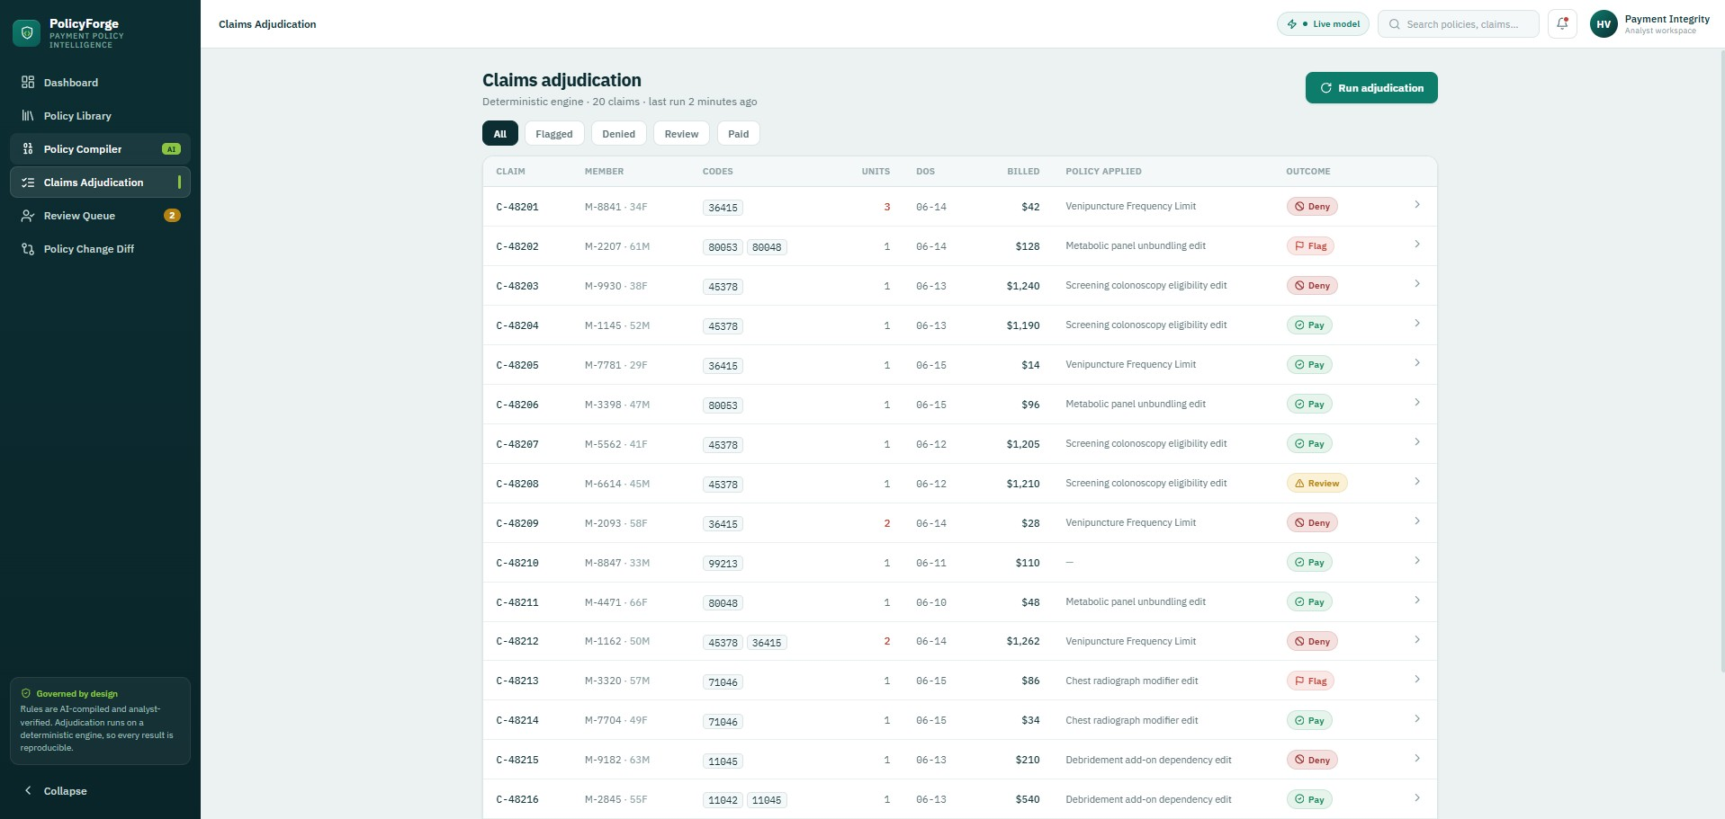
FEATURE · 3 OF 5
Claims Adjudication — the deterministic engine
Run adjudication and every claim is paid, flagged, or denied against the current rules.
Plain Python decides, so the same claim always produces the same result — open any claim for the firing condition, cited clause and exportable JSON.
PolicyForge · Cotiviti Intern Assessment
10

Slide 11
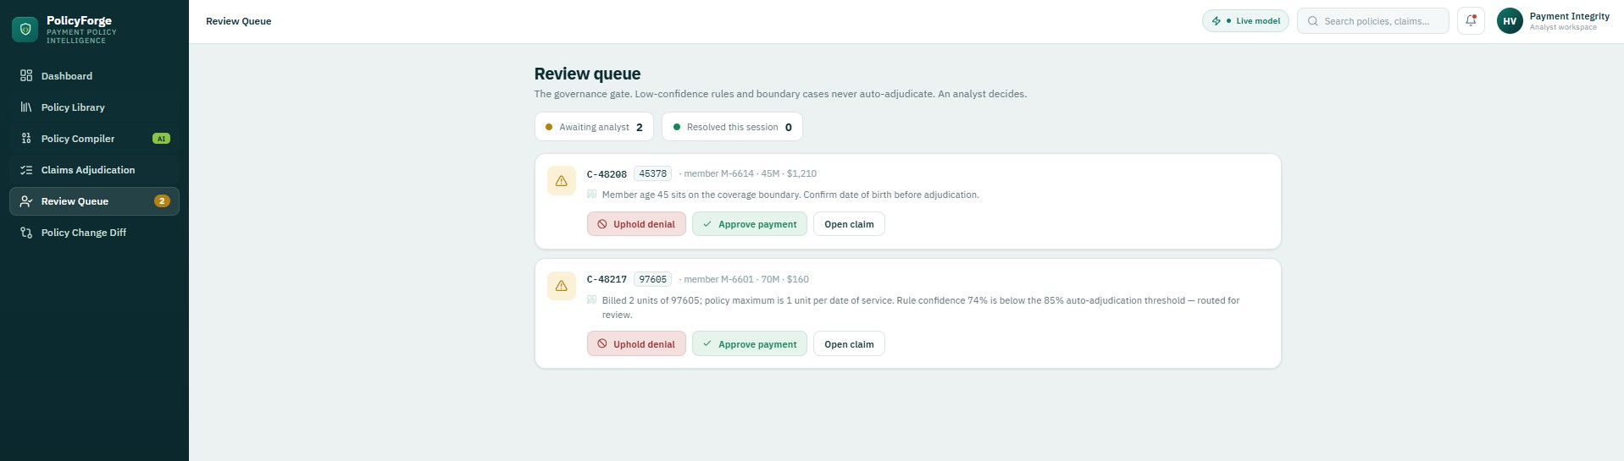
FEATURE · 4 OF 5
Review Queue — the governance gate, made visible
Boundary cases and any finding from a sub-threshold rule land here instead of adjudicating on their own.
Two distinct routes to review: an age-45 boundary case, and a real edit whose rule confidence sits below the gate. The analyst approves or upholds.
PolicyForge · Cotiviti Intern Assessment
11

Slide 12
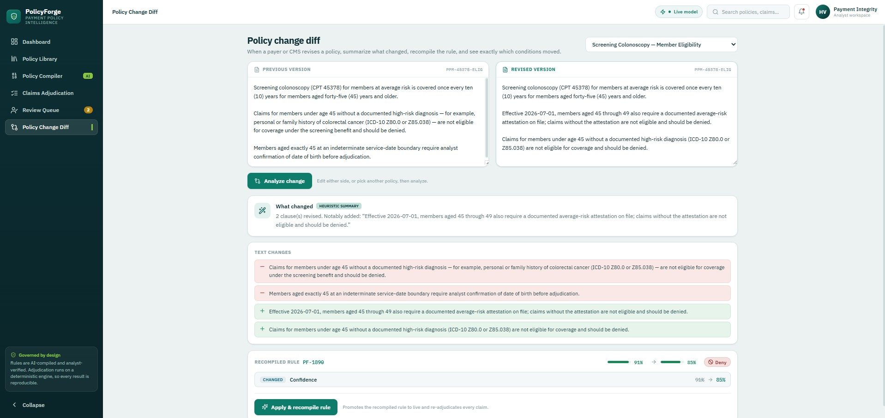
FEATURE · 5 OF 5
Policy Change Diff — maintenance made literal
Paste a revised policy; the system summarizes what materially changed, recompiles, and shows a clause-by-clause before / after.
Tighten a vague policy and watch its confidence cross the gate — its findings stop routing to review and begin adjudicating automatically.
PolicyForge · Cotiviti Intern Assessment
12

Slide 13
VALUE TO COTIVITI
How policy compilation pays off
Concrete gains that reinforce the accuracy story Cotiviti already tells.
Speed
Consistency
Shrinks policy-to-edit from days to minutes, narrowing the window in which incorrect payments occur.
The same policy produces the same draft rule regardless of which analyst handles it.
Auditability
Less abrasion
A citation and confidence score on every edit strengthens the audit trail and hardens the 99.90% accuracy claim.
A transparent rule with a plain-language reason is far easier to defend than an opaque denial.
PolicyForge · Cotiviti Intern Assessment
13

Slide 14
RISK & GOVERNANCE
Every threat is met by the same architecture
Governed-by-design is not a feature bolted on — it is the reason the approach is safe to ship.
Plausible-but-wrong rule
Human-in-the-loop confidence gate — low-confidence drafts never adjudicate alone.
Bias inherited from source
Verbatim citation on every condition, so each rule is checkable against its source.
Regulatory exposure
Deterministic engine makes behavior reproducible and independently auditable.
“Commoditizes the rule library”
It defends the asset: expert judgment becomes faster and better-documented, not replaced.
PolicyForge · Cotiviti Intern Assessment
14

Slide 15
RECOMMENDATION
Three strategic options for Cotiviti
In priority order — pursue Option 1 as a supervised copilot, add Option 2 as its natural extension.
01
PRIMARY
02
EXTEND
03
HARDEN
Governed authoring assistant
Policy change intelligence
Traceability & audit layer
Inside Payment Policy Management
Monitor · summarize · recompile
Across the whole portfolio
A copilot that drafts the executable rule from policy text, cites every clause, and routes low-confidence drafts to a certified expert.
Watch policy updates, summarize what materially changed, recompile only the affected rule, and present a clause-by-clause diff.
Attach a citation and confidence score to every edit, however authored, to harden the responsible-AI posture and make accuracy checkable.
Recommended path: supervised copilot (1) + change intelligence (2), with the deterministic engine kept as the system of record.
PolicyForge · Cotiviti Intern Assessment
15

Slide 16
THE BUILD
POC at a glance
A real enterprise application, not a sidebar demo — built to be cloned and run.
Frontend
Backend
Compiler
• React 18 + TypeScript
• Vite 7 build
• recharts + lucide-react
• Cotiviti-family teal / ink, IBM Plex
• FastAPI (Python 3.11–3.13)
• Typed Pydantic rule schema
• Deterministic adjudication engine
• In-memory store → Postgres-ready
• Groq llama-3.3-70b-versatile
• Schema-validated structured output
• Transparent heuristic fallback
• Mode shown live in the UI badge
Deployed live — frontend on Vercel, backend on Render, compiled live with Groq.
Runs locally with zero config (heuristic mode) or one Docker command; six seed policies across five logic types and twenty engineered claims.
PolicyForge · Cotiviti Intern Assessment
16

Slide 17
IN CLOSING
A governed compiler that cites its evidence
and keeps an expert accountable.
Applying rules to claims is the mature part of payment integrity. Authoring those rules from written policy is the slow, costly part — and that is where generative AI can help today without surrendering control. PolicyForge shows the loop end to end.
Author with AI, apply with code
Cite every clause, gate on confidence
A measured, commercially relevant bet
SELECTED SOURCES
Cotiviti (2024). Payment Policy Management; Responsible Use of AI in Healthcare.
McKinsey & Company (2023). Tackling Healthcare's Biggest Burdens with Generative AI; The Economic Potential of Generative AI.
Gartner (2023). Worldwide Adoption of Generative AI Across Enterprises. · CMS (2024). National Correct Coding Initiative Edits.
Harsha Venkateshwara · policy-forge-app.vercel.app
Thank you

