Slide 1

CASE STUDY ON ECOMMERCE APPLICATION ZENCART
MATHEW P
HARSHA K

Slide 2
INTRODUCTION
This project simulates a real-time e-commerce system using a console-based interface.
It enables customers to browse products, manage a shopping cart, and place orders.
The system includes admin functionalities to manage inventory and products.
Built using Python and SQL with modular architecture and object-oriented design.

Slide 3
OBJECTIVE
To develop a functional, interactive shopping system via console.
To apply object-oriented programming concepts.
To integrate database operations for storing and retrieving data.
To implement exception handling for robust and secure interaction.

Slide 4
KEY FUNCTIONALITIES
1. CUSTOMER MANAGEMENT Register, login, and view personal order history. | 2. PRODUCT MANAGEMENT Admin can add, update, and delete products. Customers can view available products.
3. CART MANAGEMENT Customers can add/remove products to/from the cart. View cart and quantities before checkout. | 4. ORDER MANAGEMENT Place orders with shipping and payment details. Order total is auto-calculated. View order history with status.

Slide 5
Stakeholders and Their Activities
CUSTOMERS
1.SignUp/Login
2.View Products
3.Add to Cart
4.Remove from Cart
5.View Cart
6.Place Orders
7.View Orders
8.Update Details
ADMIN
1.Create Product
2.View Product
3.Delete Product
4.View Customers
5.View Orders by Customer ID
6.Create Customer
7.Delete Customer

Slide 6
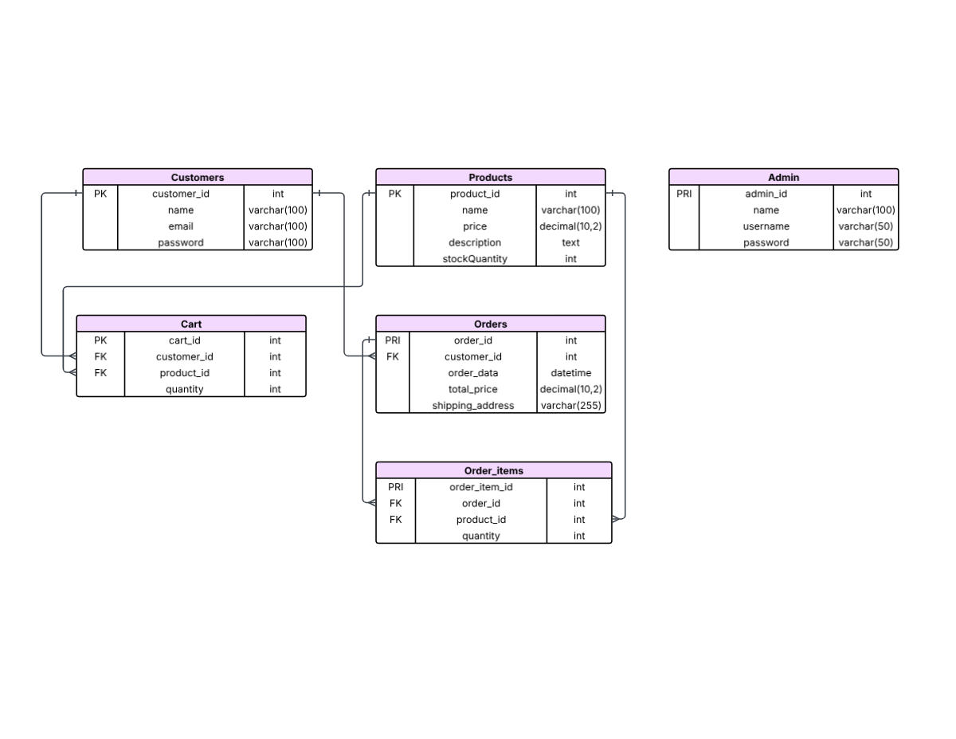
ER DIAGRAM

Slide 7
Project Management
Sprint 1
Analysing and Planning
Sprint 2
Days:2 days
SQL Schema and Basic level of Application
Sprint 3:
Sprint 4:
Days : 1 day
Days: 5 days
Role based menus definition
Days: 4 days
Testing

Slide 8


TECHNOLOGY STACK
Language: Python
Database: MySQL
IDE: VS Code
Libraries: mysql.connector
Test : pytest
Key Concepts:
OOPs
Exception Handling
SQL Integration
Unit Testing

Slide 9
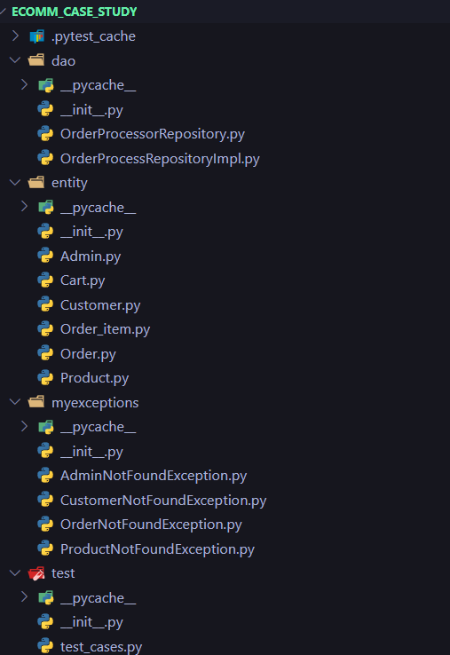
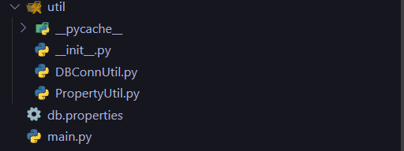
File Structure

Slide 10
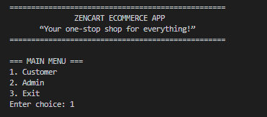
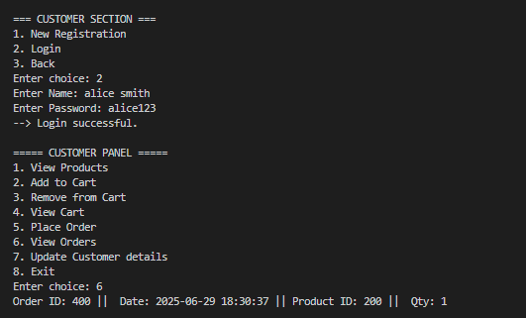
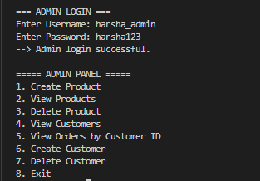
SCREENSHOTS

Slide 11
CONCLUSION
Built a console-based E-commerce system with core features like product browsing, cart, and order placement.
Used object-oriented principles and modular design.
Implemented separate roles for Admin and Customers with appropriate access
FUTURE SCOPE
Add GUI or web interface.
Integrate payment gateway.
Enable product reviews and wishlist.
Add email notifications and admin analytics.

Slide 12
Thank You

