Slide 1

Final Year Major Project
PROJECT-
VIRTUAL ASSISTANT(AI)
Presented by-
Harsha
Shalina
Srijan

Slide 2
CONTENT:-
Introduction
Why become a virtual assistant?
Hardware And Software Requirements
Modules And Packages
Working
Use Case Diagram
How it works
Features
Advantages
disadvantaged
Conclusion

Slide 3


INTRODUCTION:-
A virtual assistant is a artificial intelligence. which uses a device’s microphone to receive voice requests while the voice output takes place at the speaker. But the most exciting thing happens between these two actions.
It is a combination of several different technologies: voice recognition, voice analysis and language processing.
It is completely developed using one of the most powerful language python.

Slide 4
Why become a virtual assistant?
Independence and freedom
Changing the paradigrm from working for someone to owning your own company and choosing with whom you‘ll work
Only doing work your love
No commuting
Working with people who genuinely appreciate your contributions
Setting your own house and taking as much time off u like
Receiving compensation which honors the contributions you make
Working VIRTUALLY anywhere

Slide 5
HARDWARE AND SOFTWARE REQUIREMENTS
Hardware:
A phone with a touch screen interface.
Phone Ram should be of a minimum 512 MB.
Internet connectivity.
Software:
Operating System should be android 4.1/win 8.1/IOS 6 or higher.
Support of other basic applications like clock,web connection etc.

Slide 6
MODULE AND PACKAGES:_
pyttsx3:- This module is used for conversion of text to speech in a program it works offline. To install this module type the below command in the terminal.
pip install pyttsx3.
datetime:- Date and Time is used to showing Date and Time. This module comes built-int with Python.

Slide 7
speech Recognition:- Since we’re building an Application of voice assistant, one of the most important things in this is that your assistant recognizes your voice (means what you want to say/ ask). To install this module type th below command in th terminal.
web browser:- To perform Web Search. This module comes built-in with Python.

Slide 8
wikipedia:- As we all know Wikipedia is a great source of knowledge. We have used Wikipedia module to get information from Wikipedia or to perform Wikipedia search. To install this module type the below command in the terminal.
pip install wikipedia
os:-
The OS module in Python provides functions for interacting with the operating system. OS comes under Python’s standard utility modules. This module provides a portable way of using operating system-dependent functionality. The *os* and
*os.path*

Slide 9
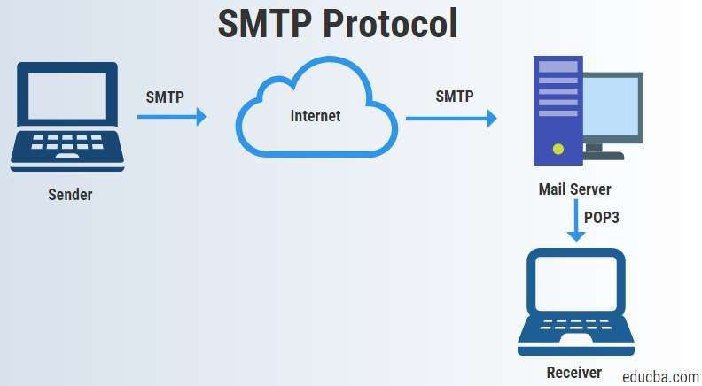
smtplib:-
“smtplib” creates a Simple Mail Transfer Protocol client session object which is used to send emails to any valid email id on the internet.

Slide 10
Any Assistant basically consists of three layers:
WORKING:-I
Speech to text
Text Analysing
Interpret commands

Slide 11
Speech to text:
A piece of software used that converts audio to text.
Text Analysing:
Converted text is just letters for computer.
A piece of software converts text to something that is understandable for computer.
Computer understands the command,so Assistant like Jarvis convert this text to computer command.

Slide 12
USE CASE DIAGRAM:-
search
Send
email
Web browser
Open new tab
Input voice
Wikipedia
Read search
user
Play/stop
music
Ask time

Slide 13

User
Sequence Diagram for task execution:-
Microphone
Compiler
Jarvis
Open Personal Assistant
Accessing Jarvis
Voice response
Start Mic
Wait until user speak
Receive data
Convert audio to text
Match text with action
Voice/Text
Response
Perform action

Slide 14
HOW IT WORKS:-
Speak something(for e.g. “Hello”)
Jarvis records the voice and match with available commands
If it is available then proper response is
And proper action is taken

Slide 15
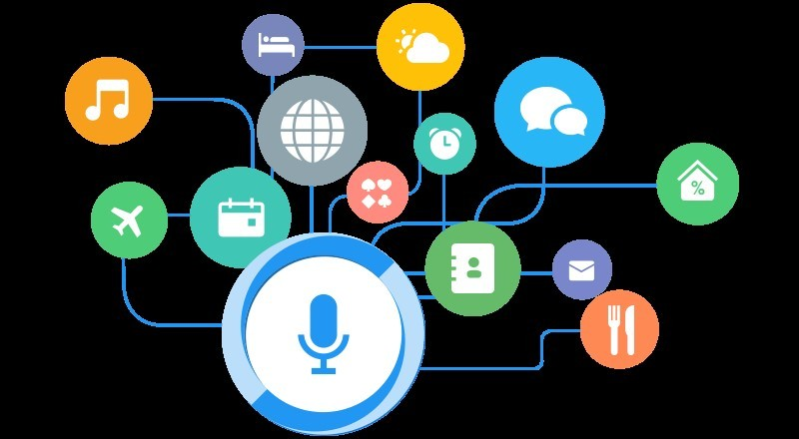
FEATURES:-
Play Music and Videos.
Send Email
Will entertain you
Get information from wikipedia
Interacting with the os
Show date and time

Slide 16
Advantages:-
These applications make small and smart hand held devices to combine multiple features.
They allow you to export and import data.
Store various information.
Make to do this.
Recognize voice commands.
Controls various applications of device.
Previous services regarding your location.
Helps to plan your whole day.
Remind you import things on accurate situations or location.

Slide 17
disadvantages:-
Listening problem-VA get problem to process wrong pronounced word and miscellaneous words
Silent mode support- VA gives response in voice output thus Wikipedia properly in silent mode.
Navigation languages-most of VA can understand only English language.
Internet access-VA needs internet connection to give desired output.

Slide 18
CONCLUSION:-
Virtual personal assistants are very effective way to organize your schedule. Now there are many Personal Digital Assistant applications available in market for various device platforms.
These new Software applications are performing really well
smartphone.
As a personal assistant Jarvis,are more portable and you can use them anytime. They also have lot of information than any assistant as they are connected with internet.

Slide 19
Thankyou

