Slide 1
ANDROID APPLICATION FOR KEEPING UP WITH THE LATEST HEADLINES
-HARSHITHAA. N (715522104022)
-SREYA. G (715522104051)
-AASTHA. V (715522104001)
-PREETHI. K (715522104040)

Slide 2
DESCRIPTION
The Android Application for Keeping Up with the Latest Headlines allows users to stay updated with the latest news by displaying a list of articles, each with a title, image, and brief description. Users can scroll through the feed and tap on articles for more details. Built using Jetpack Compose for UI, Coil for efficient image loading, and Retrofit for real-time data fetching, the app offers a smooth and modern experience for keeping up with breaking news.
User Registration and Login: Users can register with basic details and log in to access personalized content. This ensures secure, authenticated access to app features, including saved preferences and tailored news recommendations.
Main News Feed: The main feed displays the latest news articles in a scrollable list, with titles, images, and brief descriptions. It updates in real-time, ensuring users always have access to fresh headlines.
Article Details View: Tapping on an article leads to a detailed view with full content, publication date, source, and related images or videos. This offers users in-depth information and a comprehensive reading experience.
Jetpack Compose for UI Development: This project is built using Jetpack Compose, the app offers a modern, declarative UI that’s responsive and easy to maintain. It adapts seamlessly to various screen sizes for a smooth user experience.
Real-Time Data Fetching with Retrofit: Retrofit fetches news data from a remote server via RESTful APIs. It processes JSON responses and updates the app in real-time, ensuring users always have the latest headlines available instantly.
Seamless Navigation: Jetpack Compose’s navigation component allows easy transitions between the news feed and article details. The app ensures smooth, intuitive navigation, improving usability by offering clear and efficient movement through screens.

Slide 3
Main Activity.kt:
package com.example.newsheadlines
import android.content.Context
import android.content.Intent
import android.content.Intent.FLAG_ACTIVITY_NEW_TASK
import android.os.Bundle
import android.util.Log
import android.widget.TextView
import androidx.activity.ComponentActivity
import androidx.activity.compose.setContent
import androidx.activity.viewModels
import androidx.compose.foundation.Image
import androidx.compose.foundation.background
import androidx.compose.foundation.clickable
import androidx.compose.foundation.layout.*
import androidx.compose.foundation.lazy.LazyColumn
import androidx.compose.foundation.lazy.itemsIndexed
import androidx.compose.foundation.selection.selectable
import androidx.compose.foundation.shape.RoundedCornerShape
import androidx.compose.material.Card
import androidx.compose.material.MaterialTheme
import androidx.compose.material.Surface

Slide 4
import androidx.compose.material.Text
import androidx.compose.runtime.*
import androidx.compose.ui.Modifier
import androidx.compose.ui.graphics.Color
import androidx.compose.ui.text.font.FontWeight
import androidx.compose.ui.text.style.TextAlign
import androidx.compose.ui.unit.dp
import androidx.compose.ui.unit.sp
import androidx.compose.ui.viewinterop.AndroidView
import androidx.core.text.HtmlCompat
import coil.compose.rememberImagePainter
import coil.size.Scale
import coil.transform.CircleCropTransformation
import com.example.example.Articles
import com.example.newsheadlines.ui.theme.NewsHeadlinesTheme
class MainActivity : ComponentActivity() {
val mainViewModel by viewModels<MainViewModel>()
override fun onCreate(savedInstanceState: Bundle?) {
super.onCreate(savedInstanceState)
setContent {
NewsHeadlinesTheme {
// A surface container using the 'background' color from the theme
Surface(color = Color(0xFF4169E1)) {

Slide 5
Column() {
Text(text = "NEWS", fontSize = 32.sp, modifier = Modifier.fillMaxWidth(), textAlign = TextAlign.Center, color=Color((0xFF000000)))
MovieList(applicationContext, movieList = mainViewModel.movieListResponse)
mainViewModel.getMovieList()
}
}
}
}
}
}
@Composable
fun MovieList(context: Context, movieList: List<Articles>) {
var selectedIndex by remember { mutableStateOf(-1) }
LazyColumn {
itemsIndexed(items = movieList) {
index, item ->
MovieItem(context,movie = item, index, selectedIndex) { i ->

Slide 6
selectedIndex = i
}
}
}
}
@Composable
fun MovieItem(context: Context) {
val movie = Articles(
"Coco",
"",
" articl"
)
MovieItem(context,movie = movie, 0, 0) { i ->
Log.i("wertytest123abc", "MovieItem: "
+i)
}
}
@Composable
fun MovieItem(context: Context, movie: Articles, index: Int, selectedIndex: Int,
onClick: (Int) -> Unit)

Slide 7
{
val backgroundColor = if (index == selectedIndex) MaterialTheme.colors.primary else MaterialTheme.colors.background
Card(
modifier = Modifier
.padding(8.dp, 4.dp)
.fillMaxSize()
.selectable(true, true, null,
onClick = {
Log.i("test123abc", "MovieItem: $index/n$selectedIndex")
})
.clickable { onClick(index) }
.height(180.dp), shape = RoundedCornerShape(8.dp), elevation = 4.dp
) {
Surface(color = Color(0xFFFFFAF0)) {
Row(
Modifier
.padding(4.dp)
.fillMaxSize()
)

Slide 8
{
Image(
painter = rememberImagePainter(
data = movie.urlToImage,
builder = {
scale(Scale.FILL)
placeholder(R.drawable.placeholder)
transformations(CircleCropTransformation())
}
),
contentDescription = movie.description,
modifier = Modifier
.fillMaxHeight()
.weight(0.3f)
)
Column(
verticalArrangement = Arrangement.Center,
modifier = Modifier
.padding(4.dp)
.fillMaxHeight()
.weight(0.8f)
.background(Color(0xFFFFFAF0))

Slide 9
.padding(20.dp)
.selectable(true, true, null,
onClick = {
Log.i("test123abc", "MovieItem: $index/n${movie.description}")
context.startActivity(
Intent(context, DisplayNews::class.java)
.setFlags(Intent.FLAG_ACTIVITY_NEW_TASK)
.putExtra("desk", movie.description.toString())
.putExtra("urlToImage", movie.urlToImage)
.putExtra("title", movie.title)
)
})
) {
Text(
text = movie.title.toString(),
style = MaterialTheme.typography.subtitle1,
fontWeight = FontWeight.Bold
)
HtmlText(html = movie.description.toString())
}
}
}

Slide 10
}
@Composable
fun HtmlText(html: String, modifier: Modifier = Modifier) {
AndroidView(
modifier = modifier
.fillMaxSize()
.size(33.dp),
factory = { context -> TextView(context) },
update = { it.text = HtmlCompat.fromHtml(html, HtmlCompat.FROM_HTML_MODE_COMPACT) }
)
}
}
DisplayNews.kt:
package com.example.newsheadlines
import android.content.Intent
import android.os.Bundle
import android.util.Log
import android.widget.TextView
import androidx.activity.ComponentActivity
import androidx.activity.compose.setContent
import androidx.compose.foundation.Image

Slide 11
import androidx.compose.foundation.background
import androidx.compose.foundation.layout.Arrangement
import androidx.compose.foundation.layout.Column
import androidx.compose.foundation.layout.fillMaxSize
import androidx.compose.foundation.layout.padding
import androidx.compose.material3.MaterialTheme
import androidx.compose.material3.Surface
import androidx.compose.material3.Text
import androidx.compose.runtime.Composable
import androidx.compose.ui.Alignment
import androidx.compose.ui.Modifier
import androidx.compose.ui.graphics.Color
import androidx.compose.ui.tooling.preview.Preview
import androidx.compose.ui.unit.dp
import androidx.compose.ui.unit.sp
import androidx.compose.ui.viewinterop.AndroidView
import androidx.core.text.HtmlCompat
import coil.compose.rememberImagePainter
import com.example.newsheadlines.ui.theme.NewsHeadlinesTheme
class DisplayNews : ComponentActivity() {
override fun onCreate(savedInstanceState: Bundle?) {
super.onCreate(savedInstanceState)
setContent {

Slide 12
NewsHeadlinesTheme {
Surface(
modifier = Modifier.fillMaxSize(),
color = Color(0xFF000000)
) {
// Extract data from the Intent
val desk = intent.getStringExtra("desk") ?: "No Description Available"
val title = intent.getStringExtra("title") ?: "No Title Available"
val uriImage = intent.getStringExtra("urlToImage") ?: ""
Log.i("DisplayNews", "Desk: $desk")
Column(
Modifier
.background(Color(0xFFFFFAF0))
.padding(20.dp),
horizontalAlignment = Alignment.CenterHorizontally,
verticalArrangement = Arrangement.Center
) {
Text(text = title, fontSize = 32.sp, color = Color.Black)
HtmlText(html = desk)
if (uriImage.isNotEmpty()) {
Image(
painter = rememberImagePainter(uriImage),
contentDescription = "Article Image",

Slide 13
modifier = Modifier.padding(top = 16.dp)
)
} else {
// Placeholder or alternative content for when there is no image
Text(text = "No Image Available", color = Color.Red)
}
}
}
}
}
}
}
@Composable
fun HtmlText(html: String, modifier: Modifier = Modifier) {
AndroidView(
modifier = modifier,
factory = { context -> TextView(context) },
update = { it.text = HtmlCompat.fromHtml(html, HtmlCompat.FROM_HTML_MODE_COMPACT) }
)
}

Slide 14
@Preview(showBackground = true)
@Composable
fun DefaultPreview() {
NewsHeadlinesTheme {
// You can add a preview of the UI here
Column {
Text(text = "Sample Title", fontSize = 32.sp, color = Color.Black)
HtmlText(html = "Sample description here.")
}
}
}
LoginActivity.kt:
@file:Suppress("DEPRECATION")
package com.example.newsheadlines
import android.content.Context
import android.content.Intent
import android.os.Bundle
import androidx.activity.ComponentActivity
import androidx.activity.compose.setContent
import androidx.compose.foundation.Image
import androidx.compose.foundation.background

Slide 15
import androidx.compose.foundation.layout.*
import androidx.compose.foundation.shape.RoundedCornerShape
import androidx.compose.material.*
import androidx.compose.material.icons.Icons
import androidx.compose.material.icons.filled.Lock
import androidx.compose.material.icons.filled.Person
import androidx.compose.material3.Button
import androidx.compose.material3.ButtonDefaults
import androidx.compose.material3.Divider
import androidx.compose.material3.ExperimentalMaterial3Api
import androidx.compose.material3.Icon
import androidx.compose.material3.MaterialTheme
import androidx.compose.material3.Text
import androidx.compose.material3.TextField
import androidx.compose.material3.TextFieldDefaults
import androidx.compose.runtime.*
import androidx.compose.ui.Alignment
import androidx.compose.ui.Modifier
import androidx.compose.ui.graphics.Color
import androidx.compose.ui.res.painterResource
import androidx.compose.ui.text.font.FontWeight
import androidx.compose.ui.text.input.PasswordVisualTransformation
import androidx.compose.ui.tooling.preview.Preview
import androidx.compose.ui.unit.dp

Slide 16
import androidx.compose.ui.unit.sp
import com.example.newsheadlines.ui.theme.NewsHeadlinesTheme
class LoginActivity : ComponentActivity() {
private lateinit var databaseHelper: UserDatabaseHelper
override fun onCreate(savedInstanceState: Bundle?) {
super.onCreate(savedInstanceState)
databaseHelper = UserDatabaseHelper(this)
setContent {
LoginScreen(this, databaseHelper)
}
}
}
@OptIn(ExperimentalMaterial3Api::class)
@Composable
fun LoginScreen(context: Context, databaseHelper: UserDatabaseHelper) {
var username by remember { mutableStateOf("") }
var password by remember { mutableStateOf("") }
var error by remember { mutableStateOf("") }
Column(
Modifier

Slide 17
.fillMaxHeight()
.fillMaxWidth()
.padding(28.dp),
horizontalAlignment = Alignment.CenterHorizontally,
verticalArrangement = Arrangement.Center
) {
Image(painter = painterResource(id = R.drawable.news), contentDescription = "")
Spacer(modifier = Modifier.height(10.dp))
Row {
Divider(color = Color.LightGray, thickness = 2.dp, modifier = Modifier
.width(135.dp)
.padding(top = 20.dp, end = 20.dp))
Text(
text = "Login",
color = Color(0xFF4169E1),
fontWeight = FontWeight.Bold,
fontSize = 24.sp,
style = MaterialTheme.typography.headlineLarge
)
Divider(color = Color.LightGray, thickness = 2.dp, modifier = Modifier
.width(155.dp)
.padding(top = 20.dp, start = 20.dp))
}

Slide 18
Spacer(modifier = Modifier.height(10.dp))
TextField(
value = username,
onValueChange = { username = it },
leadingIcon = {
Icon(imageVector = Icons.Default.Person, contentDescription = "personIcon", tint = Color(0xFF4169E1))
},
placeholder = { Text(text = "Username", color = Color.Black) },
colors = TextFieldDefaults.textFieldColors(containerColor = Color.Transparent)
)
Spacer(modifier = Modifier.height(20.dp))
TextField(
value = password,
onValueChange = { password = it },
leadingIcon = {
Icon(imageVector = Icons.Default.Lock, contentDescription = "lockIcon", tint = Color(0xFF4169E1))
},
placeholder = { Text(text = "Password", color = Color.Black) },
visualTransformation = PasswordVisualTransformation(),

Slide 19
colors = TextFieldDefaults.textFieldColors(containerColor = Color.Transparent)
)
Spacer(modifier = Modifier.height(12.dp))
if (error.isNotEmpty()) {
Text(text = error, color = MaterialTheme.colorScheme.error, modifier = Modifier.padding(vertical = 16.dp))
}
Button(
onClick = {
if (username.isNotEmpty() && password.isNotEmpty()) {
val user = databaseHelper.getUserByUsername(username)
if (user != null && user.password == password) {
error = "Successfully logged in"
context.startActivity(Intent(context, MainActivity::class.java))
// Finish the LoginActivity if needed
// (context as Activity).finish()
} else {
error = "Invalid username or password"
}
} else {
error = "Please fill all fields"
}

Slide 20
},
shape = RoundedCornerShape(20.dp),
colors = ButtonDefaults.buttonColors(containerColor = Color(0xFF4169E1)),
modifier = Modifier.width(200.dp).padding(top = 16.dp)
) {
Text(text = "Log In", fontWeight = FontWeight.Bold)
}
Row(modifier = Modifier.fillMaxWidth()) {
TextButton(onClick = { context.startActivity(Intent(context, RegistrationActivity::class.java)) }) {
Text(text = "Sign up", color = Color.Black)
}
Spacer(modifier = Modifier.width(100.dp))
TextButton(onClick = { /* Handle forgot password */ }) {
Text(text = "Forgot password?", color = Color.Black)
}
}
}
}

Slide 21
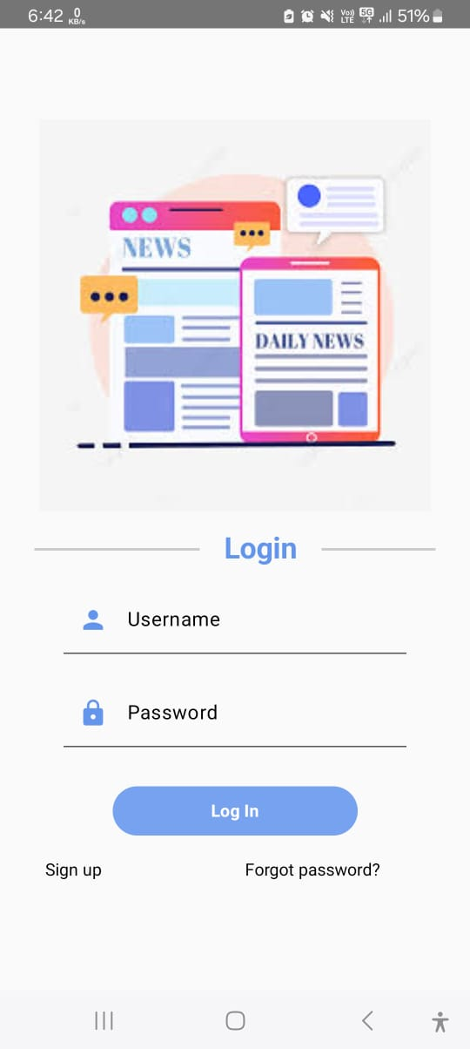
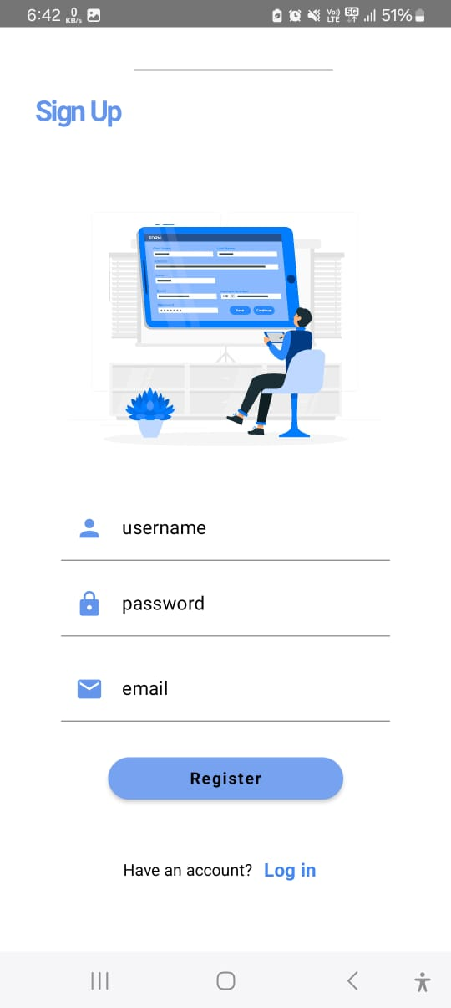
OUTPUT:

Slide 22
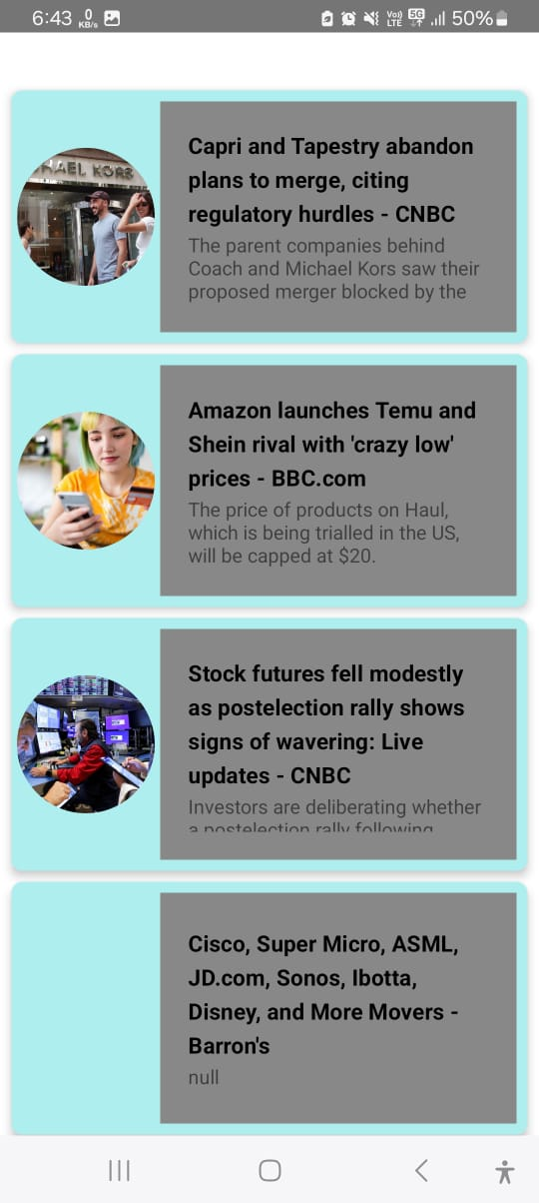
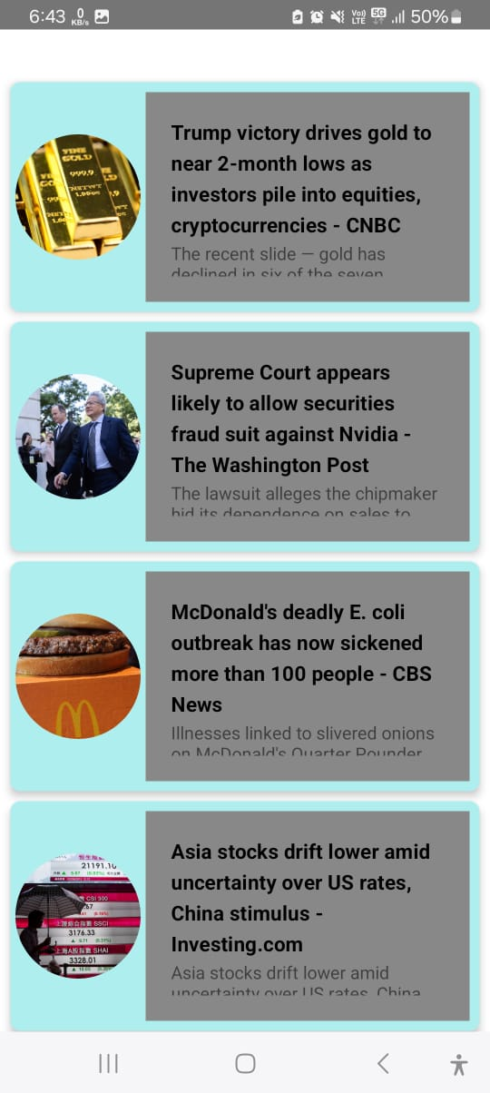

Slide 23
