Slide 1
21CS644 – Data Science and Visualization
Module 1
Doing Data Science, Cathy O’Neil and Rachel Schutt, O'Reilly Media, Inc O'Reilly Media,Inc, 2013

Slide 2

What is Data Science?
Data science is a field that deals with unstructured, structured data, and semi-structured data. It involves practices like data cleansing, data preparation, data analysis, and much more. A Data Scientist helps companies with data-driven decisions, to make their business better.
It combines various techniques from statistics, mathematics, computer science, and domain-specific knowledge to analyze data and make informed decisions

Slide 3
Big Data
Big data refers to extremely large sets of data that may be analyzed computationally to reveal patterns, trends, and associations, especially relating to human behavior and interactions.
Volume, Velocity, Variety, Veracity and Value.
-> Volume refers to the vast amount of data generated from various sources such as business transactions, social media, sensor data, and more. Big data involves processing and analyzing data sets that are typically measured in terabytes, petabytes, or even exabytes.
-> If the volume of data is very large, then it is actually considered as a ‘Big Data’. This means whether a particular data can actually be considered as a Big Data or not, is dependent upon the volume of data.
-> Hence while dealing with Big Data it is necessary to consider a characteristic ‘Volume’.
-> Velocity represents the speed at which data is generated, collected, and processed. Big data is characterized by high-velocity streams of data that require real-time or near-real-time processing to extract actionable insights.
Velocity applies to the speed at which this information arrives -- for example, how many social media posts per day are ingested -- as well as the speed at which it needs to be digested and analyzed -- often quickly and sometimes in near real time.
As an example, in healthcare, many medical devices today are designed to monitor patients and collect data. From in-hospital medical equipment to wearable devices, collected data needs to be sent to its destination and analyzed quickly.

Slide 4
Big Data
Variety refers to the diversity of data types and sources. Big data encompasses structured data, semi-structured data, and unstructured data. Managing and analyzing diverse data types is a key challenge in big data analytics
->Structured data includes more defined data types, such as databases of names and numbers.
->Unstructured data, on the other hand, includes data types like text, sounds, images, and social media posts.
->Semi-structured is a mix of the two. For example, in health care, patient data may include structured records such as age, diagnosis, and treatment history and unstructured data such as medical notes, health images, and even genetic information.
Veracity refers to the quality and reliability of data. Big data often includes data from multiple sources with varying levels of accuracy and trustworthiness. Ensuring data quality and establishing trust in the data is crucial for meaningful analysis and decision making.
-> Veracity refers to the quality, accuracy, integrity and credibility of data. Gathered data could have missing pieces, might be inaccurate or might not be able to provide real, valuable insight. Veracity, overall, refers to the level of trust there is in the collected data.
Value reflects the importance and usefulness of the insights derived from big data analytics. The ultimate goal of analyzing big data is to extract valuable insights that can drive business decisions, optimize processes, enhance customer experiences, and create new opportunities.
Organizations can use big data tools to gather and analyze the data, but how they derive value from that data should be unique to them. Tools like Apache Hadoop can help organizations store, clean and rapidly process this massive amount of data.

Slide 5
Big Data
These five Vs collectively capture the complex nature of big data and underscore the challenges and opportunities associated with analyzing and deriving value from large-scale datasets.
Big data technologies and platforms are used to handle these large and complex data sets, including tools like Hadoop, Spark, and NoSQL databases.
The insights gained from analyzing big data can be used for making better decisions, understanding customer behavior, improving business operations, and developing new products and services.

Slide 6
Data Science Hype
Data science enables companies not only to understand data from multiple sources but also to enhance decision making. As a result, data science is widely used in almost every industry, including health care, finance, marketing, banking, city planning, and more
Growing popularity and cross-industry impact.
High demand for skilled data scientists.
Unrealistic business expectations.
Ethical concerns: privacy, bias.
Future trends: AI, deep learning.
Importance of continuous education and upskilling.

Slide 7
Getting the Past Hype
Set Clear Objectives
Verify Results
Understand Limitations
Focus on Value
Educate Stakeholders
Ethical Considerations
Iterative Approach
Collaborative Culture
Continuous Learning

Slide 8
Why now?
We have massive amounts of data about many aspects of our lives, and, simultaneously, an abundance of inexpensive computing power.
Shopping, communicating, reading news, listening to music, searching for information, expressing our opinions—all this is being tracked online, as most people know.
It’s not just Internet data, though—it’s finance, the medical industry, pharmaceuticals, bioinformatics, social welfare, government, education, retail, and the list goes on. There is a growing influence of data in most sectors and most industries. In some cases, the amount of data collected might be enough to be considered “big” in other cases, it’s not.
On the Internet, this means Amazon recommendation systems, friend recommendations on Facebook, film and music recommendations, and so on.
In finance, this means credit ratings, trading algorithms, and models.
In education, this is starting to mean dynamic personalized learning and assessments coming out of places like Knewton and Khan Academy.
In government, this means policies based on data.

Slide 9

Datafication
Datafication as a process of “taking all aspects of life and turning them into data.” This concept involves capturing, quantifying, and converting different activities, behaviors, and processes into digital data that can be analyzed and utilized for various purposes. Datafication refers to the process of transforming various aspects of our lives into computerized data, which can then be monitored, tracked, analyzed, and optimized.
The process of converting different facets of our lives into digital data is known as datafication.
This includes collecting, analyzing, and utilizing vast amounts of information for various purposes.
Datafication has its roots in the advancements of technology and the increasing connectivity of our society.
With the rise of smartphones, social media, and the Internet of Things (IoT), we are constantly generating data through our actions, behaviors, and interactions.
This data is then collected and processed to gain valuable insights and make informed decisions.

Slide 10
Datafication
Social Media Platforms (e.g., Facebook, Instagram):
Social platforms collect and monitor data related to our friendships, interests, and interactions. They use this information to market products and services to us and even provide surveillance services to agencies. As a result, our behavior is influenced by the data they gather.
The promotions we see on social media are also a direct outcome of the monitored data. Datafication plays a crucial role in redefining how content is created, as it informs content rather than relying solely on recommendation systems.
Netflix
Netflix, the popular internet streaming media provider, exemplifies datafication.
Originally focused on mail order-based disc rental (DVD and Blu-ray), Netflix transformed into an online entertainment powerhouse.
By analyzing user preferences, viewing habits, and content ratings, Netflix tailors its recommendations and content offerings to individual users

Slide 11
Datafication
Insurance Industry:
Datafication is actively used in the insurance sector. Insurers utilize data to update risk profiles and develop new business models. By analyzing data, they can better assess the likelihood of a person paying back a loan or evaluate an individual’s trustworthiness.
Datafication allows us to turn previously invisible processes into valuable data that drives decision-making and optimization across various domains.
Whether it’s tracking our movements through GPS, monitoring health using fitness trackers, or predicting natural disasters, datafication plays a pivotal role in our interconnected world²

Slide 12
Datafication
Key Aspects:
Measurement and Tracking: Datafication involves measuring and tracking activities using digital technologies and sensors. This can include tracking consumer behavior online, monitoring health metrics using wearable devices, or recording operational data in industries.
Digitization of Information: Datafication involves converting analog information (e.g., paper records, physical transactions) into digital formats that can be stored, processed, and analyzed using computers and data analytics tools.
Data Integration: Datafication often involves integrating data from various sources and systems to create comprehensive datasets. This can include combining data from IoT devices, social media platforms, customer databases, and more.
Analysis and Insights: The purpose of datafication is to generate insights and knowledge from the collected data. This involves using data analytics techniques such as statistical analysis, machine learning, and data mining to uncover patterns, trends, correlations, and anomalies within the data.
Decision-Making and Optimization: Datafication enables data-driven decision-making by providing valuable information to businesses, governments, organizations, and individuals. It helps optimize processes, improve efficiency, predict outcomes, and identify opportunities for innovation.

Slide 13
Datafication
Datafication in everyday Life
From fitness trackers and smart home devices to social media and online shopping, datafication has transformed the way we live, work, and interact.
For example, fitness trackers collect data on our physical activities, sleep patterns, and heart rates, enabling us to monitor our health and make informed decisions about our well-being.
Social media platforms like Facebook and Twitter collect vast amounts of data on our preferences, interests, and online behavior. This data is then used to deliver targeted advertisements, personalize our news feeds, and connect us with like-minded individuals.
Online shopping platforms leverage datafication to recommend products based on our browsing history and purchase behavior, making the shopping experience more convenient and tailored to our preferences.
Datafication in Business and Industry
For example, e-commerce giant Amazon analyzes customer data to optimize its supply chain, reduce delivery times, and improve inventory management.
In the manufacturing sector, datafication has led to the emergence of Industry 4.0, where data is used to drive automation, predictive maintenance, and process optimization.
By collecting real-time data from sensors and machines, manufacturers can identify bottlenecks, reduce downtime, and increase productivity.

Slide 14
Datafication
Datafication in Health Care
Datafication also plays a crucial role in medical research, where large datasets are analyzed to identify new treatments, predict disease outcomes, and improve patient care.
In addition, wearable devices and mobile health apps collect data on vital signs, physical activity, and sleep patterns, allowing individuals to monitor their health and make informed decisions. This data can also be shared with healthcare professionals for remote monitoring and early intervention.
Datafication in Education
Datafication has the potential to revolutionize education by providing personalized learning experiences and improving educational outcomes.
By collecting and analyzing data on student performance, educators can identify areas where students may need additional support and tailor instruction accordingly. This helps to address individual learning needs and improve overall student engagement and achievement.
Furthermore, datafication enables the measurement of educational effectiveness, allowing educational institutions to evaluate the impact of different teaching strategies and interventions. By analyzing student data, educators can identify trends, patterns, and best practices that lead to improved learning outcomes.

Slide 15
Datafication
Datafication in Sports
In the world of sports, datafication has transformed the way teams and athletes train, strategize, and perform. Athletes now have access to wearable devices that track their performance metrics, such as heart rate, speed, and distance covered. To find opportunities for progress, enhance training programs, and avoid injuries, this data can be evaluated.
Datafication has also revolutionized sports analytics, where vast amounts of data are analyzed to gain insights into player performance, team strategies, and game outcomes.
Datafication in Government and Public Services
Datafication has transformed the way governments and public services operate, leading to more efficient and effective governance.
By collecting and analyzing data, governments can gain insights into citizen needs, preferences, and behavior, allowing them to develop policies and services that better meet the needs of the population.
For example, datafication has been utilized in urban planning to optimize transportation systems, reduce traffic congestion, and improve air quality.
Governments also use datafication to track the spread of diseases, predict and mitigate natural disasters, and enhance public safety.

Slide 16
Current Landscape and Perspectives
Mike Driscoll's analogy of data science as the "civil engineering of data" highlights the multifaceted nature of the field, combining practical skills with theoretical understanding.
Practical Knowledge of Tools and Materials: Similar to civil engineering, data science requires proficiency in using a variety of tools and technologies.
Data scientists work with
-> programming languages (like Python, R, SQL),
-> data manipulation frameworks (such as Pandas, Spark),
-> visualization libraries (like Matplotlib, Tableau), and
-> machine learning algorithms.
Theoretical Understanding of What's Possible: Beyond tool proficiency, data scientists need a deep theoretical understanding of statistics, mathematics, and machine learning concepts.
This knowledge enables them to formulate hypotheses, design experiments, and develop models that yield meaningful insights from data.

Slide 17
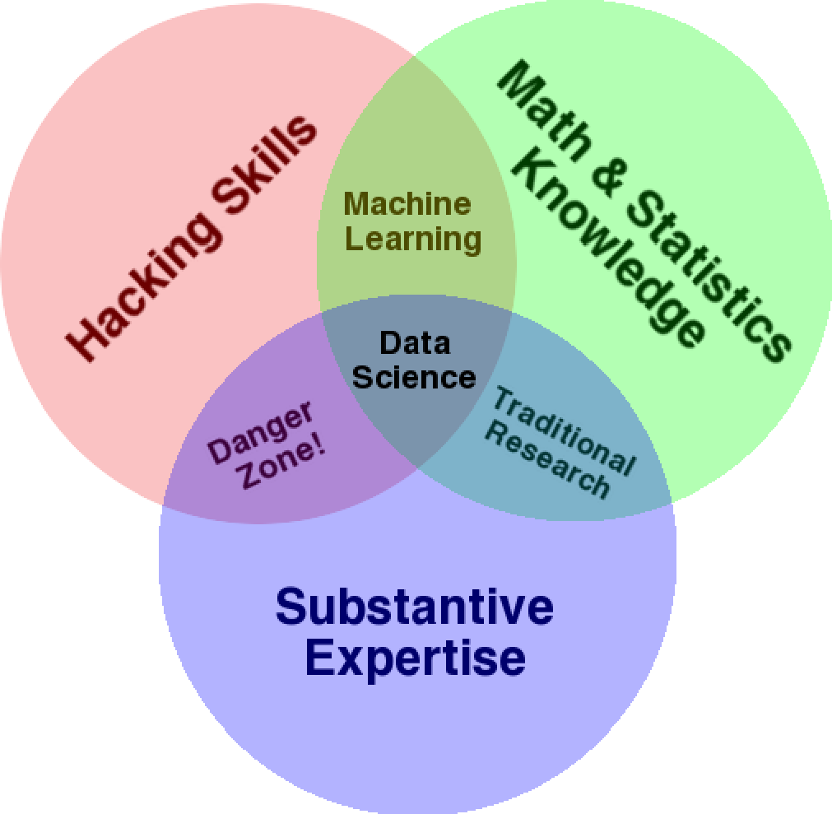
Current Landscape and Perspectives
Hacking Skills: This encompasses programming, data manipulation, and software development. Data scientists use tools and techniques to acquire, clean, and analyze data efficiently.
Mathematics and Statistics Knowledge: Understanding statistical methods, probability theory, and mathematical concepts is crucial for interpreting data and building predictive models.
Substantive Expertise: Domain knowledge in specific industries (e.g., finance, healthcare, marketing) helps data scientists contextualize their analyses and generate actionable insights.
The intersection of these skills in Conway's Venn diagram as represents, the core competencies required for effective data science.
By embracing both practical expertise (hacking skills) and theoretical foundations (mathematics/statistics), data scientists can navigate the complexities of real-world data problems and contribute meaningfully to decision-making and innovation across industries.

Slide 18
Skill Sets and Data science Jobs
Computer science:
->Proficiency in programming languages like Python, R, SQL, and others.
->Knowledge of data manipulation libraries (Pandas, NumPy) and data processing frameworks (e.g., Apache Spark). -> Understanding of algorithms, data structures, and software engineering principles for scalable data analysis.
Statistics and Math:
-> Strong foundation in statistical methods, probability theory, and hypothesis testing.
-> Experience in applying statistical techniques for data analysis, inference, and modeling.
-> Knowledge of machine learning algorithms and techniques for supervised and unsupervised learning.
Communication and Presentation Skills:
->Ability to translate complex technical concepts into clear, actionable insights for non-technical stakeholders.
->Proficiency in storytelling and data presentation, including data visualization using tools like Tableau, Matplotlib etc.
->Effective written and verbal communication to convey findings, recommendations, and insights.
Domain expertise:
->Familiarity with specific industry domains such as finance, healthcare, ecommerce, or marketing.
->Understanding of domain-specific data sources, challenges, and business objectives.
->Ability to contextualize data analysis within the industry's regulatory, ethical, and operational frameworks.

Slide 19
Skill Sets and Data science Jobs
Data Engineers: Experts in data infrastructure, database management, and data pipeline development.
Machine Learning Engineers: Specialize in deploying and optimizing machine learning models in production.
Data Analysts: Focus on exploratory data analysis, reporting, and generating descriptive insights.
Domain Experts: Provide subject matter knowledge and guidance on industry-specific challenges and opportunities.
Data science team profiles can be constructed from data scientist profiles; there should be alignment between the data science team profile and the profile of the data problems they try to solve
Rachel’s data science profile, which she created to illustrate trying to visualize oneself as a data scientist; she wanted students and guest lecturers to “riff” on this—to add buckets or remove skills, use a different scale or visualization method, and think about the drawbacks of self-reporting

Slide 20
What is Data Science?
In Academia:
an academic data scientist is a scientist, trained in anything from social science to biology, who works with large amounts of data, and must grapple with computational problems posed by the structure, size, messiness, and the complexity and nature of the data, while simultaneously solving a real world problem.
In Industry:
a data scientist is someone who knows how to extract meaning from and interpret data, which requires both tools and methods from statistics and machine learning, as well as being human.
Spends a lot of time in the process of collecting, cleaning, and munging data, because data is never clean. This process requires persistence, statistics, and software engineering skills—skills that are also necessary for understanding biases in the data, and for debugging logging output from code

Slide 21
Statistical Inference
Statistical inference involves the process of deriving insights, meaning, and information from data that has been generated by stochastic (random) processes.
This includes developing procedures, methods, and theorems to extract knowledge and make inferences about the underlying processes.
statistical inference is a fundamental discipline in data science and statistics that bridges the gap between data and real-world processes. It enables researchers and practitioners to extract actionable knowledge, formulate models, and make informed decisions based on observed data that inherently contain randomness and uncertainty.

Slide 22
Population and Samples
The population refers to the entire group of interest for a particular study or analysis. It includes all individuals, objects, or events that possess certain characteristics and about which we want to draw conclusions.
Characteristics:
Complete Set: The population encompasses every member of the defined group.
Parameters: Population parameters are descriptive measures that summarize the entire population. For example, the population mean, variance, or proportion.
Example:
If you are studying the average height of adult males in a country, the population would be all adult males in that country.

Slide 23
Population and Samples
A sample is a subset of the population that is selected and studied to make inferences or draw conclusions about the entire population.
Characteristics:
• Representative: Ideally, a sample should be representative of the population to ensure the findings can be generalized.
• Practicality: Sampling is often done due to practical constraints (time, cost, feasibility) when studying large populations.
Types of Sampling:
• Random Sampling: Every member of the population has an equal chance of being included in the sample.
• Stratified Sampling: Population is divided into subgroups (strata) and random samples are taken from each subgroup.
• Cluster Sampling: Population is divided into clusters (e.g., geographical areas) and random clusters are selected for sampling.
Example: In the height study example, if you randomly select 500 adult males from different regions of the country and measure their heights, this group of 500 individuals constitutes your sample.

Slide 24
Statistical modelling
Statistical modeling is a method used in statistics to describe and analyze relationships between variables.
->It involves creating mathematical models that represent the underlying structure of the data, allowing for the exploration, prediction, and inference of relationships between variables.
Descriptive Modeling: Describes the relationship between variables in the data.
Predictive Modeling: Uses observed data to make predictions about future outcomes.
Inferential Modeling: Provides insights into underlying processes or relationships based on data.
Statistical models can vary in complexity, from simple linear regression models to more advanced machine learning algorithms.
Linear Regression: Models the relationship between one or more predictor variables and a response variable using linear equations.
Logistic Regression: Models binary or categorical outcomes using a logistic function.
Time Series Models: Models data that evolves over time, such as ARIMA models for forecasting.

Slide 25
Probability Distributions
A probability distribution describes how the values of a random variable are distributed across different outcomes.
It assigns probabilities to each possible outcome, providing a mathematical representation of the likelihood of observing each value.
Types of Distributions:
• Normal Distribution: Bell-shaped distribution characterized by mean and standard deviation.
• Binomial Distribution: Describes the number of successes in a fixed number of independent trials.
Poisson Distribution: Models the number of events occurring in a fixed interval of time or space.
• Exponential Distribution: Models the time between events in a Poisson process.
Use in Modeling:
• Probability distributions are used to model random variables in statistical analysis and to make probabilistic statements about data.

Slide 26
Fitting a Model
Fitting a model involves estimating the parameters of a statistical model using observed data to find the best-fitting representation of the relationship between variables.
It involves optimization methods and algorithms, such as maximum likelihood estimation, to help get the parameters.
Steps:
1. Choose a Model: Select an appropriate statistical model based on the nature of the data and the research question.
2. Parameter Estimation: Use statistical techniques (e.g., maximum likelihood estimation, least squares) to estimate the model parameters that best fit the observed data.
3. Model Validation: Assess the goodness of fit of the model using measures such as residuals, R-squared (for regression), or likelihood ratios.
4. Interpret Results: Interpret the estimated parameters and use the model for prediction, inference, or decision-making.
Tools
Statistical software packages like R, Python (with libraries such as stats models or scikit-learn), or specialized software for specific types of models (e.g., SPSS for regression analysis) are used to fit and validate statistical models.

Slide 27
Fitting a Model
In summary, statistical modeling, probability theory, and model fitting form the backbone of
statistical analysis and data-driven decision-making. These concepts enable researchers and practitioners to derive insights from data, make predictions, and understand the underlying
processes that generate the observed phenomena.
A bunch of continuous density functions (aka probability distributions)

