Slide 1
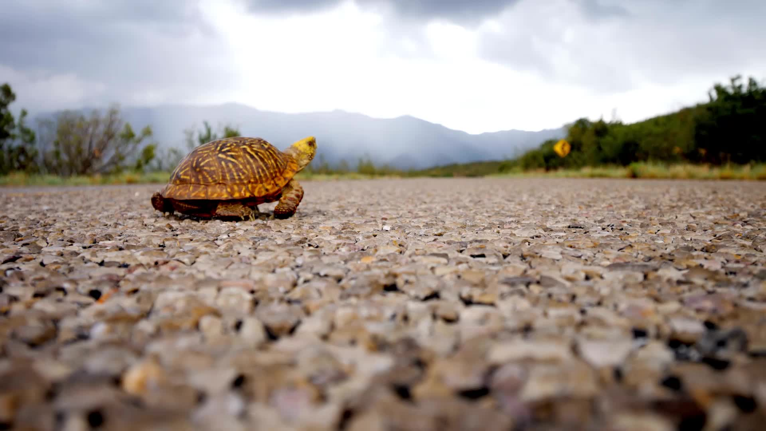
Turtle Race Game Storyboard
Sai Sree Harsha Malipeddi
AP Computer Science Principles
1.1.9 - Algorithms and Art

