Slide 1
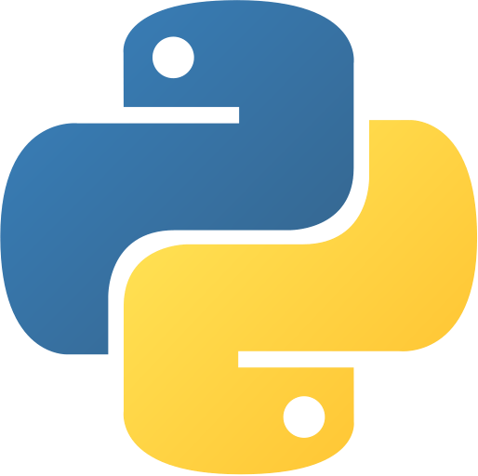

Python Class 47 & 48 Final Project – Restaurant Management System App
Harsha Malipeddi
Harsha.Malipeddi@gmail.com

Slide 2
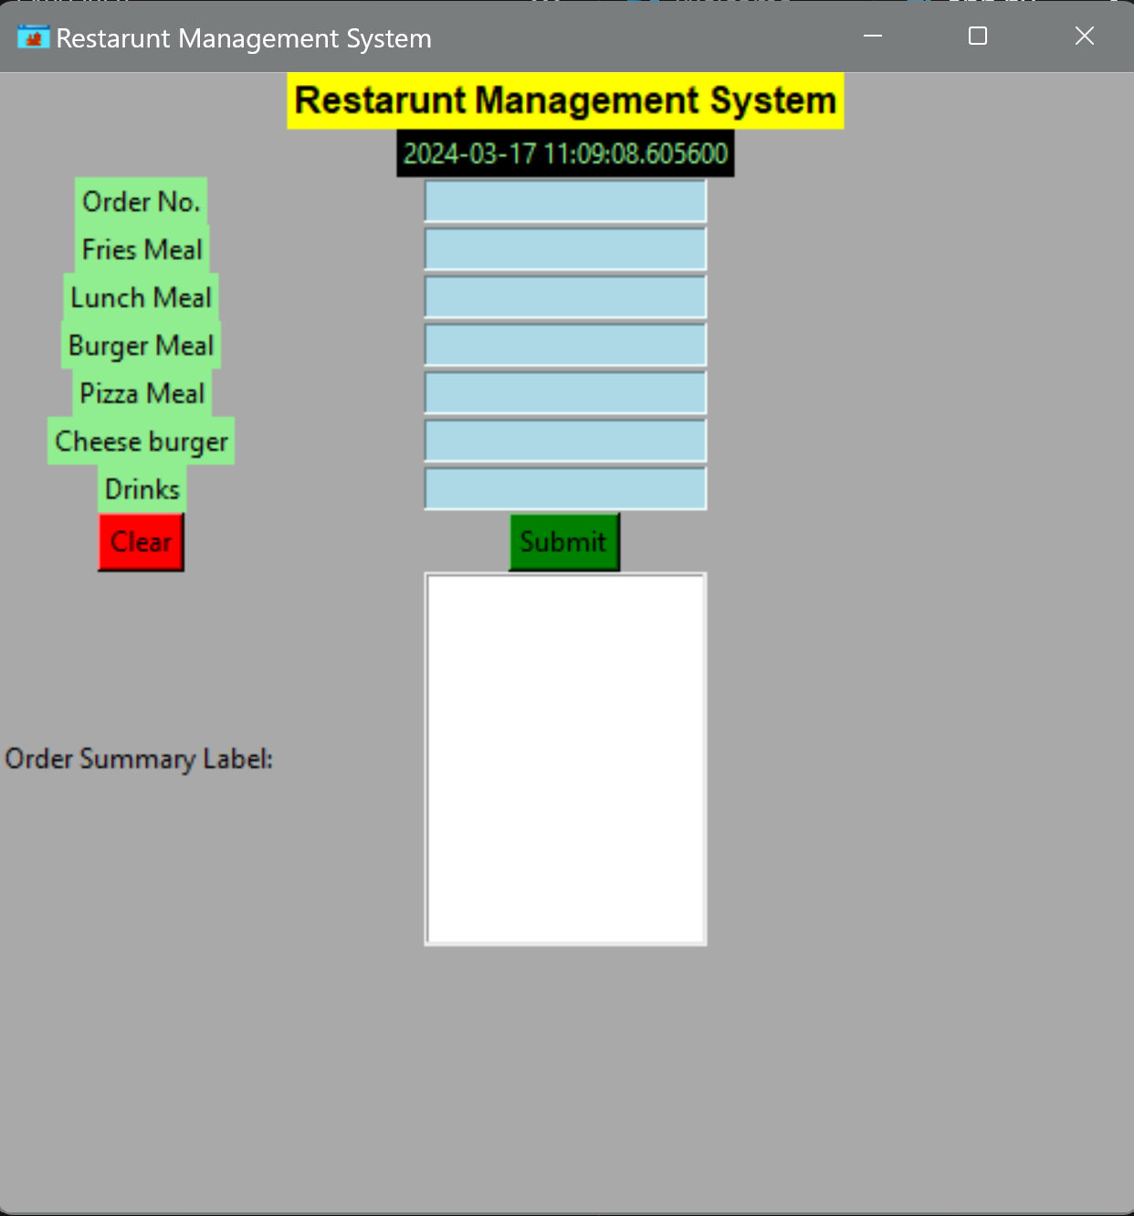
Restaurant Management System
title
appicon
header
order_no_label
datetime_label
fries_meal_label
order_no_entry
lunch_meal_label
fries_meal_entry
burger_meal_label
lunch_meal_entry
pizza_meal_label
burger_meal_entry
cheese_burger_label
pizza_meal_entry
drinks_label
cheese_burger_entry
drinks_meal_entry
clear_button
submit_button
ordersummarylabel
listbox

Slide 3
App Description
Our GUI Restaurant Management App is designed to help restaurant owners manage their business efficiently. With an easy-to-use graphical interface, this app allows restaurant staff to handle various tasks seamlessly.
Key Features :
Menu Management
Order Management
Table Reservation
Inventory Tracking
Billing and Payments
Employee Management
Customer Feedback
Our GUI Restaurant Management App aims to simplify restaurant operations, enhance customer satisfaction, and boost overall efficiency. Whether you run a small café or a fine dining establishment, this app is tailored to meet your restaurant management needs.

Slide 4
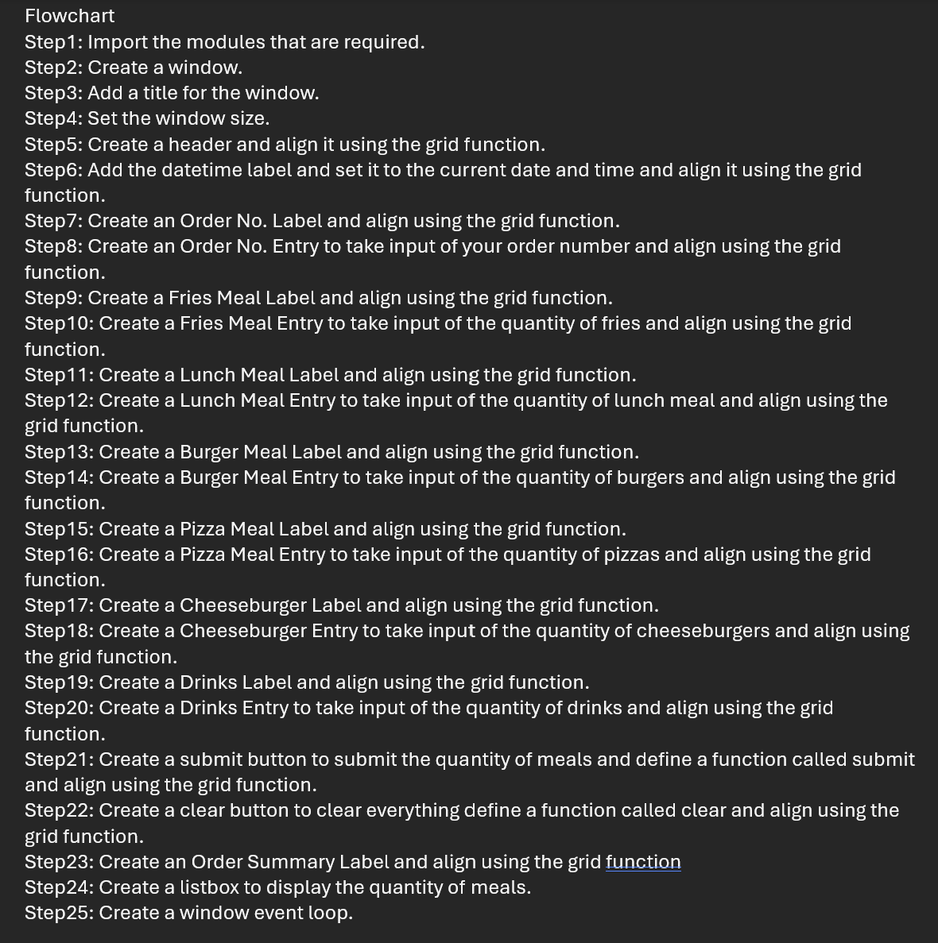
Step By Step Code

