Slide 1
DIGITAL
DESIGN &
CIRCUIT
ANALYSIS
Design and Simulation of a Smart Home Security System
A digital-logic-based approach to combining security sensor conditions and classifying situations as Safe, Warning, Intrusion, or Emergency.
ONE-ZONE RULE-BASED
SECURITY CLASSIFICATION
Logisim Simulation
AND / OR / NOT Logic
Single Security Zone
Sai Sahasra – 2620030388
Varshitha – 2620030386
Harsha – 2620030432
Section: [add section]

Slide 2
2. Introduction and Objective
INTRO
Brief introduction to the project and its purpose
The real-world setting
The design challenge
Our project focus
A home security zone contains several signals that describe what is happening: door status, motion, forced entry, heat, and whether the system is armed.
A sensor signal is often ambiguous by itself. The useful question is not just “did a sensor trigger?” but “what situation do these signals describe together?”
We implement a small, rule-based decision system in digital logic that turns a combination of binary inputs into a security classification and final alarm condition.
Project objectives
• Model one security zone using the armed state and four sensor inputs as binary signals.
• Classify situations as Safe, Warning, Intrusion, or Emergency.
• Combine sensor states with multi-condition logic instead of treating every trigger identically.
• Implement the rules as Boolean logic and gates in Logisim.
• Validate behavior by testing representative input combinations.
• Keep the design extensible so the same zone logic can be replicated for multiple zones.

Slide 3
3. Theory and Logic
THEORY
Basic concept: binary inputs combined with AND / OR / NOT logic to give a security state
Inputs
SAFE
Routine / no active threat
A
Armed / Disarmed
RULE-BASED
SECURITY LOGIC
D
Door Open
WARNING
Relevant event, not yet intrusion
Combines armed state + sensor conditions
to classify the current situation.
M
Motion
INTRUSION
Strong evidence of unauthorized entry
AND / OR / NOT
F
Forced Entry
H
Heat
EMERGENCY
Heat-related emergency condition
Final alarm condition is derived from the applicable higher-severity security state.

Slide 4
4. Logic Circuit Diagram
CIRCUIT
Signal flow for one security zone: sensors, condition logic, state outputs, final alarm
Zone Inputs
ARMED
System state
Condition & State Logic
SAFE
State output
DOOR
Door sensor
Warning path
Armed + Door or Motion
WARNING
State output
MOTION
Motion sensor
Intrusion path
Armed + Door + Motion
Intrusion path
Armed + Forced Entry
INTRUSION
State output
FORCED ENTRY
Intrusion sensor
Emergency path
Heat condition
HEAT
Heat sensor
Boolean gates implement the conditions above; the classification logic then feeds the alarm output.
EMERGENCY
State output
FINAL ALARM

Slide 5
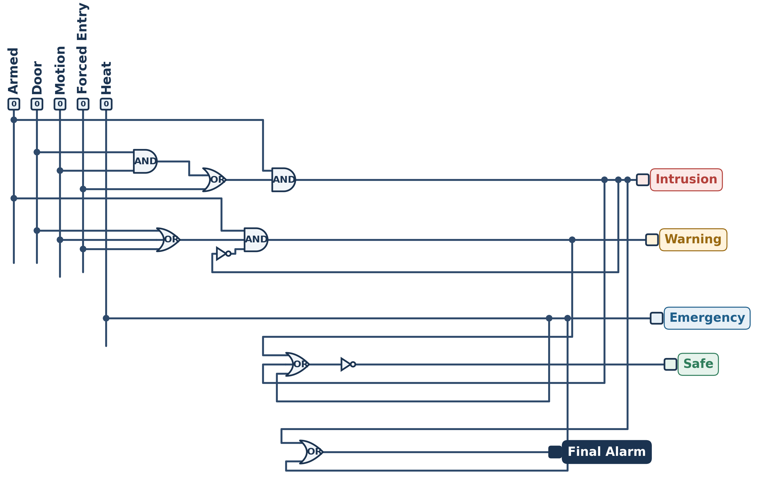
5. Circuit Design in Logisim
LOGISIM
The circuit built in Logisim and how each output is generated
INTRUSION
Armed · (Door · Motion + Forced Entry)
WARNING
Armed · (Door + Motion + Forced Entry) · NOT Intrusion
EMERGENCY
Heat
SAFE
NOT (Warning + Intrusion + Emergency)
FINAL ALARM
Intrusion + Emergency
Key principle
The circuit is deterministic: same inputs, same outputs. Heat raises Emergency even when disarmed.

Slide 6
6. Simulation Results
RESULTS
Input–output combinations and expected states from the Logisim simulation
Case
A
D
M
F
H
Situation
Expected state
Comment
Normal
0
0
0
0
0
No active security event
SAFE
Disarmed / idle
Door while armed
1
1
0
0
0
Open door
WARNING
Suspicious but not yet intrusion
Door + motion
1
1
1
0
0
Open door + movement
INTRUSION
Stronger combined evidence
Forced entry
1
0
0
1
0
Direct intrusion signal
INTRUSION
High-confidence trigger
Heat
1
0
0
0
1
Dangerous heat
EMERGENCY
Different threat category
Disarmed activity
0
1
1
0
0
Normal activity
SAFE*
Security response disabled
* Disarmed behavior follows the final truth table of the submitted circuit.
Add screenshot
Discussion: the key result is not merely “alarm ON”; it is the distinction between different conditions using combined inputs.
Paste the Logisim simulation screenshot here.

Slide 7
7. Conclusion and Applications
CONCLUSION
Outcome, applications, and possible improvements
We converted a real-world security problem into a deterministic digital decision system.
Problem addressed
A simple “any sensor → alarm” approach does not distinguish ordinary activity from stronger evidence of intrusion or a different emergency.
Outcome
The rules are expressed in Boolean logic and implemented as a one-zone circuit in Logisim, tested on representative input combinations.
Applications
Home and office security panels, shop or warehouse zone monitoring, and a teaching example of rule-based combinational logic.
Improvements
Add an entry-delay timer and latching alarm (sequential logic), keypad arm/disarm, and real sensor or microcontroller interfacing.
How it scales
The same zone-level logic can be replicated and combined to form a larger multi-zone system.
Core takeaway
Inputs → conditions → situation → alarm

Slide 8
8. References
REFERENCES
Textbooks and tools used for the project
Digital logic foundations
Tools and course material
1. M. Morris Mano & Michael D. Ciletti, Digital Design: With an Introduction to the Verilog HDL.
2. Thomas L. Floyd, Digital Fundamentals.
Use your prescribed textbook / lecture notes as the primary academic source for Boolean logic, combinational circuits, and truth tables.
1. Logisim – digital logic design and simulation tool (Carl Burch).
2. Course lecture notes on Boolean algebra, logic gates and combinational circuits.
Thank you

