Slide 1
ER Triage Management System
Team No: 25
Problem Solving Using Programming (Java) · 26SC1101E
By: Ritwik (2620030356), Harsha (2620030432)

Slide 2
Abstract
The ER Triage Management System is a Java console application that helps emergency-room staff decide who should be treated first.
For every patient it reads age, consciousness, heart rate, pain level and complaint type, validates each input, and classifies the patient as RED, YELLOW or GREEN. Injuries and illnesses follow slightly different rules through inheritance.
The program then builds a treatment queue ordered by urgency and pain level, and lets staff search for a patient by name.
RED
Treat immediately
YELLOW
Treat soon
GREEN
Can wait
5
classes
3
triage levels
3
menu options

Slide 3
Understanding Problem Statement
The problem
Triage rules
An emergency room often has more patients than staff can treat at once.
Ordering by arrival or by memory is slow and inconsistent.
Staff need a fast, rule-based way to rank patients by urgency.
Unconscious, heart rate under 40 or over 150, or pain 9 and above
RED
Heart rate 40-49 or 111-150, pain 6+ (injury 5+), or age 5 and under / 65 and over with pain 4+
YELLOW
What the program must do
All other stable patients
Read each patient's vitals and complaint type and reject invalid input.
Assign RED, YELLOW or GREEN using fixed rules.
Show the treatment queue and search patients by name.
GREEN
Heart rate 0: declared dead, not added to the queue
NO PULSE

Slide 4
Existing System
Nurse-led triage protocols and full hospital software
!
Judgment-based triage
Protocols like ESI and Manchester rely on a nurse's assessment, so the same patient can be rated differently by different staff.
!
Paper records in small clinics
Smaller clinics often still record patients by hand, which makes lookup and counting slow.
!
Complex commercial software
Hospital EHR systems are powerful but costly, need setup and training, and are too big for a learning project.
!
Hidden decision rules
Inside large systems the triage logic is not visible, so a beginner cannot see or learn how a category is decided.

Slide 5
Proposed System
A rule-based Java program that closes each gap
Fixed rules, same answer every time
The same vitals always give the same category, whoever enters them.
1
What the program adds
Input is checked and bad values are asked again
RED, YELLOW or GREEN from fixed rules
Injury and illness follow different rules (inheritance)
Queue sorted by category, then higher pain first
Search by name, ignoring capital letters
Patients stored and searchable
All patients sit in a list; search finds one by name in a single step.
2
Small console program
Runs with plain Java. No setup, no training, no cost.
3
Rules you can read
The triage rules are written in plain code in getCategory().
4

Slide 6
CO 1 Topics
Program structure
class ER, main(String[] args), imports
Input, variables and constants
1
static Scanner sc = new Scanner(System.in);
int age = readInt("Age: ", 0, 120);
boolean conscious = readInt(
"Is the patient conscious? (1=yes, 0=no): ",
0, 1) == 1;
static final int RED = 1; // in Patient
Variables and data types
int age, boolean conscious, String name
2
Constants
static final int RED = 1;
3
Operators
arithmetic, relational, logical, assignment, ++
4
Expressions and precedence
brackets in the age check, readInt(...) == 1
5
Console input and output
print, println, Scanner nextInt / nextLine
6

Slide 7
CO 2 Topics
if / else-if ladder
getCategory() and categoryName()
Triage ladder in Patient.getCategory()
1
if (!conscious || heartRate < 40
|| heartRate > 150 || pain >= 9)
return RED;
else if (heartRate < 50 || heartRate > 110
|| pain >= yellowPainLimit()
|| ((age <= 5 || age >= 65) && pain >= 4))
return YELLOW;
else
return GREEN;
switch with break
the ER menu in main
2
while loop
readInt and readHeartRate input loops
3
do-while loop
readName and the menu loop
4
do-while in readName
do {
System.out.print(prompt);
name = sc.nextLine().trim();
if (name.isEmpty())
System.out.println("Name can't be empty.");
} while (name.isEmpty());
for loop
patient loop in main, search in findPatient
5
continue
skips a no-pulse patient in main
6

Slide 8
CO 3 Topics
Methods and decomposition
readInt, readName, findPatient, showQueue
Linear search
1
static int findPatient(ArrayList<Patient> patients,
String target) {
for (int i = 0; i < patients.size(); i++) {
if (patients.get(i).getName()
.equalsIgnoreCase(target))
return i;
}
return -1;
}
Parameters and return values
findPatient returns an index or -1
2
Method overloading
printLine() and printLine(String title)
3
Enhanced for-each loop
for (Patient p : patients) in showQueue
Method overloading
4
static void printLine() {
System.out.println("==============================");
}
static void printLine(String title) {
printLine();
System.out.println(" " + title);
printLine();
}
Searching
linear search in findPatient
5
Not used in this project: recursion, 2D arrays.

Slide 9
CO 4 Topics
1
Classes, objects, constructors
Patient, two constructors, this
Overriding: injuries turn YELLOW at pain 5
class TraumaPatient extends Patient {
@Override int yellowPainLimit() { return 5; }
}
2
Encapsulation
private fields, getName(), getAge()
static members and toString()
static final, categoryName(), toString()
try-catch-finally in readInt
3
try {
value = sc.nextInt();
checkRange(value, min, max);
valid = true;
} catch (InputMismatchException e) {
System.out.println(
"That's not a number, try again.");
sc.next();
} catch (InvalidVitalsException e) {
System.out.println(e.getMessage());
} finally {
sc.nextLine();
}
4
Inheritance and overriding
TraumaPatient extends Patient
5
Interface
Patient implements Comparable<Patient>
6
Exceptions: throw and throws
custom InvalidVitalsException, checkRange()
7
try-catch-finally
readInt: two catch blocks and a finally block

Slide 10
CO 5 Topics
Strings and immutability
name is a String; trim() returns a new one
Sort order: category first, then higher pain
1
public int compareTo(Patient other) {
if (getCategory() != other.getCategory())
return getCategory() - other.getCategory();
return other.pain - pain;
}
Core String operations
trim(), isEmpty(), concatenation with +
2
String comparison
equalsIgnoreCase() in findPatient
Trim input, then sort the list
3
name = sc.nextLine().trim();
Collections.sort(patients);
Ordering with Comparable
compareTo() in Patient
4
Library sorting
Collections.sort(patients) in showQueue
5
Not used in this project: file I/O, StringBuilder, split(), Comparator.

Slide 11
CO 6 Topics
Collections: List
ArrayList<Patient> stores all patients
patients (sorted treatment queue)
1
Kiran
RED
Meena
YELLOW
Rahul
YELLOW
Asha
GREEN
Generics
ArrayList<Patient>, Comparable<Patient>
2
Creating, filling and iterating the list
List operations
add, get, size, isEmpty
ArrayList<Patient> patients = new ArrayList<>();
patients.add(p);
for (Patient p : patients) {
System.out.println(position + ". " + p);
position++;
}
3
Iterating collections
for-each loop and indexed for loop
4
Not used in this project: HashMap, HashSet, lambdas, streams.

Slide 12
Conclusion
Conclusion
Future scope
Delivers rule-based triage and a prioritised treatment queue in a small, readable Java program.
Inheritance and overriding make new patient types easy to add.
A custom exception and input checks keep the program from crashing.
Applies CO1 to CO5 topics and the ArrayList part of CO6.
Save patient records to a file or database.
Add arrival and waiting time to the sort order.
Add more vitals, such as blood pressure and SpO2.
Show statistics with streams.
Build a GUI or web front end.

Slide 13
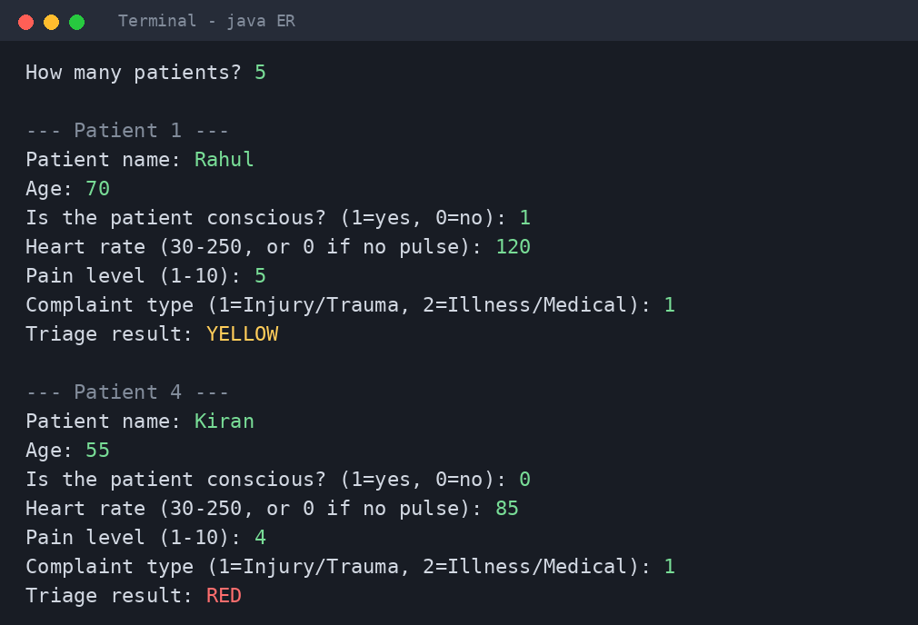
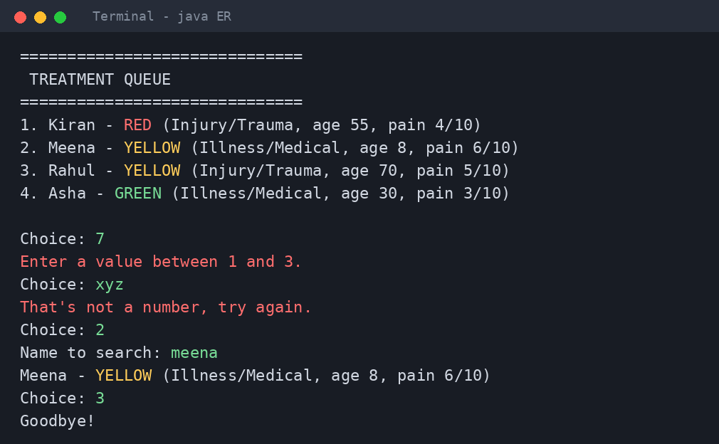
Output
Data entry with automatic triage result
Sorted queue, input validation and search
1
Bad input is asked again, never a crash
2
Queue order: RED, then YELLOW, then GREEN
3
Name search ignores capital letters

