Slide 1


SAMSUNG PRISM
Generative AI
Hackathon
3rd Edition 2026 – 27
EchoFlow
Teach your phone a task once, by voice and taps. Then just ask.
Theme ID
3 · Teachable Voice Automation
Team
Cryzen · Ramaiah Institute of Technology
Members
Arush Parikh (1ms25ci021@msrit.edu) · Harsha B S (1ms25ci051@msrit.edu)
Atharv Raj (1ms25ci025@msrit.edu) · Harshil Jain (1ms25ci052@msrit.edu)
GitHub
github.com/harsha31bs07-blip/echoflow-android
Notes:
EchoFlow is our Theme 3 entry: you teach your phone a task once, by voice and by doing it, and after that you just ask — with the same words, different words, or different values. It never pays.

Slide 2


Theme 3: Teachable Voice Automation
Teach a phone task once.
Ask again in any words, with any values.
Teach by voice + taps
Replay any way
Never pays
Say the task, then do it once in the real app. EchoFlow records the steps and turns the values you said into slots.
The exact words, a paraphrase, or new values — another dish, a quantity of two, the Work address — run the same lesson.
It stops at every checkout, payment, OTP, password and login screen and says “Your turn.” Payment is always yours.
Accessibility Service APIs only
No app SDKs or deep links
No hard-coded flows
No web fallbacks
Notes:
The theme in one line: teach once, reuse any way. The rules we built to: only Accessibility Service APIs, no app-specific code, no hard-coded flows, and a hand-off at every payment or credential screen.

Slide 3

Existing Solutions & Gaps
SUGILITE (CHI 2017)
SkillDroid (2026)
No existing solution combines all five
First programming-by-demonstration on Android. Recorded scripts rely on heuristics that break when the UI changes.
Replay-first and LLM-optional, strong on generalisation — but no payment/OTP safety layer validated on real apps.
Teach once from a live demonstration
Paraphrase + slot generalisation
Runs locally on the phone
App shortcuts & RPA
Voice assistants
Need per-app integration, deep links or SDKs; fragile to every app update.
Bixby and Google Assistant handle declared intents; they cannot learn a new task from a demonstration.
Deterministic safety: never taps Pay
Any app, no integration
EchoFlow does all five, tested on a real phone with real apps.
Notes:
Prior work either learns but breaks or isn't safe, or is safe but can't learn. The gap is the combination: teach-once, generalise, stay local, never pay, and work on any app without integration.

Slide 4



Our Solution & Architecture
:core — pure Kotlin, 203 unit tests
TEACH
Gemini (optional)
TeachingRecorder
FlowCompiler
Saved lesson
advisory only, via a relay
You: voice or taps
taps + screens
steps → slots
flow JSON
Bubble
RUN
speech · typing · TTS
IntentMatcher
DecisionLayer
ReplayEngine
SafetyGuard
exact · template · similar
run · confirm · ask · teach
resolver + recoveries
the only way to act
Run records
“Did the last run succeed?”
Accessibility Service
click · text · scroll · launch
Every action passes SafetyGuard
The LLM only advises
Fails closed; nothing sensitive stored
Notes:
Two lanes. Teaching records your taps and the screens they happened on, and compiles them into a lesson with slots. Running matches what you said to a lesson, decides whether to run, confirm, ask or offer to teach, and replays — every single action goes through SafetyGuard first. Gemini is optional and advisory.

Slide 5
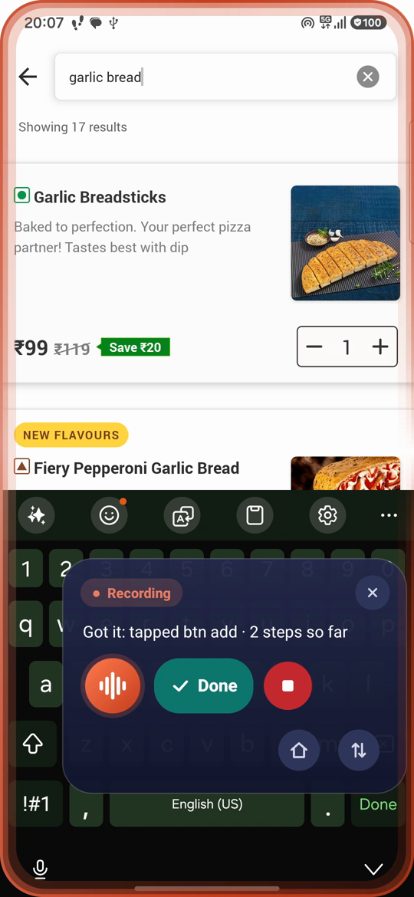
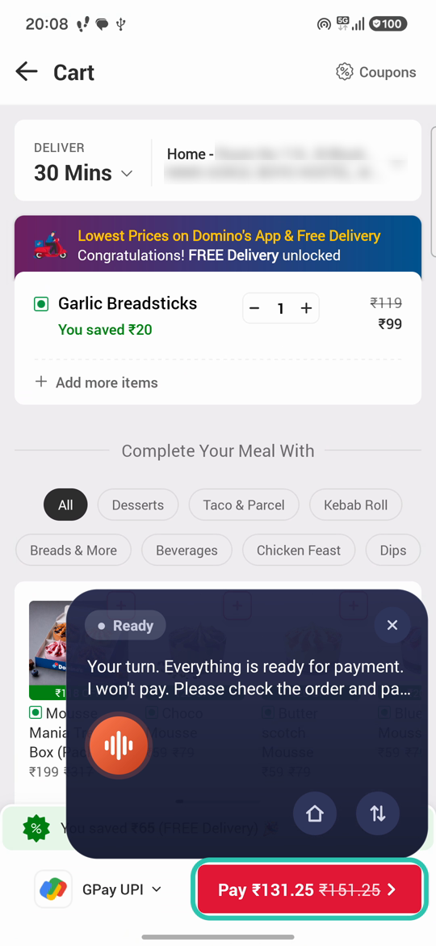

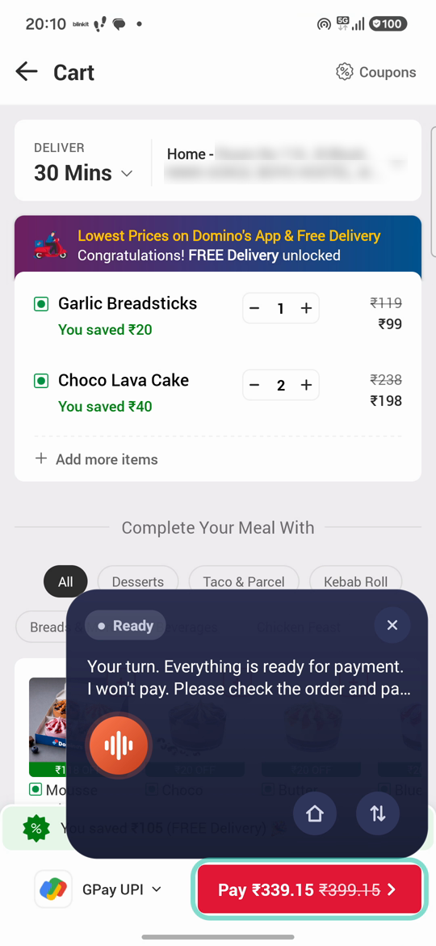
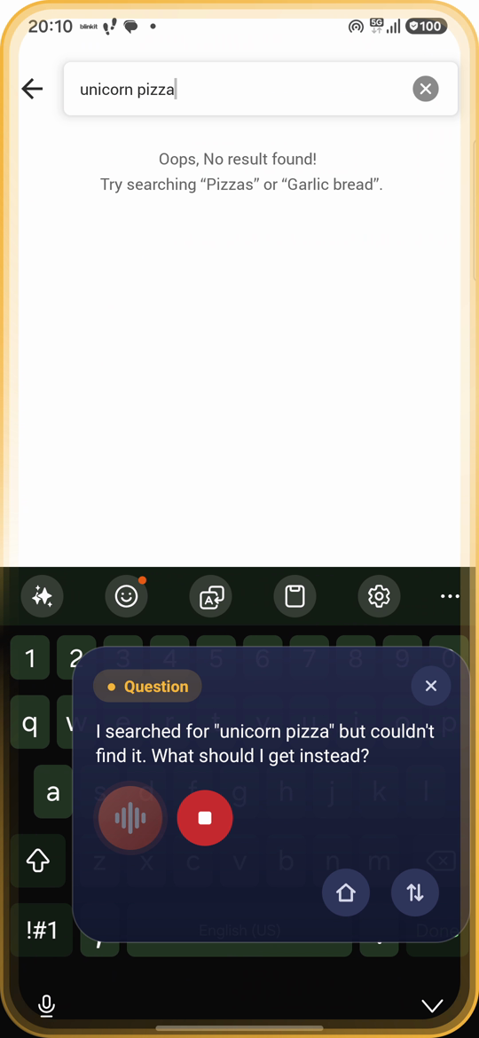

Demo & Product Walkthrough
a
b
c
d
e
Teach
Exact replay
Paraphrase
New values
Stuck → asks
“Order a Garlic Bread on Domino’s.” → yes → search, Add, cart → Done
Same words: replays the lesson and stops at Pay
“Get me garlic bread from Domino’s.” Already in cart: not added again
“Order two Choco Lava Cakes.” New item, quantity set to 2
“Unicorn pizza”: not found, asks what to get instead, then stops
Watch the full demo: EchoFlow_Demo_v8.mp4 (4:36, one continuous recording)
Notes:
Real frames from the submitted demo video, in the required order: teach, exact replay, paraphrase, changed value, and asking when stuck. Nothing here is mocked up.

Slide 6








Tools & Tech Stack
Kotlin
Accessibility Service
SpeechRecognizer + TTS
JVM core + Android app, JDK 17
UI-tree snapshots, click, text, IME, scroll, gestures
On-device speech in, natural-pitch voice out
Floating overlay UI
Gradle (KTS)
JUnit 5
Edge handle, teach panel, Flow Inspector
compileSdk 35 · minSdk 30 (Android 11+)
203 unit tests, real Swiggy / Zomato / Amazon screen fixtures
Gemini Flash-Lite (optional)
Galaxy S24 FE
Git + GitHub
Through a Cloudflare Worker relay; capped, no key on the phone
Every official test run on a real phone with real apps
Signed release APK v1.2.3 · no API keys inside
Notes:
Everything that decides lives in a pure-Kotlin module with 203 unit tests; the Android layer is thin. AI is optional and only advises.

Slide 7



Impact & Use Case
Accessibility
Safe by design
For anyone who repeats phone tasks
Voice-first, never voice-only: answer by voice, tap or typing. AA contrast, 48 dp targets, TalkBack headings.
Never automates payment, OTP, login or password screens — validated on real Swiggy, Zomato and Amazon.
Food orders, shopping searches, everyday app chores. Show it once; after that, one sentence does it.
Works offline
Any app
1 demonstration → endless variations
No account, no API key, no server needed. Optional AI help works out of the box.
Anything that shows its UI to accessibility services can be taught. No app-specific code.
Notes:
Who it helps: people who repeat the same phone chores, and people for whom tapping through apps is hard. It is safe by design and needs no account or server.

Slide 8


Innovation, Results & Limitations
14/14
3/3
203
0
official tests passed on a real phone (T1–T14)
bonus tests: stray-tap filter, Amazon → Myntra, missing slot asked
unit tests in the pure-Kotlin core
taps on Pay or Place Order, in every run
What's new
Known limitations (documented)
Teach once from a live demonstration: no scripts, no SDKs
Values become slots: item, quantity, address, even another app
Run · confirm · ask · teach — it asks instead of guessing
Weighted element finder (id, text, row, description, parent) plus recoveries for pop-ups, scrolling and items already in the cart
Deterministic, local safety that fails closed
Size pickers (Amazon apparel) are not automated: it asks
Secure pickers (Swiggy's cart address sheet) need a fallback
Cross-app reuse validated for Amazon → Myntra only
Apps that hide their UI from accessibility can't be taught
One phone and one account tested so far
Notes:
Results: all fourteen official tests and the three bonus tests ran on a real Galaxy S24 FE with real apps, and EchoFlow never tapped Pay. We also publish our limitations — docs/LIMITATIONS.md — rather than claiming everything works.

Slide 9



What's Next
1
Next
2
Then
3
Later
On-device Gemini Nano for private paraphrases and slots
Screenshot fallback for screens apps hide
Beyond shopping: rides, travel, bills
More apps validated: Swiggy, Flipkart, Blinkit
Multi-step form filling with learned fields
Opt-in encrypted sync of lessons across devices
Notes:
Next: on-device Gemini Nano so even paraphrase help stays private, and more apps validated. Then screens apps hide and form filling. Later: more domains and opt-in sync.

Slide 10



Brownie Points: What Sets Us Apart
Teach it live
Zero pay taps
Works offline
Judges can teach a brand-new flow in front of them — nothing is pre-recorded or app-specific.
SafetyGuard is local and deterministic. A checkout screen still allows quantity and address edits; Pay is never tapped.
No API key, account or server. Optional AI help runs through a capped relay with no key on the device.
Inspectable
Never voice-only
Honest by default
The Flow Inspector shows every learned step, slot and safety hand-off.
Voice-first, but you can speak, tap or type any answer. AA contrast, TalkBack, 48 dp targets, system font size.
Real-phone test log, safety fixtures and a limitations document — not “all passed” claims.
203 JVM unit tests · T1–T14 and B1–B3 run on a real Galaxy S24 FE with Zomato, Amazon, Myntra and YouTube
Notes:
Six reasons EchoFlow stands out — most importantly, judges can teach it something new live, and it will never pay.

Slide 11
Checklist: Updated on Public GitHub
Working prototype code
Official test results
public GitHub repository
docs/TEST_RUN.md · T1–T14, B1–B3
README
Target apps declaration
reproducible setup + judges' quick start
docs/ARCHITECTURE.md
Demo video (≤ 5 min)
Known limitations
EchoFlow_Demo_v8.mp4 · 4:36, unedited
docs/LIMITATIONS.md
Presentation
Safety validation
this deck
docs/SAFETY_FIXTURES.md
APK
Test traceability
release/EchoFlow.apk · v1.2.3, signed, no keys
docs/TEST_MATRIX.md
Architecture
Research & prior art
docs/ARCHITECTURE.md (with diagrams)
docs/RESEARCH.md
Notes:
Every deliverable is on the public repository, linked here.

Slide 12
Thank you
EchoFlow — teach once, ask any way, payment stays with you.
github.com/harsha31bs07-blip/echoflow-android
Team Cryzen · Ramaiah Institute of Technology
Organised by the Language AI Team and the PRISM Team, Samsung R&D Institute India
Notes:
Thank you. The APK, the source, the demo video and every test result are on the public repository.

