Slide 1
Introduction to CSS3
CSS3 is the latest evolution of the Cascading Style Sheets language.
It brings new features for styling and layout.
Example:
body {
background-color: lightblue;
}

Slide 2
Selectors in CSS3
Selectors are used to target HTML elements.
Example:
p {
color: red;
}

Slide 3
CSS3 Colors
CSS3 supports RGBA, HSLA, gradients, etc.
Example:
div {
background: linear-gradient(red, yellow);
}

Slide 4
CSS3 Borders
Borders can have radius, images, and more.
Example:
div {
border: 2px solid black;
border-radius: 10px;
}

Slide 5
CSS3 Backgrounds
Multiple backgrounds, gradients, and more.
Example:
div {
background-image: url('bg.jpg');
background-size: cover;
}

Slide 6
CSS3 Text Effects
New properties for shadows and overflow.
Example:
h1 {
text-shadow: 2px 2px 5px gray;
}

Slide 7
CSS3 Transitions
Transitions allow smooth property changes.
Example:
div {
transition: width 2s;
}

Slide 8
CSS3 Animations
Keyframe animations for advanced effects.
Example:
@keyframes example {
from {background-color: red;}
to {background-color: yellow;}
}

Slide 9
CSS3 Transforms
Transform elements with rotate, scale, etc.
Example:
div {
transform: rotate(45deg);
}

Slide 10
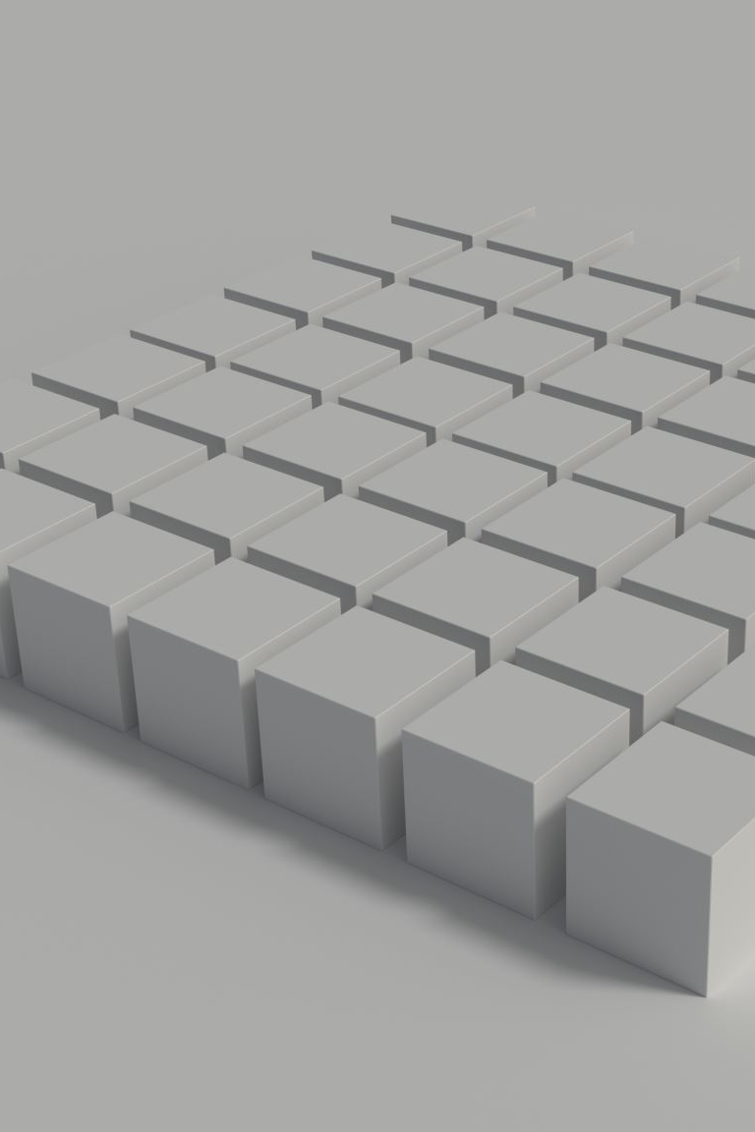
CSS3 Flexbox
Flexible box layout for responsive design.
Example:
.container {
display: flex;
justify-content: center;
}

Slide 11

CSS3 Grid
Grid layout system for web pages.
Example:
.container {
display: grid;
grid-template-columns: auto auto;
}

Slide 12
Conclusion
CSS3 enhances the styling of web pages.
Responsive, animated, and modern UIs are easier to build.

