Slide 1

Introduction to CSS3 Styling
CSS3 is the latest evolution of the Cascading Style Sheets language, bringing new features for styling and layout.
Example: body { font-family: Arial; }

Slide 2

Selectors in CSS3
CSS3 introduced new selectors for better targeting of elements.
Example: div > p { color: blue; }

Slide 3
Colors and Opacity
CSS3 supports RGBA, HSLA, and opacity for advanced color and transparency control.
Example: p { color: rgba(255, 0, 0, 0.5); }

Slide 4
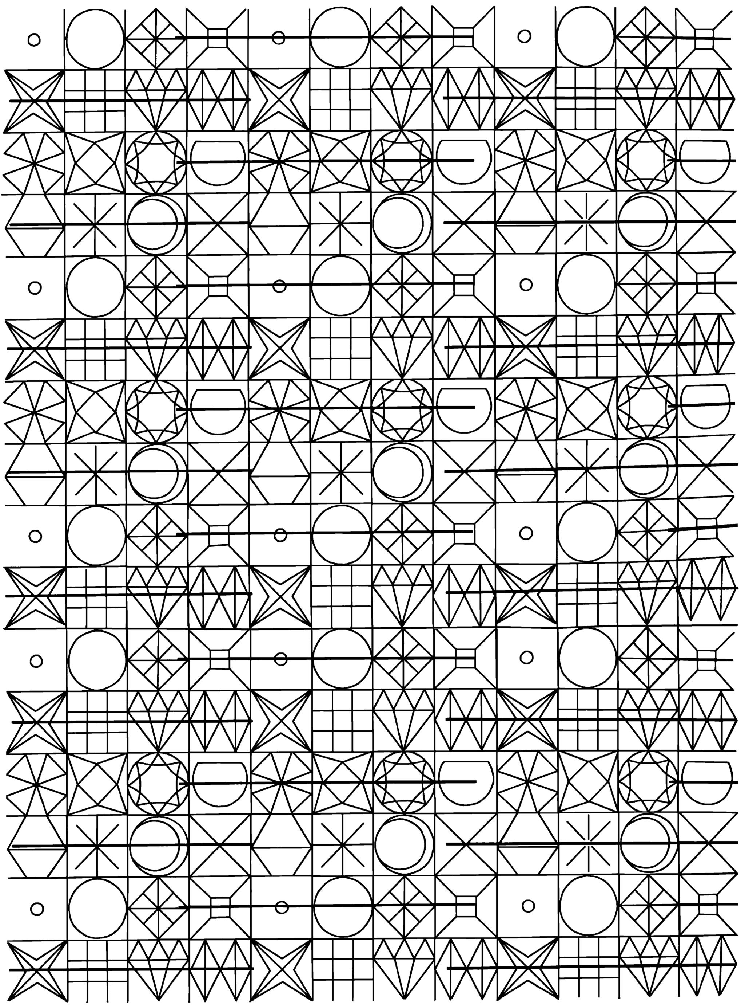
Rounded Corners
The border-radius property is used to create rounded corners.
Example: div { border-radius: 10px; }

Slide 5

Box Shadow
CSS3 allows adding shadows to elements using box-shadow.
Example: box-shadow: 5px 5px 5px grey;

Slide 6

Text Shadow
Text-shadow adds shadow to text elements.
Example: h1 { text-shadow: 2px 2px 5px red; }

Slide 7

Gradients
CSS3 supports linear and radial gradients.
Example: background: linear-gradient(red, yellow);

Slide 8
Transitions
Transitions allow changes in CSS properties to occur smoothly over a duration.
Example: div { transition: all 0.3s ease; }

Slide 9
Transforms
CSS3 transform property applies 2D or 3D transformations to elements.
Example: div { transform: rotate(45deg); }

Slide 10
Animations
CSS3 supports keyframe animations for complex effects.
Example: @keyframes slide { from {left: 0;} to {left: 100px;} }

Slide 11
Media Queries
Media queries help create responsive designs for different devices.
Example: @media (max-width: 600px) { body { background: lightblue; } }

Slide 12

Conclusion
CSS3 adds powerful styling tools that enhance user experience and design flexibility.
Explore and experiment with CSS3 features for modern web design.

