Slide 1
MONTE CARLO INTERVENTION
- Sreeharsha Sura

Slide 2
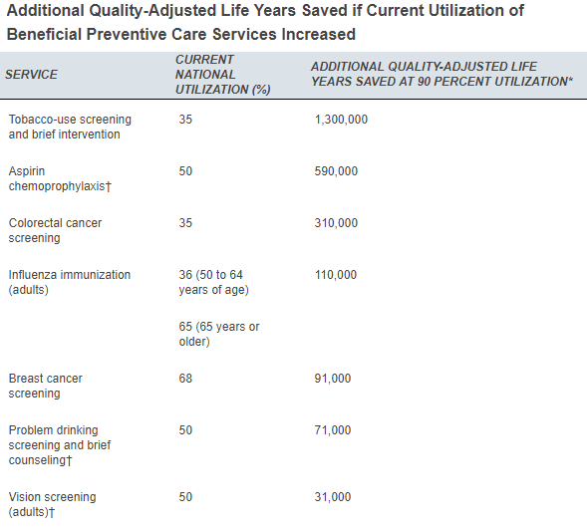
What is the Project about?
Scenario
Why this topic?
Loss of health and wealth
Clinically Preventable Burden
Quality Adjusted Life Years
Savings
Health benefits
Intervention
Effects

Slide 3
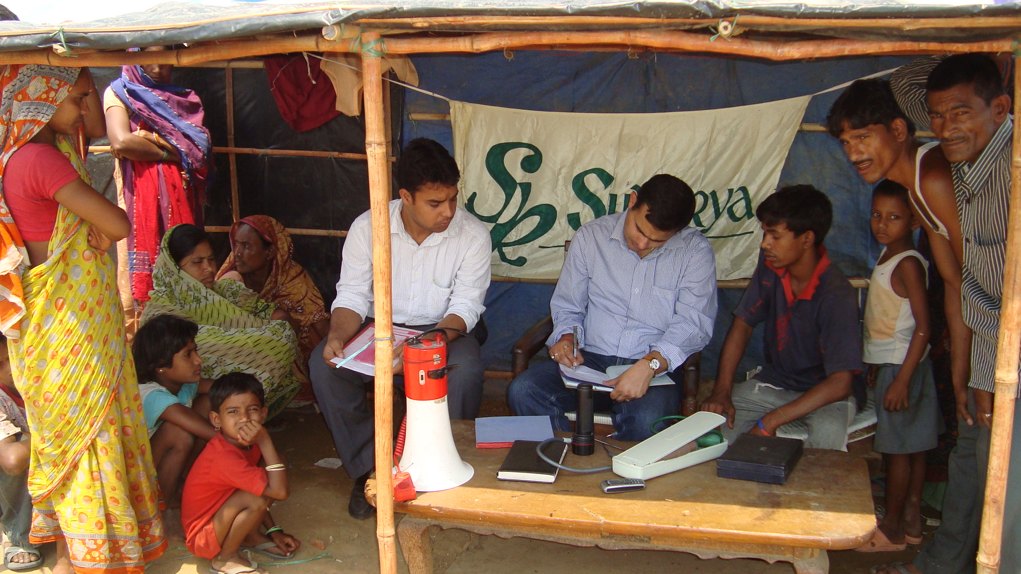
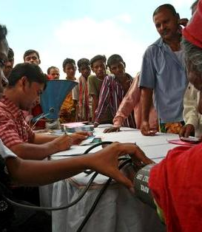
Scenario Explanation
NGO
Third World and developing Countries
Alcohol and Smoking
Health Interventions and Counselling
300 – 500 people
Fluctuation of 0.2-0.5
Three Year Period
Monitory Impact
Monte Carlo Simulation

Slide 4
Random Variables
Distribution
Life years lost due to chronic diseases
Life years lost due to acute conditions
Reach of Counselling
Impact of Counselling
Patient Volume
Fluctuation
Hypothesis???

Slide 5
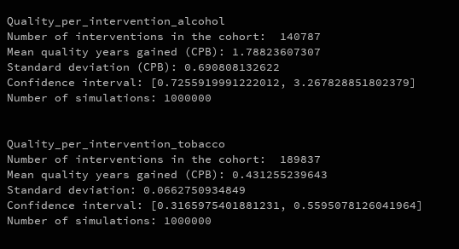
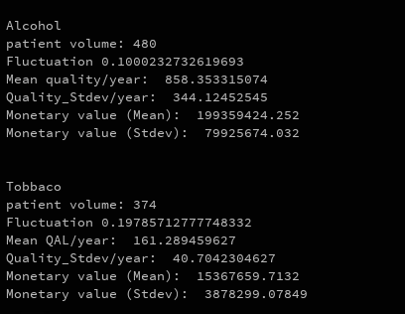
Intermediate Results

Slide 6


