Slide 1
MONTE CARLO INTERVENTION
- Sreeharsha Sura

Slide 2
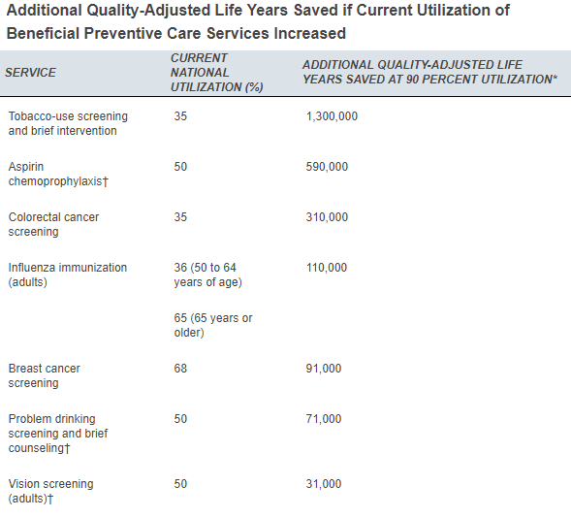
What is the Project about?
Scenario
Why this topic?
Loss of health and wealth
Clinically Preventable Burden
Quality Adjusted Life Years
Savings
Health benefits
Intervention
Effects

Slide 3
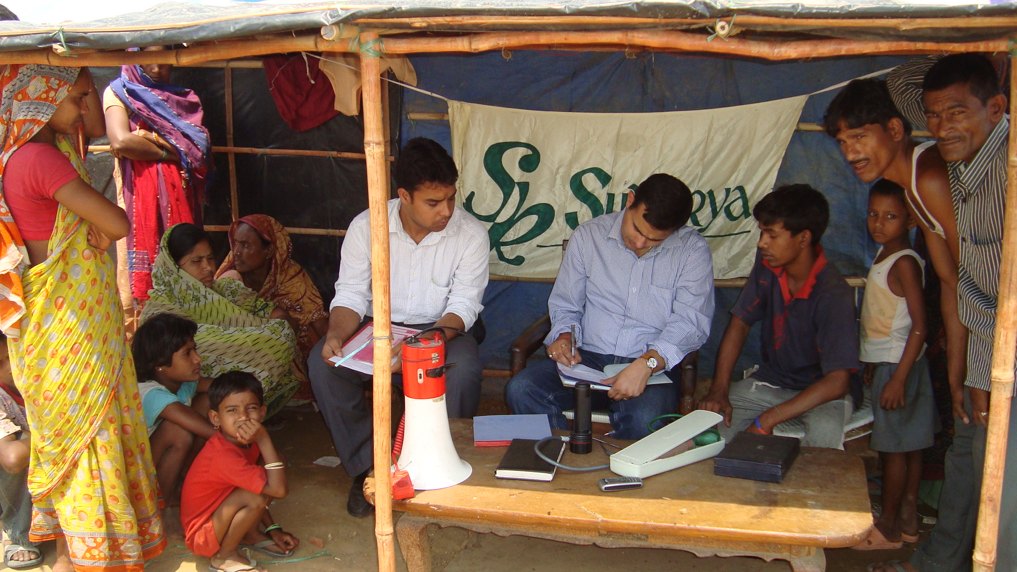
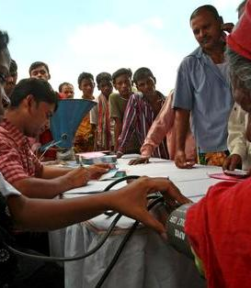
Scenario Explanation
NGO
Third World and developing Countries
Alcohol and Smoking
Health Interventions and Counselling
300 – 500 people
Fluctuation of 0.2-0.5
Three Year Period
Monitory Impact
Monte Carlo Simulation

Slide 4
Hypothesis and Random Variables
Adds at least 5 years per person of life if Smoking is Quit
Saves $12000 per person in Clinical bills per person
Distribution
Life years lost due to chronic diseases
Life years lost due to acute conditions
Reach of Counselling
Impact of Counselling
Patient Volume
Fluctuation

Slide 5
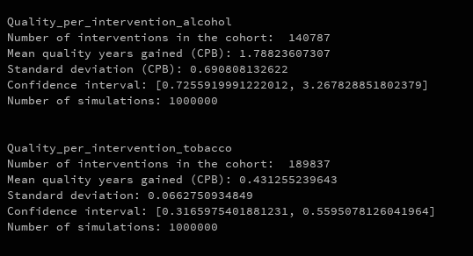
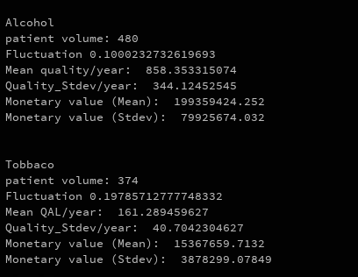
Intermediate Results

Slide 6


