Slide 1
Motor Temperature of an Electric Motor
Team Name : Group 1 R Language
Mentor Name : Varun Vennelaganti &
Byom Kesh Jha

Slide 2
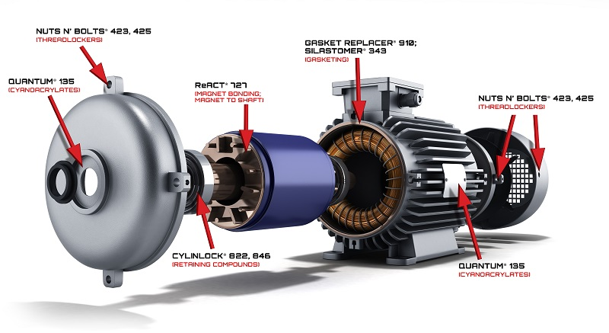
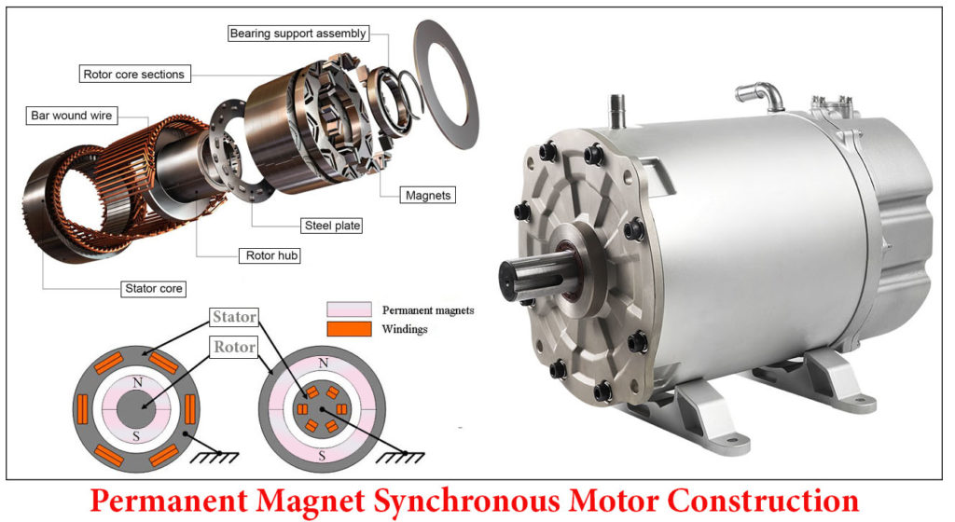

Slide 3
Business Objective : Prediction of Motor temperature and Motor speed based on the below variables , Ambient , Coolant , u_d , u_q , Torque , i_d , i_q , pm , Motor_speed , Stator_yoke , Stator_tooth , Stator_winding .
A permanent magnet synchronous motor (PMSM) : is a synchronous electric motor which uses permanent magnets embedded in the inductor. A permanent magnet synchronous motor consists of a rotor and a stator.
The stator is equipped with coils, while external surface magnets are attached to the rotor. AC voltage is applied to the stator coils, which causes them to generate a magnetic field that continuously moves in a circle due to the three phases of the flowing current. A further magnetic field surrounds the magnets attached to the rotor. The rotation of the rotor ultimately results from the attraction and repulsion of the two magnetic fields.
Advantages
• Maximum efficiency • Dynamic speed control possible • Fast reaction to load change • Small installation space, low weight

Slide 4
Data Set Details
A comprehensive csv files containing all measurement sessions and features. Each row represents one snapshot of sensor data at a certain time step. Sample rate is 2 Hz (One row per 0.5 seconds). Each variable has a different “Profile id ”
This Data set contains Train & Test data . The Train data contains 698649 readings with 14 variables and the test data contains 299421 readings with 13 variables .

Slide 5
Exploratory Data Analysis
Exploratory Data Analysis Firstly we get the summary of the data set , if we closely observe that the mean and the median values does not match , which implies that there might be presence of the outliers and might be skewed . Then the second , third & fourth moments of business decision are performed . From the above analysis coolant , u_d , u_q , motor_speed , stator_yoke have positive skewness and ambient , torque , i_d, i_q , pm , stator_tooth and stator_winding has negative skweness . Similarly all the variables have positive kurtosis which means thinner peaks and longer tails . The correlation between the variables were found out . It was found that stator yoke and stator tooth had hig correlation , stator winding and stator tooth had high correlation , i_q and torque had high correlation and coolant and stator yoke has high correlation from the heat map , corro-gram and correlation plot . The box plot , histogram were also plotted .

Slide 6
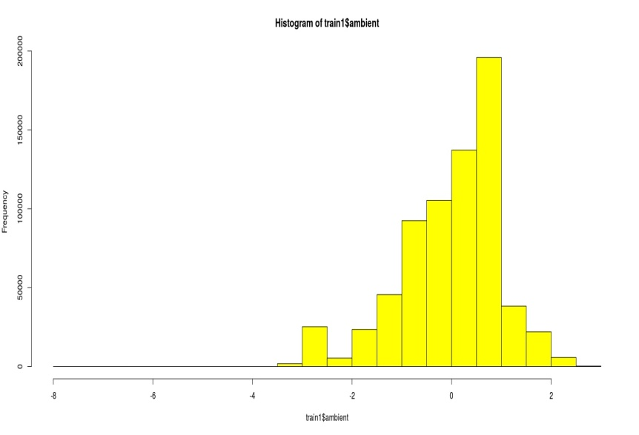
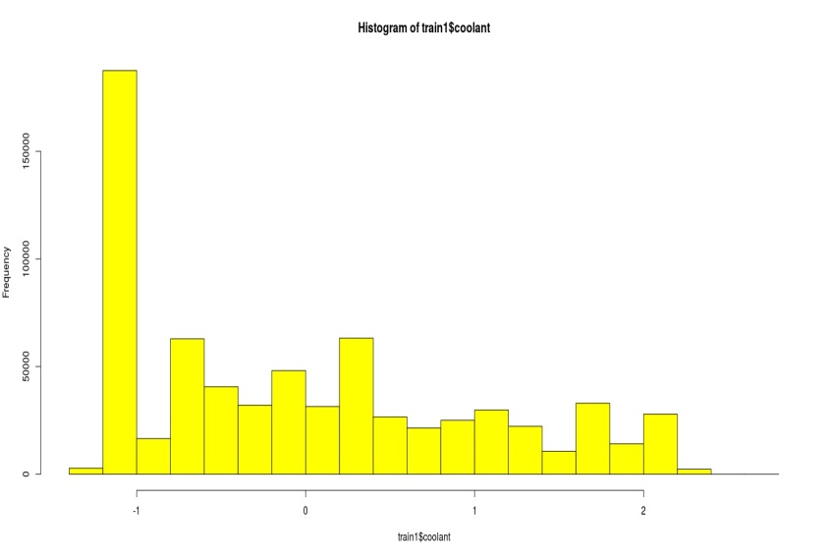
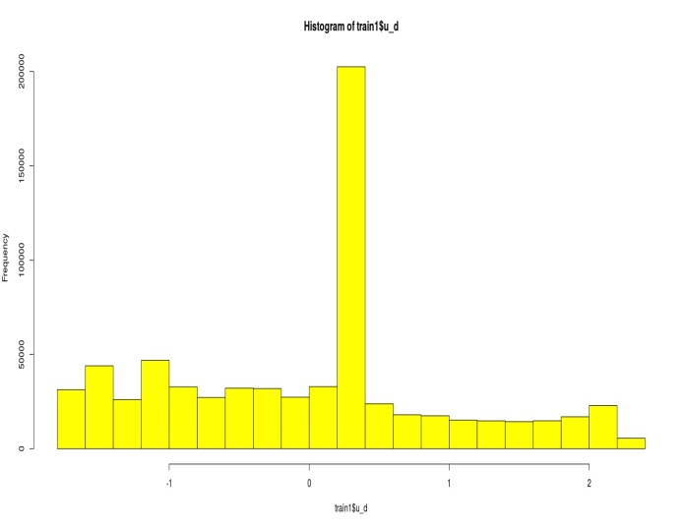
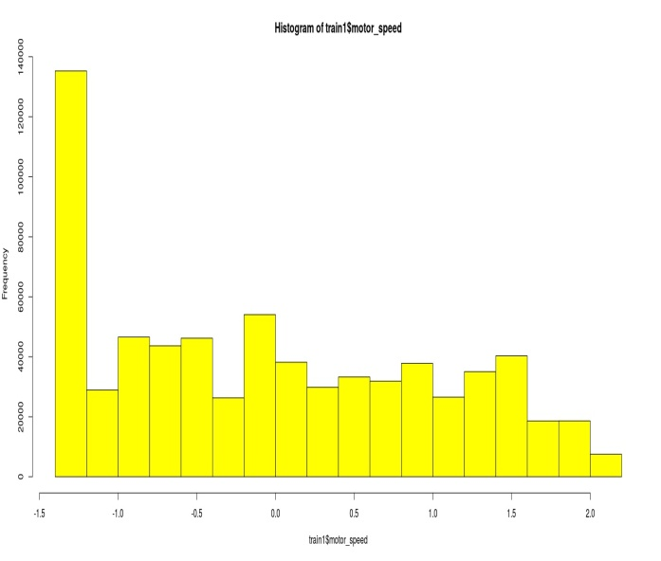
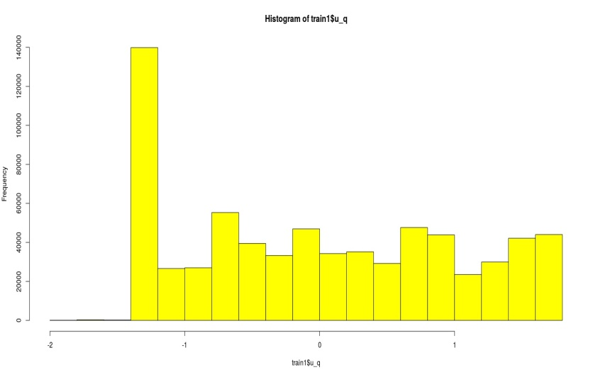
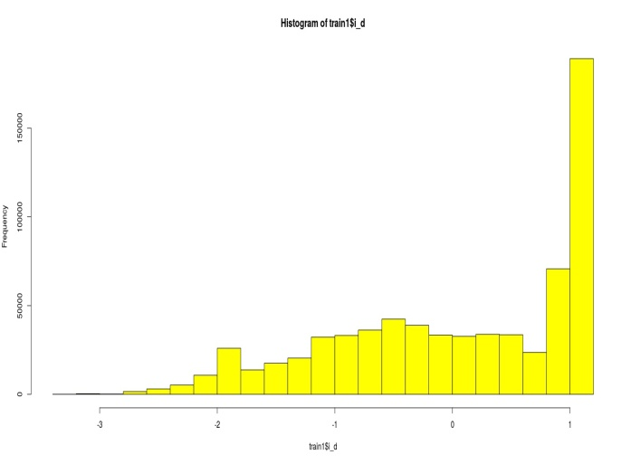
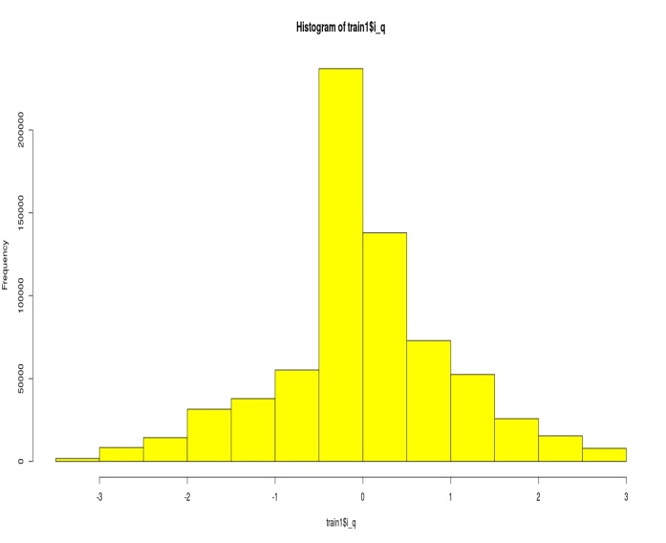
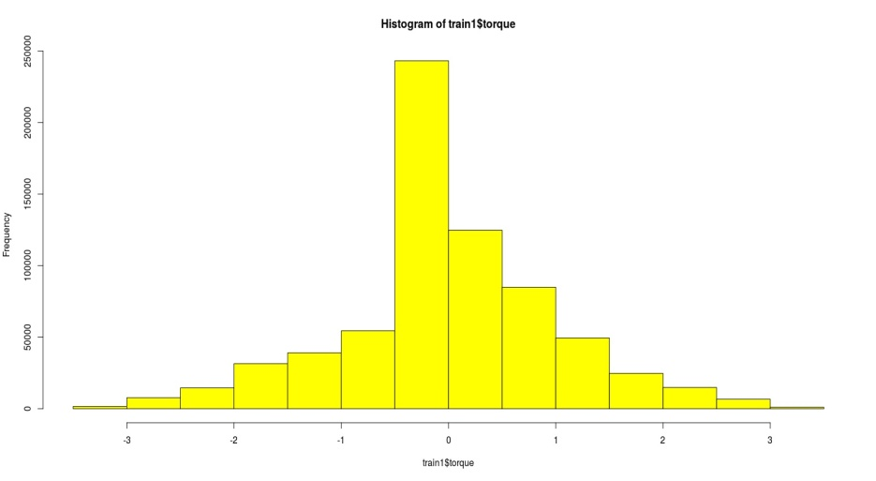
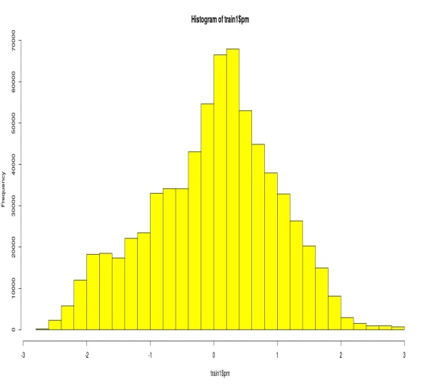

Slide 7
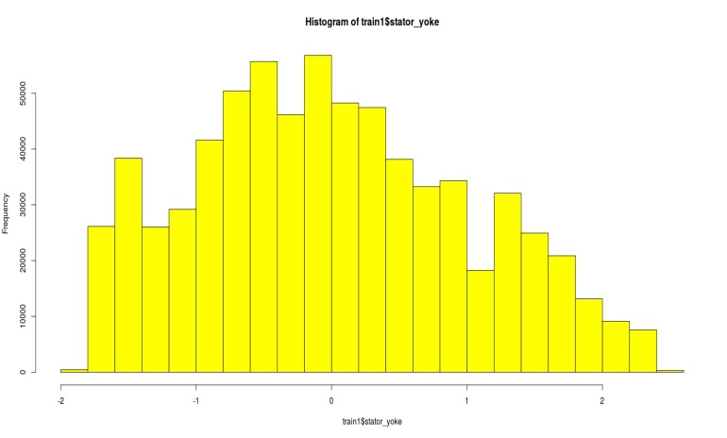
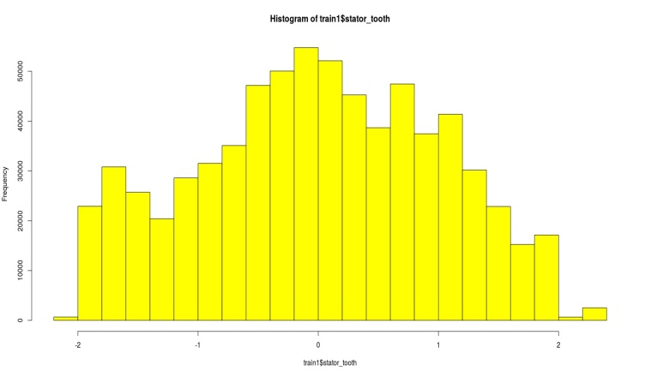
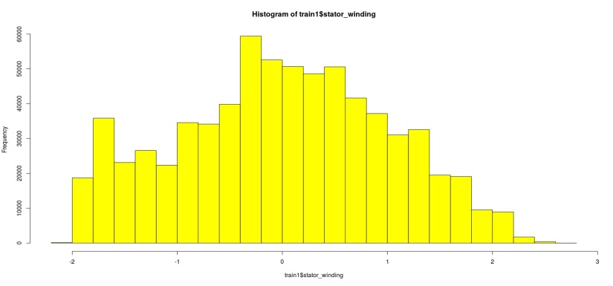
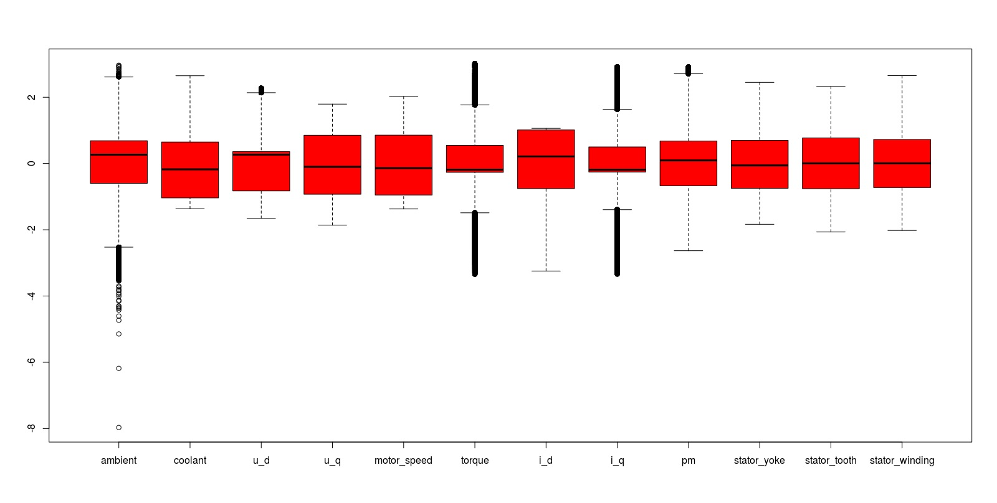

Slide 8
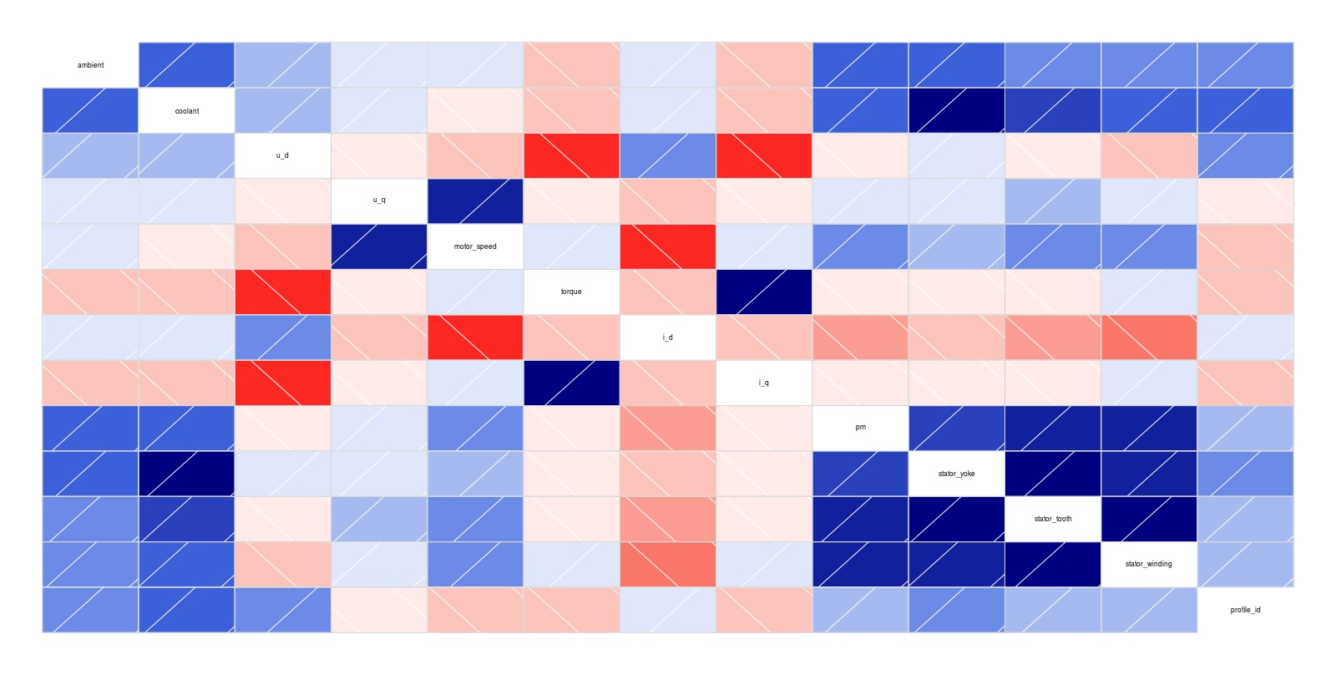
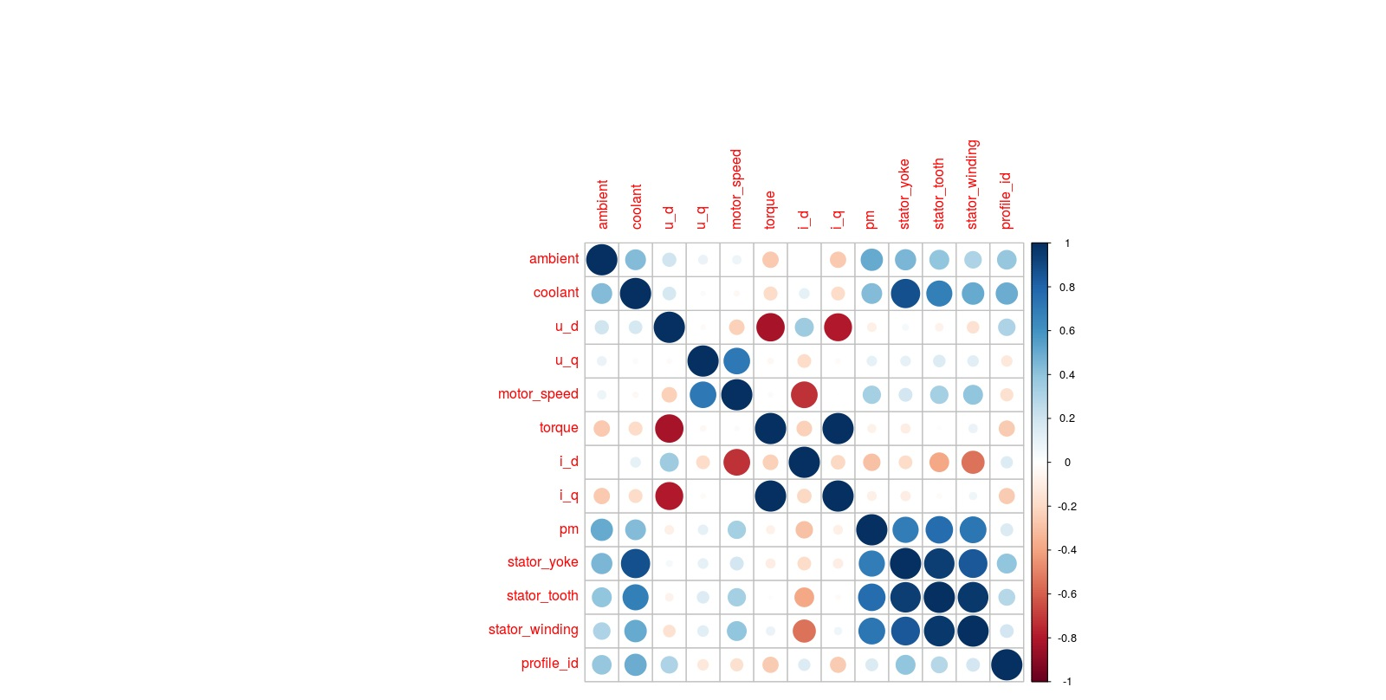
Corr-gram
Correlation plot

Slide 9
Model Building
Data Partition details : Considering random sample , since the data was large .
Algorithms used : Predictions :
Multi linear Regression Multiple R2 : 0.7723 , RMSE :
0.4749 & MAE : 0.3617
Decision Tree Multiple R2 : 0.8856 & RMSE :0.3821
Random Forest OOB estimate of error rate of 0%
Accuracy with 96%.
4. Principal Component Analysis Dimension was reduced to 5 & with K-means clustering 2 clusters were formed .
Support Machine Vector Out of all types kernels only
Kernel : Laplace dot Accuracy : 83%

Slide 10
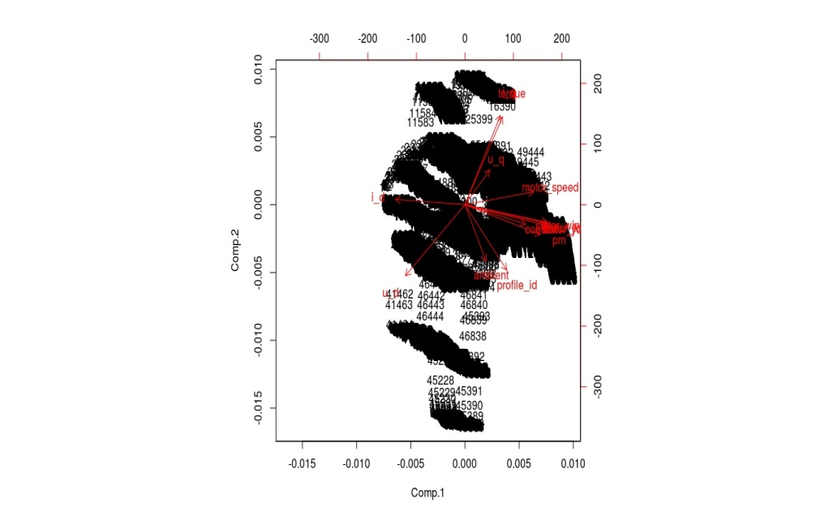
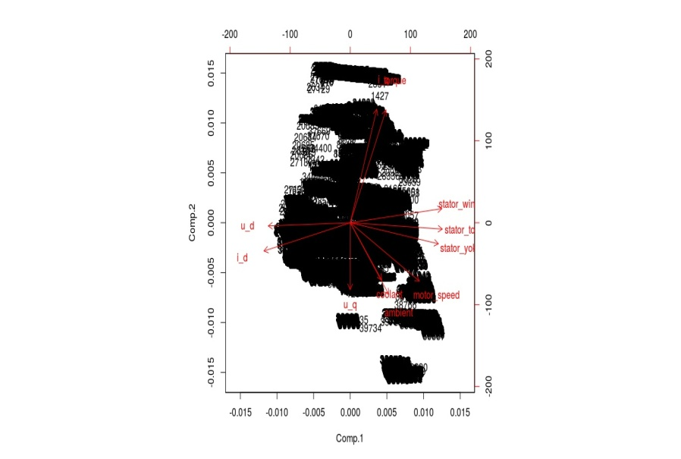
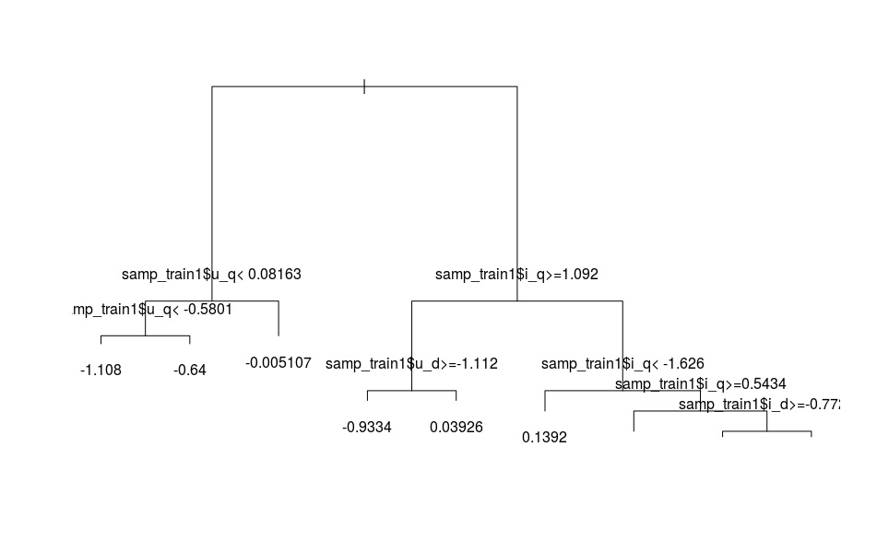
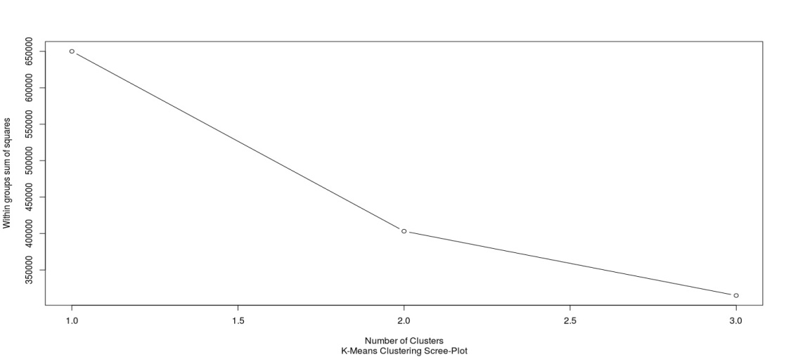
Bi-plot of Train &Test
Regression Tree
Scree Plot

Slide 11
Multiple linear Regression : Since few of the variables from the sample were correlated , it was removed and the model was built and predicted . There were presence of influencers and which are removed .
Decision Tree : This uses the decision tree algorithm which helps us to find out the variables that are dependent and results in the variation of pm. The tree is as shown above .
Random Forest: Through this model it was found with 96% accuracy. We can suggest the best fitted model for deployment. With confusion matrix and statistics Kappa value with 1.
Principle component Analysis : The 13 variables are reduced to 5 prime component which helps in determining the variables with similarities. From bi-plot for train coolant , stator wind , pm ,stator yoke , stator tooth are similar , then torque & i_q are similar . Then for test torque & i_q are similar . Along with PCA using clustering analysis (K means) 2 clusters were formed as shown in the scree plot .
Support Machine Vector : By using the Laplace dot the accuracy was found out with 83% accuracy. It is also known that the svm values are more accurate than other kernels .

Slide 12
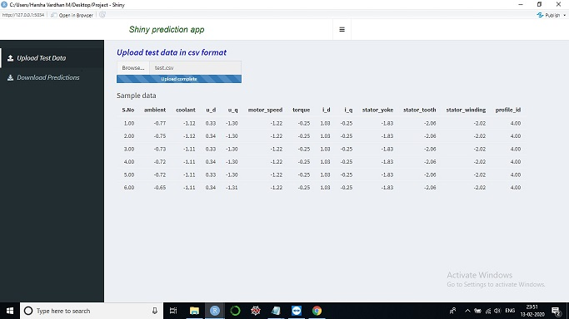
Model Deployment
The process of deployment refers to application of the built model for prediction on the new data set.
Here , using the test data we predicted the model as shown below .

Slide 13

We have done xg.rda file for deployment to get the prediction values with -2.14 and the rmse value with 0.03 .

Slide 14
Challenges Faced & overcomed
The given data was huge & it was a time consuming process . Hence the model was built by taking the sample data.
We tried building the model in cloud as it can store large amount of data and would get better rmse values
But even though we used sample data ,which was also quite large the session would expire in the cloud . So we switched back to the rstudio in our laptops .

Slide 15
Thank you
Project By :
Mamatha
Padmini M G
Nila
Harsha Aditiya
Harsha Vardhan

