Slide 1
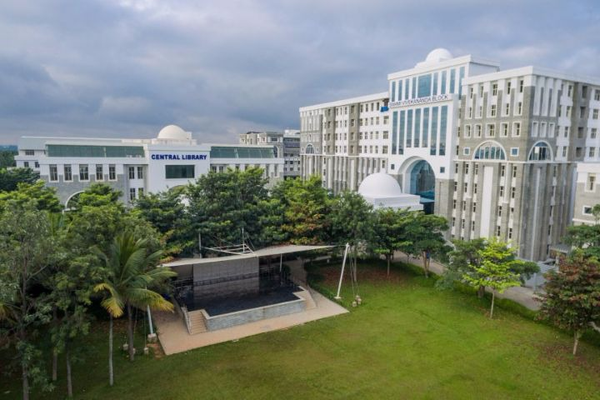
ERP SYSTEM FOR COLLEGE MANAGEMENT
GROUP-03

Slide 2
BATCH - 3
FRONT END
KETAKI RAMDAS TANPURE 2492776
HARSH PRASHANT KURULKAR 2491559
JAVVADI USHA NAGA SRI LAKSHMI 2492192
KOMAL SHESHARAJ PATIL 2491522
BACK END
HARSHA M 2491739
JYOTI MAHADEV GAIKWAD 2492765
GUNTUR AKSHAY KUMAR 2491437
GUGGILA BHAVITHA 2491841
GUDURU DEEEPIKA 2491793
KAIPA RAJAGOPAL REDDY 2491832

Slide 3
CONTENTS
Introduction
Modules for ERP system
System requirements
Features available
Tools and Languages
Advantages
Disadvantages
Future scope and improvements
References
Conclusion

Slide 4
INTRODUCTION
The objective was to propose a design of ERP for college management system is
It provides a simple interface for maintenance of different student, faculties, library and other information.
It can manage daily activities of college which include the management of Faculty, Students, Courses and Library Records, Assignments, Admission Process, Results and Reports, Exams, Attendance, Timetable, Fees and Other Report.

Slide 5
MODULES FOR ERP SYSTEM
Admin
Student
Faculty login
Login
Library login
About us

Slide 6
HOME PAGE
Tabs
Home
Admin
Student
Faculty
Library
About us
Login
Login
Login
Login
Info

Slide 7





SYSTEM REQUIREMENTS
Front end: Angular
Server Side: Spring Boot
Back-end: Hibernate , MY SQL
Server: Tomcat 8.0

Slide 8
TOOLS AND LANUAGES REQUIRED
Front End | Back End
Visual Studio | MYSQL
Angular | Spring Tool suite
Html | Eclipse IDE
Css | Spring Boot

Slide 9
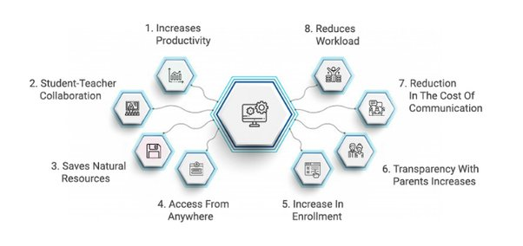
ADVANTAGES

Slide 10
DISADVANTAGES
The installation of the ERP system is costly
Change of staff, companies can employ administrators who are not trained to manage the ERP system of the employing company, proposing changes in business practices that are not synchronized with the system.
Costs of an ERP Software
Third-party software add-ins
Implementation costs
Maintenance
Initial and continuous training
Complex Data Conversion
Developing a solid data conversion strategy can be difficult
You have to define, examine and analyze data sources
Bad data conversion will cause delays and increased costs

Slide 11
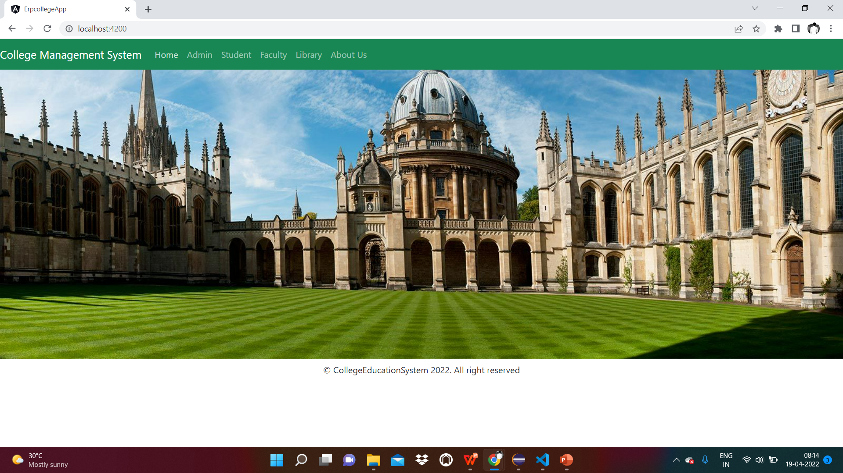
HOME PAGE

Slide 12
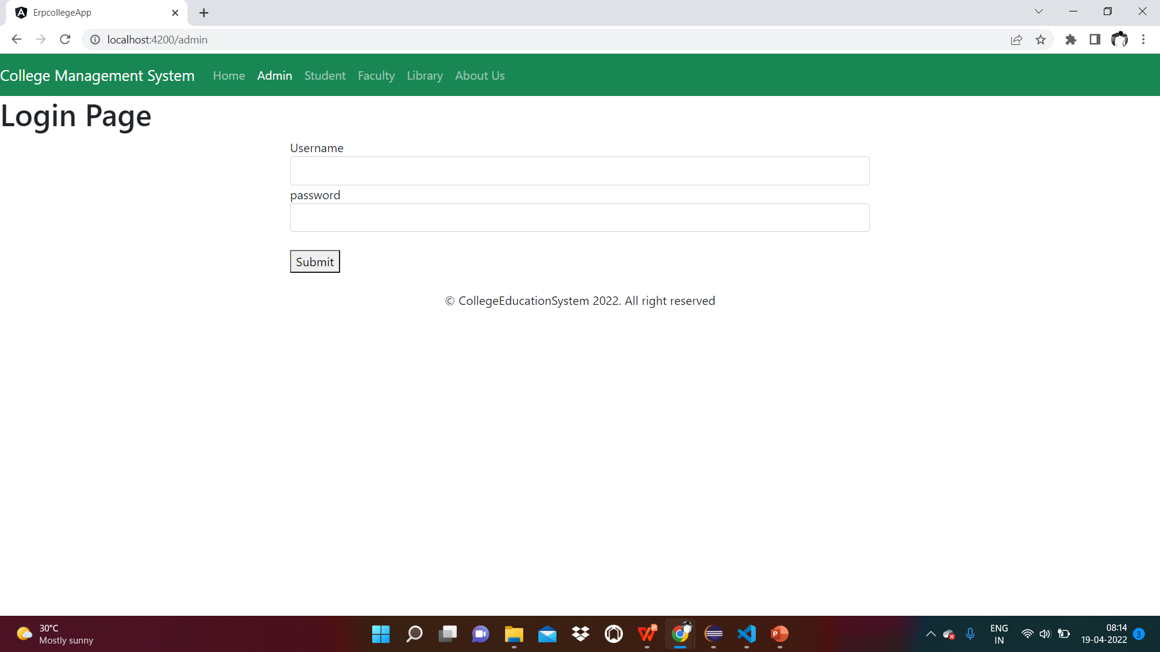
LOGIN PAGE

Slide 13
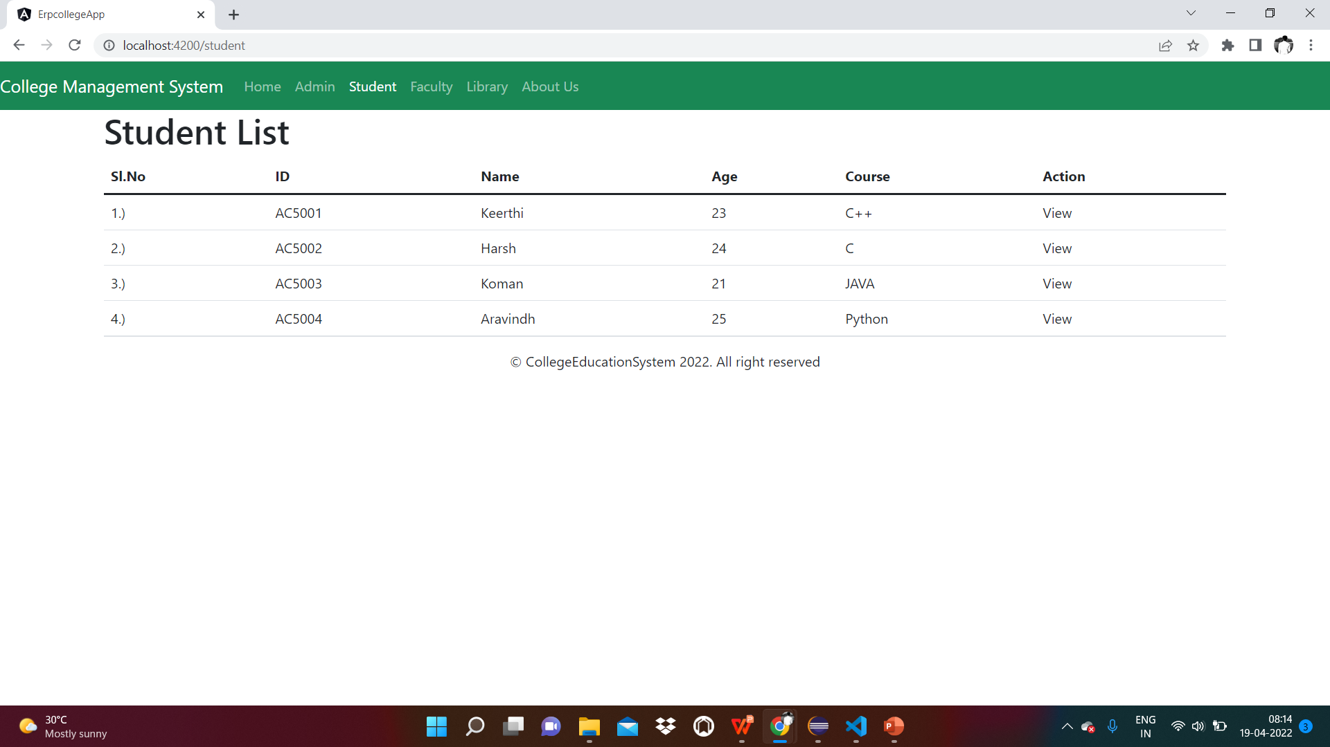
STUDENT

Slide 14
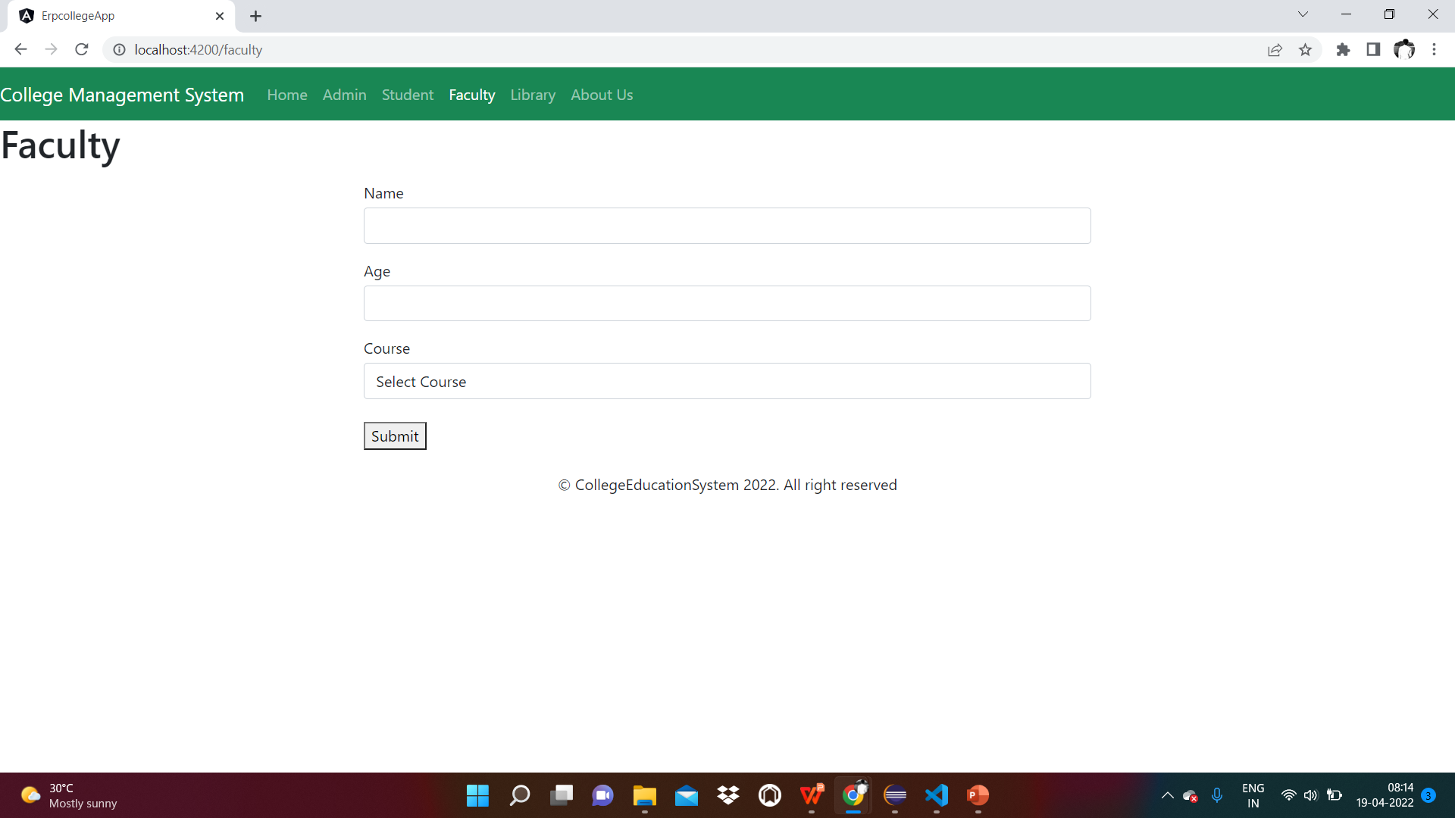
FACULTY

Slide 15
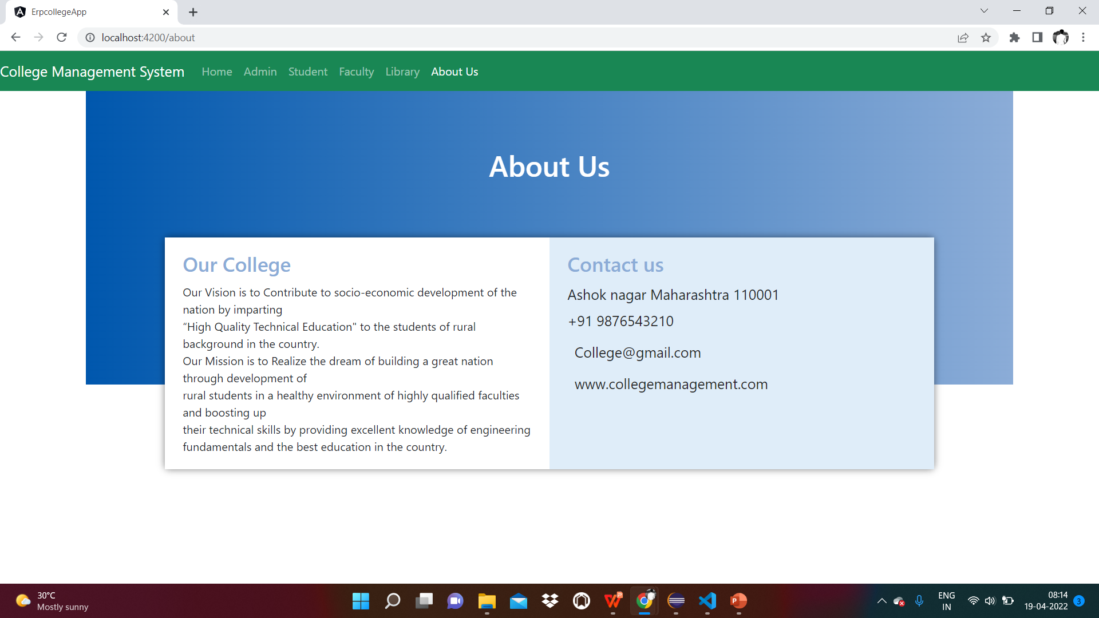
ABOUT US

Slide 16
FUTURE SCOPE AND IMPROVEMENTS
Future Enhancements Make online exam more effective, efficient and more dynamic so that it helps to get a good support from the student. It has been marking while this application open in other browser due to designing support. It’s more support to Mozilla as compare to other browser. Online result printing and more user interaction functionality and features need to be developed. Needs to improve more security for the purpose of the safety.

Slide 17
REFERENCES
http://books.google.com
http://sourceforge.net
http://www.gnu.org
http://www.thefreecountry.com

Slide 18
CONCLUSION
The “ERP” system has been developed by us and also done enhancement in application through applying our knowledge gained in class room, referring to certain books, browsing some sites and through the help of external and internal faculties and using our knowledge related to subject it. We are very thankful to all our team members that extended all their support and helped us complete this project successfully.

Slide 19


